Slide 1
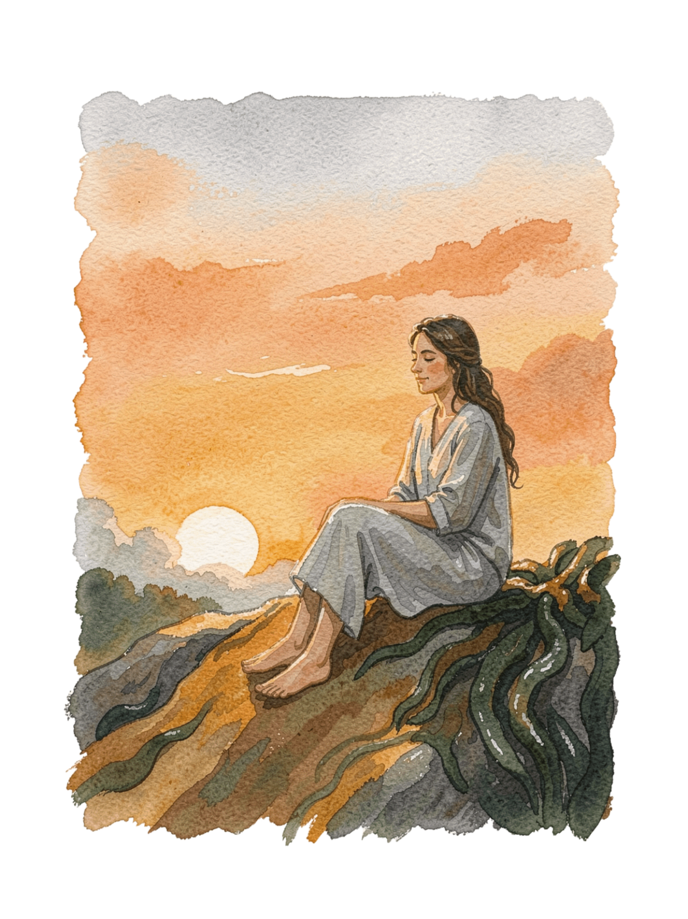
Happiness vs. Physical Facility
An exploration of the difference between material comfort and inner well-being.
Name : Atharv Kiran Chougule
Roll No : 07

Slide 2
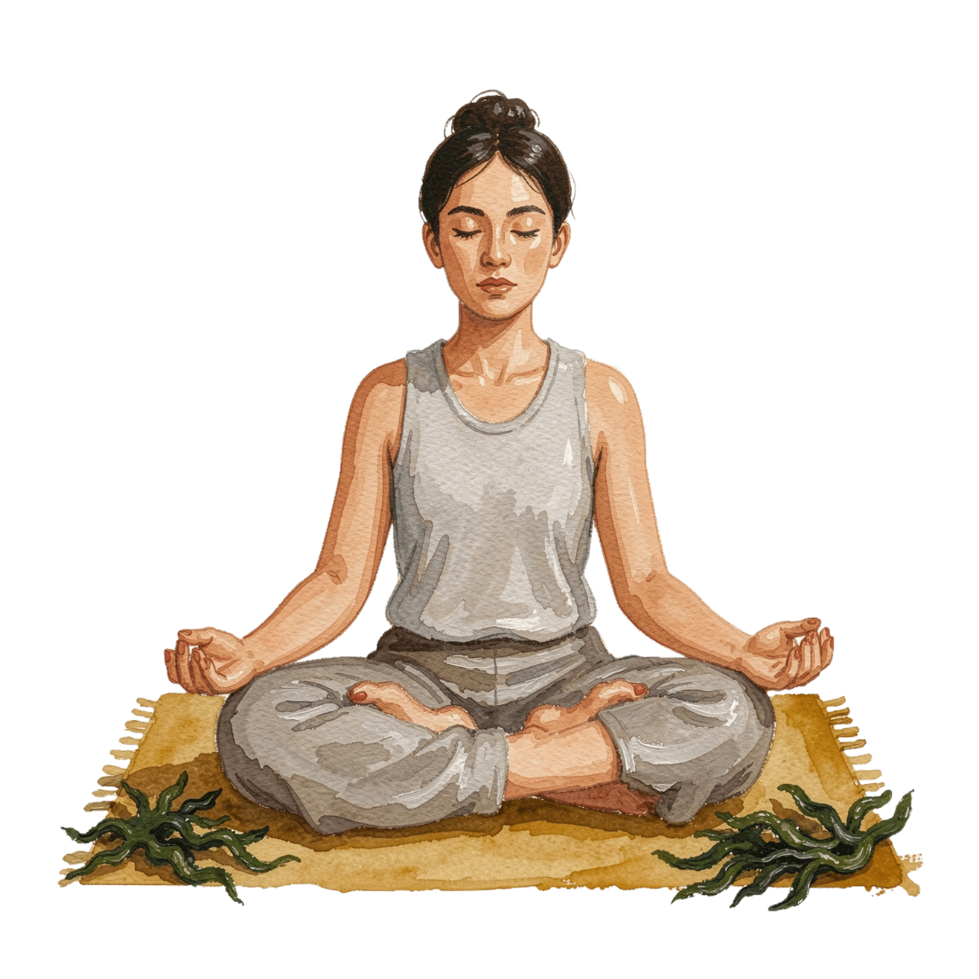

Concept
Happiness
Physical Facilities
The Key Distinction
A state of inner satisfaction, peace and contentment.
Material things that provide comfort and convenience — such as a house, mobile phone, vehicle, money and clothes.
Physical facilities can support a comfortable life, but they do not automatically create lasting happiness.

Slide 3
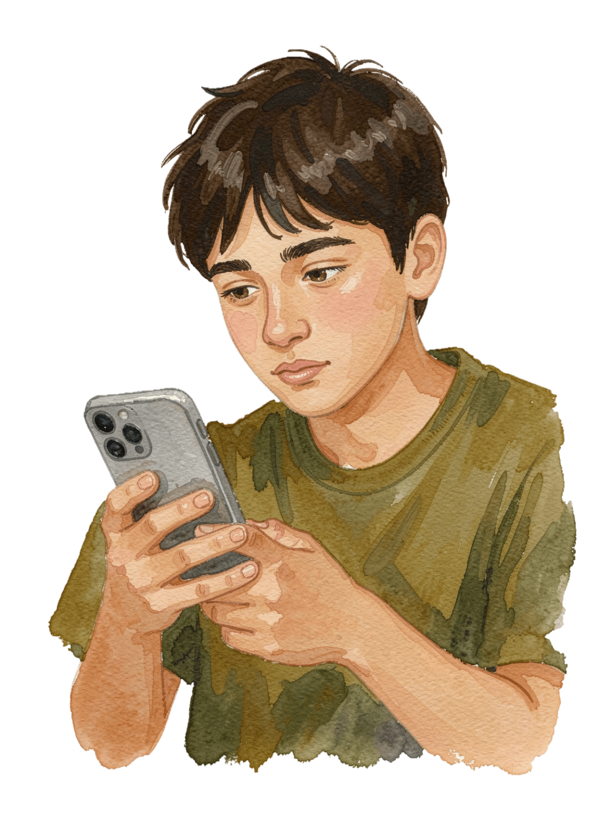
Example
1
The Purchase
A student buys an expensive smartphone and feels happy for some time.
2
The Fade
After a few days, the excitement may reduce and the student may want a newer phone.
3
The Contrast
Spending time with family or helping a friend can create satisfaction without buying anything.
4
The Insight
Physical facilities and happiness are related, but they are not the same.

Slide 4
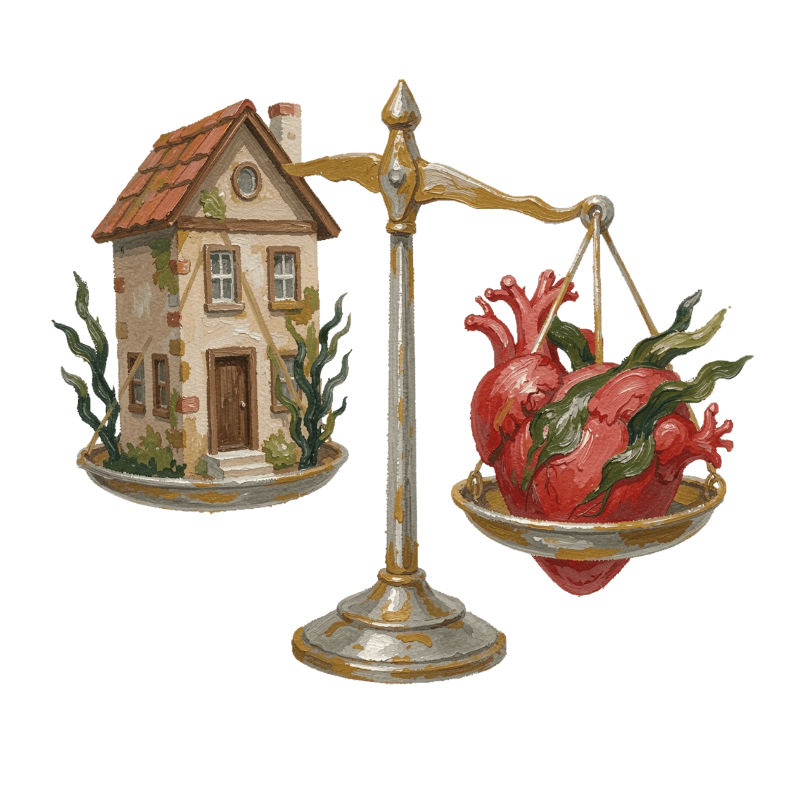
Analysis
Body vs. Mind
Comfort Has Limits
Balance Is Key
Physical facilities satisfy the needs of the body and provide convenience. Happiness is connected with thoughts, relationships, understanding and inner satisfaction.
Therefore, a balanced approach is important.
More facilities can improve comfort up to a certain point. Continuous comparison with others means material facilities may not bring lasting satisfaction.

Slide 5




Reflection
What We Chase
What We Should Ask
What Truly Helps
A Wiser Approach
As students, we often connect happiness with good marks, gadgets, money or social status.
Maintaining good relationships, managing expectations and appreciating what we have can support happiness.
Physical facilities should be used wisely rather than treated as the only source of happiness.
We can reflect on whether these things give lasting satisfaction or only temporary excitement.

Slide 6

Conclusion
Different Concepts
Happiness and physical facilities are different concepts.
Role of Facilities
Physical facilities provide comfort and help meet physical needs.
Source of Happiness
Happiness comes from inner satisfaction, healthy relationships and a balanced way of living.
A Meaningful Life
A meaningful life requires both appropriate physical facilities and harmony within ourselves.

