Slide 1
How to improve Search Engines with Deep Learning?
Dr Nabil FEGAIERE
Atypical Skills
CEO & Founder

Slide 2
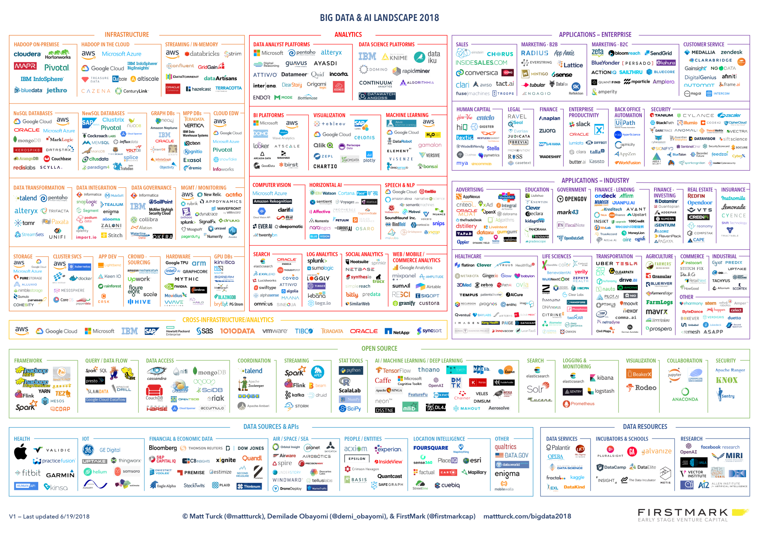

Introduction
© Nabil FEGAIERE – Atypical Skills

Slide 3
Context
1985 = MINSIS
Manage Tables with Fields:
Simple (One value, Numeric, Characters, Variable Size)
Composed (sub table)
Array (many values, Simple or Composed or Array)
Nested structure (N1NF=Non First Normal Form)
Unstructured Data
Not Normalised
Analyse Fields:
Simple value
Text value: (Natural Language Processing)
Tokenisation
Prefix and Suffix Dictionary (Normalisation)
Stop words list
Query: boolean language
Reformulation: Thesaurii
Bibliography, Table of Contents
Internal Sources
Technologies:
Processor: HP3000
OS: MPE V
Programming Language: Cobol
Not Open, Not Scalable
© Nabil FEGAIERE – Atypical Skills

Slide 4
Context
2018 = ELASTICSEARCH
Manage Tables with Fields:
Simple (One value, Numeric, Characters, Variable Size)
Composed (sub table)
Array (many values, Simple or Composed or Array)
Nested structure (N1NF=Non First Normal Form)
Unstructured Data
JSON
Analyse Fields:
Simple value
Text value: (Natural Language Processing)
Tokenisation
Prefix and Suffix Dictionary (Normalisation)
Stemming/Lemmatisation
Stop words list
Query: boolean language
Reformulation: Synonym file
Probability/Statistics: tf/idf, BM25
Bibliography, Table of Contents, Documents, Twitters, logs
Internal & External Sources
Technologies:
Processor: intel
OS: linux/windows
Programming Language: Java
Open, Scalable
© Nabil FEGAIERE – Atypical Skills

Slide 5


Context
2016
Compagny working on the domain of Culture
Document to Ingest:
PDF, doc & Social Media
Language:
English - French - Arabic
Elasticsearch
2.x
Customer 1
2017-2018
Compagny working in Banking
Document to Ingest:
PDF & Social Media
Language:
English - French
Elasticsearch
5.X – 6.x
Customer 2
© Nabil FEGAIERE – Atypical Skills

Slide 6
Ingestion Architecture
Elastic
Search
PDF, Doc
Ingest Pipeline
Kafka Connect
Source
Twitter
KAFKA
Kafka Connect
Sink
Elasticsearch
Twitter
© Nabil FEGAIERE – Atypical Skills

Slide 7
Elasticsearch Text Analysis
Analyzer Anatomy (custom)
Character Filters
Token Filters
Tokenizer
Standard
Simple
Whitespace
Stop
Keyword
Pattern
Language (english, french …)
Fingerprint
Built-in Analyzers
© Nabil FEGAIERE – Atypical Skills

Slide 8
Elasticsearch Text Analysis
Built-in Tokenizers
Built-in Token Filters
Built-in Character Filters
Word Oriented:
Standard
Letter
Lowercase
Whitespace
UAX URL Email
Classic
Thai
Partial Word:
N-Gram
Edge N-Gram
Structured Text:
Keyword
Pattern
Simple Pattern
Simple Pattern Split
Path
Standard
ASCII Folding
Flatten Graph
Length
Lowercase
Uppercase
NGRAM
Edge NGRAM
Porter Stem
Shingle
Stop
Word Delimiter
Word Delimiter Graph
Stemmer
Stemmer Override
Keyword Marker
Keyword Repeat
Snowball
Phonetic
Synonym
Synonym Graph
Compound Word
Reverse
Elision
Truncate
Unique
Pattern Capture
Pattern Replace
Trim
Limit Token Count
Hunspell
Common Grams
Normalization
CJK Width
CJK Bigram
Delimited Payload
Keep Words
Keep Types
Classic
Apostrophe
Decimal Digit
Fingerprint
Minhash Token
HTML Strip
Mapping
Pattern Replace
© Nabil FEGAIERE – Atypical Skills

Slide 9
Elasticsearch Synonyms
PUT /test_index
{
"settings": {
"index" : {
"analysis" : {
"analyzer" : {
"synonym" : {
"tokenizer" : "whitespace",
"filter" : ["synonym"]
}
},
"filter" : {
"synonym" : {
"type" : "synonym",
"synonyms_path" : "analysis/synonym.txt"
}
}
}
}
}
}
© Nabil FEGAIERE – Atypical Skills

Slide 10

Elasticsearch Synonyms
med => medical, medicine
tech => technology
# Spelling differences
gynaecology, gynecology
tumour, tumor
# Profession and Specialty are normalised
cardiology, cardiologist
dentistry, dentist
# Common abbreviations and expansions
gynae => gynecology
paeds => paediatrics
# acronyms
ICU => intensive care unit, intensive care
PICU => paediatric intensive care unit, paediatric intensive care, pediatric intensive care unit, pediatric intensive care
# words to be treated as synonyms
cardiac, cardiology
cancer, oncology, tumour, tumor, malignancy
atrial fibrillation, atrial fibrilation, AFib, AF, A-fib, arrhythmia, irregular heartbeat
# Subspecialty are treated equally
dentistry, orthodontics
# Important to be bring up same results
diabetes, diabetic
chronic, longterm, long term, long-term
© Nabil FEGAIERE – Atypical Skills

Slide 11
Architecture to generate Synonym file
Synonym
Generation
Trained
Models
Train Domain Vocabulary
PreTrained
Models
Synonym
Files
Elastic
Search
Ingest Pipeline
PDF, Doc
Indexes
KAFKA
Kafka Connect
Sink
Elasticsearch
Twitter
Kafka Connect
Source
Twitter
© Nabil FEGAIERE – Atypical Skills

Slide 12
Pretrained Models
❶ Google News Word2Vec model
Vocabulary size: 3 000 000 words
❷ Stanford GloVe model
Vocabulary size: 400 000 words
❸ Wikipedia FastText model
Vocabulary size: ngrams
© Nabil FEGAIERE – Atypical Skills

Slide 13
Pretrained Models
❶ Google News Word2Vec model
Vocabulary size: 3 000 000 words
w1 = "polite"
similar_words = model.wv.most_similar(positive=w1, topn=10)
print(similar_words)
[('courteous', 0.7520974278450012),
('everybody_Pendergrast', 0.7189082503318787),
('respectful', 0.6748368144035339),
('mannerly', 0.6553859114646912),
('gracious', 0.6316325664520264),
('considerate', 0.6307362914085388),
('mannered', 0.627892255783081),
('exceedingly_polite', 0.6189174652099609),
('rude', 0.6183222532272339),
('unfailingly_polite', 0.6108803749084473)]
© Nabil FEGAIERE – Atypical Skills

Slide 14
Pretrained Models
❷ Stanford GloVe model
Vocabulary size: 400 000 words
w1 = "polite"
similar_words = model.wv.most_similar(positive=w1, topn=10)
print(similar_words)
[('courteous', 0.7728187441825867),
('respectful', 0.713880717754364),
('unfailingly', 0.6171650290489197),
('gracious', 0.5790604948997498),
('thoughtful', 0.5612462759017944),
('considerate', 0.5538341999053955),
('amiable', 0.542062520980835),
('politely', 0.5371882319450378),
('cheerful', 0.5348200798034668),
('demeanor', 0.5340679883956909)]
© Nabil FEGAIERE – Atypical Skills

Slide 15
Synonym Generation
Gensim
Word₁
[ …………..…]
Word_{1,} Word_{2,} Word_{10,} Word_{2000,} Word_{200000,} Word₂₀₀₂₀₀
C₁
Word₂
[ …………..…]
Word_{3,} Word_{21,} Word_{100,} Word₂₁₀₀₀
C₂
Word₃
[ …………..…]
most_similar
C₃
Word_{5000,} Word₅₀₀₁
Word₄
Word₅
Word_{6000,} Word_{6001,} Word_{333000,} Word_{333001,} Word₂₅₀₀₀₀
C_{m}
Word_{k}
Summary results for word2vec (n=3000000)
Maximum size of a cluster (MSC) | 10 | 20 | 10
Level of similarity (LOS) | 0.7 | 0.7 | 0.85
Number of Clusters (m) | 212965 | 136078 | 34103
Word_{n}
[ …………..…]
© Nabil FEGAIERE – Atypical Skills

Slide 16
Train Domain Vocabulary Module
SpaCy
Gensim
Using Word2vec: needs a huge volume of data to train (fails)
GloVe: do not need an important volume of data to train and could be parallelized (better for our use case)
FastText: based on ngram: good for use of partial word. (we have to test it)
© Nabil FEGAIERE – Atypical Skills

Slide 17
Thank you

