Slide 1
UAkron Course Evaluation Project
Internet System Programming
Project by:
Nick Gallimore
Karun Kuikel
Prakash Biswa

Slide 2
What are used in the Project?
HTML-Hypertext Markup Language
CSS – Cascading Styling Sheet
Database
JavaScript – (search.js)
PHP – (config.php, deleval.php, evaluate.php, geteval.php, login.php, logout.php, nuke.php etc)
JSON – (courses.json)
MySQL- ( createprojectdatabase.sql, createtables.sql, insert_courses.sql)

Slide 3
What is the Project about?
UAkron Course Evaluation
Create account for log in
Search for courses at UA
Evaluate the courses if its taken already
Display date & time of the courses

Slide 4
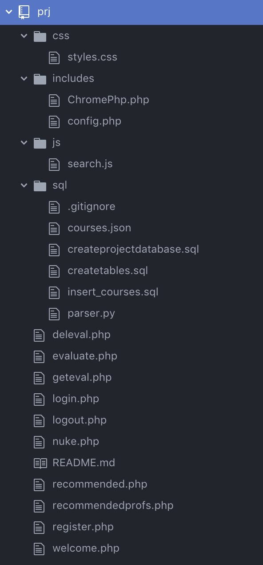
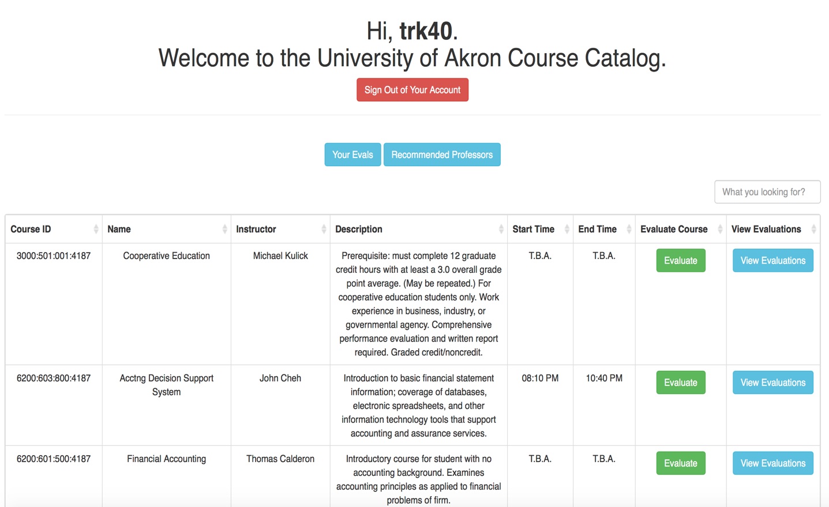
Design of the Project

Slide 5
Issues Doing the Project
Data Alteration
The data from the course catalog has upside down question mark that made parsing difficult. (i.e. ¿)
Extra Characters – had to escaped it
Don’t load all your data on one page

Slide 6
Conclusion
The conclusion is that we learn a lot from this project…
Learned to be aware of things.
Learned way to optimize the programs
Make programs load faster

