Slide 1
Introduction to RoR
Ruby on Rails
Yingcai Xiao

Slide 2
Ruby
Interpreted
Dynamic data typing
Object-oriented:
  encapsulation
  Inheritance (code reuse by sub-classing)
  polymorphism
Can run locally or on a server (Rails)
.

Slide 3
Ruby in CS Labs
Ruby is installed on CS lab computers.
Login onto a lab computer or one of the winremote computer.
Start Cygwin
You will be in a simulated Unix environment.
Try the following Unix commands:
  ls, pwd, mkdir ruby, cd ruby, ruby –h,
.

Slide 4
Ruby in CS Labs
Start interactive ruby by typing
irb
line = gets
Go, ISP, GO
puts line
exit
.

Slide 5
Ruby in CS Labs
Copy ruby programs from the T drive.
cp /cygdrive/T/Xiao/ISP/Ruby/*.* .
ruby word_table.rb
Go, ISP, Go!
Ctr D
Word Frequency
Go 2
ISP 1
.

Slide 6
Data Structures & Algorithms
Data Types: Scalars and Arrays
Scalars:
  Numeric: Fixnum, Bignum, Float
  String (value type, p5 of C15.ppt)
Arrays: non-uniform
  Array: similar to C++, with sub-array operations and shift, unshift, push, pop
  Associative Array, Hash, key=>value,
    Similar to PHP.
.

Slide 7
Data Structures & Algorithms
Operators/Controls
  no ++ or –
  gets/puts
  EOF for keyboard input: Ctrl-D (Unix/Mac), Crel-Z (PC)
  Case statement can be a right operand
  “for” loop is replaced by for-in
  for value in list
  puts value
  end
.

Slide 8
Data Structures & Algorithms
Operators/Controls
  break/next
  3 object comparisons:
  == (value)
  equal (reference)
  eql (type)
.

Slide 9
Data Structures & Algorithms
UDT: class
    class Name
    ..
    end
  Class Name begins with upper case
  Instance name begins with lower case
  Constructor “new” calls initialize
  Classes are dynamic, can add members later.
  getter/setter
.

Slide 10
Data Structures & Algorithms
UDT: class, Inheritance
    class Name < Parent
    ..
    end
  Support multiple inheritance
.

Slide 11
Data Structures & Algorithms
UDT: Blocks & Iterators
  A segment of code delimited by
  { } or do/end
  Built-in iterators
times:
5.times {puts “ISP”}
each:
list.each {|value| puts value}
upto, step, collect
.

Slide 12
Data Structures & Algorithms
Pattern Matching
string =~ /pattern/
Substitutions
str.sub(pattern, replacement)
str.gsub(pattern, replacement)
word_table.rb
.

Slide 13
Data Structures & Algorithms
# word_table.rb from PWWW
# Input: Text from the keyboard. All words in the input are
# separated by white space or punctuation, possibly followed
# by white space, where the punctuation can be a comma, a
# semicolon, a question mark, an exclamation point, a period,
# or a colon.
# Output: A list of all unique words in the input, in alphabetical
# order, along with their frequencies of occurrence
.

Slide 14
Data Structures & Algorithms
# word_table.rb
freq = Hash.new
line_words = Array.new
# Main loop to get and process lines of input text
while line = gets
# Split the line into words
line_words = line.chomp.split( /[ \.,;:!\?]\s*/)
.

Slide 15
Data Structures & Algorithms
# word_table.rb
# Loop to count the words (either increment or initialize to 1)
for word in line_words
if freq.has_key?(word) then
freq[word] = freq[word] + 1
else
freq[word] = 1
end
end
End
.

Slide 16
Data Structures & Algorithms
# word_table.rb
# Display the words and their frequencies
puts "\n Word \t\t Frequency \n\n"
for word in freq.keys.sort
puts " #{word} \t\t #{freq[word]}"
end
.

Slide 17
Ruby References
https://www.ruby-lang.org
https://www.ruby-lang.org/en/downloads/
https://www.ruby-lang.org/en/documentation/
https://www.tutorialspoint.com/ruby/
https://www.codecademy.com/learn/ruby
http://tryruby.org/
.

Slide 18
Ruby Installation
Download the current stable version
https://www.ruby-lang.org/en/downloads/
Needs download tools:
  PC: RubyInstaller
  Mac/Unix: rbenv and RVM
Needs 2.2.0 above to run Active Support
.

Slide 19
.
Rails

Slide 20
Rails
Framework for developing Web applications.
A framework is a standardized system of reusable templates.
Based on the MVC (Model-View-Controller) web application architecture.
RoR (Ruby on Rails) uses predefined M,V,C classes (in Ruby) to form the templates.
.

Slide 21
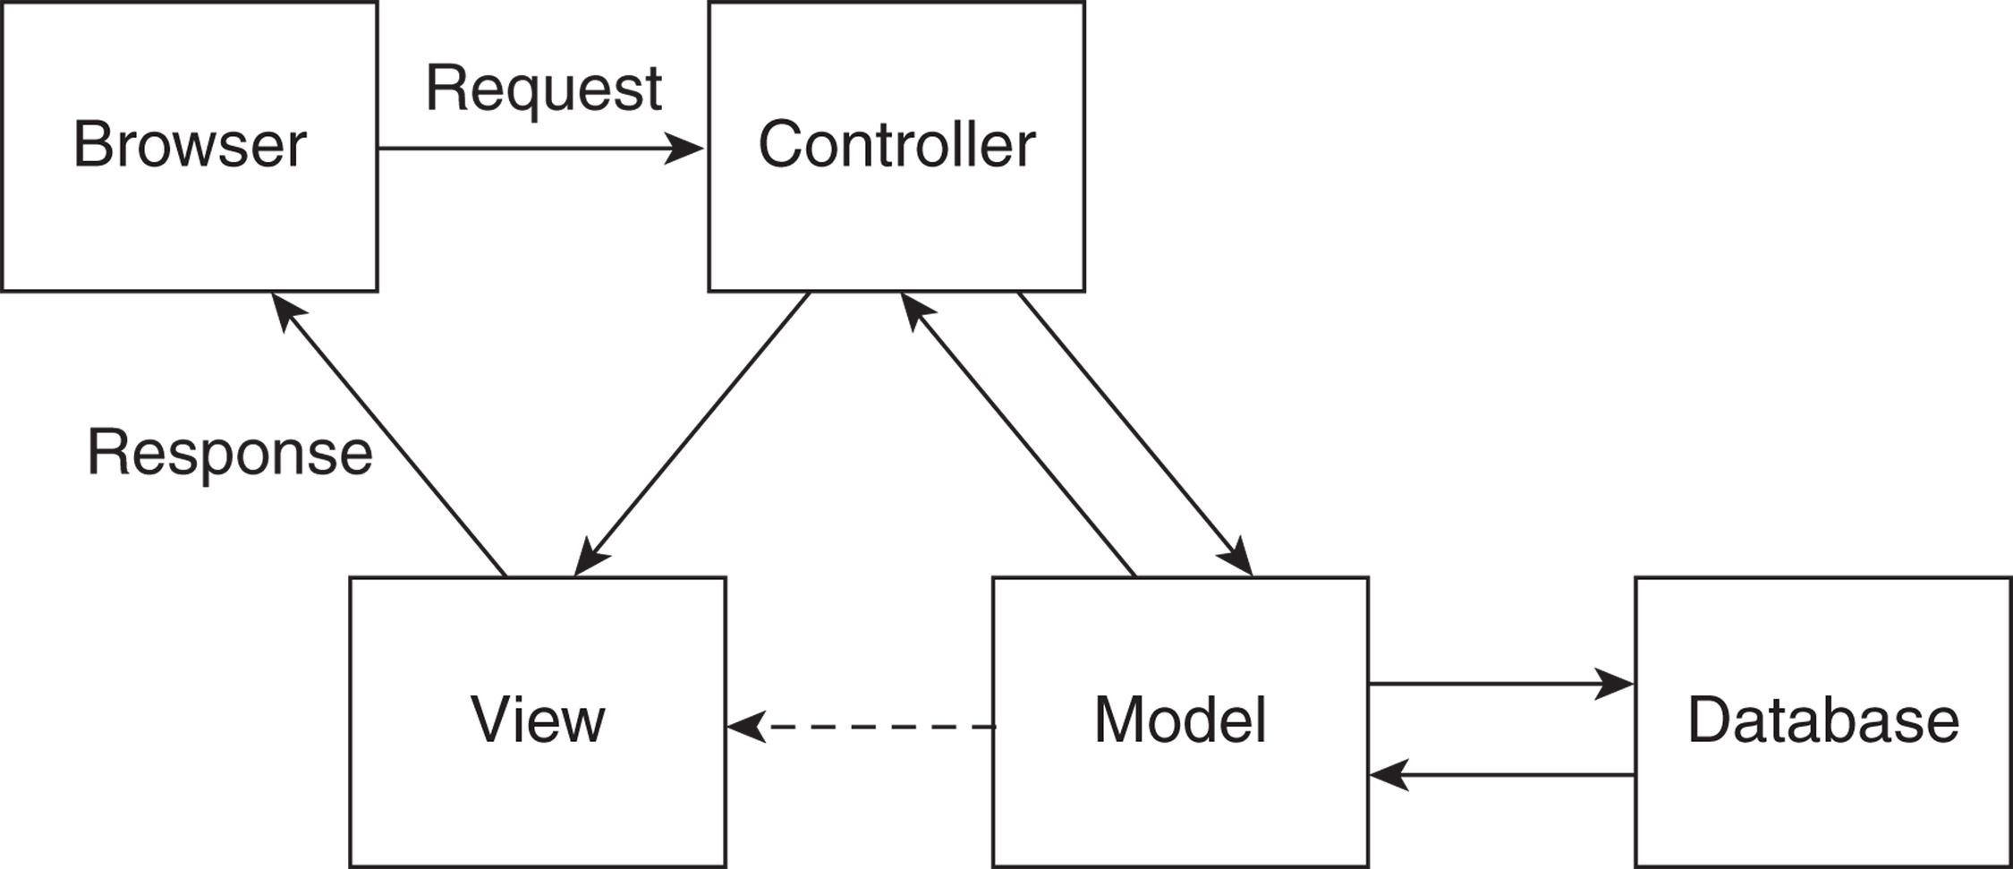
Rails MVC Architecture (PWWW)
.

Slide 22
Architecture of a Four-Tier Application
DBMS / Database Server
Application Server
WEB
S
E
R
V
E
R
WEB
C
L
I
E
N
T
Supporting Software
App User Interface
User Interface
Application Logic
Database Engine
Database
Database API
Architecture of a Four-Tier Application
Notes:
Wednesday 3/18/2015 day and evening

Slide 23
Architecture of RoR Web Applications
DBMS / Database Server
RoR Web Applications
WEBrick
or any
Web Server
on the same system.
Web
C
L
I
E
N
T
Supporting Software
App User Interface
(View)
User Interface
Application Logic
(Controller)
Database Engine
Database
Database API
(Model:ORM)
Architecture of RoR Web Applications
Notes:
Wednesday 3/18/2015 day and evening

Slide 24
.
Installing Rails

Slide 25
Rails Installation
Rails comes with Ruby along with RubyGems
PWWW uses SQLite3 (SQLite.org) for database
Command line installations
gem install sqlite3
gem install rails
Or
sudo gem install sqlite3
sudo gem install rails
.

Slide 26
Rails Server Startup
Start the webrick server (came with Rails)
rails server webrick
URL to access the server
http://localhost:3000/
.

Slide 27
Rails Hosting
http://www.railshosting.org/free-rails-hosting
https://www.airpair.com/ruby-on-rails/posts/rails-host-comparison-aws-digitalocean-heroku-engineyard
https://www.heroku.com/
http://api.rubyonrails.org/
Detailed instructions on using Amazon AWS Cloud:
http://dsaigoud.com/amazon-aws-instance-setup-and-j2ee-app-deployment.jsp
.

Slide 28
.
Programming RoR
Notes:
Day

Slide 29
RoR Web Application Development
Automatically generates web apps
Apps are composed of MVC classes
Similar to our PA4 but without GUI, everything is Command Line
.

Slide 30
.
RoR Web Application Development
A “Hello World” Example

Slide 31
Architecture of RoR Web Applications
DBMS / Database Server
RoR Web Applications
WEBrick
or any
Web Server
on the same system.
Web
C
L
I
E
N
T
Supporting Software
App User Interface
(View)
User Interface
Application Logic
(Controller)
Database Engine
Database
Database API
(Model:ORM)
Architecture of RoR Web Applications
Notes:
Wednesday 3/18/2015 day and evening

Slide 32
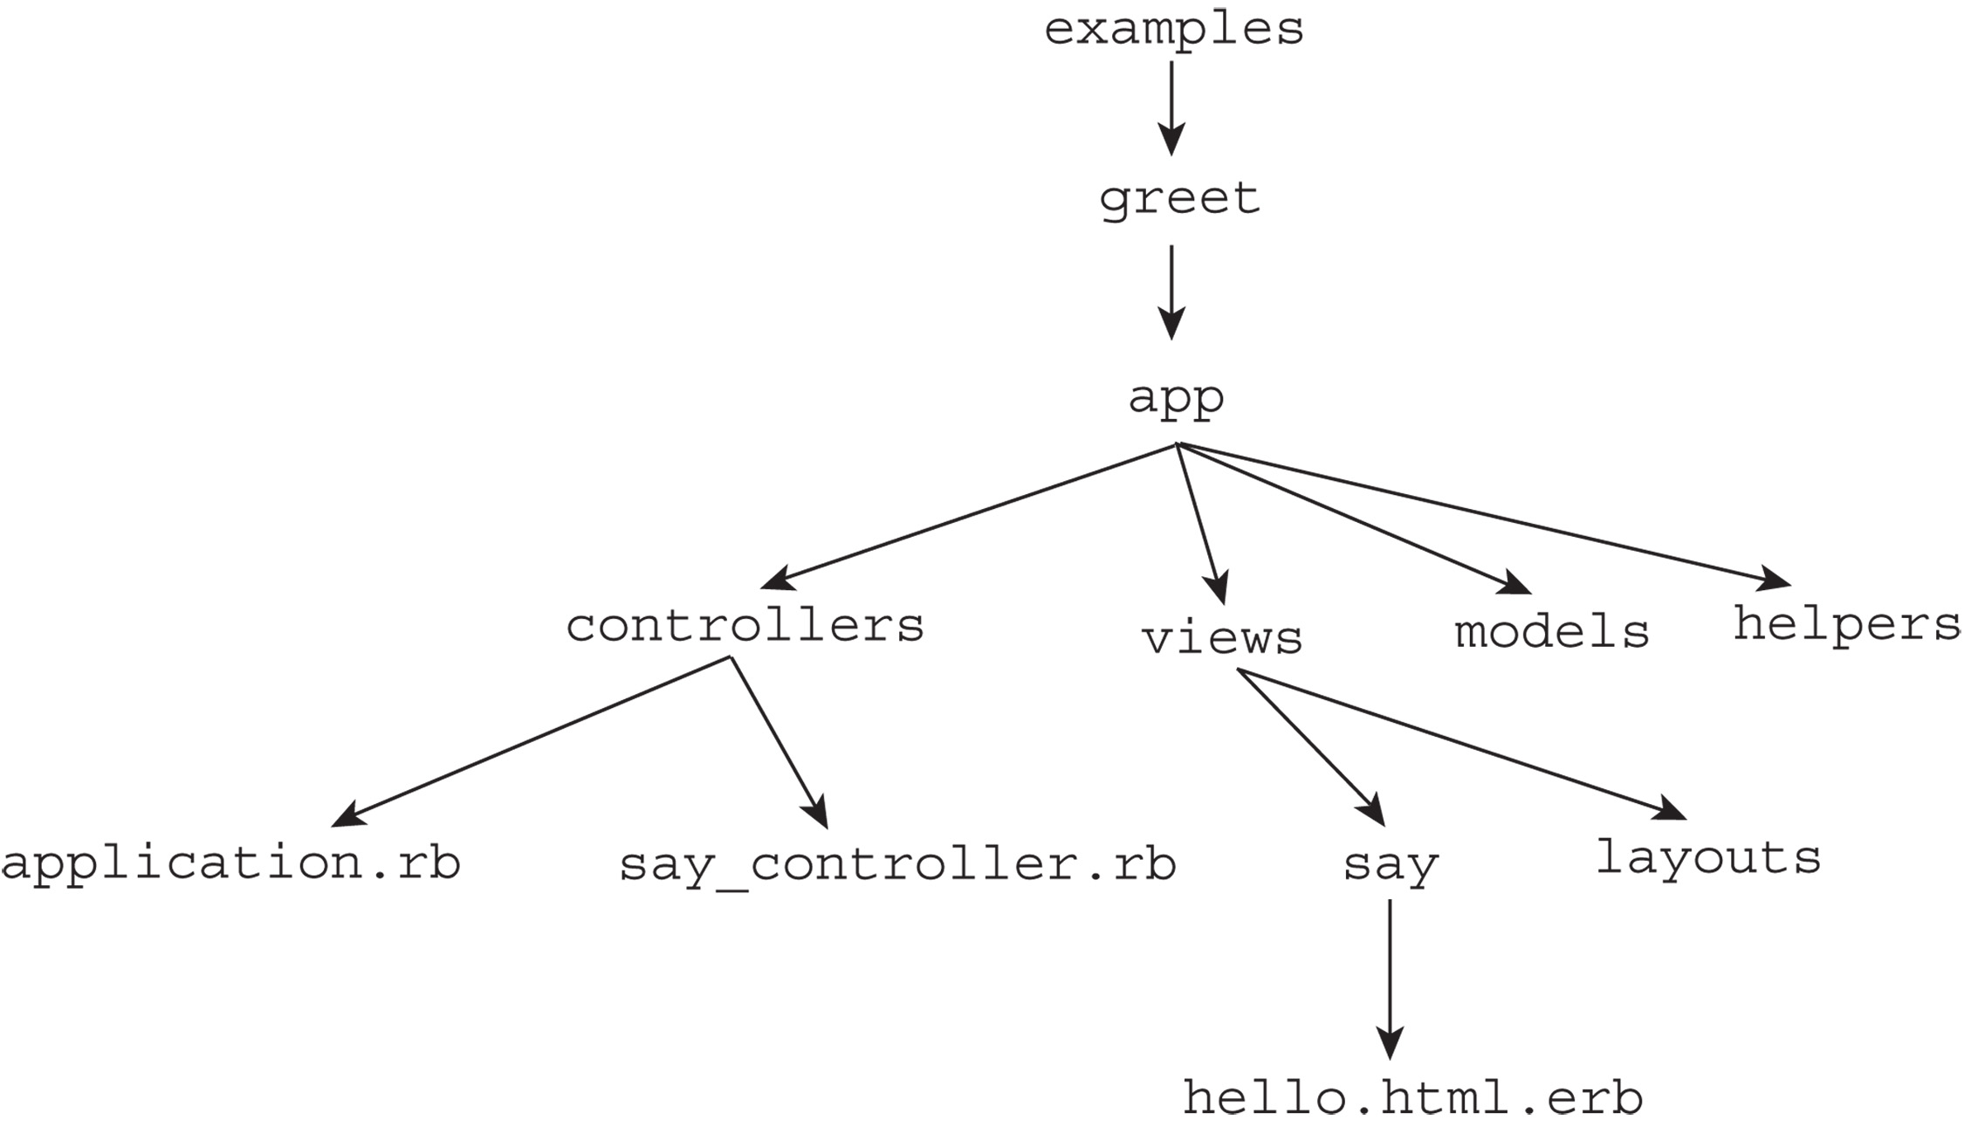
Programming RoR: Examples
>rails new greet
.

Slide 33
Greet Example
>rails generate controller say hello
It generates the code for the controller class named “say” with a method named “hello”.
say_controller.rb
class SayController < ApplicationController
def hello
end
end
.

Slide 34
Greet Example
The same command also generated the code for the view
app/views/say/hello.html.erb
Embedded Ruby
<!DOCTYPE html>
<!-- hello.html.erb - the template for the
greet application
-->
<html lang = "en">
<head>
<title> greet </title>
<meta charset = "utf-8" />
</head>
<body>
<h1> Hello from Rails </h1>
</body>
</html
.

Slide 35
Programming RoR: Examples
>rails new greet
.

Slide 36
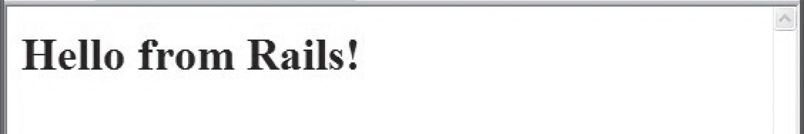
Dynamic response of the application server
to a user request
http://localhost:3000/say/hello
0. Web Client->HTTP Get->Webrick->Rails->App
1. Instantiate SayController class
2. Call the hello action method
3. Search the views/say directory for hello.html.erb
4. Process hello.html.erb with Erb
5. Return the resulting hello.html to the
requesting browser

Slide 37
Greet Example Customization
<!DOCTYPE html>
<!-- hello.html.erb - the template for the
greet application
-->
<html lang = "en">
<head>
<title> greet </title>
<meta charset = "utf-8" />
</head>
<body>
<h1> Hello from Rails </h1>
    It is now <%= t = Time.now %> <br />
    Number of seconds since midnight:
    <%= t.hour * 3600 + t.min * 60 + t.sec %>
</body>
</html
.

Slide 38
.
RoR Web Application Development
A 4-tier Enterprise Example

Slide 39
Architecture of RoR Web Applications
DBMS / Database Server
RoR Web Applications
WEBrick
or any
Web Server
on the same system.
Web
C
L
I
E
N
T
Supporting Software
App User Interface
(View)
User Interface
Application Logic
(Controller)
Database Engine
Database
Database API
(Model:ORM)
Architecture of RoR Web Applications
Notes:
Wednesday 3/18/2015 day and evening

Slide 40
ORM (Object Relation Model)
We need to create a database for the enterprise application.
The database is going to be relational. But we don’t have to define the schema using DDL.
We will let Rails to do that for us.
Rails will create a class to specify the schema:
The name of the class (object model) is the singular of the relational table name.
The name of the member variables are the names of the columns of the table.
The member methods of the class are inherited from the ActiveRecord class.
.

Slide 41
ORM (Object Relation Model)
Here are the implementation steps:
Create the application
>rails new cars
(2) Create the class to define the schema (cars/db/migrate)
>rails generate scaffold corvette
body_style:string miles:float year:integer
(3) Create the database table
>rake db:migrate
(4) The application, the controller, the view, are all automatically created without writing a single line of Ruby code! (Familiar? PA3)
http://localhost:3000/corvettes
.

Slide 42
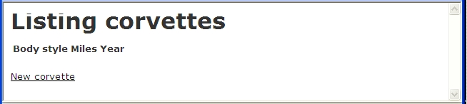
Programming RoR: Examples
http://localhost:3000/corvettes
.

Slide 43
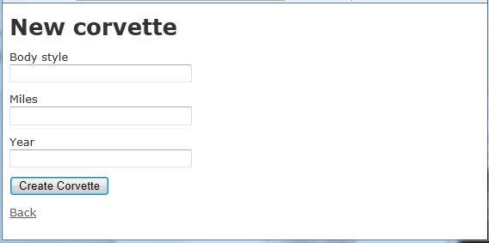
Programming RoR: Examples
When clicking on “New corvette”
.

Slide 44
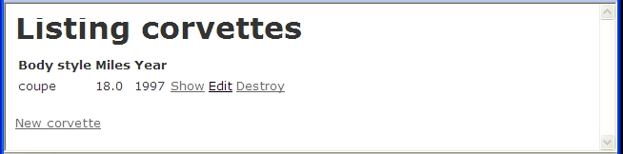
Programming RoR: Examples
After entering a “New corvette”
.

Slide 45
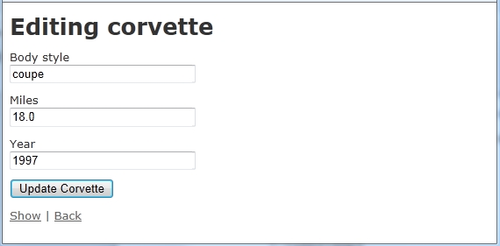
Programming RoR: Examples
UI for Editing
.

Slide 46
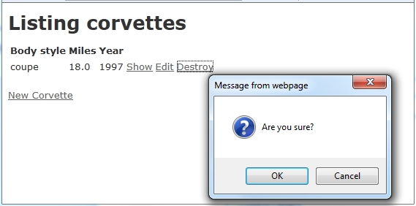
Programming RoR: Examples
For Destroy
.

Slide 47
Application?
Recreate your Social List web application using RoR in 5 minutes without writing a single line of code!
.

Slide 48
Creation?
Convert your PA3 as the GUI of Rails commands for other programmers (?) to create similar applications!
.

Slide 49
What did we learn?
Knowledge
Comprehension
Application
Creation
Techniques for the above
.

