Slide 1

David Campion – Michael Flynn – Nathan Field – Nikita Fedans

Slide 2
Housekeeping
Roles
Tasks
Nikita Fedans: Hardware & Backend
Nathan Field: Front and back end
Michael Flynn: Database and frontend
David Campion: frontend & CSS
Assembling & coding for the lock, fingerprint sensor and opening button
Worked on the Frontend and linked the fingerprint sensor to the website
Created the database, hosted it, and worked on the frontend
Styling of web page

Slide 3
Progress
Completed: website and database hosted. Lock wired correctly and working. Fingerprint able to register new users and verify user’s fingerprints. Fingerprint scans put into database and visible on log, on website. https enabled.
Left to do: write all face recognition code. Be able to add/delete a fingerprint to a user record in the database through the website. Connect the display for user feedback. Clean up website styling and put together secure boxes to mount sensors.

Slide 4
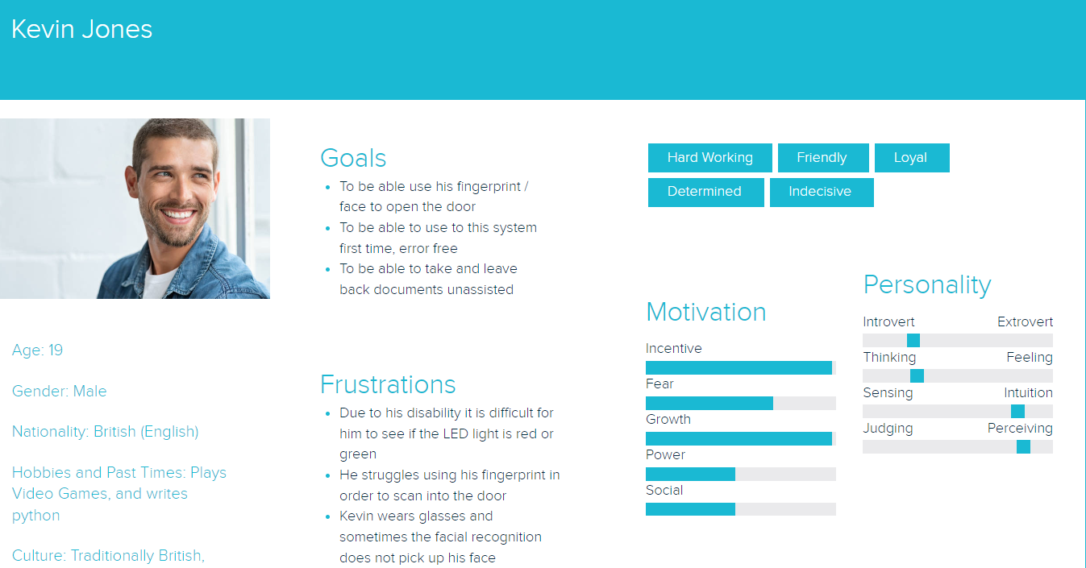
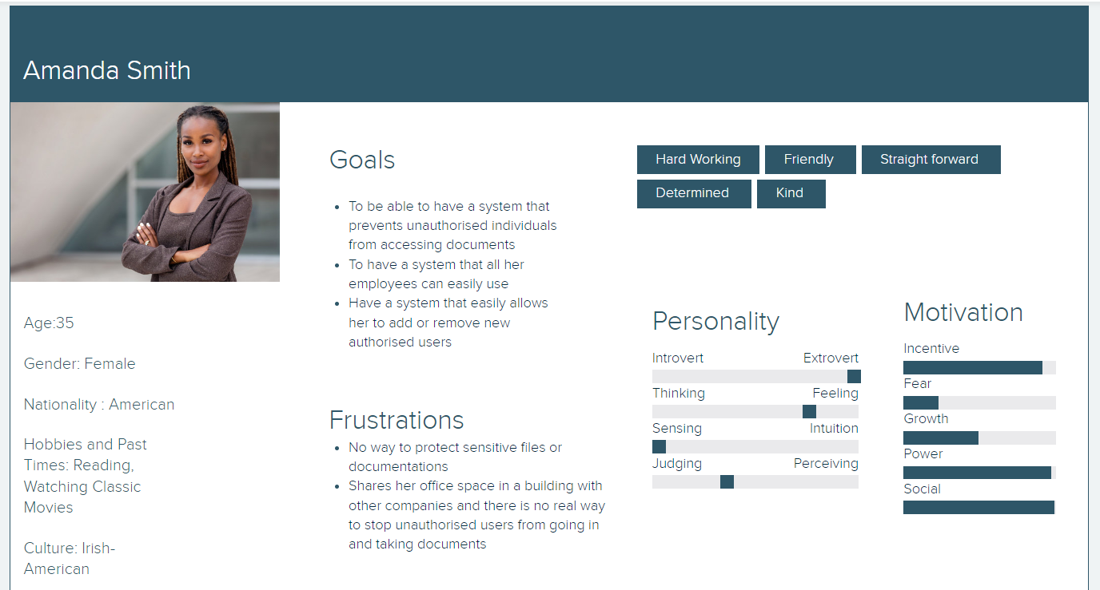
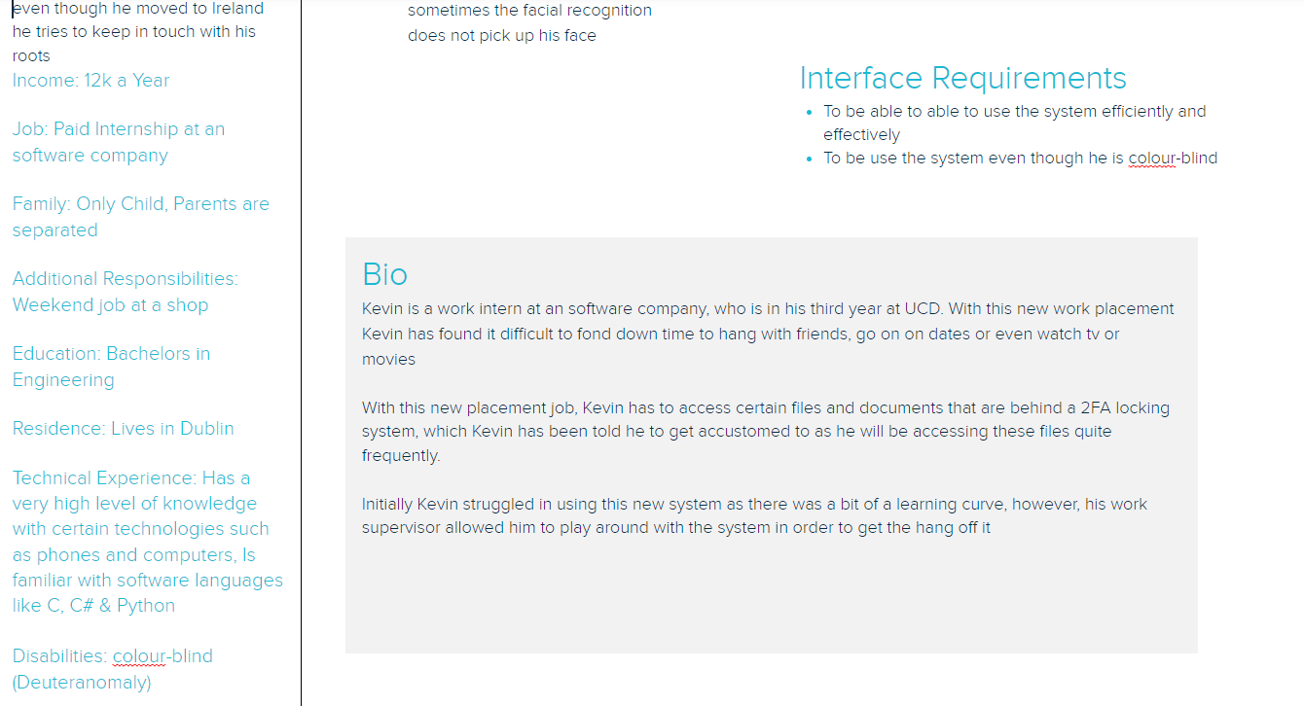
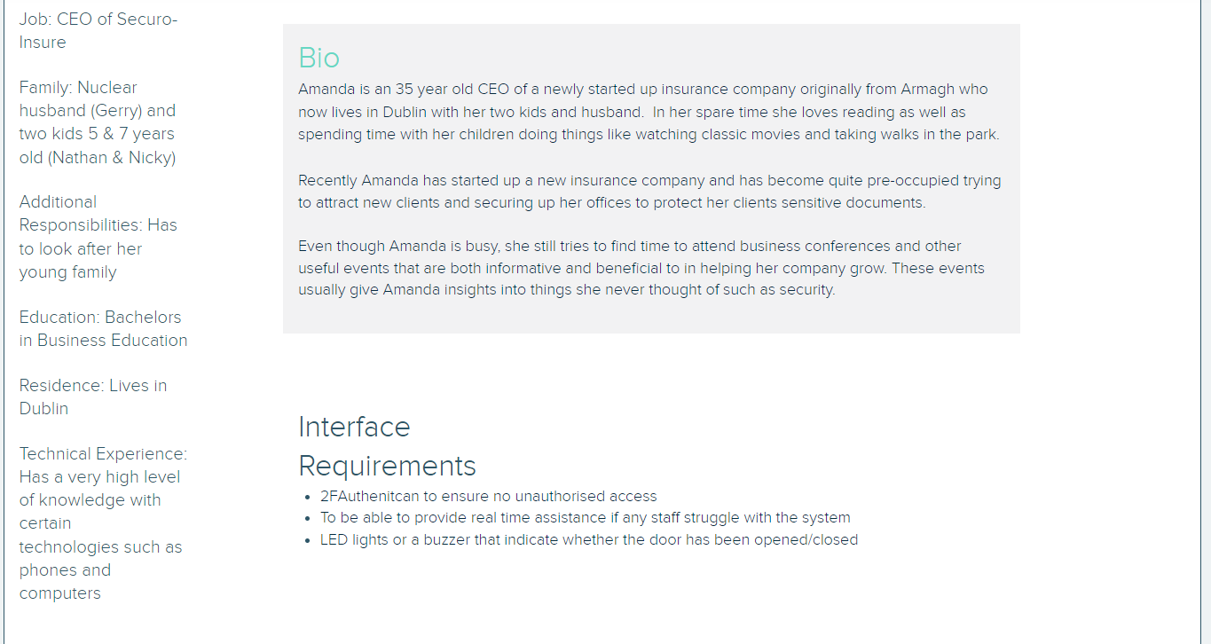
Persona 1
Persona 2

