Slide 1
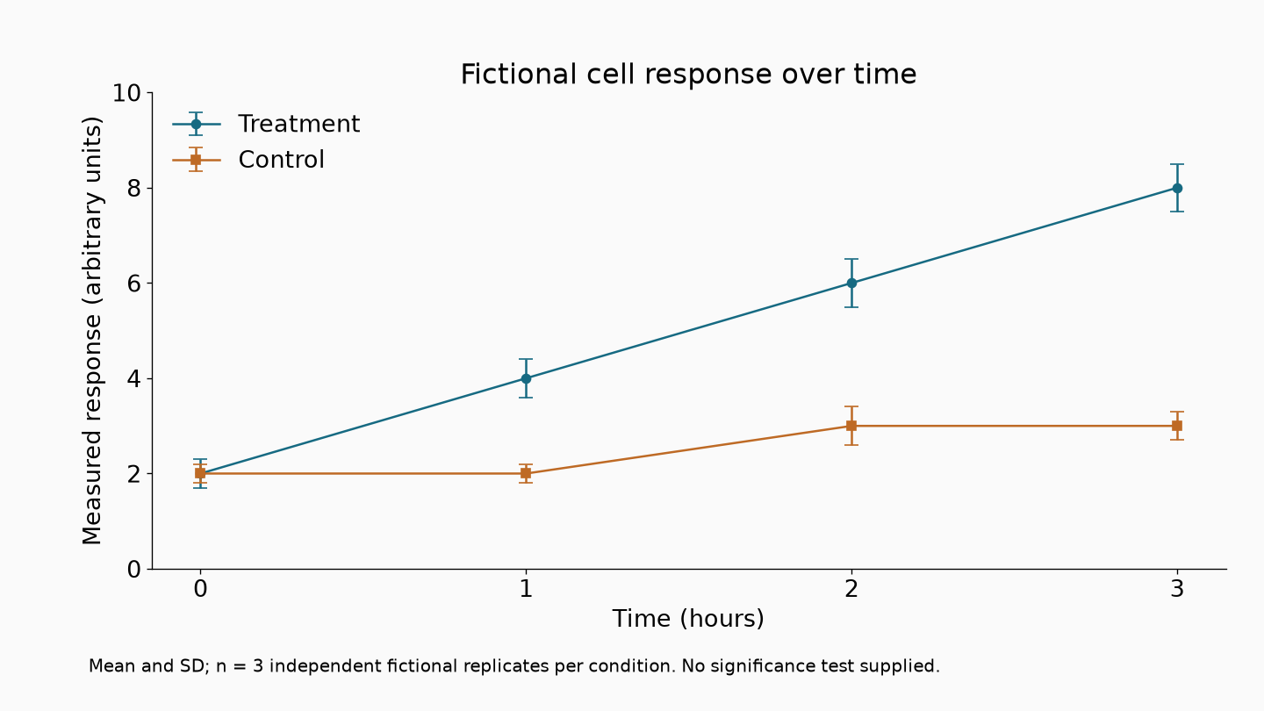
Fictional Meridian University | BIO201 | Image lecture slide 1

Slide 2
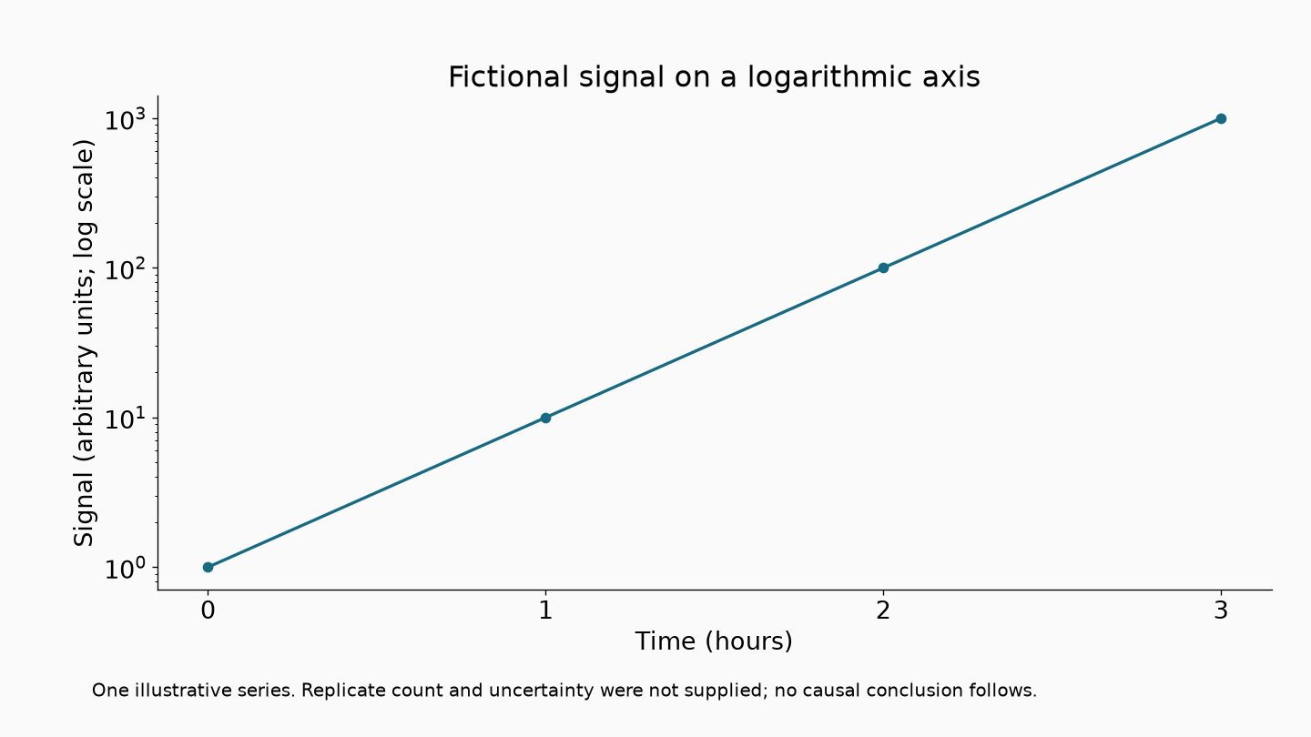
Fictional Meridian University | BIO201 | Image lecture slide 2

