Slide 1
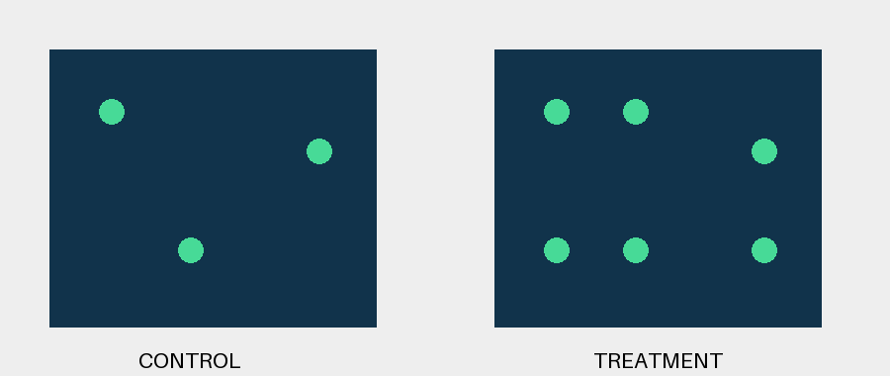
SYNTHETIC ONLY: fluorescence controls
Notes:
Fictional diagram; spot counts alone cannot establish efficacy.

