Slide 1
Smart Inhaler
Nico Finkelstein, Yash Jayswal, Dan Knight
Notes:
- Intro names, manager, and project

Slide 2
Problem
“Create a solution which leverages IoT and
patient data that will improve or sustain patient’s health”
Solution
Smart Inhaler:
Help prevent asthma attacks using non-invasive IoT
data and predictive analytics
Notes:
Begin story
Grace is grandma
Nancy is nurse

Slide 3
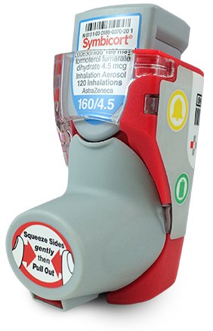


Innovation and Opportunities
→
(X,Y)
+
Advanced Analytics
Smart devices
Front End and HCI
Notes:
Arrival – time in car

Slide 4
Relevance
IoT:
- Smart Inhaler
- fitness Device
Patient Data:
- heart rate
- BMI
- activity level
- temperature detection
- air quality
Improved Health:
- decreased risk of asthma attack
- increased quality of life
+
Notes:
Logged out of carelink

Slide 5
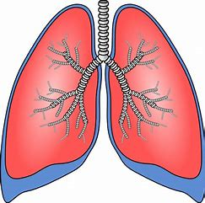
Marketability
- Total Addressable Market
- 15 Million Americans
- It is a growing market
- This number has doubled in 30 years
- Competition
- No current smart Inhaler on the market
- There could be
- Value
- Asthma costs the US $80 billion a year
- https://thoracic.com

Slide 6
Completeness and Demo
nfink10.herokuapp.com

