Slide 1
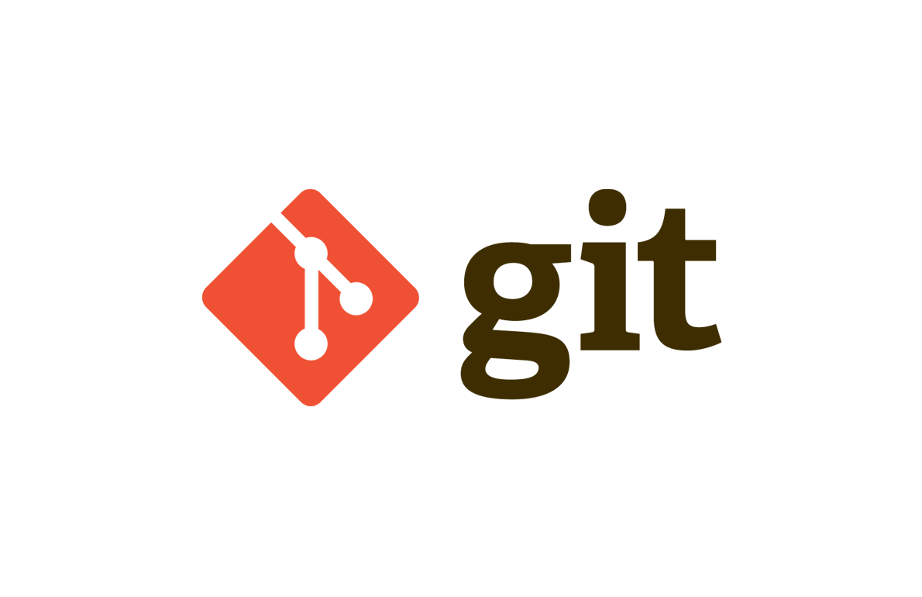
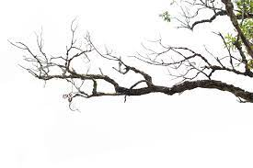
Let's learn the basics of Git branch in a different way
박승한(seunpark)
김성수(seonkim)
이우상(ulee)
Notes:
hello This is seunpark, the leader of the "Da" team who made Dash that can check the basics of Git branch in a short time.

Slide 2
Index
What is Dash?
Level
Persona
Subject
01
02
03
04

Slide 3
Dash?
Notes:
Before I explain, it is necessary to clear up what a Dash is.
What is a Dash?
If we look at the conditions of our Edutone,
first of all,
Dash means a short project that can be solved within 30 minutes to 2 hours
Also, Dash is not an orthodox learning, but a PBL-type learning method that can have multiple purposes.
This is definitely a different position from piscine,
which we know, for learning a lot of content in a short amount of time and with high quality.

Slide 4
01
What is Dash?
Dash
PBL focused on providing keywords and arousing interest in topics
Notes:
In summary, Dash should focus on “providing keywords” and “generating interest” about a topic.

Slide 5
01
What is Dash?
Providing keyword indirectly
Interesting
The goal is to know the keywords in question.
To get more information or content that needs deep learning, you need to learn our Dash and find it yourself.
Solve problems by taking examples such as 42 problems or coding tests -> Prevention of lowering of learning intention with interesting content.
Notes:
This is Some of our Dash features.
We will show the provision of information indirectly.
Rather than directly understanding the principles of any one topic, students learn by solving problems through figurative examples and comparing them with real topics.
Therefore, it is essential to take time to think about our Dash in relation to the Git branch.
If you approach our Dash only for solving problem, you can't get anything
Also, borrowing the form of questions such as 42 Seoul and coding tests, interest in the problem can be raised.

Slide 6
02
Level
No Norminette
No Forbidden Function
No Exception handling
Most codes supported
Kind explanation
Notes:
In order to achieve these objectives, the level has been significantly adjusted.
No Norminette.
You just have to focus on the content.
No Forbidden Function
You can show off your skills to the fullest.
By removing many other restrictions, we have created a Dash that can focus on content.

Slide 7

03
Persona
Non-user of version control tool Mr.Kim
Bongpajeon, who needs a minishell soon
Notes:
Considering what has been said so far,
our Dash target is for those who have never used Git or especially those who are new to team projects.
The goal is to make these people more curious about Git in the future.

Slide 8
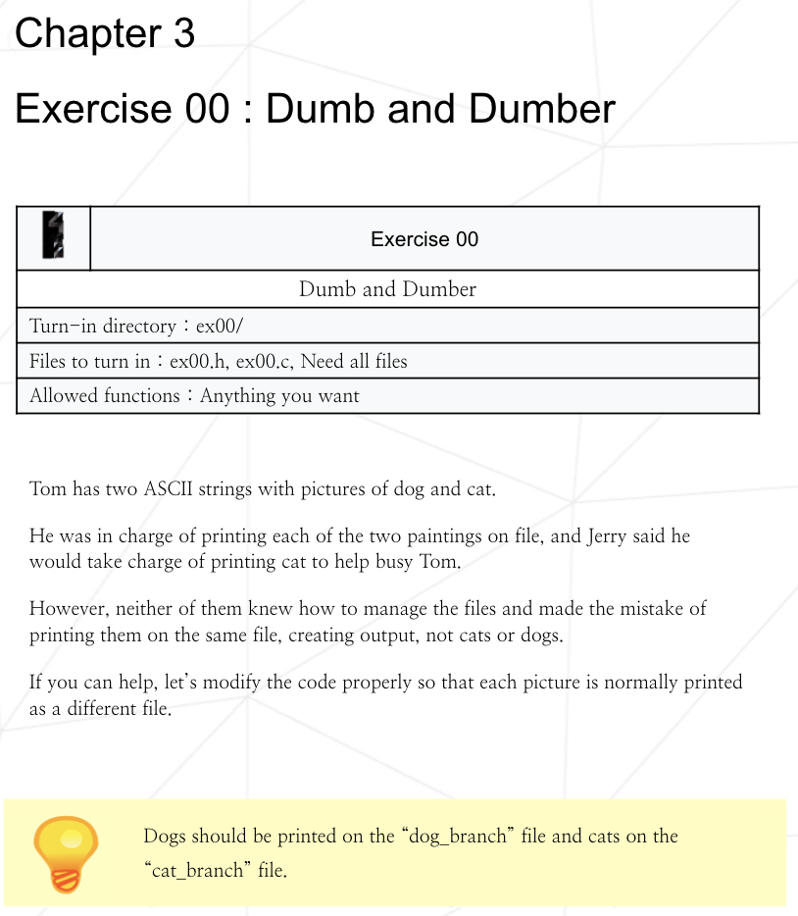
04
Subject
ex00
Goal: Why should you split a branch
Providing shared code by analogy to a shared resource problem in the form of each progressing through a branch
Time taken: about 30 minutes
Notes:
The subject has two exercises.
The first exercise was written on the topic of "Why should I split branches?"
It was created by comparing the shared code to a shared resource exercise

Slide 9
04
Subject
In order to use a shared resource by multiple people, divide the thread...
In order to use one code by several people, divide it into branches…
Notes:
In fact, there is no awkwardness in the context
if a shared resource is replaced with “A code” among articles related to shared resources.

Slide 10
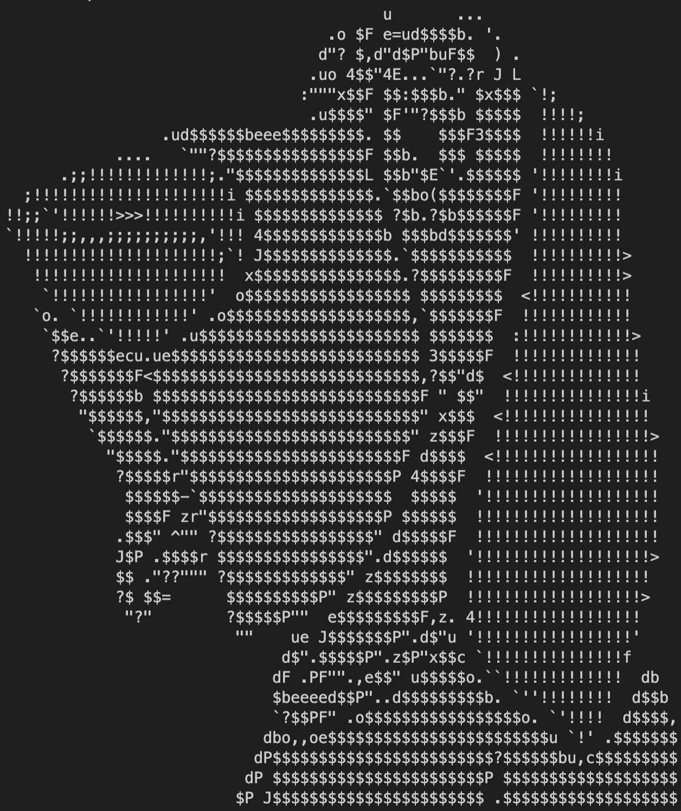
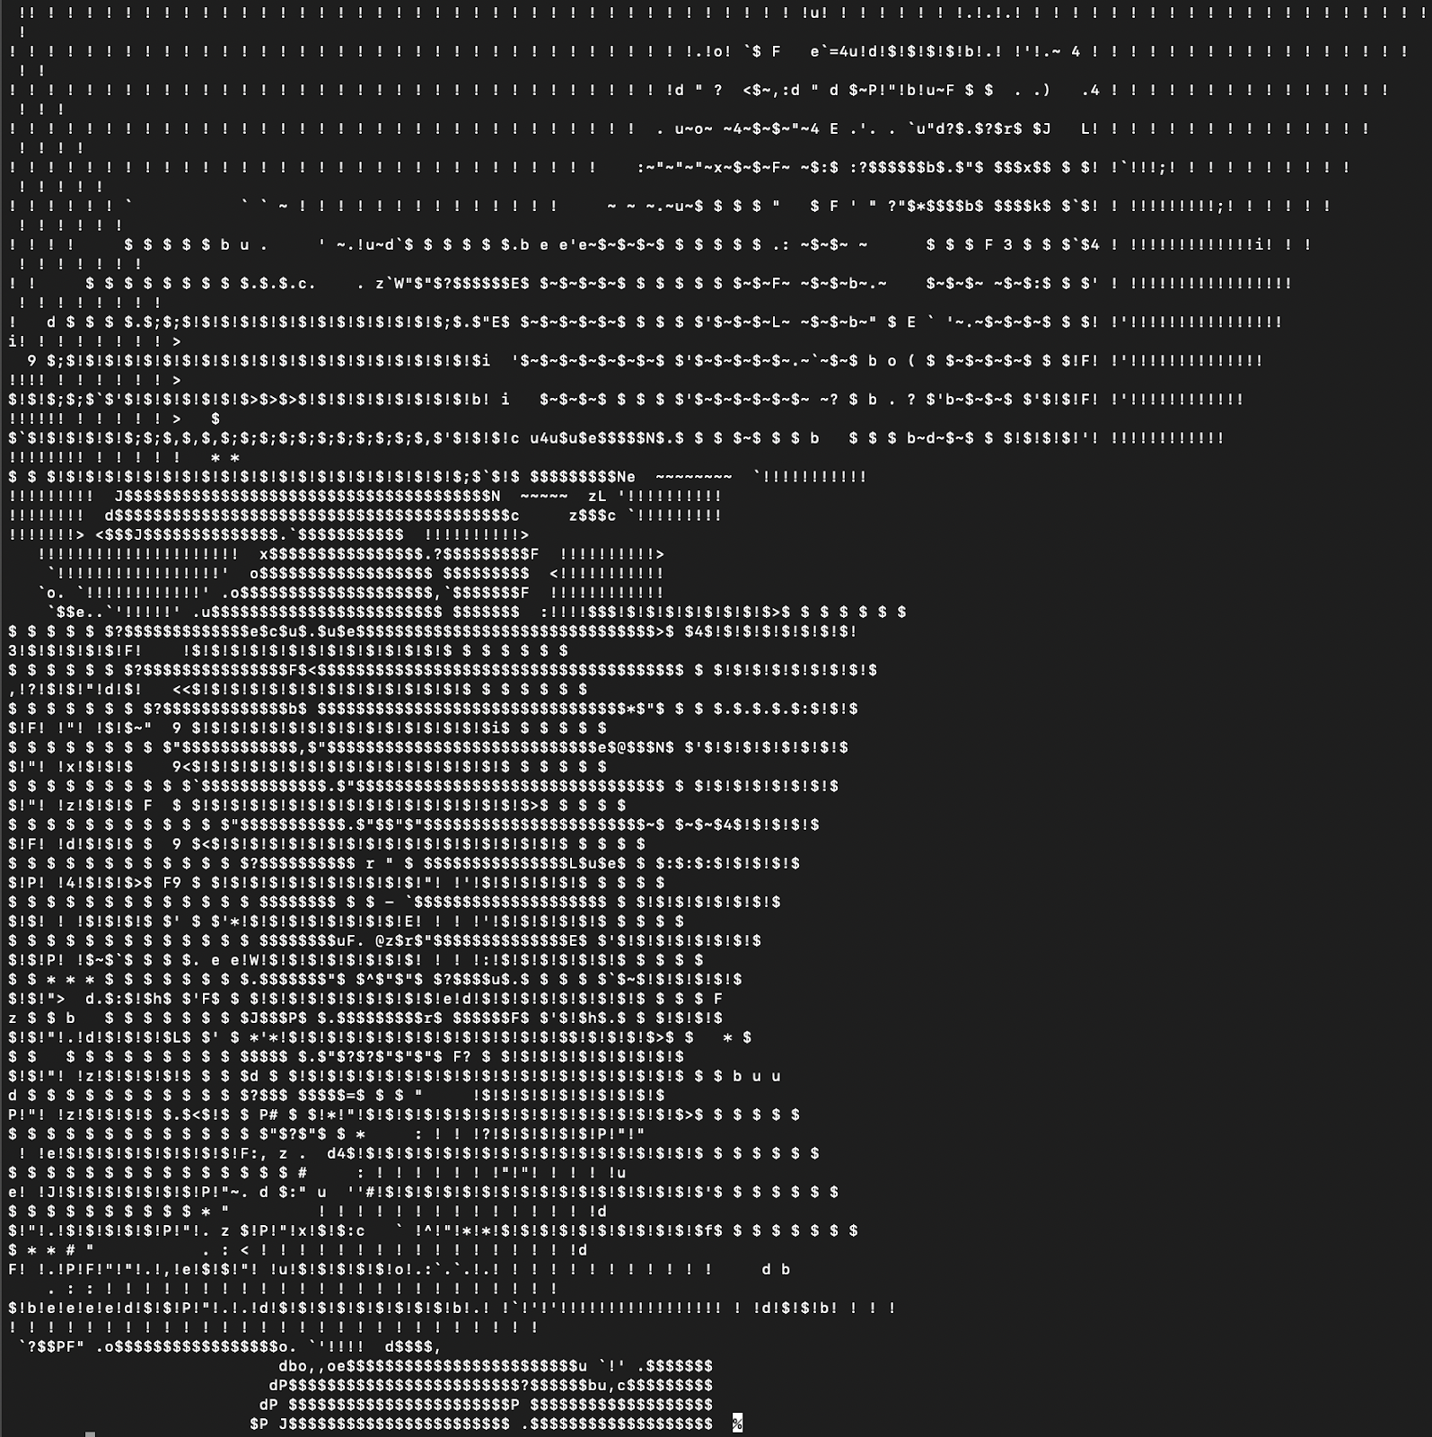
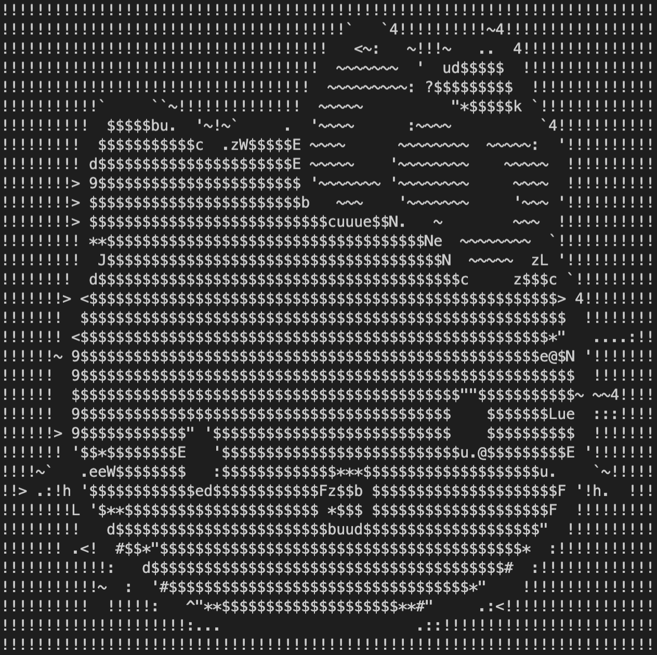
04
Subject
Notes:
The goal of this subject is for the student to identify and fix problems in the provided code.
They will find that they need to separate their workspaces
if they have work going on at the same time.

Slide 11
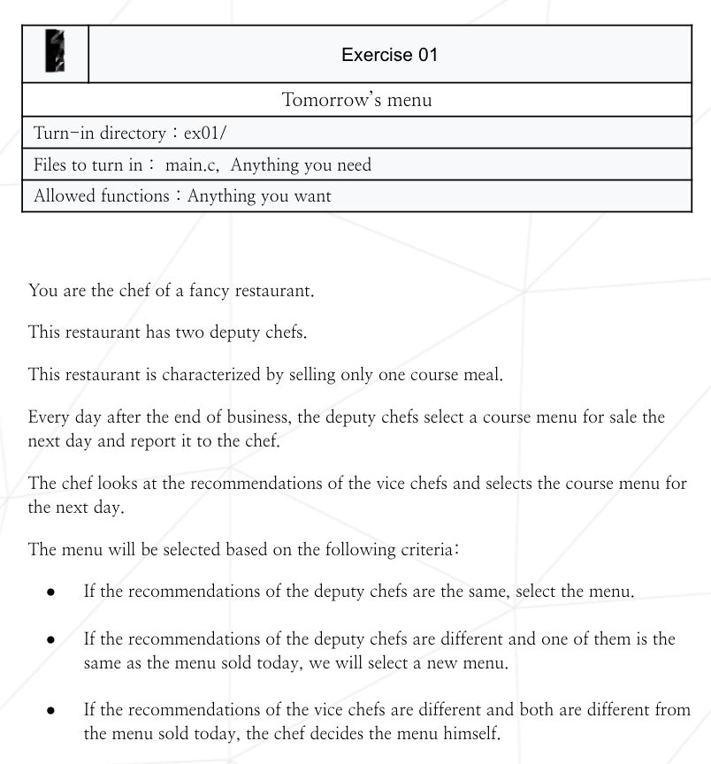
04
Subject
ex01
Goal: What happens when merge
The goal is to indirectly understand 3-way merge through the process of receiving one menu of today and two expected menus to be made tomorrow and merging them into one menu.
Time taken: about 30 minutes
Notes:
The second exercise’s topic is what happens when merging.
The goal is to understand the principle of merging through several cases, such as when a common part is modified in each branch.

Slide 12
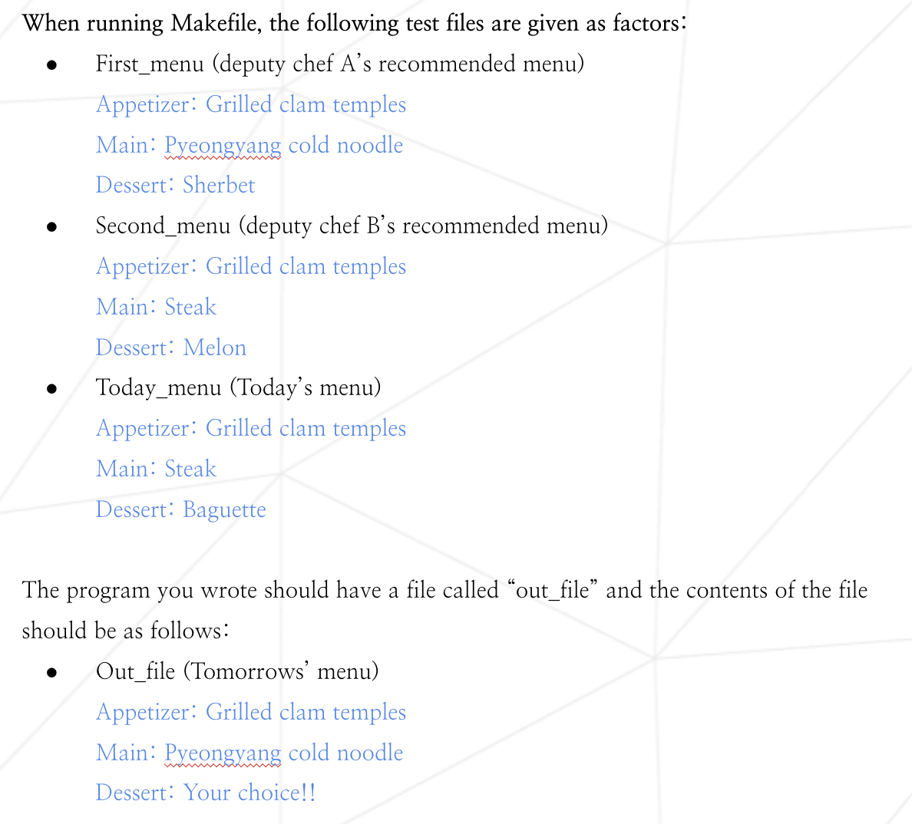
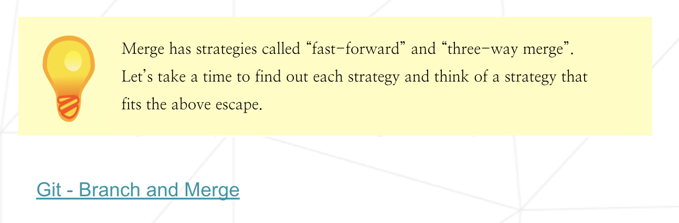
04
Subject
Notes:
if deputy chefs recommended menu is The result of each branch and Today’s menu is common ancestor commit,
You can check which files are compared and when to check whether they have been changed through an example.
When the task is completed, it will inform you of the merge strategy, and you will be able to confirm once again that the work you did in the task is similar to the strategy of merge.

Slide 13
Thank you
Notes:
Thank you for listening to our presentation
Thank you

