Slide 1
Project presentation:
Crow flow optimization
Anti-panic group:
Flöry Nikolaus, Omeradzic Amir, Zengerle Thomas
Notes:
/home/thomas/Ubuntu One/MATLAB/Projekt/report/presentation/cfo.odp

Slide 2
Introduction
Motivation
  disaster at big-scale evens such as the Love-parade 2010 with high people densities.
  Personal experience: queues at ski-lifts guided by obstacles
  Improve overall situation by decreasing people density without loss of efficient evacuation.

Slide 3
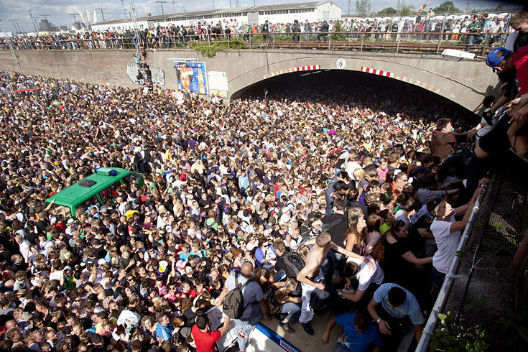
Introduction

Slide 4
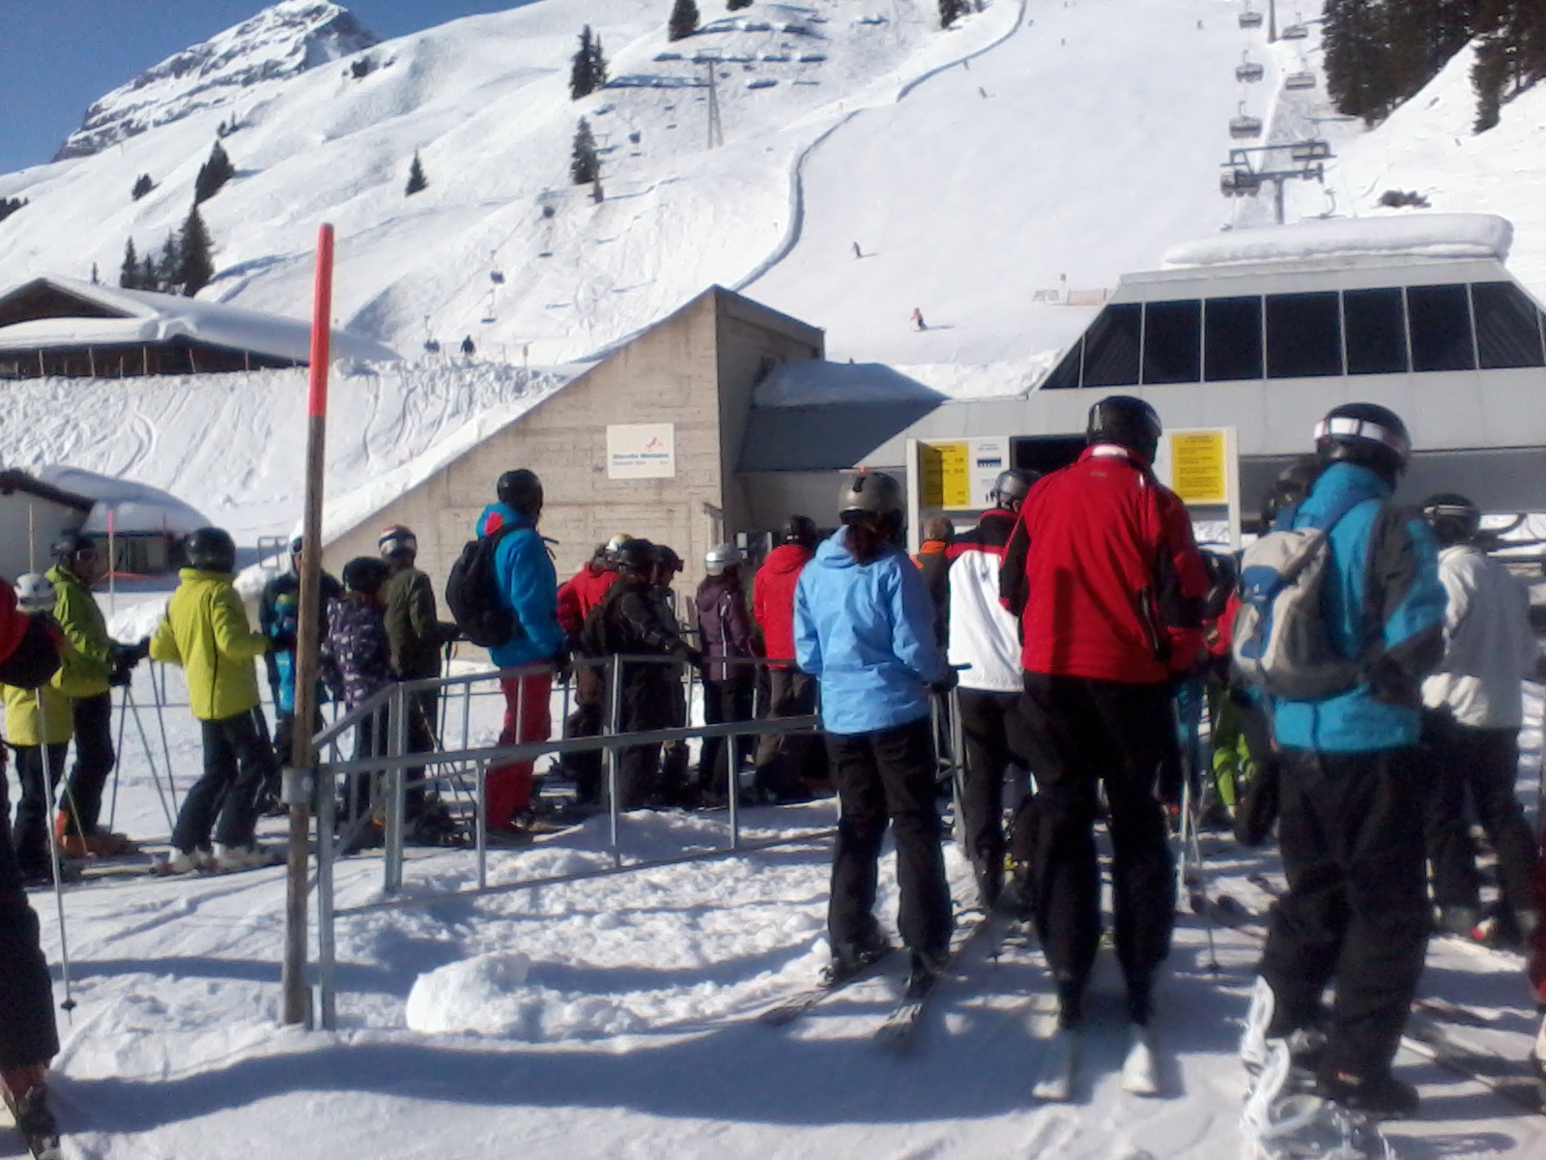
Introduction

Slide 5
Introduction
Research question:
  What exactly will happen to the moving crowd if there is an obstacle in their route?
  Will it have an influence onto the overall velocity of the evacuation?
  Will people get out of the room faster?
  Is there a special relation between the size of obstacles, the number and positioning of them relative to the exit?

Slide 6
The model
Cellular automata:
  discretisation of time and space
  exclusion principle (one person per cell)
  motion to neighboured cells
  every person acts individually
Simulation taking place on static floor field
Transition between cells with probabilistic dynamics

Slide 7
Implementation
The potential matrix:
  Static floor field realised by a physically motivated „potential“
  The matrix elements are filled up with information about its distance to the exit
  Restriced elements (i.e. walls, obstacles) are filled up with zeros
The obstacles:
  Obstacles are placed into the potential matrix by setting matrix elements to zero.

Slide 8
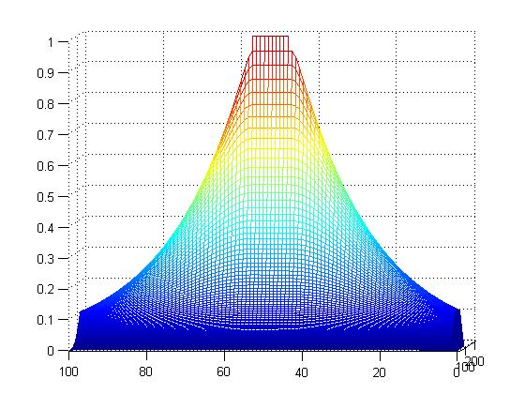
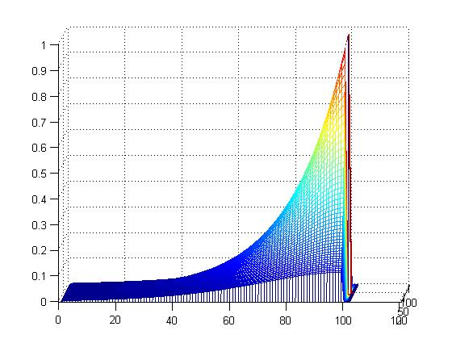
Implementation

Slide 9
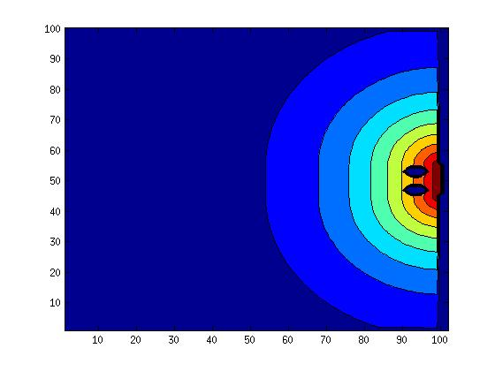
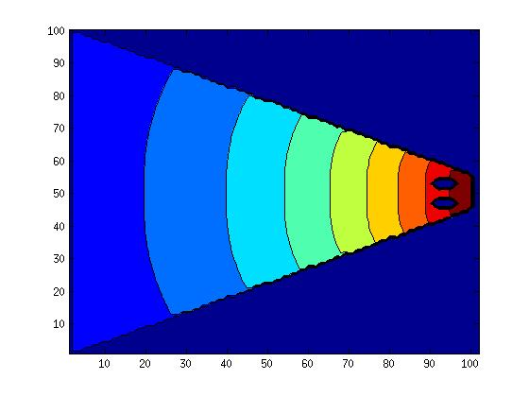
Implementation

Slide 10
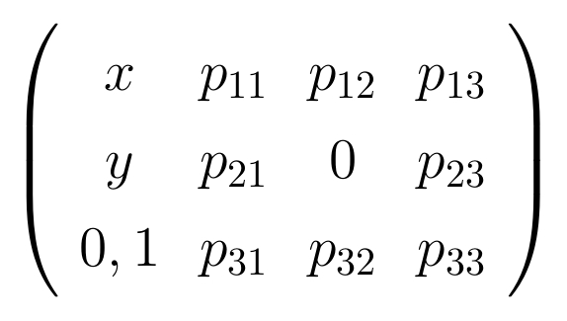
Transition
Each person sees the values around him and chooses the highest value as his next place.

Slide 11
Transition
A zero-valued place cannot be moved to.
The choice between more than one highest values is done randomly
chaos-parameter for realistic, non predictable behaviour

Slide 12
Transition
chaos parameter:
  Set between 0 and 1.
  Represents the rate of chaos and desire of getting to the exit
  random number in range [1-chaos, 1+chaos] is muliplied to each value of a cell
  then the highest value is determined
  garanties that simulations won`t be ecaxtly the same every time.

Slide 13
Implementation
Realised by a MATLAB-script where the main functions are called and where the iteration is taking place
Information stored in a 3x4xpers-matrix
Two kinds of iterations:
  "Partially random" (random permutation of active people)
  "Totally random" (random choice of arbitrary active person)
=> Result: Partially random more "natural"

Slide 14
Simulation and Results
Standard paramters
  100x100-matrix
  exit width of 10 cells
  chaos parameter of 0.2
  density of people 0.2
Variation of obstacles (0,1,2)
Variation of the room shape (rectangle and cone)
Measurement of the flux and density depending on variation

Slide 15
Key results (rectangular room)
No obstacle:
  highest people density
  fastest evacuation
  => high risk of injuries
One central obstacle:
  second highest density
  slowest evacuation
=> two obstacles: most balanced result, slight increase in time but safer due to lowest density
Two obstacles at the edges:
  Lowest density
  slightly slower than simulation without obstacle

Slide 16
Key results (cone-shaped room)
overall density higher
relative results stay the same for variation of obstacles
observation for cone:
  higher flux for no obstacle
    => cone natuarlly optimizes the flux
  influence of obstacle(s) higher
    => decrease of flux is more remarkable

