Slide 1


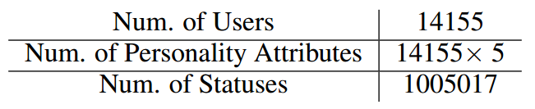
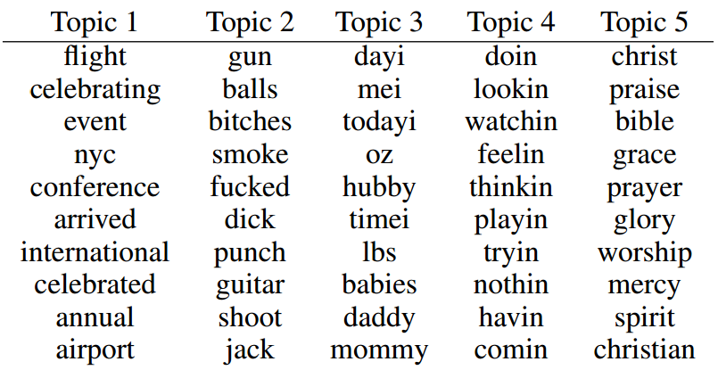
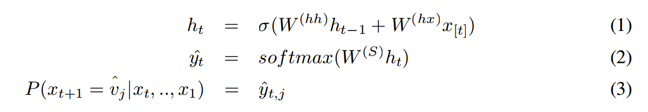
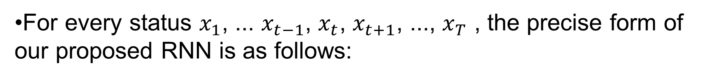
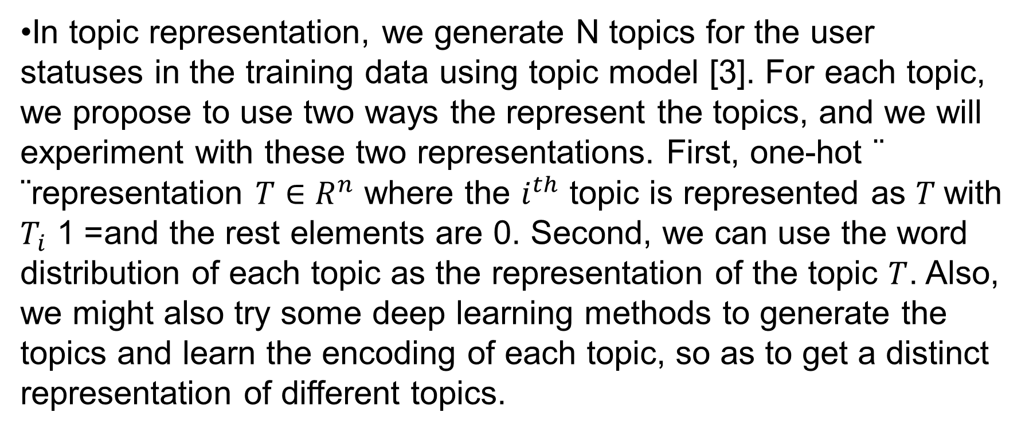

User Status Generation Based on Personality and Topic
Yilun Wang, Shijie Liu
Department of Computer Science, Stanford University
Introduction
Method
Experiment Result
MIPS
1. Topic Represetation
1. Data processing
Social media status may be very easily generated by a human being, but seems to be an almost impossible task for computers, considering individuals with different personalities should be able to generate very distinct states on various topics like music, sports or politics.
In this project, we aims to present a model that automatically generates social media status of users based on different user personality and topic. We will first represent each topic with some encoding, which will be concatenated with users' personality attribute to form the input vector. The input vector will then be passed into a pre-trained Recurrent Neural Network to generate distinct user status for different user and on different topics.
In topic representation, we generate N topics for the user statuses in the training data using topic model [3]. For each topic, we propose to use two ways the represent the topics, and we will experiment with these two representations. First, one-hot ¨ ¨representation $T∈R^{n}$ where the $i^{th}$ topic is represented as $T$with $T_{i}$= 1 and the rest elements are 0. Second, we can use the word distribution of each topic as the representation of the topic $T$. Also, we might also try some deep learning methods to generate the topics and learn the encoding of each topic, so as to get a distinct representation of different topics.
We intersect the user personality table and user status table from the data in myPersonality project. Then, we remove users with less than 50 status 2 update.
2. Topic representation
We have clustered the user statuses into 50 topics using LDA, and, as an example, here are the top words for five topics
2. Personality Represetation
For each user’s status update, we use the corresponding user’s personality attributes P collected using International Personality Item Pool (IPIP) Five-Factor Model. P for each user is in 5 dimension and the attributes are representing traits of openness, conscientiousness, extraversion, agreeableness, and neuroticism respectively.
3. Sentence generation
3. Recurrent Neural Network
Dataset
For every status $x_{1}$, ... $x_{t−1}$, $x_{t}$, $x_{t+1}$, ..., $x_{T}$ , the precise form of our proposed RNN is as follows:
We have collected the data from the myPersonality project1, which contains 3.1 million users’ personality data and 22 million statuses of 154 thousand users. For each status, in addition to the actual sentence, we also have the personality of the user who posted the sentence, which is a five dimensional vector. Sample status:
20,f0f22d5778b6f68461be966150233e99,2009-06-20 22:06:40,just got a dear john letter from the important job she was holding her breath for the past month... sad day
where $h_{0}$ ∈ $R^{D_{h}}$ is some initialization vector for the hidden layer at time step 0, $x_{[t]}$ is the word vector of the word at time step t, $W^{(hh)}$, $W^{hx}, W^{(S)}$are the weights we need to learn.
In both the forward and backward propagation, we are going to represent $h_{0}$ as the concatenation of the topic and personality representation vectors.
In status generation, we will to concatenate the representations of topics and users’ personality attributes as input vector, and will use the trained RNN to output the words at each timestamp. At the test time, given the input vector (topics and personalities), we are able to generate status through the RNN model we trained.
Reference
[1] Karpathy, A., & Fei-Fei, L. (2014). Deep visual-semantic alignments for generating image descriptions. arXiv preprint arXiv:1412.2306.
[2] Vinyals, O., Toshev, A., Bengio, S., & Erhan, D. (2014). Show and tell: A neural image caption generator. arXiv preprint arXiv:1411.4555.
[3] Blei, D. M., Ng, A. Y., & Jordan, M. I. (2003). Latent dirichlet allocation. the Journal of machine Learning research, 3, 993-1022.
Future work
We may want to train a different recurrent neural network with distinct parameters for each topic or a group of topic, so that the status generated can be more distinguishable. However this requires more analysis and training time.
Notes:
1

