Slide 1

RUST
Nicolás Meléndez
@nfmelendez

Slide 2
Rust language v1.1
Mozilla sponsor since 2009
Using it for Servo. Mozilla’s browser engine in development.
@nfmelendez

Slide 3
Rust language v1.1
RUST is systems programming language that combines low-level control with high-level convenience and safety guarantees.
@nfmelendez

Slide 4
Rust language v1.1
Safety: prevent mutating, no aliasing, and no race conditions. Control: over performance, deterministic destruction, no GC. Convinience: Able to express your model.
@nfmelendez

Slide 5
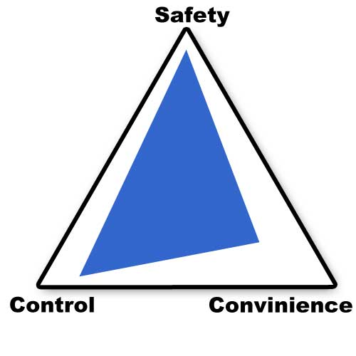
Rust language v1.1
-Rust says: I give you control and
Safety but if you follow some
rules
@nfmelendez

Slide 6
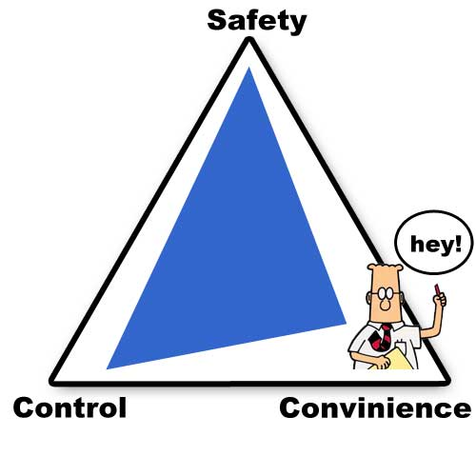
Rust language v1.1
-Rust says: I give you control and
Safety but if you follow some
Rules -Dev: I accept your rules only if you tell me at compile time.
@nfmelendez

Slide 7
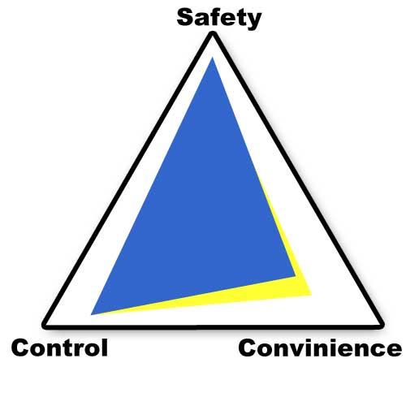
Rust language v1.1
-Rust says: I give you control and
Safety but if you follow some
Rules -Dev: I accept your rules only if you tell me at compile time. -Rust says: Ok. Deal.
@nfmelendez

Slide 8

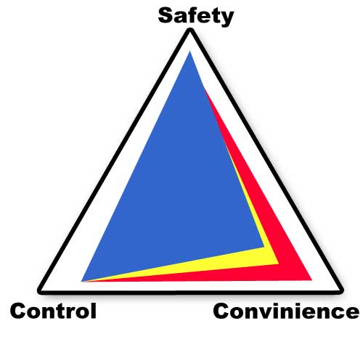
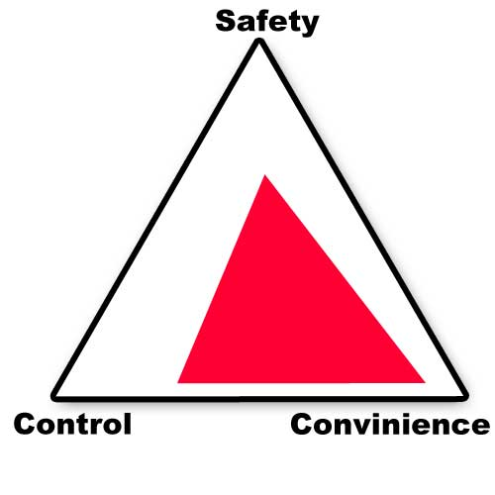
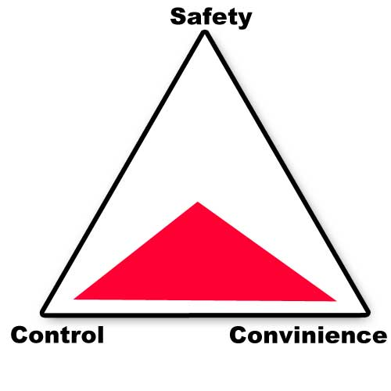
Rust language v1.1
You get this to break the rules. Very useful for…. (next talk).
@nfmelendez

Slide 9
Rust language v1.1
Enforcement of ownership and borrowing
benefits
1- Memory control & safety (no GC) 2- Data-race freedom (avoid concurrency bugs)
3- Lack of substantial runtime (easy to embed)
@nfmelendez

Slide 10

Rust language v1.1
Ownership
Example O01
@nfmelendez

Slide 11
Rust language v1.1
Shared Borrow (&T)
Aliasing | mutable
@nfmelendez

Slide 12
Rust language v1.1
Mutable Borrow (&mut)
Aliasing | mutable
@nfmelendez

Slide 13
Rust language v1.1
Borrowing rules
1- You can borrow inmutable references
many times (example B01) 2- You cannot borrow more than
one mutable reference. Only one. example B012 3- Cannot exist a mutable reference
and an inmutable one simultaneously
@nfmelendez

Slide 14

Rust language v1.1
Data Race
Aliasing
Mutation
No ordening
@nfmelendez

Slide 15
Rust language v1.1
Data Race
Aliasing (Actors)
Mutation (Inmutation functional)
No ordening (Mutex)
@nfmelendez

Slide 16
Rust language v1.1
Concurrency Model
Avoid Aliasing using ownership model only. (example C01)
Avoid mutation, using inmutable enforcement and Arc<T> references counters. (example C02)
Avoid no ordening, using mutex.
@nfmelendez

Slide 17
Rust language v1.1
Tooling
Sublime text with rust package downloaded.
Cargo dependecy system + building
Debug. Only lldb? No UI or better?
@nfmelendez

Slide 18
Rust language v1.1
GRACIAS
Examples in : https://github.com/nfmelendez/rust-talk-examples
@nfmelendez

