Slide 1

DevOps Foundations
Amanda Tan and Nicholas Moore
17th August 2020

Slide 2
Agenda
What is DevOps?
Project methodologies and frameworks
Defining work items
Common git commands
Branching models
Continuous Integration, Continuous Deployment

Slide 3
What is DevOps?

Slide 4

What is DevOps?
DevOps is the union of people, process, and tools to enable continuous delivery of value to our customers.
Increase flow of value
Shorten cycle times
Continuously Improve

Slide 5
IT challenges
There is extreme pressure on Ops teams to configure and provision apps and infrastructure as quickly so that Dev teams can test and release new code
Highly integrated / interdependent infrastructure with no end-to-end ownership of a service
Complicated DR (“non modular”)
Configuration Drift due to deficiencies in Information Technology Service Management (ITSM) process implementation / execution
High service delivery lead time and over or under provisioned resources
Lack of collaboration between Dev and Ops teams
No room for change windows, running out of support and issues with patching

Slide 6

Developer challenges
There is extreme pressure on Dev teams to develop, test and release new code into production
Length of time to provision dev/test environments
Bugs are discovered late in release cycle
Increasing number of development languages to support
Lack of application telemetry and time to resolve issues
Lack of collaboration between Dev and Ops teams
Releasing applications into production occurs infrequently and is complicated due to the number of updated features releasing at once

Slide 7
Data Scientist challenges
How is DevOps relevant to a data scientist?
Slow and inconsistent development
Bugs are discovered late in release cycle
Model performance monitoring (model is no longer making accurate predictions)
Complex dependencies between application code, ML model, data, etc.
Lack of collaboration between Dev, Data and Ops teams
Difficult to reproduce models

Slide 8
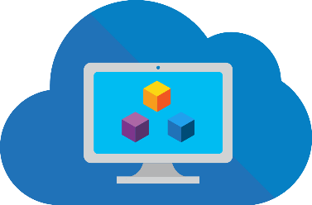
One team responsible for the application
And responsible for the complete lifecycle
Application
Custom Application or Consumer Off the Shelf (COTS) Application
Plan + Track
Release
Data
Internal or external data including security and privacy
Infrastructure
From the marketplace or a deployment template managed by central IT
Develop + Test
Monitor + Learn

Slide 9
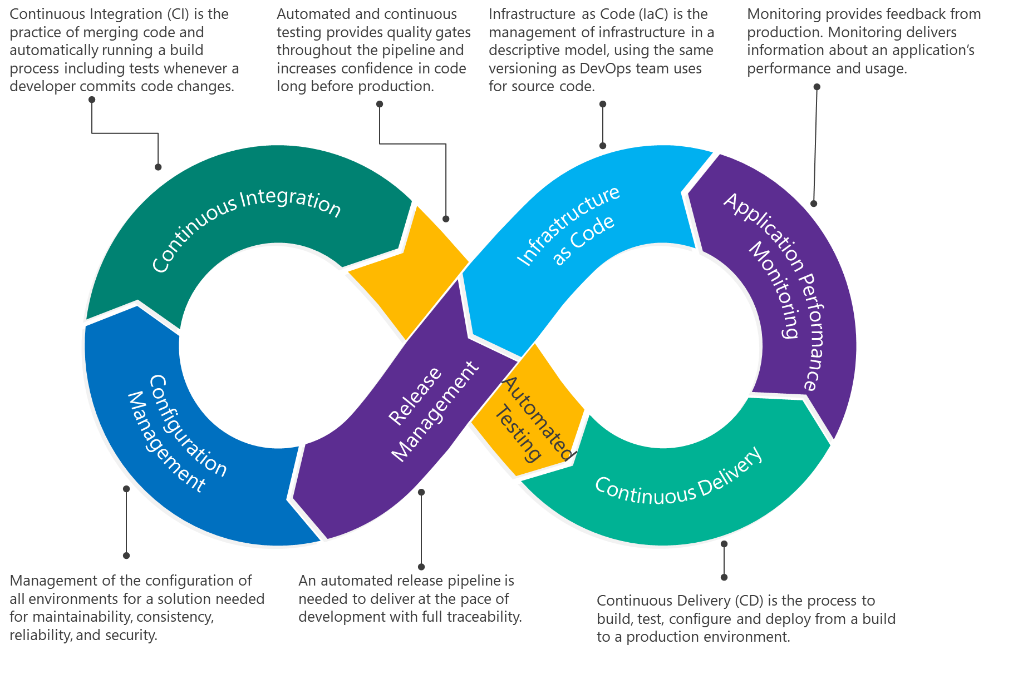
DevOps Practice

Slide 10
Methodologies and Frameworks
Allows team members to collaborate and decide on the most effective and efficient ways to complete work while making sure that the end users receive what they want and need
DevOps
Agile
Scrum
Kanban
DevOps is the union of people, process, and products to enable continuous delivery of value to our end users
Agile Values:
Individuals and Interactions over Processes and Tools
Working Software over Comprehensive Documentation
Customer Collaboration over Contract Negotiation
Responding to Change over Following a Plan
An Agile Framework
Defines specific roles (product owner, scrum master, scrum team)
Sprints produce an ‘increment’
Introduces concepts such as sprint planning, sprint reviews and retrospectives, daily scrums.
An Agile Framework
Japanese for ‘billboard’
Kanban Practices:
Visualising Work
Limiting Work in Progress items
Manage Flow
Make Process Policies Explicit
Feedback Loops
Improve Collaboratively
Source: Scrum Alliance

Slide 11
Boards

Slide 12
Git Foundations

Slide 13
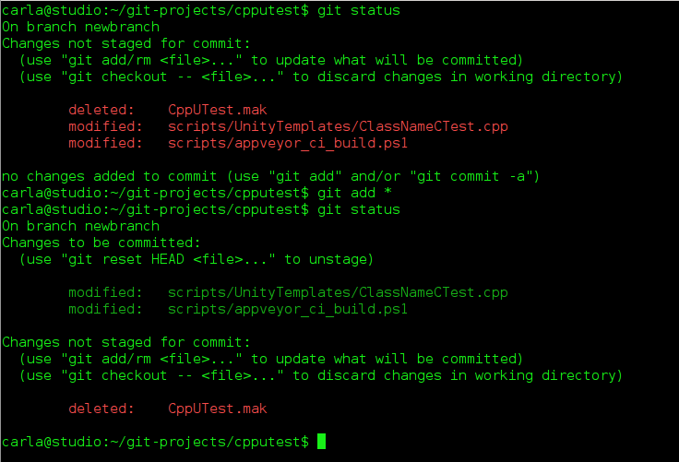
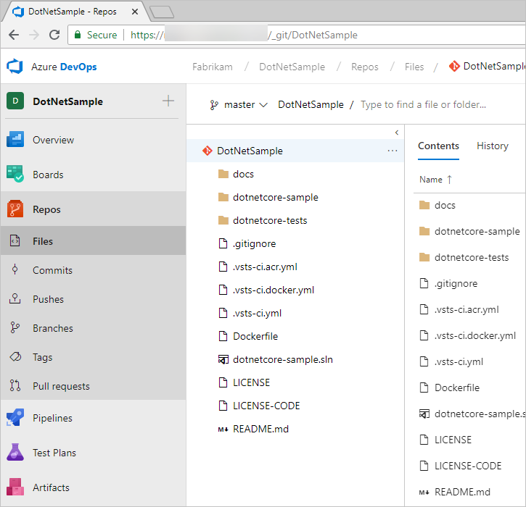
What is Git?
Keeps track of code changes
Facilitates collaborative code development
Distributed from of version control
Users keep the entire code history on their local machine

Slide 14
Common Git Commands
WORKING DIRECTORY
STAGING AREA
LOCAL REPOSITORY
REMOTE REPOSITORY
git add
git commit
git commit -a
git push
git pull / git clone
git merge
git fetch

Slide 15
Collaborative Development
(1) Fork
Remote
DEVELOPER REPOSITORY
MAINTAINER REPOSITORY
(5) Pull Request
(2) Clone
(4) Push
Local
DEVELOPER REPOSITORY
(3) Commit

Slide 16
Branching Models

Slide 17

Git Flow
Branching model
Follows software lifecycle steps
Repositories can be initalised to use Git Flow

Slide 18
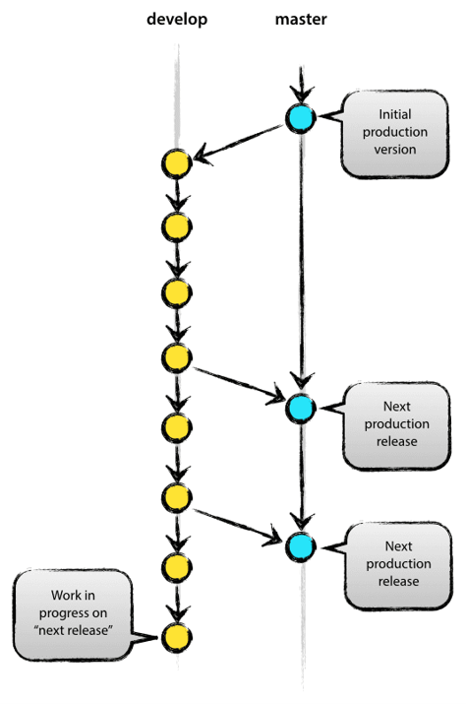
Git Flow – Main Branches
Master branch contains production ready code
Develop branch contains code for all completed features
Master branch tags releases
Both branches have an infinite lifespan

Slide 19
Git Flow – Supporting Branches
Feature branch used to develop features for an upcoming or distant release
Release branch used for QA and bug fixing purposes in support of an upcoming release
Hotfix branch used for critical bug fixes in production code
All branches have a limited
lifespan

Slide 20
Git Flow – Supporting Branches
Feature branch used to develop features for an upcoming or distant release
Release branch used for QA and bug fixing purposes in support of an upcoming release
Hotfix branch used for critical bug fixes in production code
All branches have a limited
lifespan

Slide 21
Git Flow – Supporting Branches
Feature branch used to develop features for an upcoming or distant release
Release branch used for QA and bug fixing purposes in support of an upcoming release
Hotfix branch used for critical bug fixes in production code
All branches have a limited
lifespan

Slide 22
CI/CD

Slide 23
Continuous Integration
Prevent developers from stepping on each other’s code
Eliminate integration issues
Elements:
Version Control
Branching
Automated Builds
Goals
Harness collaboration
Enable parallel development
Minimise integration debt
Act as a quality gate
Automate everything!

Slide 24
Continuous Delivery
Deploy new features fast and safely
Automating release process to deploy a change into different environments in a fully automated manner
Continuous stream of customer value
Build
Test
Configure
Deploy

Slide 25
Journey of Data Adoption in DevOps
Level 1
Level 2
Level 4
No data artifacts in Version Control
Level 3
Migration scripts managed under version control
Schema development under version control, no automated deployment
Automated deployments based on automated “diff” scripts
Level 5
Full DevOps CI/CD adoption of schema in repo with code, Automated Tests, and Automated Pipelines
It’s a journey to bringing the data world into your DevOps processes
Most teams begin with getting their “migrations” under version control
From there we can get teams to collaborate by authoring schema in code (not directly in db)
Then we can start to treat database development just like code app development

Slide 26
Questions?

Slide 27
References
A successful Git Branching Model: https://nvie.com/posts/a-successful-git-branching-model/

