Slide 1


Slide 2

JSON APIs
JSON API is an easy-to-parse and lightweight data interchange format that works with HTTP ¹
It delineates how clients should request or edit data from a server, and how the server should respond to said requests. ¹
A main goal of the specification is to optimize HTTP requests ¹
Optimized in terms of the number of requests and the size of data packages exchanged between clients and servers. ¹
Clients and servers both send JSON API data in request documents with the header Content-Type: application/vnd.api+json without specifying media type parameters ¹
Clients built around JSON APIs are able to take advantage of its features around efficiently caching responses, sometimes eliminating network requests entirely. ²

Slide 3
JSON APIs vs. SOAP APIs
Web services are created using either JSON or SOAP ⁵
SOAP is a standard protocol for sending messages and has many rules and several security features that increase its complexity. ⁵
JSON is an architectural style developed to overcome the problems of SOAP. ⁵
JSON API uses the JSON format while SOAP APIs use the XML format ³
JSON is a human and machine readable format. ⁴
SOAP is an XML file that is machine readable. ³
JSON is more lightweight and less verbose so it's easier to read and write. ³

Slide 4
Example of JSON vs. XML
XML used in Soap API
<?xml version="1.0" encoding="UTF-8"?>
<authentication-context>
<username>my_username</username>
<password>my_password</password>
<validation-factors>
<validation-factor>
<name>remote_address</name>
<value>127.0.0.1</value>
</validation-factor>
</validation-factors>
</authentication-context>
JSON used in JSON REST API
{ "username" : "my_username", "password" : "my_password", "validation-factors" : { "validationFactors" : [
{
"name" : "remote_address“,
“value" : "remote_address“
} }
]
}
}

Slide 5
JSON Request Header
JSON uses HTTP Headers and is required ⁶
In JSON API, both clients and servers send JSON API data in request documents with the following header without specifying media type parameters: Content-Type: application/vnd.api+json ¹
Clients that include the JSON API media type in their Accept header must specify the media type there at least once without any media type parameters ²
Clients must ignore any parameters for the application/vnd.api+json media type received in the Content-Type header of response documents. ²
Server must respond with a 415 unsupported media type status code if a request specifies the header Content-Type: application/vnd.api+json with any media type parameters. ²
JSONRequest does not send or receive cookies or passwords in HTTP headers. ⁶

Slide 6
JSON Request Body
JSON Request is a global JavaScript object. ²
Every request body must be underneath a single JSON object. ⁷
For all request types, the body must contain a collection whose value is an empty array or an array of resource identifier objects. ²
Data: the information specific to a resource or resources, must live within this top-level object under the data member, the data member is a key/value pair. ⁷
The primary data is a representation of the requested resource. ¹
Relationships to data can be fetched through GET calls. ¹
Values in key/value pairs are either JSON objects or strings. ²

Slide 7
Response Body
The body of the response is a JSON text, encoded in UTF-8. ⁶
A JSON Get does an HTTP GET request, gets the response, and parses the response into a JavaScript value. ⁶
A request will fail if the response is not strictly in JSON format. ⁶
Requests for collections must respond with an array of resource objects. ⁶
A server must return 403 Forbidden in response to an unsupported request to create a resource with a client-generated ID. ²
If a POST request did not include a client-generated ID and the requested resource has been created successfully, the server must return a 201 Created status code. ²
The response should include a Location header identifying the location of the newly created resource. ²
A server must return a 404 Not Found when processing a request that references a related resource that does not exist. ²

Slide 8
Benefits of JSON APIs
Compound documents, a unique ability in JSON API, allowing servers to send related resources alongside the requested primary resources. ¹
If implemented correctly this could decrease the number of necessary HTTP requests. ¹
These work by using the include parameter which enables you to include additional resources in an initial request. ¹
Sparse Field sets, which enable clients to only request data from specific fields. ¹
This works by adding the field you want to retrieve to the URI parameter with the resource name and the fields you want. ¹
This offers additional customization and can decrease large responses.¹
JSON API comes with many features to optimize the API return package. ¹
Special server side operations include sorting, as well as pagination; the ability to limit the number of returned resources to a subset, with first, last, next and previous links. ¹
Caching, is in essence built into HTTP. Since JSON API access data in the same way, they don't need to store data in various locations which can bring significant optimization benefits. ¹

Slide 9
End-to-End Data Flow
JSON API denotes how resources are called and how associated links are shared. ¹
The API supports CRUD also know as create, read, update and delete. ³
A client sends a request for a resource or collection using the header application/vnd.api+json. ²
If available, the server responds with the requested resource. ²
If not available, the server responds with an error code explaining why the resource wasn't available. ²
The client receives the resource from the server. ²

Slide 10
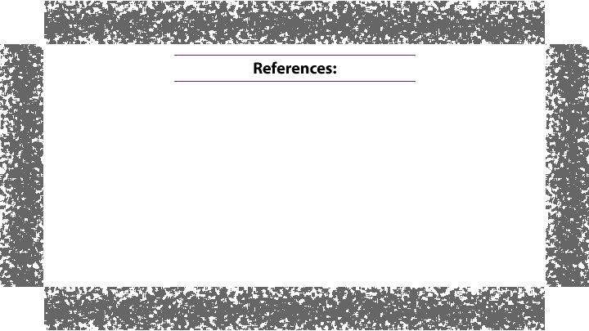
Doerrfeld, Bill. “The Benefits of using JSON API.“ nordicapis.com, 2017,
https://nordicapis.com/the-benefits-of-using-json-api/
(2) https://jsonapi.org/
Monus, Anna. “SOAP vs. REST vs. JSON – A 2020 Comparison.” raygun.com, 2020,
https://raygun.com/blog/soap-vs-rest-vs-json/#restjson
https://restfulapi.net/introduction-to-json/
https://www.educba.com/json-vs-soap/
Crockford, Douglas. “JSON Request.” json.org, 2012,
https://json.org/JSONRequest.html
Prakash, Neel. “An over view of JSON API: A text-based data exchange format.” valuebound.com, 2017,
https://www.valuebound.com/resources/blog/overview-of-json-api

