Slide 1
Entry 2 By: Madailein Logan
Mrs. Campbell,
5/1/2020,
Language Arts, Wellness, & Biology

Slide 2
Description: The PSA is to educate teens of the causes and symptoms of Skin Cancer and how to avoid it. 4/25/20.

Slide 3
The Cancer PSA Project
The Cancer PSA Project involved three different classes; Wellness, Language Arts, and Biology. The purpose was to educate a certain demographic on a certain type of cancer through an engaging PSA. My group chose Skin Cancer because it can be prevented easily. We targeted the demographic of teens by using an Instagram post to convey statistics and then had adolescents of the same age as the target demographic explain the risks and consequences of getting Skin Cancer. I would like to pursue a career in the medical field and this project has helped to better understand how to convey complex medical information understandably and how to target a certain demographic. This can help work with specific age groups and help patients understand what they are going through.

Slide 4
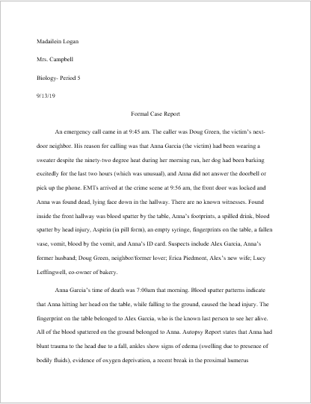
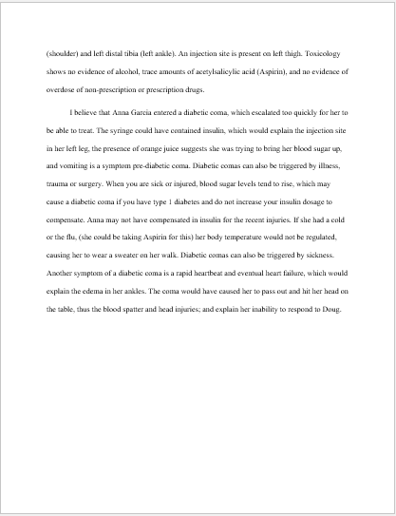
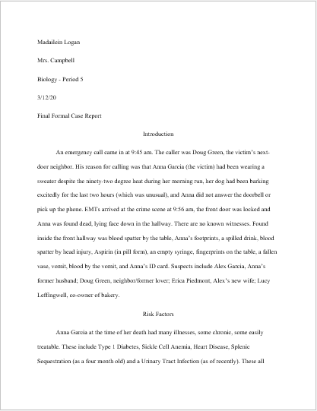
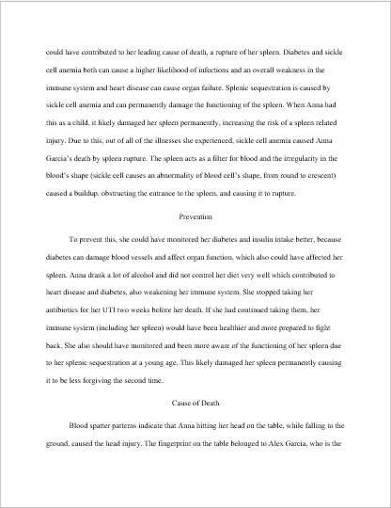
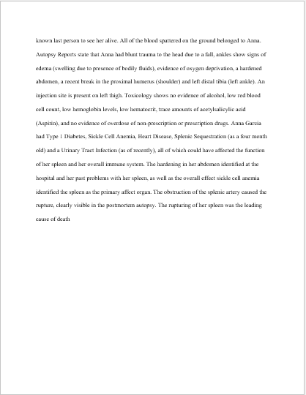
Description: Here is my first case report and my final to show my progression in my knowledge and identification of the cause. 3/12/20

Slide 5
Anna Garcia Formal Case Reports
When first starting Biology, we were assigned the case of a women named Anna Garcia and were asked to determine her cause of death. Overtime we discovered more information, and started to hypothesize her cause of death. At first I believed that she had entered a diabetic coma, then I believed that her ex-husband did it to collect on her insurance, and I finally found the true cause of death; the rupturing of her spleen. This project helped me to understand different diseases better and how they can effect each other, all of which can help me in a medical career. It also taught me how to do different lab tests and use medical equipment, which gives me a head start.

Slide 6

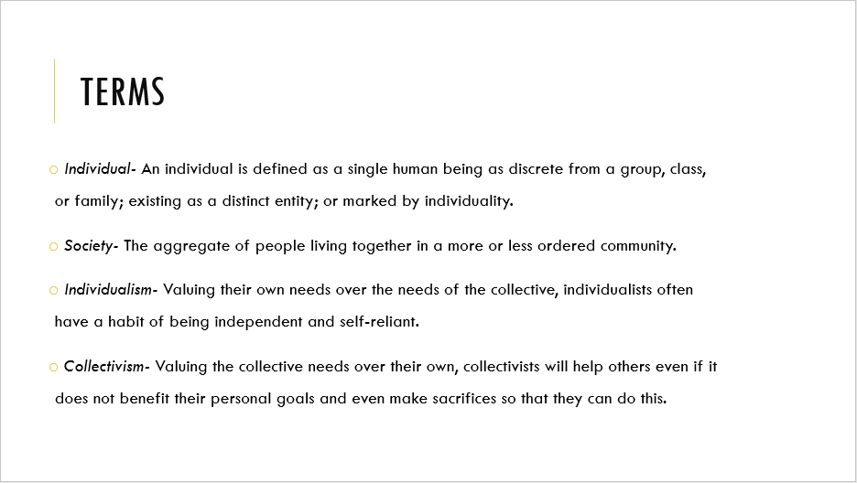
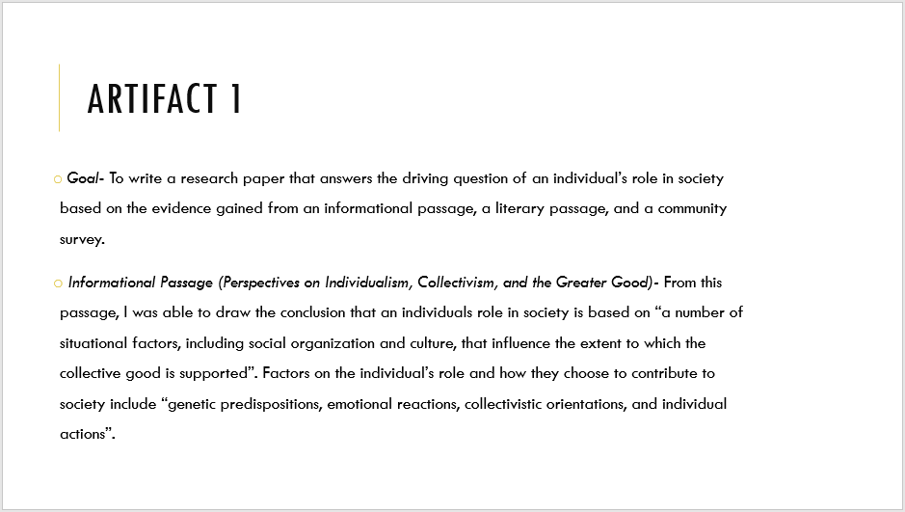
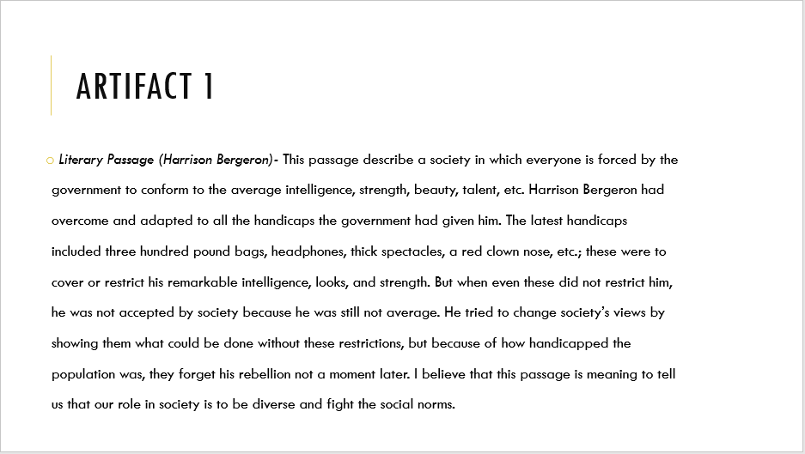
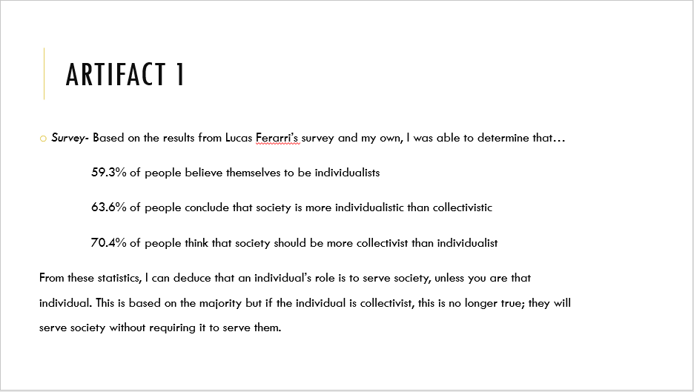
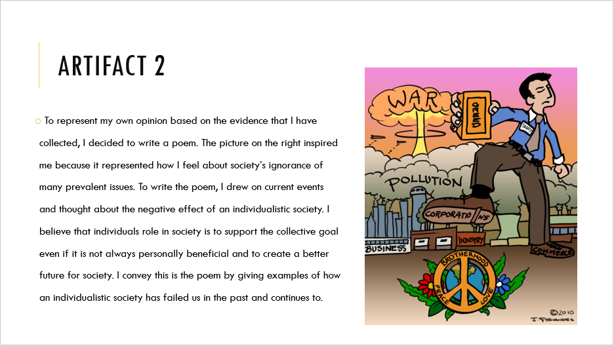
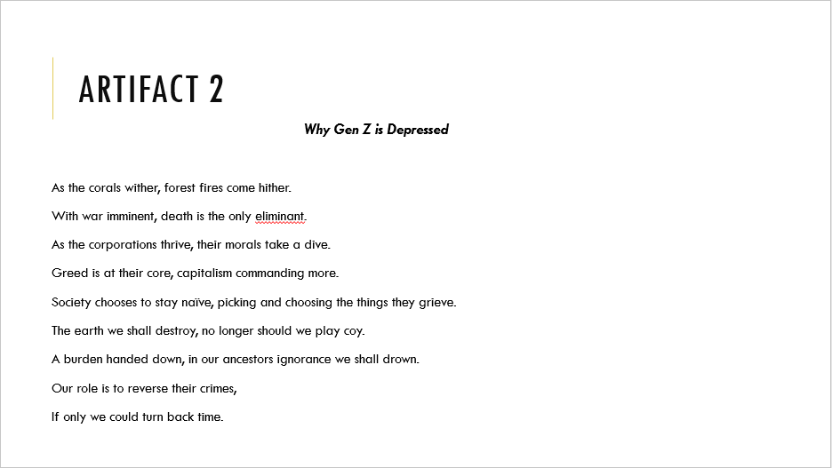
Description: This is Artifact 3 from the Individual Role Project. The goal of this presentation was to present my findings on individualism, collectivism, and the role individuals have in society. 10/10/19

Slide 7
Individual role project
In the Individual Role Project, we learned the definitions of individualism and collectivism and focused on the driving question “What is an individual’s role in society?” We had to complete three different artifacts, the 1st artifact being a research paper based on literary passages and a survey. I began my 2nd Artifact by choosing to do a poem, I found an image that inspired me and illustrated my stance on the driving question and wrote it based on this. I chose to use a Power Point in my Oral Presentation for my 3rd Artifact. I drafted a script, created notecards, and practiced before presenting to my classmates. This project helped me to understand that I am a collectivist and that I will not be fulfilled by a career that does not help people. This lead me to look more seriously at medical careers because you get to interact with the people you help and it helps to improve the functioning of society.

