Slide 1
FluMeter
Can you catch the flu today?

Slide 2
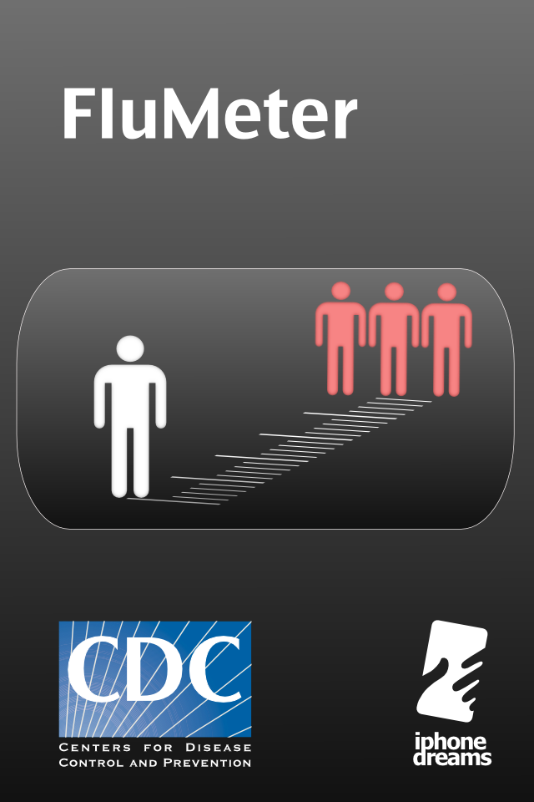
FluMeter introduction
What is Influenza?
Flu is inside the Weather – innovative approach
How it works
Prevent the flu

Slide 3
Intro
FluMeter iPhone application uses weather conditions in user’s location and calculates the probability of aerosol contraction of influenza and other respiratory viruses
It incorporates CDC nationwide information and multimedia news channel
The operating principle is based on publications (1,2)
Aerosol Influenza Transmission Risk Contours: A study of humid tropics versus winter temperature zone, Hanley and Borup, Virology Journal, 2010
Transmission is Dependent on Relative Humidity and Temperature, Anice Lowen, Samira Mubareka, John Steel, Peter Palese, PLoS Pathogens, 2007

Slide 4
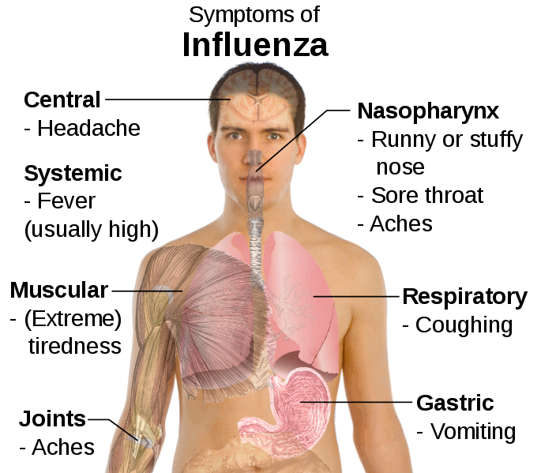
What is Influenza?
Influenza mostly transmits through air by coughs or sneezes
Yearly more than 250000 people die
Antiviral and antibiotics treatment is available

Slide 5
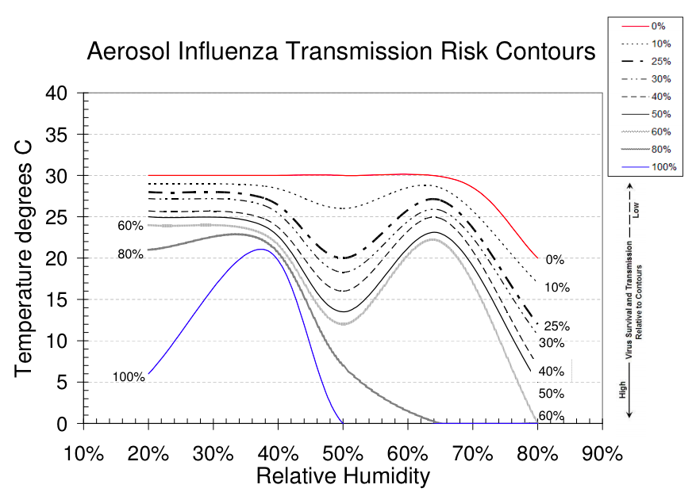
Flu is in the Weather
Hanley et. al. has shown that flu virus is sensitive to weather conditions i.e. Temperature and Humidity
The Risk Contours are built basing on physical properties of enveloped viruses

Slide 6

How it works (Basics)
The theory used by Hanley et al is based on osmotic properties of enveloped viruses which survival rate depends on Relative Humidity and Temperature
Osmotic pressure
(P₂-P₁)=k_{b} T Ns/V
Explode

Slide 7
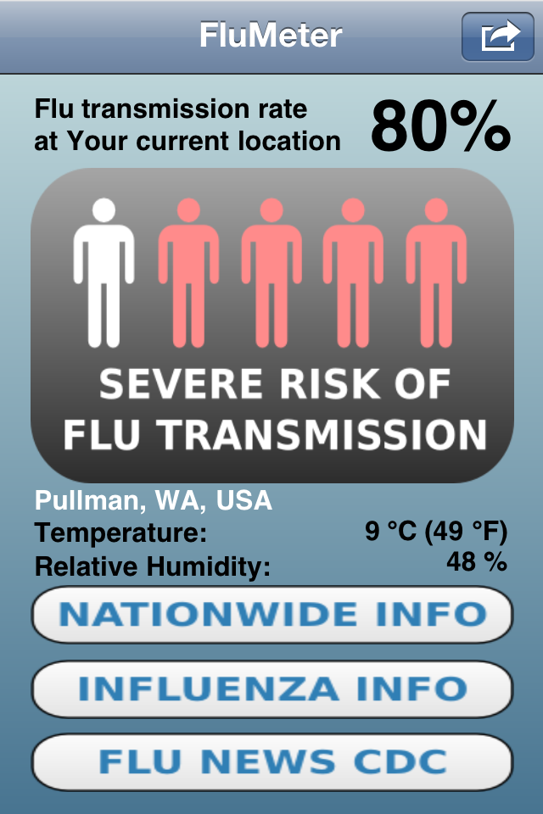
How it works
The application is requesting GPS location of the user
Using the location it requests precise weather in the region (usually provided by airport weather stations)
Using the Risk Contours from (1) the application calculates the influenza contraction probability

Slide 8
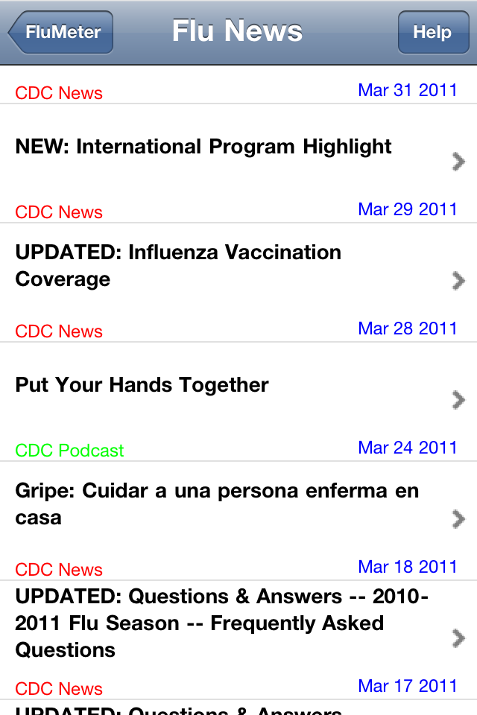
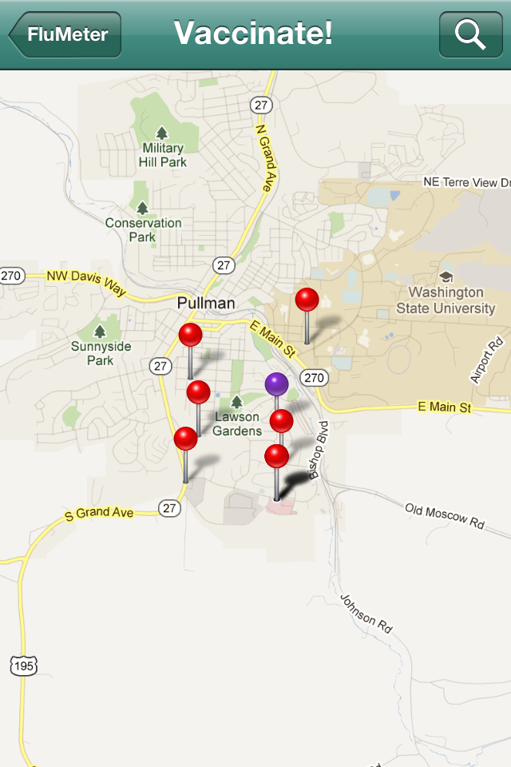

Conclusion
Prevent the flu by controlling humidity and temperature indoors
Monitor CDC updates
Vaccinate

