Slide 1
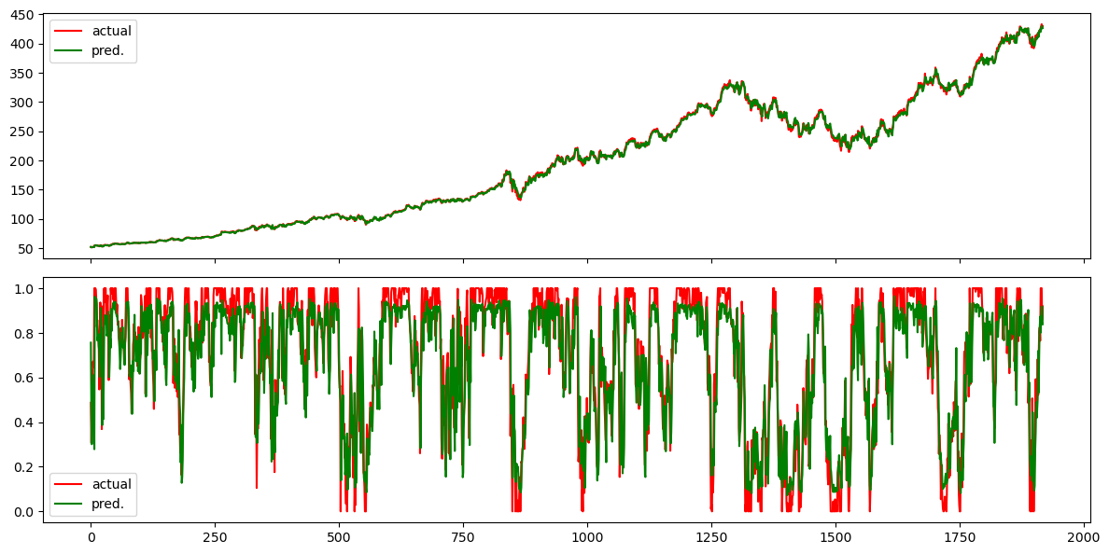
Dense 2 layer NN, 64 neurons per layer

Slide 2
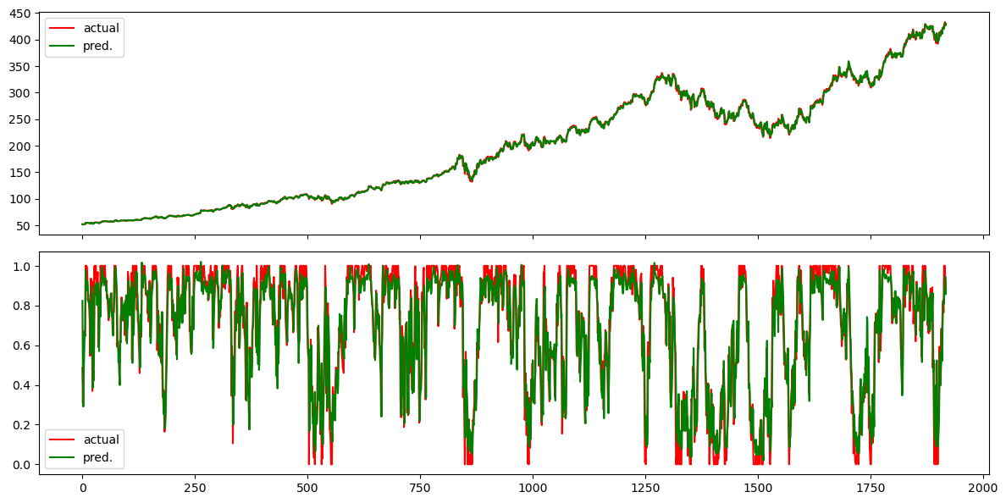
2 layer of LSTM with 32 neurons per layer, trained with minmax scaling per rolling window

Slide 3
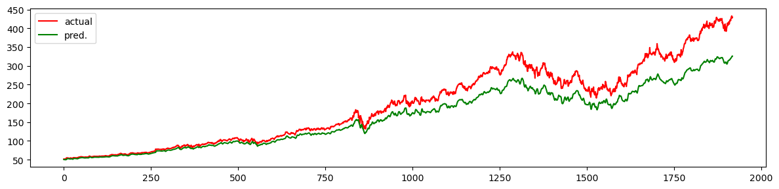
2 layer of LSTM with 32 neurons per layer, trained with minmax scaling for whole time series

