Slide 1

Christian Crush
For CST-452
by Noah Funderburgh
Presentation:
https://www.loom.com/share/6fca9df33c8a465f9b067f90432d2cd6

Slide 2
Purpose of this project
The Christian Crush project is being undertaken to address the unique needs of the Christian community in the online dating landscape. In today's digital age, many people turn to online platforms to find meaningful relationships. However, most popular dating apps do not cater specifically to the values and beliefs held by Christians. This project aims to fill that gap by providing a platform where Christian singles can connect with others who share their faith and values.

Slide 3
Target Audience
Christian Crush is being undertaken to provide a dedicated platform for Christian singles seeking meaningful relationships grounded in shared faith and values. Unlike mainstream dating apps, Christian Crush emphasizes spiritual compatibility, creating a respectful and secure online community where users can confidently seek partners who share their commitment to Christian teachings and lifestyle. By embedding a Christian worldview into the app, Christian Crush aims to foster connections that honor faith, promote moral values, and support the building of Christ-centered relationships.

Slide 4

Objectives
Complete all planned features including user registration, profile creation, matchmaking, and messaging.
Ensure app is functionable
Runs smoothly without any crashing or delays
Take proper security measures
Hash passwords
Validate User Input

Slide 5
Key Features
Secure user registration with email validation.
Image upload and preview functionality.
Like based matching system to find potential partners
Ability to send, receive, and read messages, with time stamps.
Intuitive navigation and clear user flows.

Slide 6
Technology Stack
C# was my primary programming language for the logic behind the website
MySQL was used for data storage
xUnit was used for testing and is known for working well with C#
Selenium was used to help automate the web browser interactions

Slide 7
Database Design
Used relational structure
Enforced relationships through foreign keys
Helpful for linking users to profile or messages
Database is designed with future growth in mind
No changes needed for more users/profiles

Slide 8
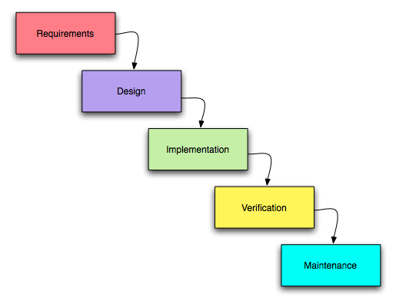
Waterfall Methodology
I chose the Waterfall methodology due to the class's short four-week timeline. Its structured, sequential phases—planning, design, implementation, testing, and deployment—fit well within this tight schedule. By requiring each phase to be completed before moving to the next, Waterfall reduces the risk of scope creep and ensures all project requirements are clear upfront, making it ideal for meeting project goals efficiently.

Slide 9
User Registration and Authentication
User Registration
Simple Signup Process
Password Validation:
Profile Creation
Error Handling
Authentication:
Secure Login
Password Hashing
Session Management
Custom Authorization

Slide 10
Matching and Messaging
Messaging:
One-on-One Conversations
Real-Time Updates:
Message History
All previous messages is accessible
Matching:
Profile Swiping
Automatic Matching
Match List

Slide 11
Profile Management
Users can create profiles
Allows users to upload up to three images
Validate all data user entered before inserting it
Verified profile isn’t already created

Slide 12

Challenges
Time deadline
Timeframe we had to complete the project in was shorter than usual
User Interface Design
Creating a user-friendly interface that is easy to understand and looks good

Slide 13
Project Demo
Loom Link: https://www.loom.com/share/db527b3ebfd04abbb28c1d7bc3e7893b

Slide 14
Image References
Cross+logo images – browse 389,404 stock photos, vectors, and video. Adobe Stock. (n.d.-a). https://stock.adobe.com/search?k=cross%2Blogo&asset_id=199388609
They importance of challenges - ITR parking-updated. ITR Parking-updated -. (2021, October 15). https://itrps.com/recent-events-posts/understanding-that-challenges-develop-character-and-define-who-we-really-are/
Goals & Objectives. Powering Your Potential. (2022, November 15). https://poweringyourpotential.co.uk/resource/goals-objectives/
Comparing traditional systems analysis and design with Agile Methodologies. The Traditional Waterfall Approach. https://www.umsl.edu/~hugheyd/is6840/waterfall.html

