Slide 1
Design of modular predictive controller for building automation
Master thesis
Nafiz Farhan Bin Zainurin
M.Sc. Wenyan Ye
Prof. Dr. Ping Zhang

Slide 2
Content
Motivation
Objective
Literature Review
System Model
Design of Modular Model Predictive Controller
Software development and Implementation
Case Study
Conclusion
Future Work
Appendix
Q&A Session

Slide 3

Background
Energy Management
Global energy crisis: Building sector contributes 40% of global energy consumption (Perez, 2008).
Residential buildings: High energy consumption for heating, lighting, cooling and appliances.
Work from home post-pandemic: Increase energy demand.
Rising energy price due to war: worsening the situation.
Crucial to have an effective energy management.
Balancing between low energy consumption while maintaining thermal comfort
Strategy to achieve this conflicting objective.
www.facilitiesnet.com
Notes:
Strategy to achieve this conflicting objective without disrupting daily activity.
How do we balance these 2 conflicting objective, one which is low energy consumption but also maintaining thermal comfort without disrupting daily activity.
What kind of strategy should we use.

Slide 4
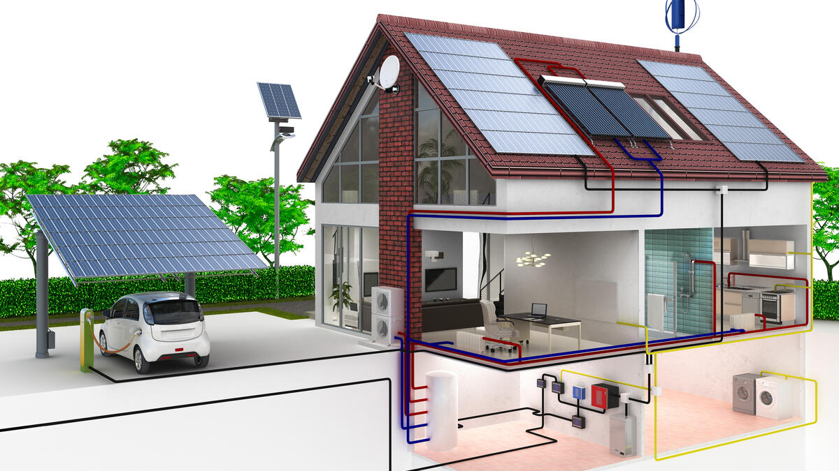
Motivation
Building Energy Management
Building energy management strategy: Thermostat, PID control, passive/active method, smart device/IOT and advance building infrastructure.
Model Predictive Control: Popular strategy with multiple advantages:
Incorporates multiple conflicting objective.
Handles nonlinear system
Incorporate predictive disturbance (weather and occupancy pattern).
Handle constraints and physical limitation.
[3]
www.haus.de
Notes:
Smart device such as smart plug, smart appliance, smart lightning, smart thermostat.
Advance building infrastructure such as IOT
Active method such as occupant lighting control, demand based ventilation. Require monitoring and automation system. Passive method such as building orientation, placement of window for natural lighting

Slide 5



Motivation
Challenge
Building energy management: Rapidly evolving technology.
Traditional MPC limitations: Requires reengineering entire system for expansion
Consumer concerns: Limited knowledge, economic constraints
Modular MPC benefits: Provides flexibility and scalability for energy management system
[5]
[6]
[4]
www.clipart-library.com
deposit-photos.com
blog.eonetwork.org
Notes:
What kind of challenge I am trying to solve here?
Building energy management: Rapidly evolving technology with numerous technology developed every year.
Consumer might want to extend their EMS but this might require reengineering the whole energy management system, if traditional MPC were to be used.
Moreover, the consumer might be hesitant to install all the equipment or appliances at once due to limited knowledge or economical constraints.
Modular MPC helps the consumer by providing the necessary flexibility and scalability prospect to their building energy management system.

Slide 6
Objective
Design modular MPC for energy management in residential house.
Implement scalable MPC framework for subsystem integration/removal with MPC strategy adjustment.
Consider subsystems: battery and electric vehicle.
Consider disturbances: ambient temperature, solar irradiance, COP, heat demand, charging of EV and price of electricity.
GUI and database are developed to enable parameter modification, data entry, visualization and storing of parameter.
Notes:
Designing a modular model predictive control for energy consumption management in residential house. This would mean that the MPC framework is scalable and allow for the integration of new or removal of old subsystem with adjustment made to MPC strategy(dynamic model, constraints and cost function). Subsystems consider are limited to battery and electric vehicle. The disturbances taken into account are ambient temperature, solar irradiance, COP, heat demand, charging of EV and price of electricity. GUI and database are developed to enable parameter modification, data entry, visualization and storing of parameter.

Slide 7
Literature Review
There are multiple strategies developed for building energy management(BEM),
PID control (Fiducioso, 2019)
Artificial Neural Network (ANN) (Afram,2017)
Fuzzy logic (Shepherd, 2003; Soetedjo, 2018),
Internet-of-Things (Ashraf, 2018)
Widely used traditional controllers: PID, fuzzy logic, rule-based controllers
Advantages: Simplicity and ease of implementation
Limitation: cannot handle constraints, time-varying disturbances and nonlinear dynamics (Afram & Janabi, 2014).
Notes:
Other than MPC, there is also other strategy develop for building energy management
These traditional controllers (e.g. PID, fuzzy logic, and rule-based controllers) are widely used due to their simplicity and ease of implementation.
However, these traditional controllers have some limitation, such as cannot handle constraints, time-varying disturbances, and nonlinear dynamics (Afram & Janabi, 2014).

Slide 8
Literature Review
Advancement in computing, processing power and building automation: enable successful implementation of MPC in BEM (Serale et al.,2018).
Key challenge: Obtaining accurate yet computationally feasible building dynamic model (Cigler et al., 2013).
Solution:
Resistance-capacitance network modelling (Mirakhorli and Dong, 2016),
Black box method like ANN-based MPC for approximating nonlinearity accurately (Afram et al., 2017).
Modular MPC enables future expansion without system reengineering.
This master thesis proposes a flexible and adaptable modular MPC framework.
Notes:
-There are several challenges when implementing energy management using MPC in real building. One of the most frequent discussed problems in the literature is obtaining the dynamic model of the building.
-Although there are numerous papers discussing application of MPC in building energy management, there is limited literature available on modular MPC, which allows for future expansion without significant system modification
-This master thesis aims to bridge that gap by proposing a methodology that addresses the need for a flexible and adaptable modular MPC framework.

Slide 9
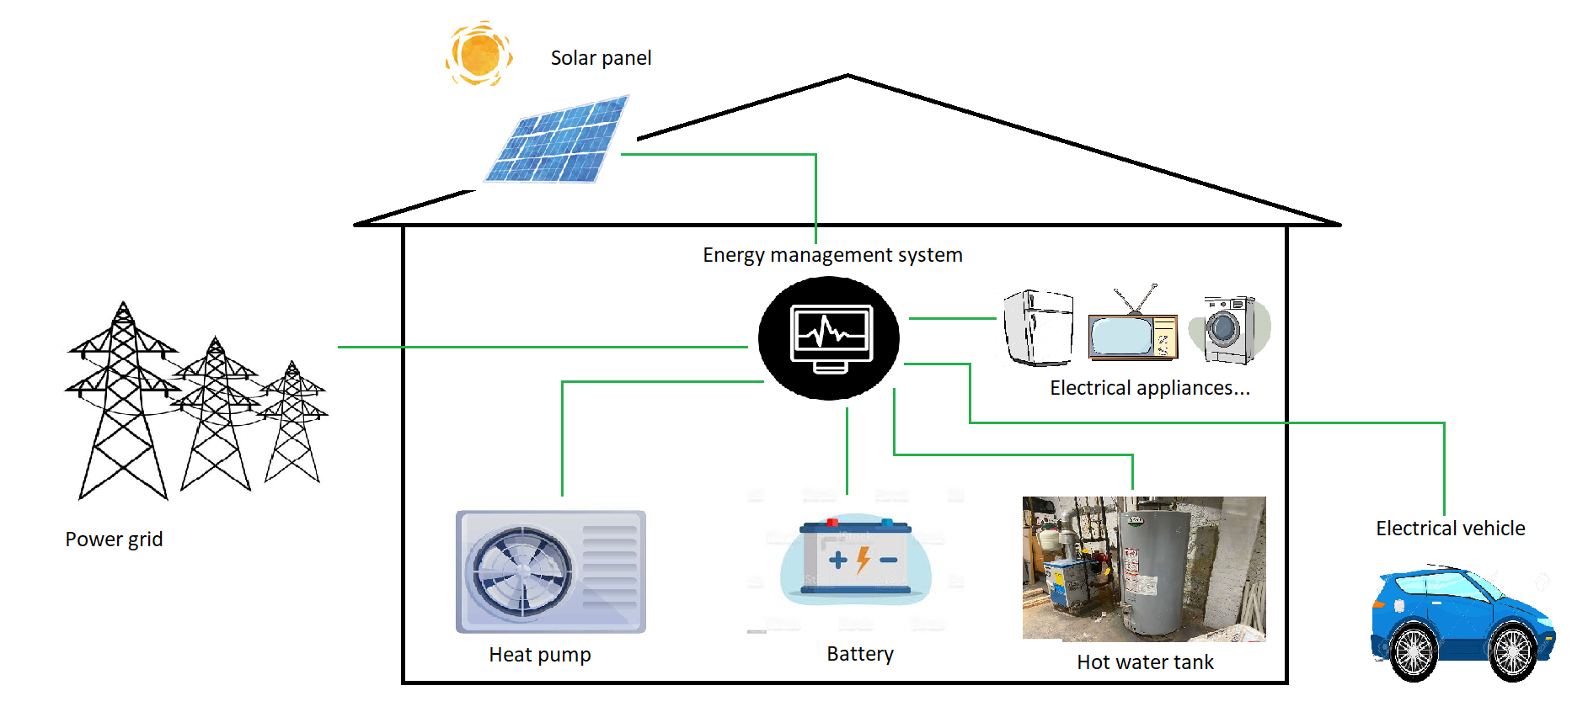
General Overview of Plant

Slide 10
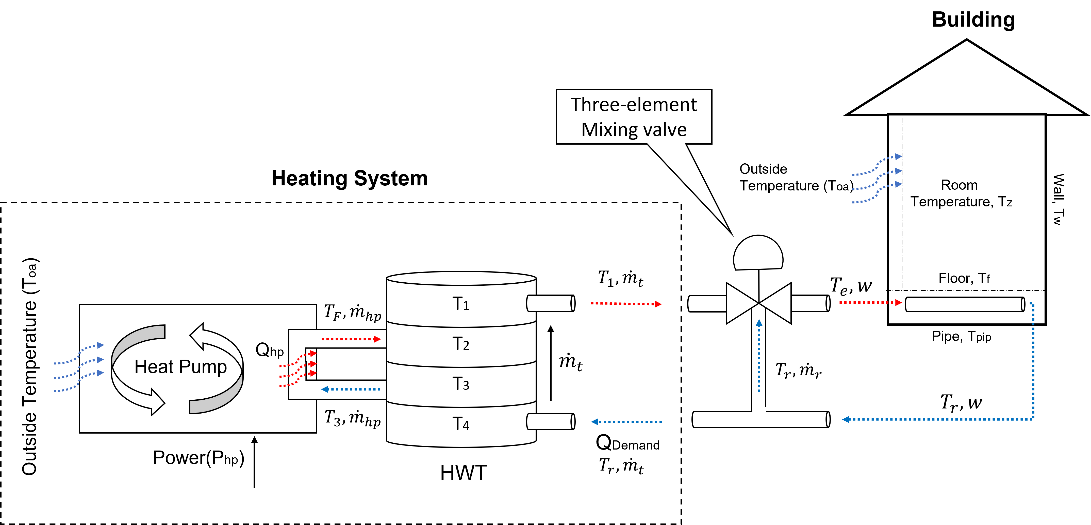
General Overview of Plant

Slide 11
Energy Storage System
Energy Storage System(ESS) is a necessary component in energy management system.
This system store excess energy during period of low demand or high renewable energy production.
The stored energy is then utilized during high demand or limited renewable energy availability.
They optimize energy usage and reduce dependency of power from the grid, thus economically beneficial to the consumer.
Notes:
By optimizing the energy usage, discharging the stored energy when needed and charging it when there is an excess of power

Slide 12








Energy Storage System
Dynamic of the energy storage system(ESS)
$$P_{sto}=Power applied to the ESS$$
$$\frac{d({SOC}_{sto})}{dt}={SOC}_{sto}+η_{sto}T_{s}P_{sto}$$
$$η_{sto}=\left\{\begin{matrix}η_{ch}, if P_{sto}>0 \\ \frac{1}{η_{dis}}, if P_{sto}<0\end{matrix}\right.$$
$$η_{sto}=charging∕discharging coefficient$$
but
$$T_{s}=Sampling time$$
$$δ\left(t\right)=Binary operator$$
So,
$$\frac{d({SOC}_{sto})}{dt}={SOC}_{sto}+η_{ch}δ\left(t\right)T_{s}P_{sto}+\frac{1}{η_{dis}}(1−δ(t))T_{s}P_{sto}$$
Equation is nonlinear due to combination
between continuous and binary variables
charging
discharging
Equation is simplified by considering
both coefficients are the same. Thus,
$$η_{sto}=\left\{\begin{matrix}η_{sto}, if P_{sto}>0 \\ \frac{1}{η_{sto}}, if P_{sto}<0\end{matrix}\right.$$
$$\frac{d({SOC}_{sto})}{dt}={SOC}_{sto}+η_{sto}^{\operatorname{sgn}\left(P_{sto}\right)}T_{s}P_{sto}$$
Notes:
The delta symbol is a binary operator which takes value between

Slide 13


Energy Storage System
Dynamic model of a battery
$$\frac{d({SOC}_{bat})}{dt}={SOC}_{bat}+η_{bat}^{\operatorname{sgn}\left(P_{bat}\right)}T_{s}P_{bat}$$
Dynamic model of battery inside electric vehicle
$$\frac{d({SOC}_{ev})}{dt}={SOC}_{ev}+η_{ev}^{\operatorname{sgn}\left(P_{ev}\right)}T_{s}P_{ev}$$

Slide 14







Model Predictive Control
System dynamic
Constraint
Continuous
$$\dot{x}=f(x,u,u_{d})$$
subject to
Discrete
$$x\left(k+1\right)=f(x\left(k\right),u\left(k\right),u_{d}(k))$$
$$x\left(0\right)=x_{0}$$
$$x\left(k+1\right)=f\left(x\left(k\right),u\left(k\right)\right), k=0,1,…,N−1$$
Cost function
$$x\left(k\right)∈𝕏, k=0,1,…,N−1$$
$$\min_{x,u }{\sum_{k=0}^{N−1}{ℓ\left(x\left(k\right),u\left(k\right)\right)}+V_{f}(x(N))}$$
$$u\left(k\right)∈𝕌, k=0,1,…,N−1$$
$$x(N)∈𝕏_{f}$$
$$x≔(x\left(0\right),x\left(1\right),…,x(N))$$
$$u≔(u\left(0\right),u\left(1\right),…,u(N−1))$$
Notes:
In Model Predictive Control (MPC), we use the dynamic model of the plant to determine the optimal control sequence and predict the behavior of the system over a defined prediction horizon. This approach aims to optimize the performance of a dynamic system by solving an optimization problem. The objective is to find the optimal state trajectory (x) and corresponding control trajectory (u) that minimize the overall cost function.while satisfying specified constraints.
k=0,1,..,N-1 (over the prediction horizon)

Slide 15






Model Predictive Control
$$States,x={\left[\begin{matrix}\begin{matrix}T_{1} & T_{2} & T_{3}\end{matrix} & \begin{matrix}T_{4} & time & \begin{matrix}{SOC}_{bat} & {SOC}_{ev}\end{matrix}\end{matrix}\end{matrix}\right]}^{T}$$
$$P_{pv,used}+P_{pv,sold}=P_{pv,total}$$
$$Controls,u={\left[\begin{matrix}\begin{matrix}P_{hp} & {\dot{m}}_{t}\end{matrix} & \begin{matrix}P_{bat} & P_{ev}\end{matrix}\end{matrix}\right]}^{T}$$
$$Disturbances,u_{d}={\left[\begin{matrix}\begin{matrix}T_{oa} & P_{pv,used} & P_{pv,sold}\end{matrix} & \begin{matrix}Q_{demand} & P_{cost} & COP\end{matrix}\end{matrix}\right]}^{T}$$
State Constraints
Control Constraints
$$T_{i,min}≤T_{i}≤T_{i,max}, i=1,2,3,4$$
$$P_{hp,min}≤P_{hp}≤P_{hp,max}$$
$${SOC}_{bat,min}≤{SOC}_{bat}≤{SOC}_{bat,max}$$
$${\dot{m}}_{t,min}≤{\dot{m}}_{t}≤{\dot{m}}_{t,max}$$
$${SOC}_{ev,min}≤{SOC}_{ev}≤{SOC}_{ev,max}$$
$$P_{bat,min}≤P_{bat}≤P_{bat,max}$$
$$P_{ev,min}≤P_{ev}≤P_{ev,max}$$

Slide 16


Model Predictive Control
Cost function
$$obj=\sum_{i=0}^{N−1}{W_{1}P_{cost}J\left(J>0\right)+W_{2}J\left(J<0\right)+W_{3}J^{2}}$$
Where J is a linear combination of power between source and load
$$J=P_{hp}−P_{pv}+P_{bat}+P_{ev}$$
Notes:
1st) penalize power consume is bigger that power produce(solar panel). At this phase we require the power from the grid because PV cannot provide enough power to operate the heat pump. Therefore buying energy from the grid is govern by energy price. When price is expensive, the MPC is encourage to use the power from the battery or buy less from the grid. But when the price is cheap, MPC will buy electricity from the grid as much as it need and store the rest in battery. In other words, MPC will shift the purchase of electricity from expensive period to cheaper period.
2nd term is when the power supplied is greater than power consumed. In this scenario, the MPC should consider using battery or EV to store excess energy. This stored energy can be beneficial when the demand is high.
3rd term penalize the quadratic of net power regardless whether it is positive or negative.

Slide 17







Modular MPC
States
$${SOC}_{bat}={\left[\begin{matrix}{SOC}_{bat,1} & ⋯ & {SOC}_{bat,n_{bat}}\end{matrix}\right]}^{T}$$
$$x={\left[\begin{matrix}\begin{matrix}T_{1} & T_{2} & T_{3}\end{matrix} & \begin{matrix}T_{4} & time & \begin{matrix}{SOC}_{bat} & {SOC}_{ev}\end{matrix}\end{matrix}\end{matrix}\right]}^{T}$$
$$N_{bat}$$
$${SOC}_{ev}={\left[\begin{matrix}{SOC}_{ev,1} & ⋯ & {SOC}_{ev,n_{ev}}\end{matrix}\right]}^{T}$$
Guarded by a for loop
$$N_{ev}$$
Input
$$P_{bat}={\left[\begin{matrix}P_{bat,1} & ⋯ & P_{bat,n_{bat}}\end{matrix}\right]}^{T}$$
$$u={\left[\begin{matrix}\begin{matrix}P_{hp} & {\dot{m}}_{t}\end{matrix} & \begin{matrix}P_{bat} & P_{ev}\end{matrix}\end{matrix}\right]}^{T}$$
$$N_{bat}$$
$$P_{ev}={\left[\begin{matrix}P_{ev,1} & ⋯ & P_{ev,n_{ev}}\end{matrix}\right]}^{T}$$
$$N_{ev}$$

Slide 18


Modular MPC
State constraints
Guarded by for loop
$$p=n_{states}−N_{bat}−N_{ev}$$
$$q=n_{inputs}−N_{bat}−N_{ev}$$
$$\overline{x}=\left[\begin{matrix}\begin{matrix}{\overline{x}}_{1} & {\overline{x}}_{2}\end{matrix} & \begin{matrix}⋯ & {\overline{x}}_{p}\end{matrix}\end{matrix}\right]+\left[{\overline{SOC}}_{bat,p+N_{bat}}\right]+\left[{\overline{SOC}}_{ev,p+N_{bat}+N_{ev}}\right]$$
$$\underline{x}=\left[\begin{matrix}\begin{matrix}{\underline{x}}_{1} & {\underline{x}}_{2}\end{matrix} & \begin{matrix}⋯ & {\underline{x}}_{p}\end{matrix}\end{matrix}\right]+\left[{\underline{SOC}}_{bat,p+N_{bat}}\right]+\left[{\underline{SOC}}_{ev,p+N_{bat}+N_{ev}}\right]$$
Take into account that if n_bat or n_ev is zero, the expression to the right of red dotted line will be skipped.
Input constraints
Guarded by for loop
offset_bat= n_states – N_bat – N_ev
offset_ev = offset_bat
for i = offset_bat:offset_bat + N_bat
//assign battery constraints
offset_ev++
For j = offset_ev:offset_ev + N_ev
//assign ev constraints
$$\overline{u}=\left[\begin{matrix}\begin{matrix}{\overline{u}}_{1} & {\overline{u}}_{2}\end{matrix} & \begin{matrix}⋯ & {\overline{u}}_{q}\end{matrix}\end{matrix}\right]+\left[{\overline{P}}_{bat,q+N_{bat}}\right]+\left[{\overline{P}}_{ev,q+N_{bat}+N_{ev}}\right]$$
$$\underline{u}=\left[\begin{matrix}\begin{matrix}{\underline{u}}_{1} & {\underline{u}}_{2}\end{matrix} & \begin{matrix}⋯ & {\underline{u}}_{q}\end{matrix}\end{matrix}\right]+\left[{\underline{P}}_{bat,q+N_{bat}}\right]+\left[{\underline{P}}_{ev,q+N_{bat}+N_{ev}}\right]$$

Slide 19






Modular MPC
Cost function
$$obj=\sum_{i=0}^{N−1}{W_{1}P_{cost}J\left(J>0\right)+W_{2}J\left(J<0\right)+W_{3}J^{2}}$$
Where J is a linear combination of power between source and load
$$J_{bat}=\left\{\begin{matrix}0, if N_{bat}=0 \\ \sum_{i=0}^{N_{bat}}{P_{bat,i}} if N_{bat}>0\end{matrix}\right.$$
$$J_{bat}=\sum_{i=0}^{N_{bat}}{P_{bat,i}}$$
$$J=P_{hp}−P_{pv}+J_{bat}+J_{ev}$$
$$J_{ev}=\left\{\begin{matrix}0, if N_{ev}=0 \\ \sum_{i=0}^{N_{ev}}{P_{ev,i}} if N_{ev}>0\end{matrix}\right.$$
$$J_{ev}=\sum_{i=0}^{N_{ev}}{P_{ev,i}}$$

Slide 20
Modular MPC
Screenshot
The user is required to input the following parameter for the battery:
Initial value of SOC [kWh]
Efficiency Coefficient, eta_bat
Min SOC value [kWh] – Used for state constraint
Max SOC value [kWh] – Used for state constraint
Max discharging power[kW] – Used for input constraint
Max charging power[kW] – Used for input constraint
The user is required to input the following parameter for the electric vehicle:
Initial value of SOC [kWh]
Efficiency Coefficient, eta_ev
Min SOC value [kWh] – Used for state constraint
Max SOC value [kWh] – Used for state constraint
Max discharging power[kW] – Used for input constraint
Max charging power[kW] – Used for input constraint

Slide 21



Modular MPC
State
Input/Control
$$x={\left[\begin{matrix}\begin{matrix}T_{1} & T_{2} & T_{3}\end{matrix} & \begin{matrix}T_{4} & time & \begin{matrix}{SOC}_{bat} & {SOC}_{ev}\end{matrix}\end{matrix}\end{matrix}\right]}^{T}$$
$$u={\left[\begin{matrix}\begin{matrix}P_{hp} & {\dot{m}}_{t}\end{matrix} & \begin{matrix}P_{bat} & P_{ev}\end{matrix}\end{matrix}\right]}^{T}$$
$$N_{bat}$$
$$N_{ev}$$
$$N_{bat}$$
$$N_{ev}$$
$$\frac{d({SOC}_{bat})}{dt}={SOC}_{bat}+η_{bat}^{\operatorname{sgn}\left(P_{bat}\right)}T_{s}P_{bat}$$
for i = i + N_bat:
SOC_bat[i] + eta_bat[i]**sign(P_bat[i])*Ts*P_bat[i]
$$\frac{d({SOC}_{ev})}{dt}={SOC}_{ev}+η_{ev}^{\operatorname{sgn}\left(P_{ev}\right)}T_{s}P_{ev}$$
for j = j + N_ev:
SOC_ev[j] + eta_ev[j]**sign(P_ev[j])*Ts*P_ev[j]

Slide 22
Development and Implementation
The MPC program was developed in Python environment with the help of CasADi library.
CasADi is a open-source software tool for numerical optimization and algorithmic differentiation. It provides a platform for solving nonlinear optimization problem.
The GUI was designed using Qt Creator and PyQt library in Python.
Qt is a cross-platform C++ application development framework used for creating GUI. PyQt is a binding for Qt that allows developers to use Qt with python
The database utilized into the program is SQLite, suitable for lightweight application.
The database is used to store the parameters to compute the MPC.

Slide 23
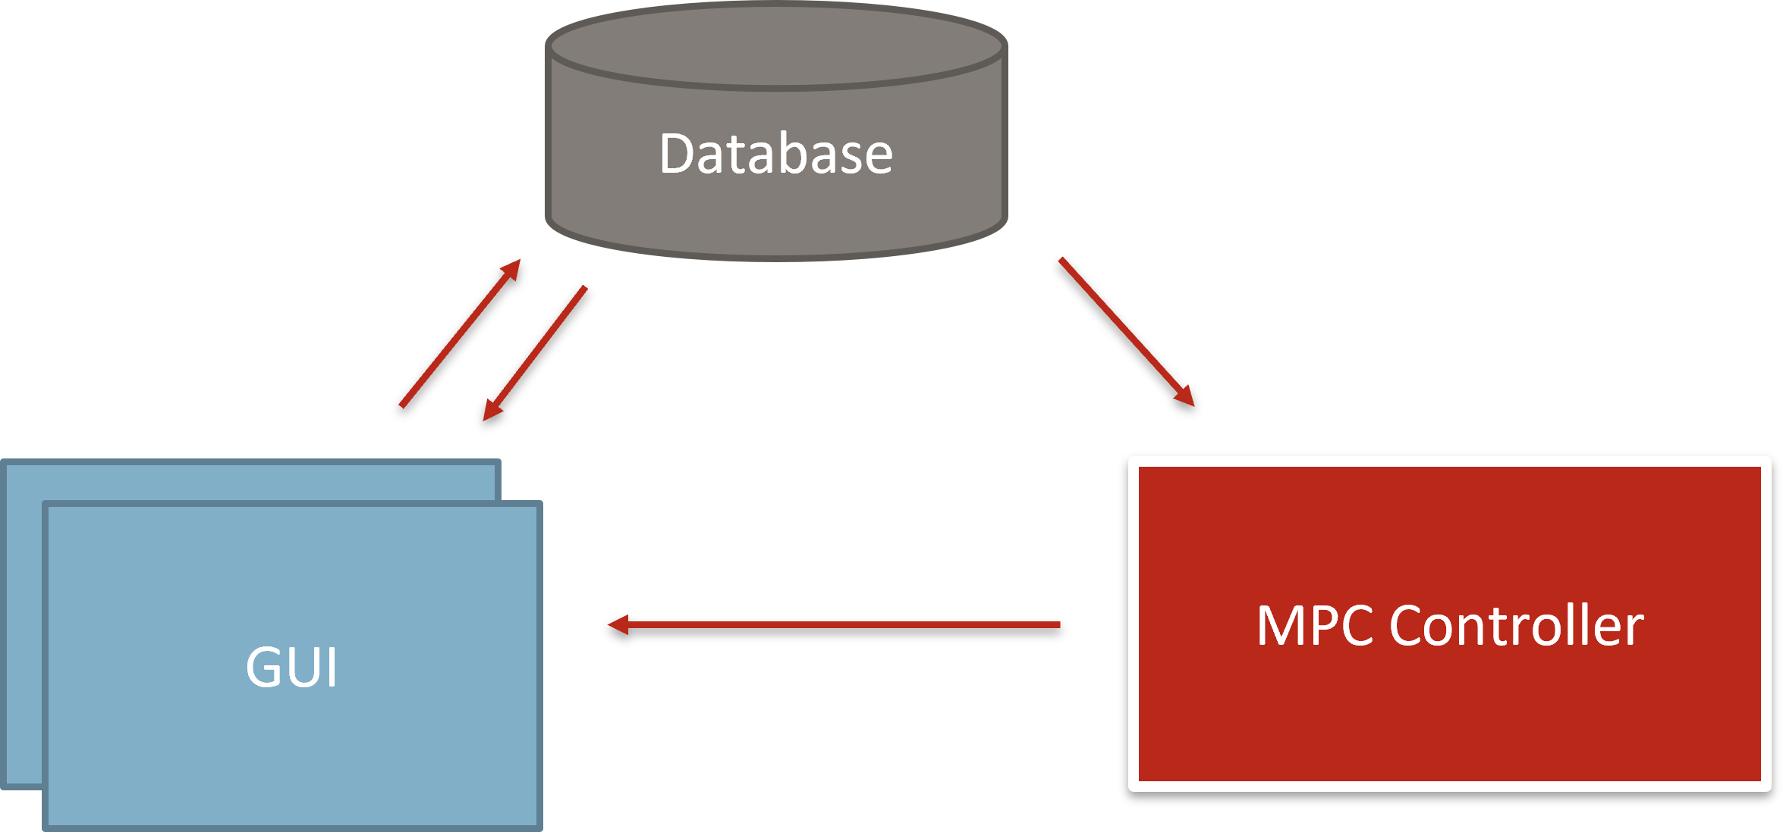
Development and Implementation
Software Architecture
There are two types of GUI developed
Main GUI – Visualize Result
Secondary GUI – Data entry
Parameter saved in the secondary GUI are stored directly in the database.
MPC program will fetch the parameter from the database and execute its computation
After MPC complete it computation, it will pass the data to the main GUI for visualization.

Slide 24

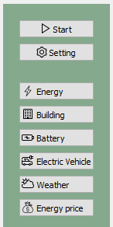
Development and Implementation
Main GUI

Slide 25
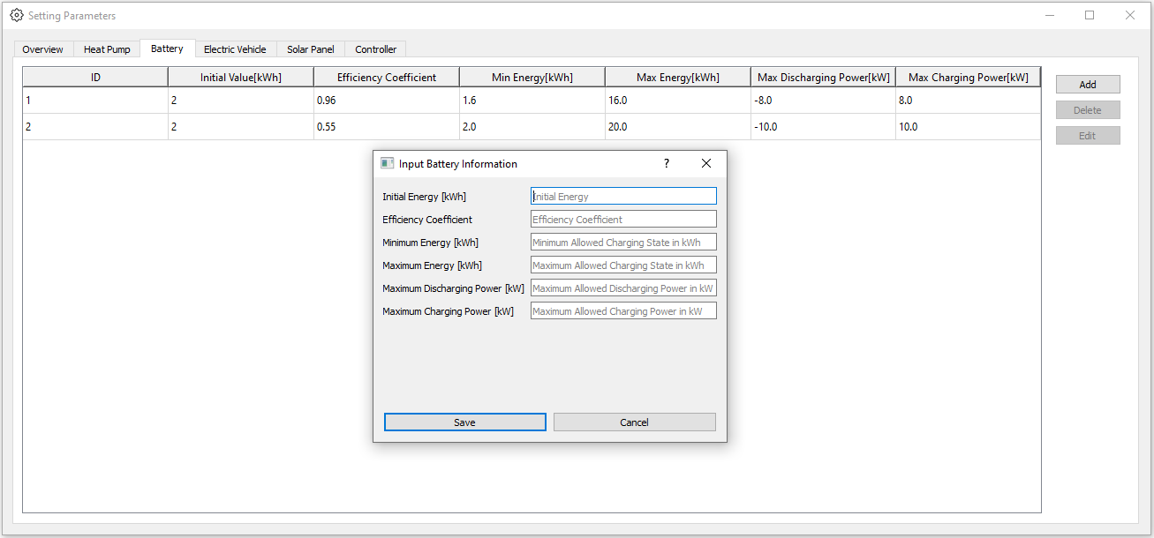
Development and Implementation

Slide 26
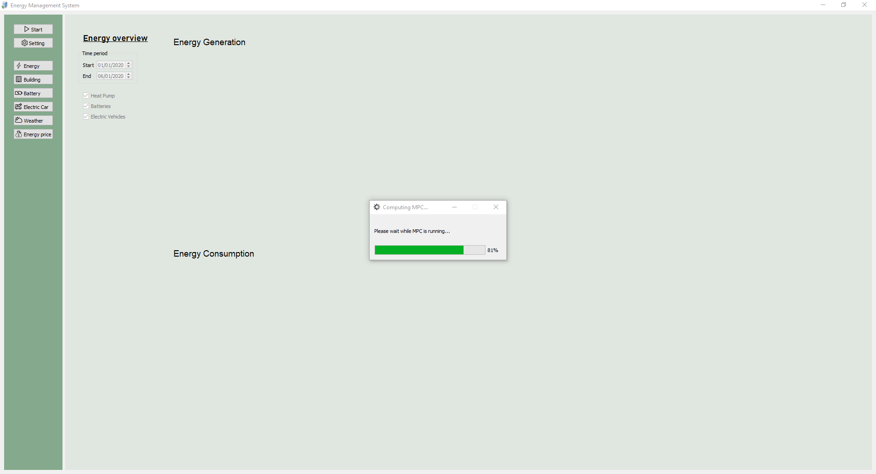
Development and Implementation
When MPC program start, a progress bar will appear to indicate how the status of the computation.
The window for the progress bar is a bit delay because it is running MPC computation in the background.

Slide 27
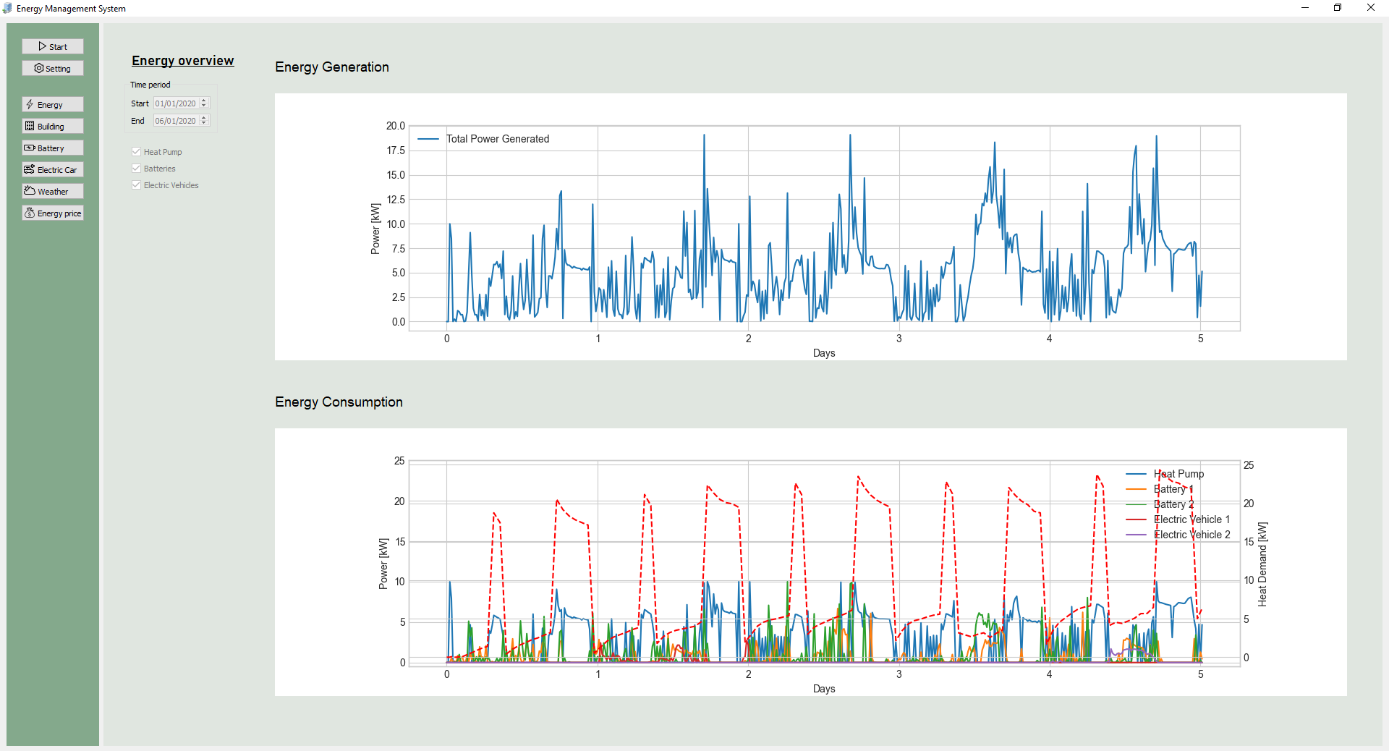
Development and Implementation
When the computation end, the progress bar will close itself and the all the result will plotted

Slide 28

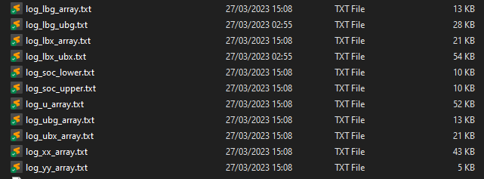
Development and implementation
Log files is also generated in the end and are stored in the text file for later analysis and visualization.

Slide 29
Case Study 1
Case study 1: One battery and one electric vehicle
Sampling time: 15 minutes
Prediction horizon: 24 hours
Simulation length: 5 days
Battery:
Charging and discharging coefficient: 0.96
Initial State of Charge(SOC): 2 kWh
Min State of Charge(SOC)/Storage Value : 1.2 kWh
Max State of Charge(SOC)/Storage Value: 12 kWh
Min charging power: -8 kW
Max charging power: 8 kW
Electric Vehicle:
Charging and discharging coefficient: 0.88
Initial State of Charge(SOC): 20 kWh
Min State of Charge(SOC)/Storage Value : 0 kWh
Max State of Charge(SOC)/Storage Value: 48 kWh
Min charging power: 0 kW
Max charging power: 8 kW

Slide 30
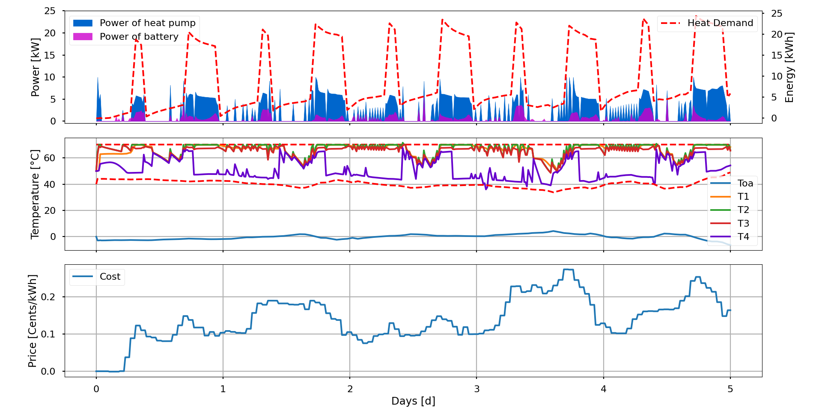
Case Study 1
The graph display the interaction between outside temperature, power consumption by heat pump, power discharge by battery and electricity price in maintaining temperature of the hot water tank(HWT) within predefined boundary.

Slide 31
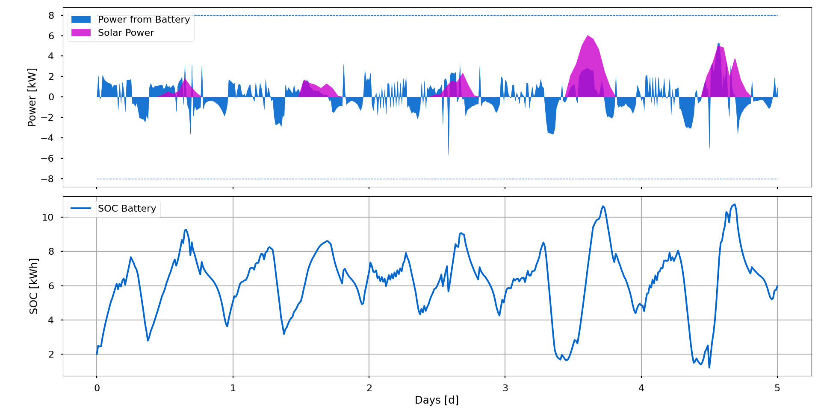
Case Study 1
The graph illustrate the dynamic relationship between battery power, solar power and the state of charge(SOC) of the battery. The charging and discharging of the battery operate within the specified limit.

Slide 32
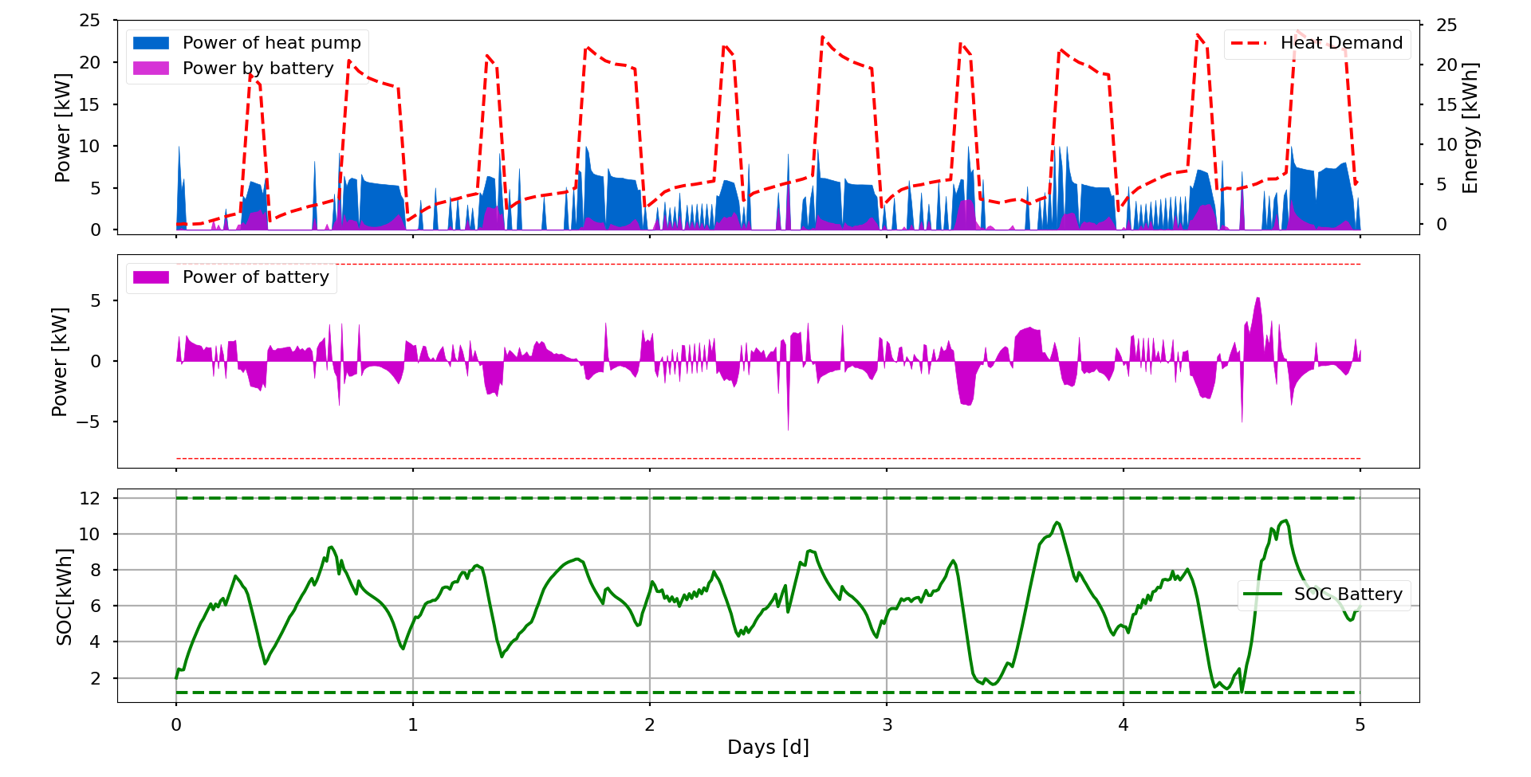
Case Study 1
The graph illustrate the relationship between battery power, battery state of charge(SOC) and the power required to support the heat pump operation.
The battery SOC is within the limit of operation.

Slide 33
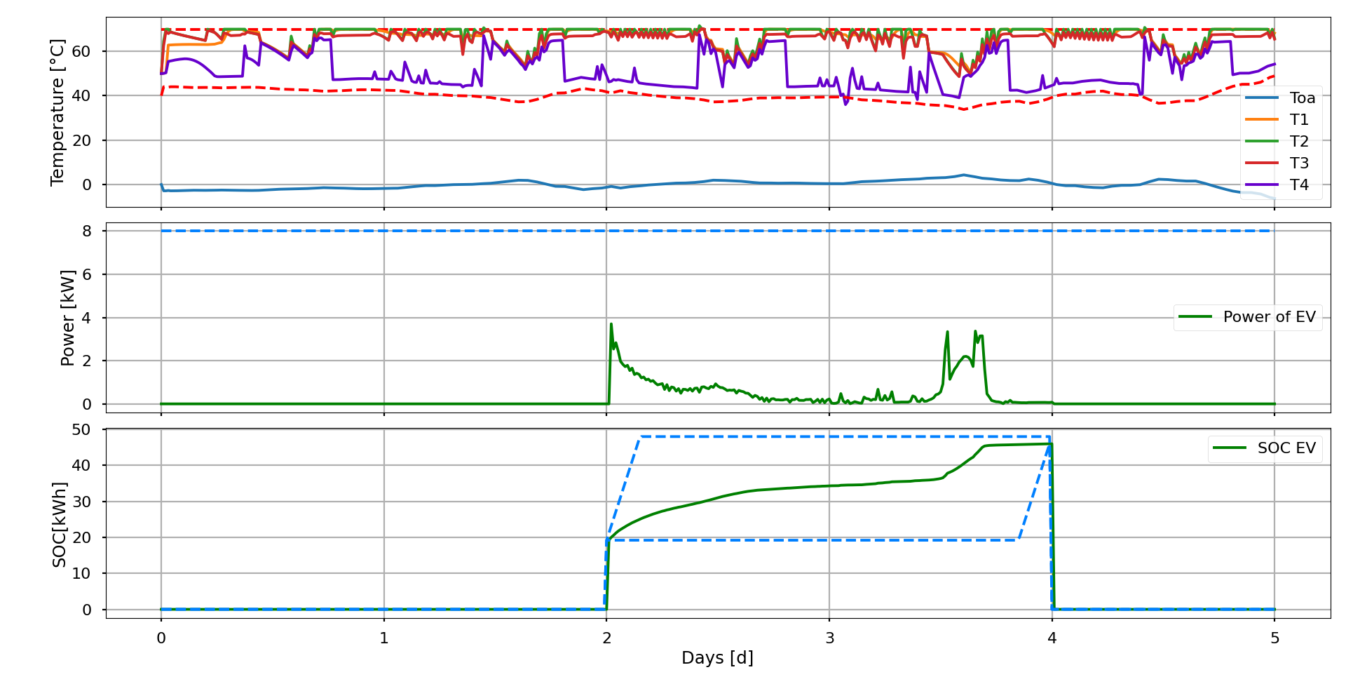
Case Study 1
The integration of EV charging does not impact the operation of the heat pump, as the hot water tank maintains its temperature within the specified range. The charging of the EV is also in predefined limit.

Slide 34
Case Study 2
Case study 1: Two battery and two electric vehicle
Sampling time: 15 minutes
Prediction horizon: 24 hours
Simulation length: 5 days
Battery:
Charging and discharging coefficient: 0.96
Initial State of Charge(SOC): 2 kWh
Min State of Charge(SOC)/Storage Value : 1.6 kWh
Max State of Charge(SOC)/Storage Value: 16 kWh
Min charging power: -8 kW
Max charging power: 8 kW
Electric Vehicle 1:
Charging and discharging coefficient: 0.88
Initial State of Charge(SOC): 38 kWh
Min State of Charge(SOC)/Storage Value : 0 kWh
Max State of Charge(SOC)/Storage Value: 48 kWh
Min charging power: 0 kW
Max charging power: 8 kW
Battery:
Charging and discharging coefficient: 0.55
Initial State of Charge(SOC): 2 kWh
Min State of Charge(SOC)/Storage Value : 2 kWh
Max State of Charge(SOC)/Storage Value: 20 kWh
Min charging power: -10 kW
Max charging power: 10 kW
Electric Vehicle 2:
Charging and discharging coefficient: 0.95
Initial State of Charge(SOC): 30 kWh
Min State of Charge(SOC)/Storage Value : 0 kWh
Max State of Charge(SOC)/Storage Value: 40 kWh
Min charging power: 0 kW
Max charging power: 10 kW

Slide 35
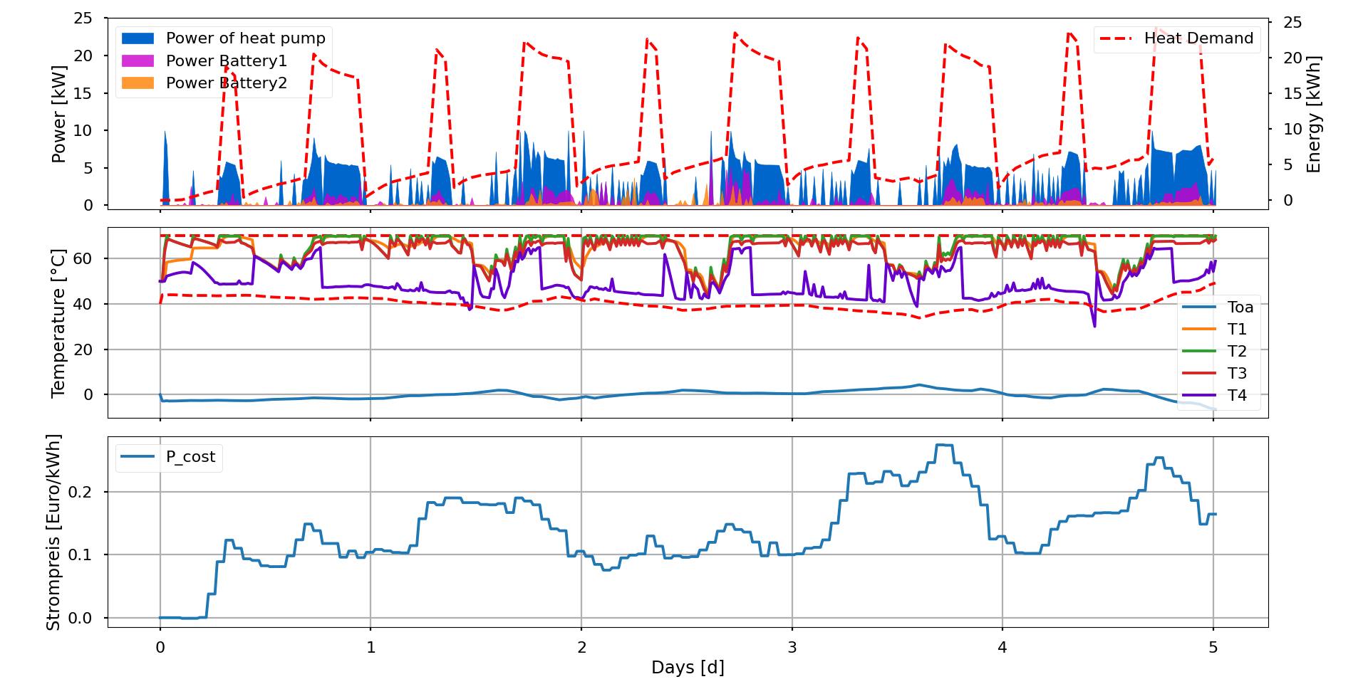
Case Study 2
The graph display the interaction between outside temperature, power consumption by heat pump, power discharge by battery and electricity price in maintaining temperature of the hot water tank(HWT) within predefined boundary.

Slide 36
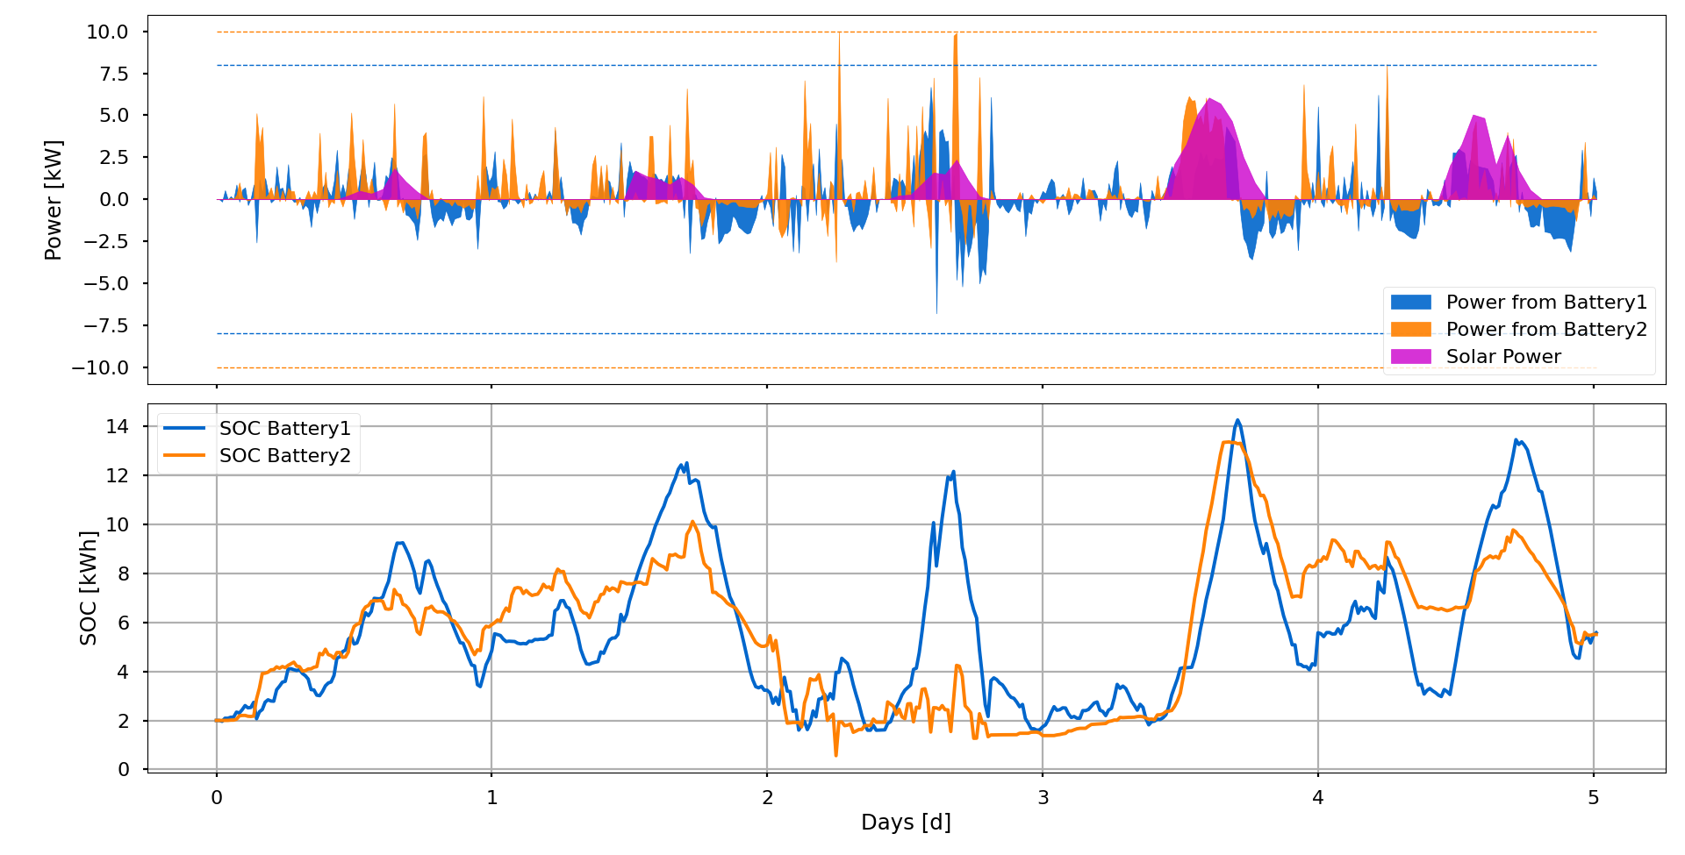
Case Study 2
The graph illustrate the dynamic relationship between battery power, solar power and the state of charge(SOC) of the battery. The charging and discharging of the battery operate within the specified limit.

Slide 37
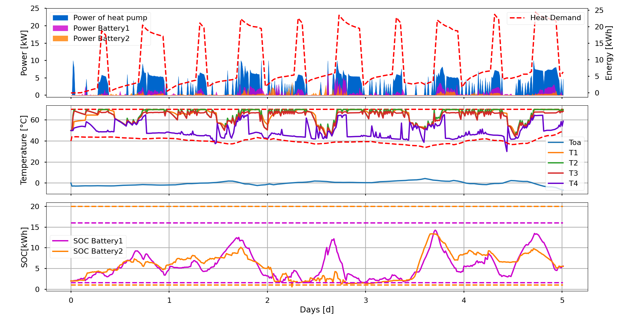
Case Study 2
The graph display the interaction between outside temperature, power consumption by heat pump, the state of charge(SOC) of the battery. The temperature of the hot water tank(HWT) are within predefined boundary.

Slide 38
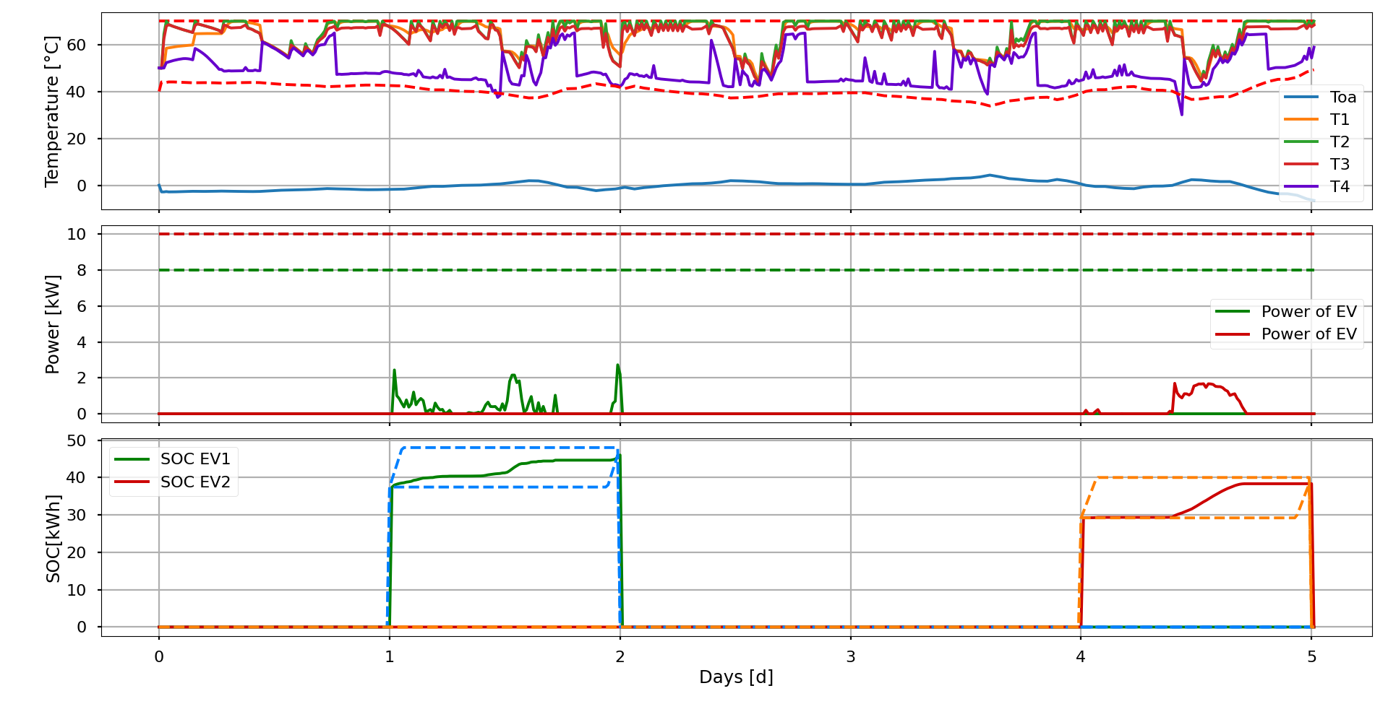
Case Study 2
The integration of EV charging does not impact the operation of the heat pump, as the hot water tank maintains its temperature within the specified range. The charging of the EV is also in predefined limit.

Slide 39
Conclusion
Developed a flexible and scalable modular MPC for building energy management.
User friendly GUI allows for customization of parameters and provides visualization for analysis.
Case studies show successful regulation of hot water tank and power supply to the heat pump.
Control strategies achieve the expected outcomes and operate within the constraints.
Potential for real-time implementation in physical buildings with proper hardware and software optimization.

Slide 40
Future Work
Improve computation time by optimizing code and data structure using CasADi’s API
Include real-time energy pricing and online weather forecasting API .
Include occupancy pattern in the predictive model to increase efficiency and occupancy comfort.
Consider asset degradation of components such as battery, heat pump, EV and hot water tank for durability and system efficiency.
Implement thread and multiprocessing functionality to reduce delay, enhance user experience and program stability.

Slide 41
Appendix

Slide 42
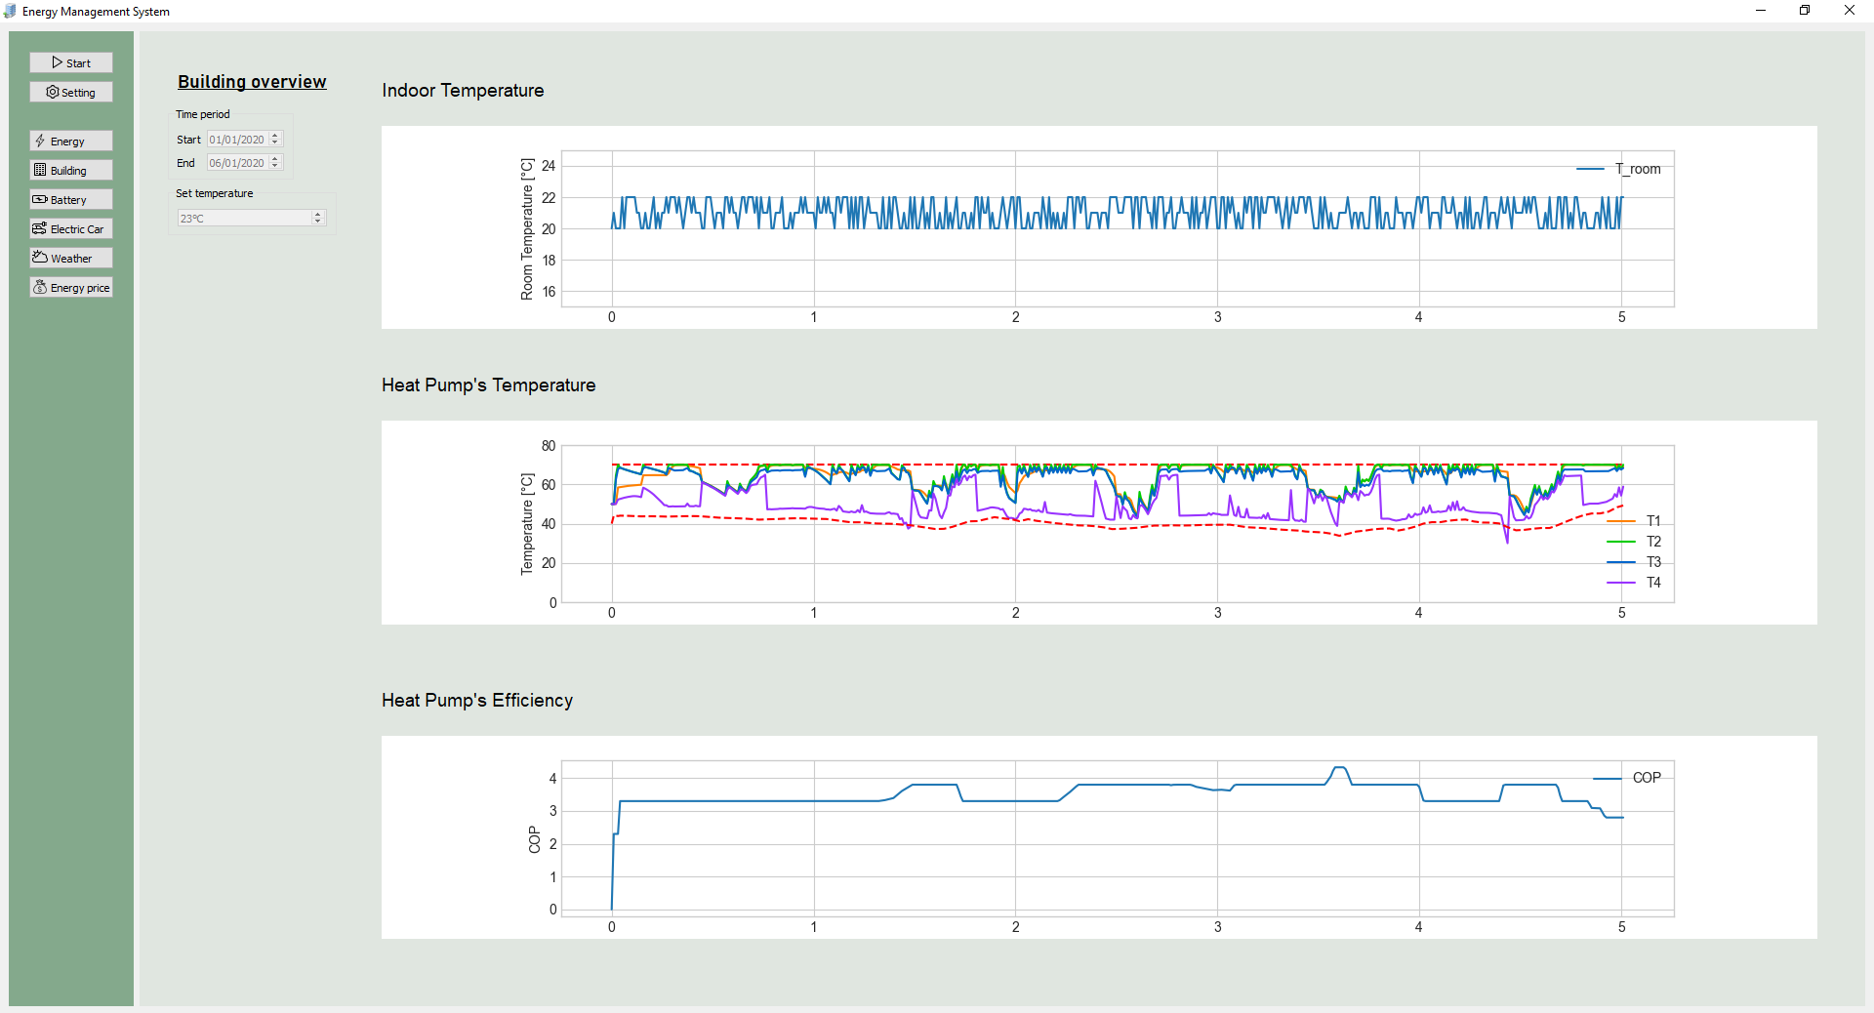
Appendix

Slide 43
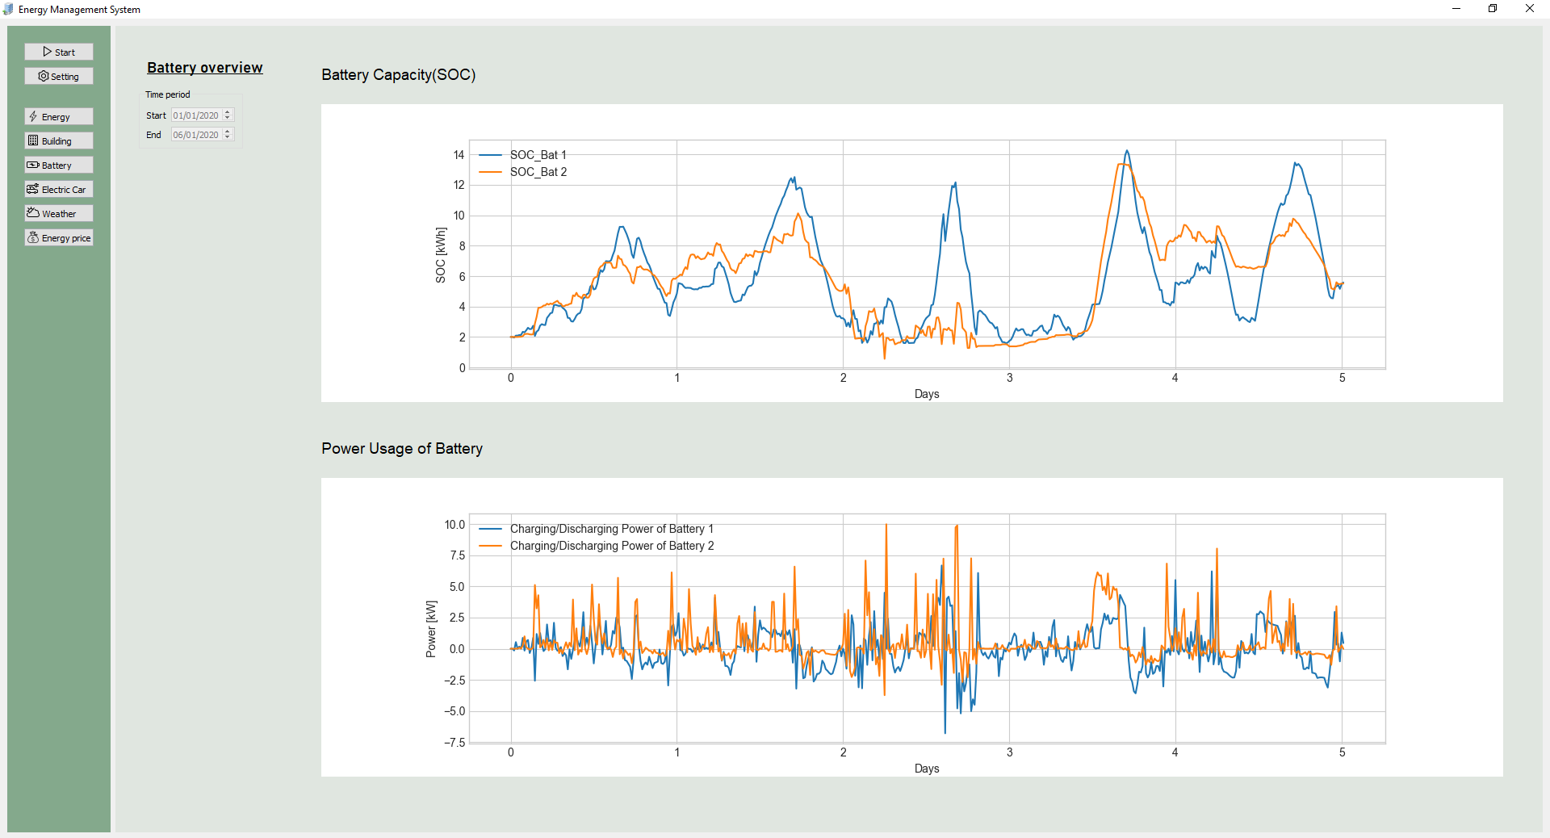
Appendix

Slide 44
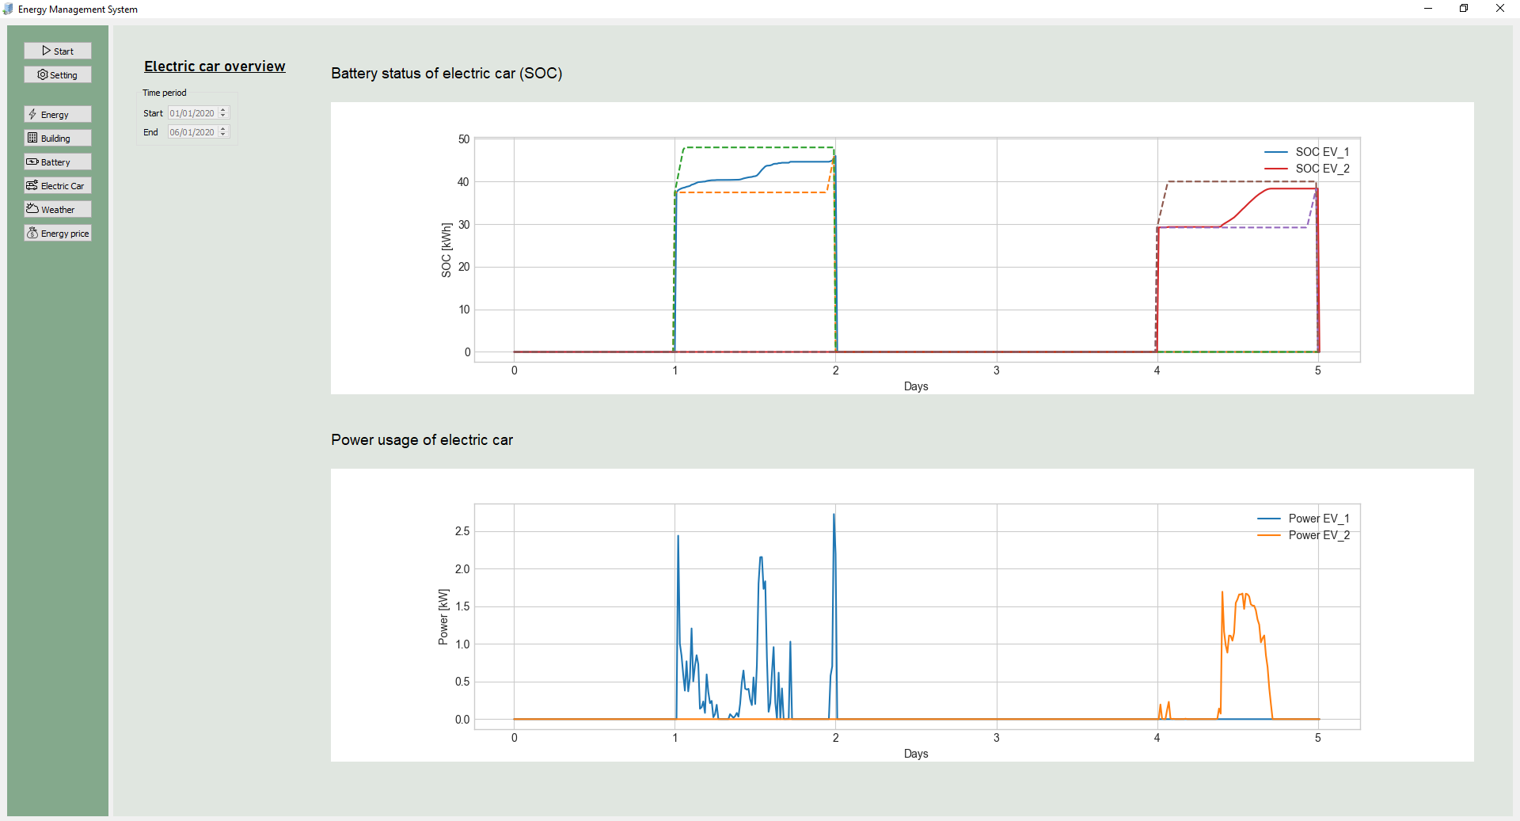
Appendix

Slide 45
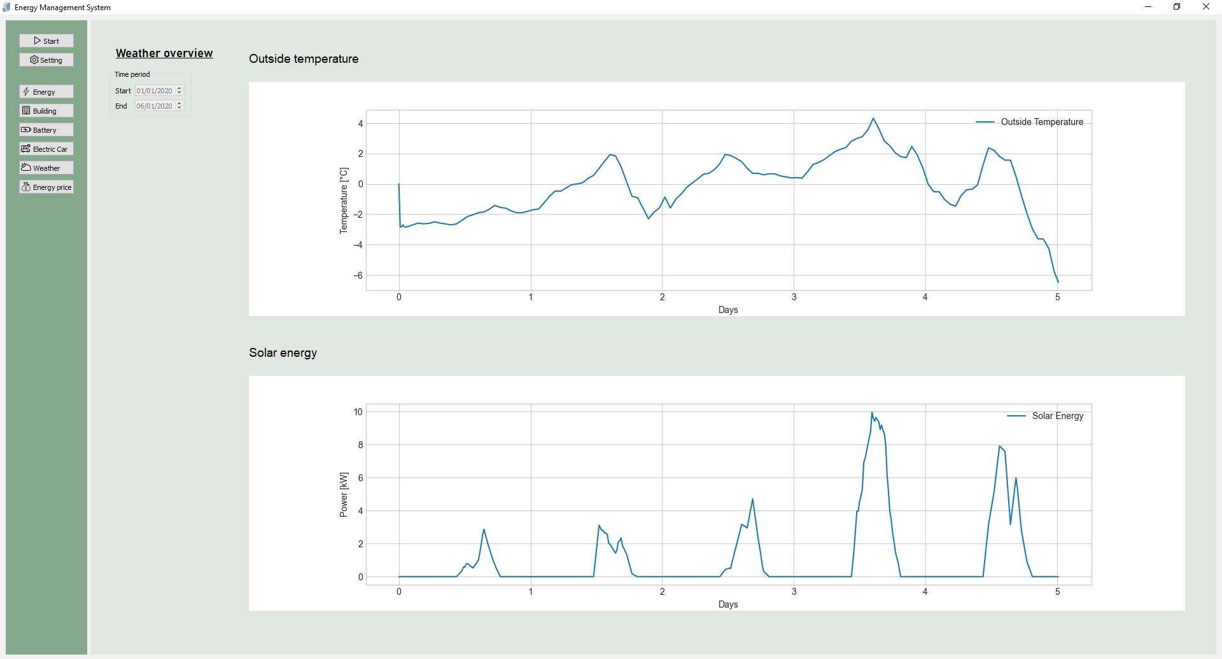
Appendix

Slide 46
Appendix

Slide 47
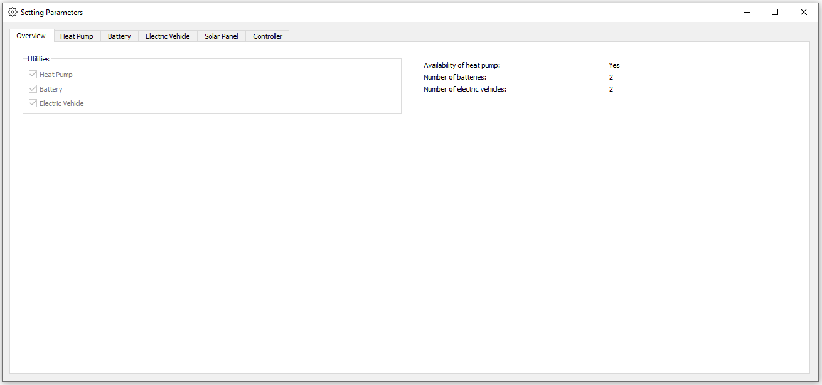
Appendix

Slide 48
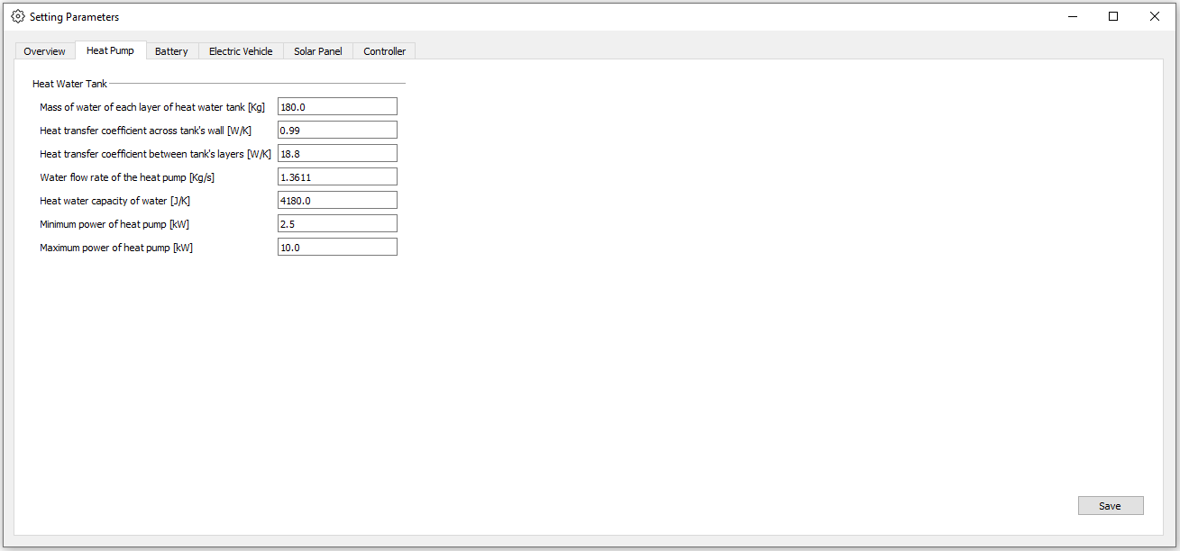
Appendix

Slide 49
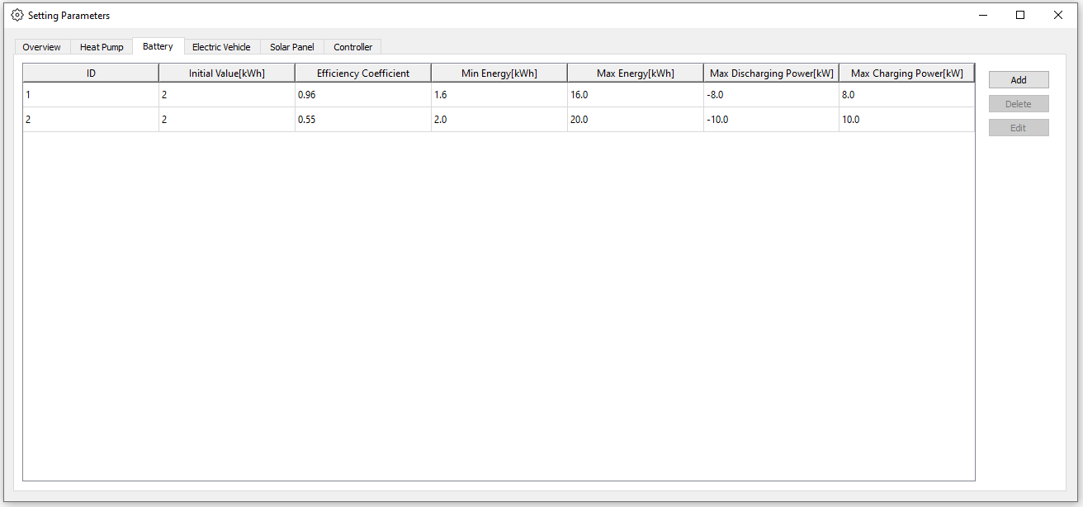
Appendix

Slide 50
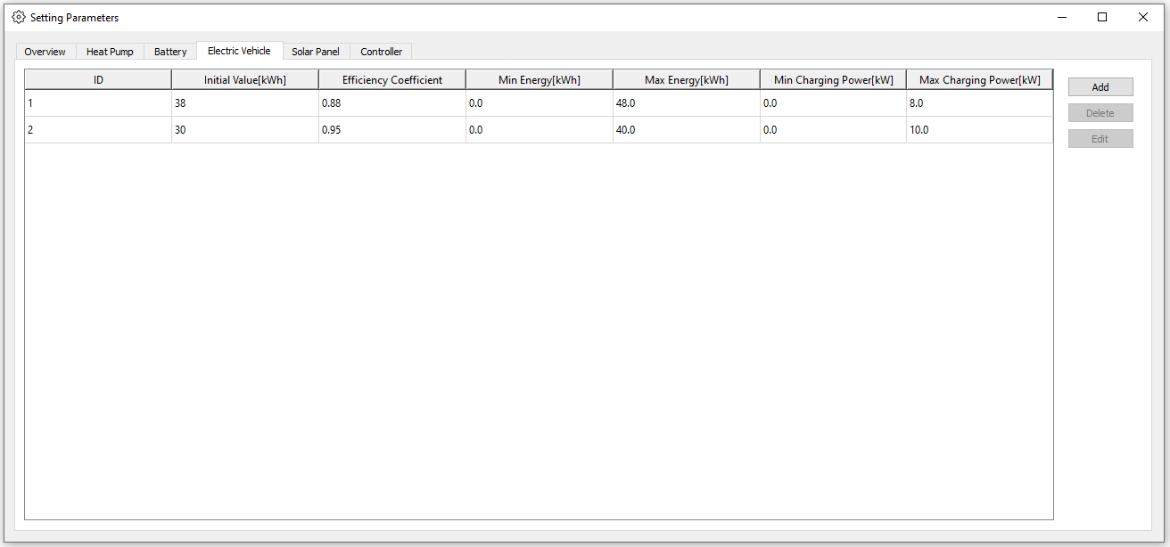
Appendix

Slide 51
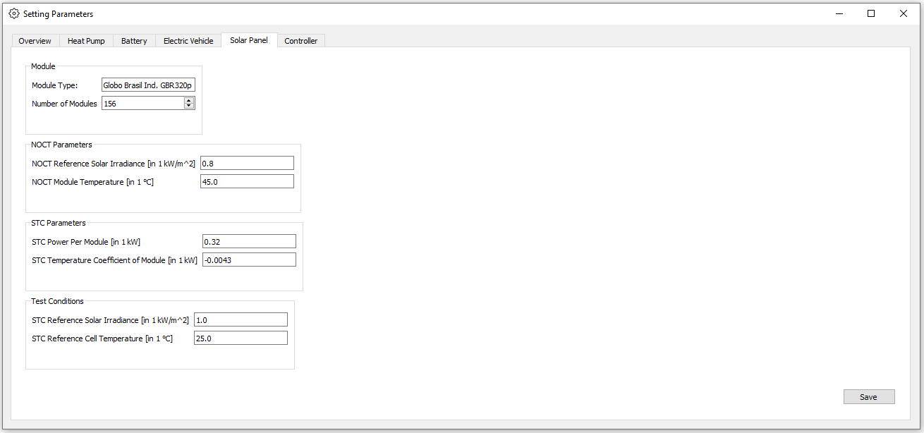
Appendix

Slide 52
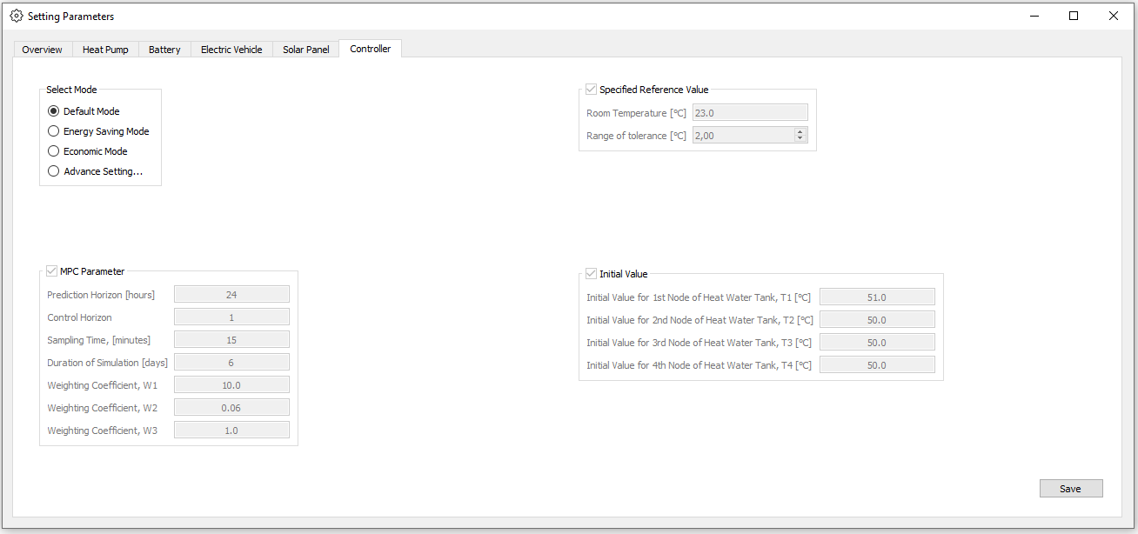
Appendix

Slide 53
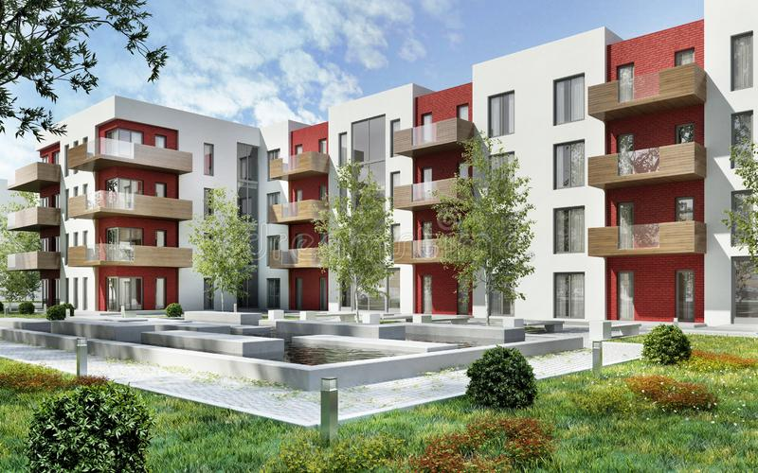
Building’s Model
Building model is an important component in MPC development.
Model based on the work of Rastegarpour and Ferrarini, 2021.
Building’s dynamic model derived from energy balance equation, considering wall, zone, floor and pipeline components.
These 4 components serve as states dynamic of the system, with the zone as key objective, which is the room temperature.
www.dreamstime.com

Slide 54
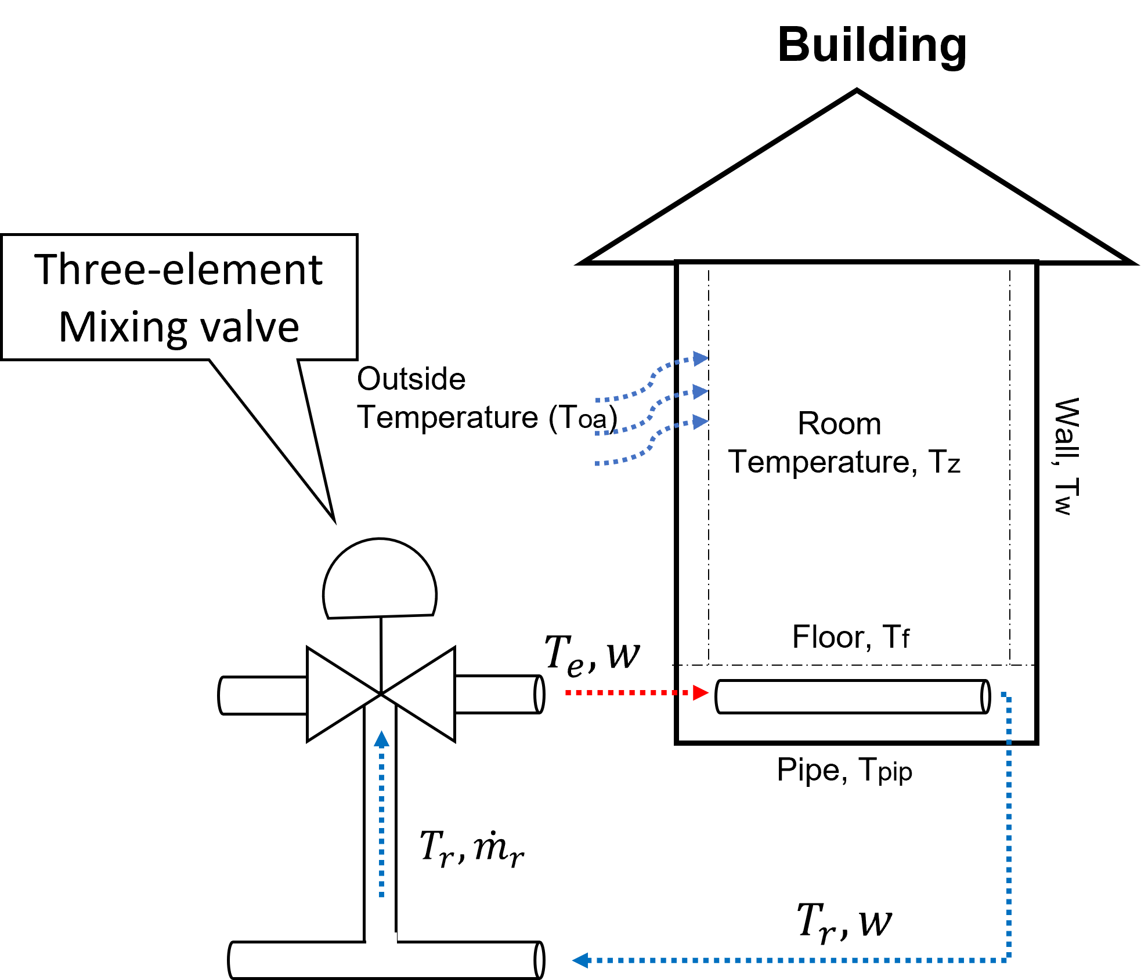






Building’s Model
$$C_{w}\frac{dT_{w}}{dt}=k_{w,oa}\left(T_{oa}−T_{w}\right)+k_{w,z}(T_{z}−T_{w})$$
$$C_{z}\frac{dT_{z}}{dt}=k_{w,z}\left(T_{w}−T_{z}\right)+k_{f,z}(T_{f}−T_{z})$$
$$C_{f}\frac{dT_{f}}{dt}=k_{f,z}\left(T_{z}−T_{f}\right)+k_{f,pip}(T_{pip}−T_{f})$$
$$C_{pip}\frac{dT_{pip}}{dt}=k_{f,pip}\left(T_{f}−T_{pip}\right)+wC_{wat}(T_{e}−T_{pip})$$
$$wT_{e}={\dot{m}}_{t}T_{1}+{\dot{m}}_{r}T_{r}$$
$$w={\dot{m}}_{t}+{\dot{m}}_{r}$$

Slide 55
Building’s Model
Heat demand
Heat demand profile approach: Does not require a building model, making it suitable for situation with changing building characteristic (e.g. renovation, occupancy pattern).
Practical advantage: Avoids the complexity of building model identification.
Data availability: Utilizes readily available data from energy monitoring system or smart meters.
Limitation: Data is limited to past occasions and does not provide accurate information for current or future time periods.

Slide 56
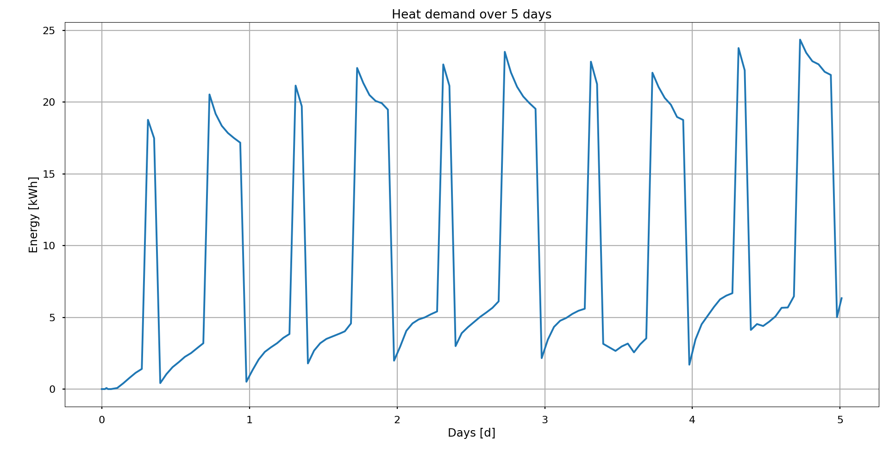
Building’s Model

Slide 57
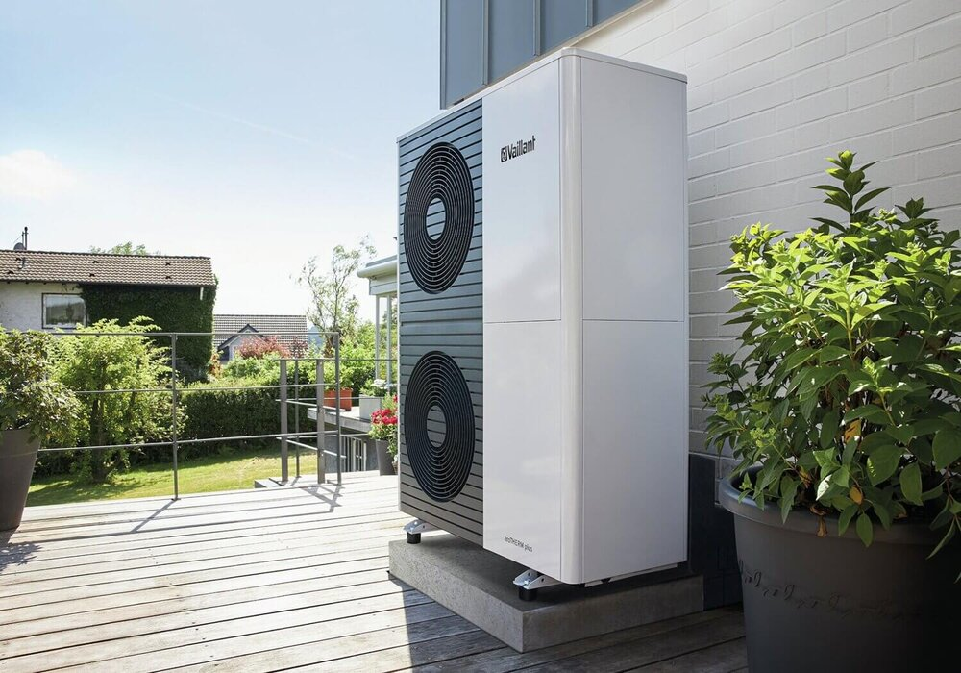
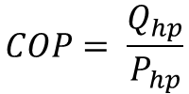
Heat Pump
Heat pump is an efficient and environmental friendly heating system.
Heat pump capture surrounding heat and transfer it to the residential home.
The efficiency of a heat pump can be measured by the Coefficient of Performance(COP), which indicates the ratio of generated thermal power to power input.
The value of COP can vary based on factors like load, external temperature and operating conditions.
$$COP= \frac{Q_{hp}}{P_{hp}}$$
www.greensquare.co.uk
Notes:
They do not produce heat by burning fossil fuel but rather capture the surrounding heat and transfer those heat into the residential home
-Q_hp = is the heat generated by the heat pump
-P_hp = amount of power consumed to operate the heat pump

Slide 58
Heat Pump
Modeling COP: Various approaches exist to model the coefficient of performance(COP)
Constant value (Verhelst, 2012)
Polynomial function (Huang et al., 2006)
Linear expression (Rastegarpour et al., 2021.)
Experimental Data
Chosen method: Utilize generated COP values from experimental data correspond to outside temperature.
The simulated heat pump used in this thesis is an air-to-water heat pump, designed to provide heat to the Hot Water Tank(HWT).
Notes:
Some authors use a constant value of COP value to simplified optimal control formulation and avoid nonlinearity. And also because the implemented controller have limited computational power. However these approach is not the best practice because COP value is greatly affected by external factor and this will lead to inaccuracy.

Slide 59



Heat Pump
There are two approach used in this thesis to model the COP of a heat pump
Linear expression of outside temperature and temperature of water from tank
$$\frac{d({COP}_{1})}{dt}=−\frac{1}{τ}{COP}_{1}+\frac{1}{τ}(a_{1}+a_{2}T_{oa}+a_{3}T_{3})$$
$$\frac{d({COP}_{2})}{dt}=−\frac{1}{τ}{COP}_{2}+\frac{1}{τ}(b_{1}+b_{2}T_{oa})$$
Experimental data(Look-up table).
$$COP=f(T_{oa})$$

Slide 60
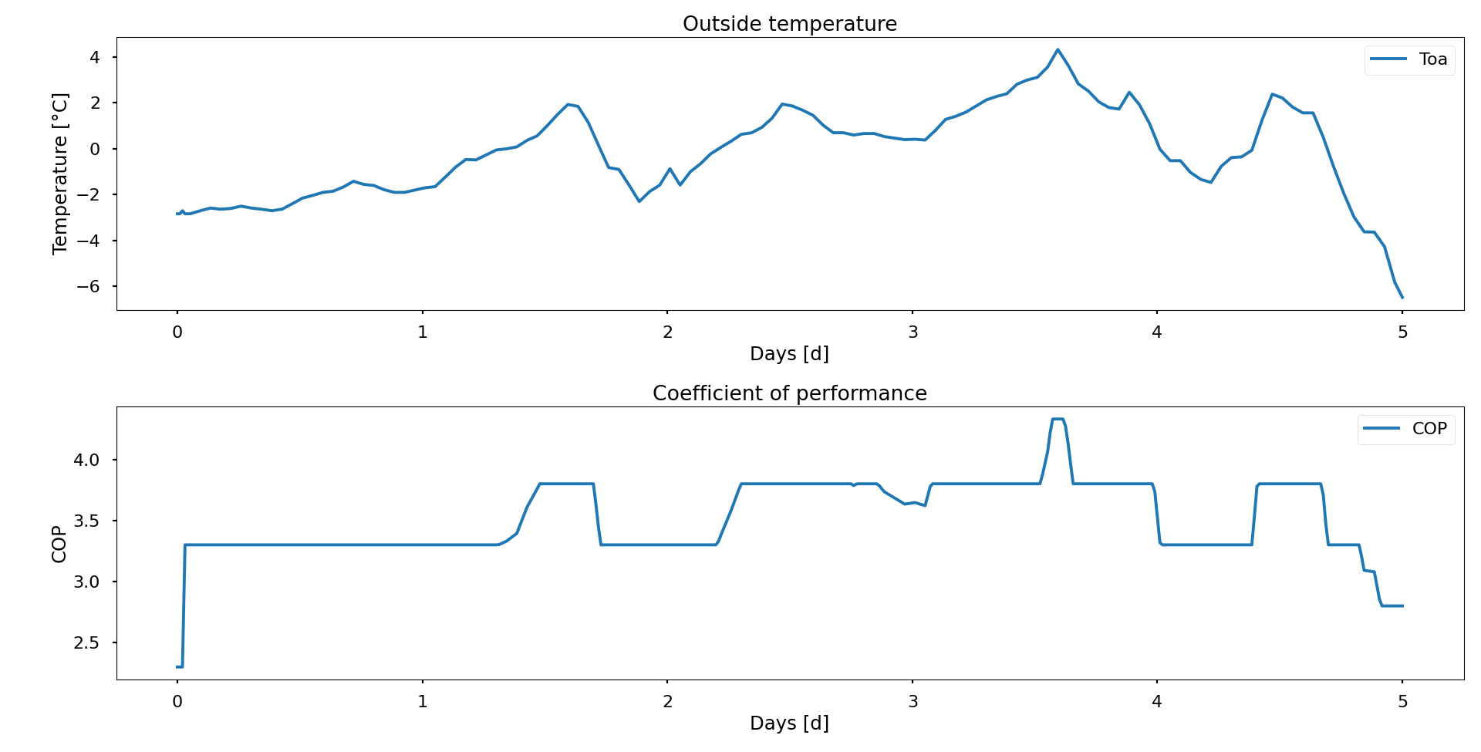
Heat Pump

Slide 61
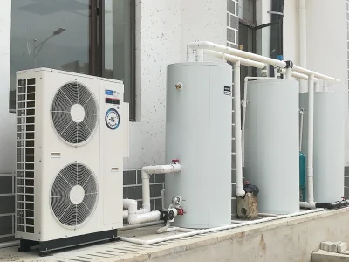
Hot Water Tank
Hot Water Tank(HWT) role: Supplies required heat demand to the building and provides hot water for daily use.
Controller role: Regulates the operation of the heat pump and HWT for effective and efficient system performance.
HWT model: Divided into 4 nodes to capture temperature variation with heat exchange between neighbouring nodes and surrounding temperature.
focussolar.com
Notes:
Lumping all nodes together would oversimplify the model and result in inaccurate behaviour.

Slide 62
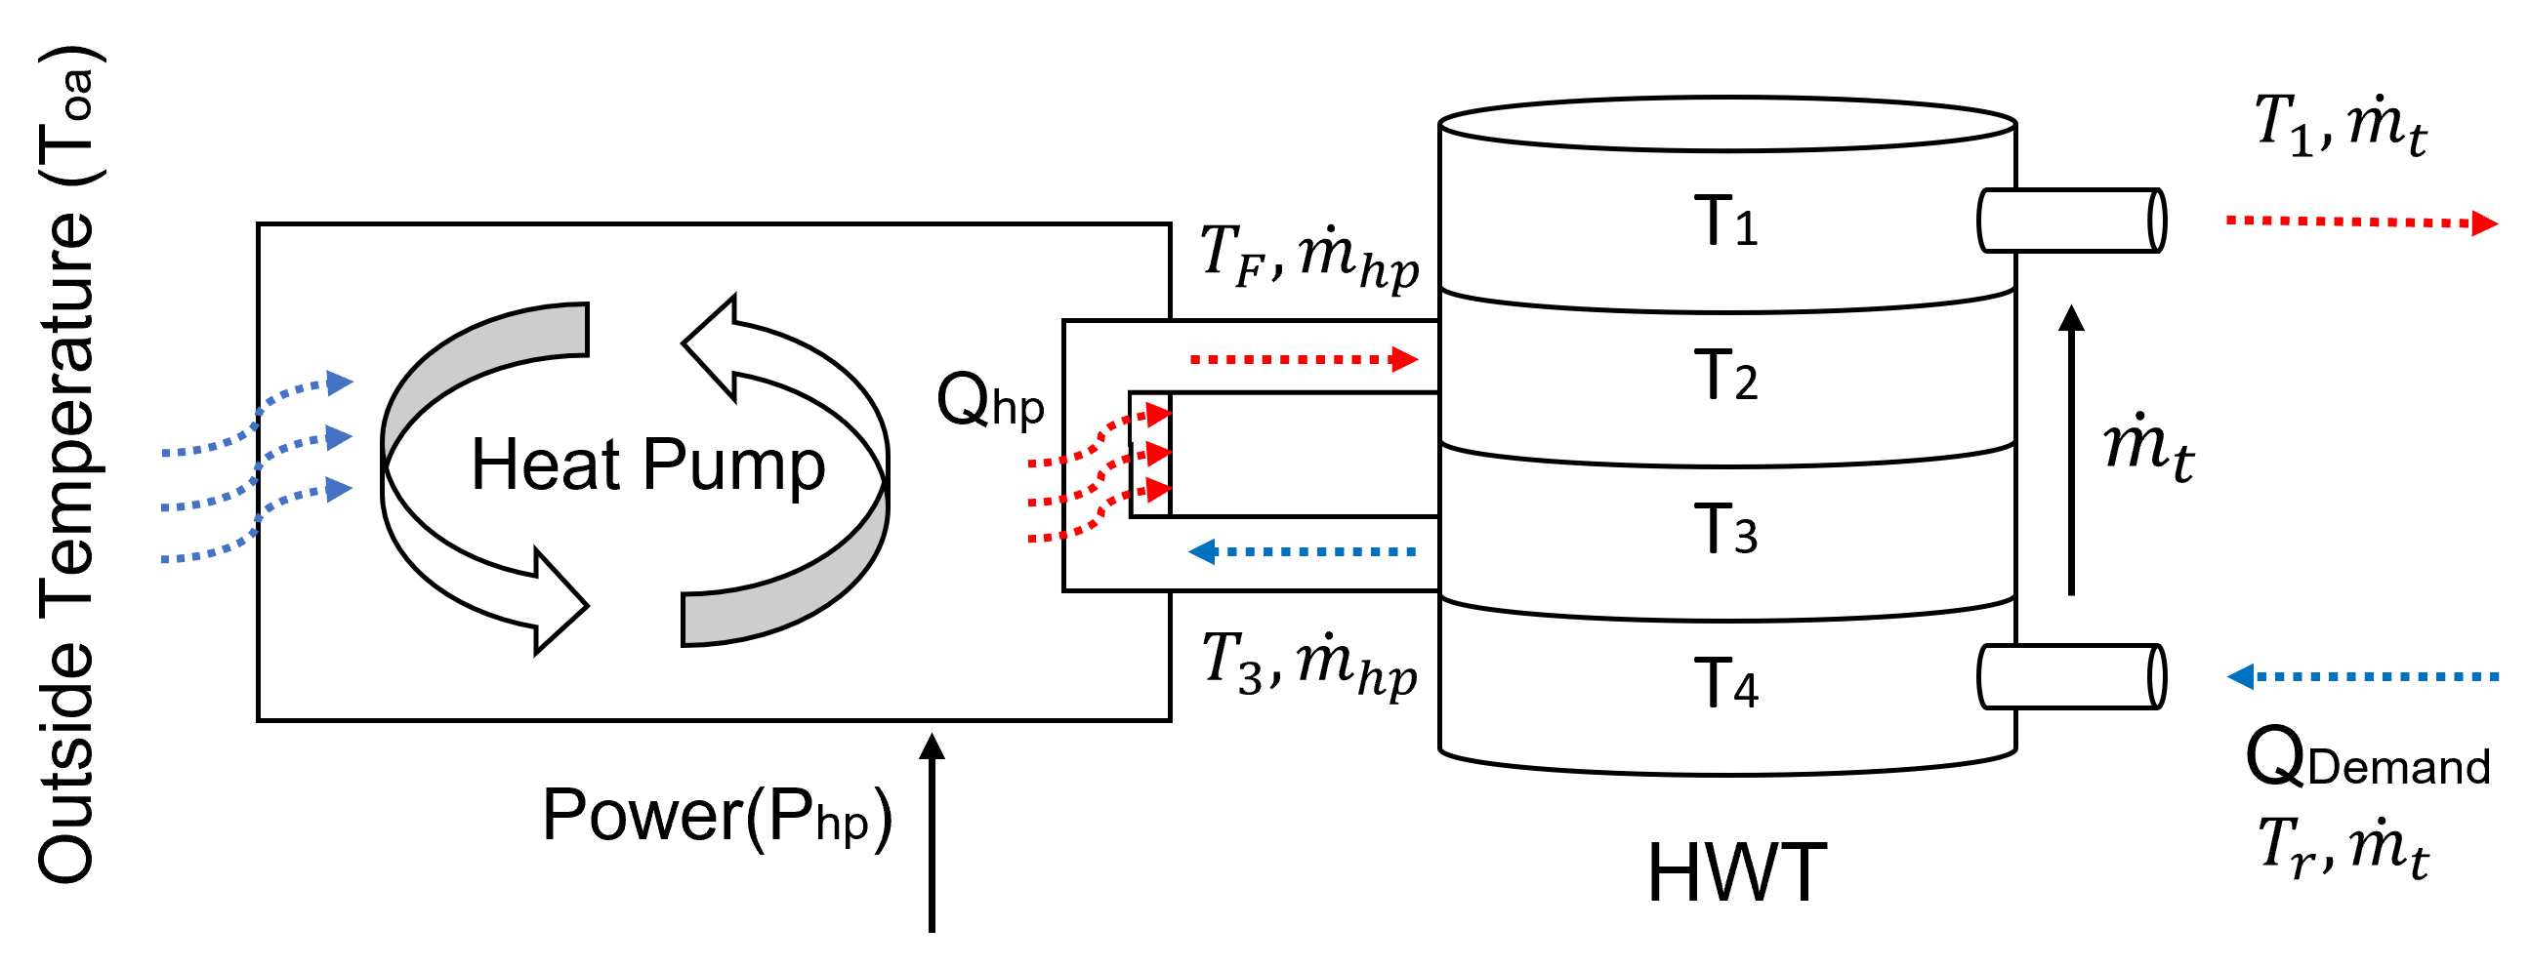



Hot Water Tank
$$mC_{wat}\frac{dT_{1}}{dt}= k_{t}\left(T_{2}−T_{1}\right)+k_{wt}\left(T_{1}−T_{oa}\right)+{\dot{m}}_{t}C_{wat}(T_{2}−T_{1})$$
$$mC_{wat}\frac{dT_{2}}{dt}= k_{t}\left(T_{3}−T_{2}\right)+k_{wt}\left(T_{2}−T_{1}\right)−k_{wt}\left(T_{2}−T_{oa}\right)+{\dot{m}}_{t}C_{wat}\left(T_{3}−T_{2}\right)+{\dot{m}}_{hp}C_{wat}(T_{F}−T_{2})$$
$$mC_{wat}\frac{dT_{3}}{dt}= k_{t}\left(T_{4}−T_{3}\right)+k_{t}\left(T_{3}−T_{2}\right)−k_{wt}\left(T_{3}−T_{oa}\right)+{\dot{m}}_{t}C_{wat}\left(T_{4}−T_{3}\right)+{\dot{m}}_{hp}C_{wat}(T_{2}−T_{3})$$
$$mC_{wat}\frac{dT_{4}}{dt}= k_{t}\left(T_{3}−T_{4}\right)−k_{wt}\left(T_{4}−T_{oa}\right)+{\dot{m}}_{t}C_{wat}\left(T_{1}−T_{4}\right)−Q_{Demand}$$
$$T_{F}=\frac{Q_{hp}}{{\dot{m}}_{hp}C_{wat}}+T_{3}$$
$$Q_{hp}=COP∗P_{hp}$$

Slide 63
References
Pérez-Lombard L., Ortiz J., Pout C. (2008). "A review on buildings energy consumption information". In: Energy and Building, pp. 394-398.
Satyavada, H. and Baldi, S. (Apr. 2016). “An integrated control-oriented modelling for HVAC performance benchmarking”. In: pp. 262–273.
Fiducioso, M., Curi, S., Schumacher, B., Gwerder, M., and Krause, A. (2019). Safe Contextual Bayesian Optimization for Sustainable Room Temperature PID Control Tuning.
Afram, A., Janabi-Sharifi, F., Fung, A. S., and Raahemifar, K. (Apr. 2017). “Artificial neural network (ANN) based model predictive control (MPC) and optimization of HVAC systems: A state of the art review and case study of a residential HVAC system”. In: Energy and Buildings Vol. 141, pp. 96–113.
Shepherd, A. B. and Batty, W. J. (Feb. 2003). “Fuzzy control strategies to provide cost and energy efficient high quality indoor environments in buildings with high occupant densities”. In: Building Services Engineering Research and Technology Vol. 24 (1), pp. 35–45.
Soetedjo, A., Nakhoda, Y. I., and Saleh, C. (2018). “Embedded Fuzzy Logic Controller and Wireless Communication for Home Energy Management Systems”. In: Electronics Vol. 7 (9).
Ashraf, M., Adly, I., and Shehata, K. (Apr. 2018). “IoT-BASED SMART BUILDING MANAGEMENT SYSTEM”. In: The International Conference on Electrical Engineering Vol. 11 (11), pp. 1–15.

Slide 64
References
Afram, A. and Janabi-Sharifi, F. (2014). Theory and applications of HVAC control systems - A review of model predictive control (MPC).
Serale, G., Fiorentini, M., Capozzoli, A., Bernardini, D., and Bemporad, A. (Feb. 2018). “Model Predictive Control (MPC) for enhancing building and HVAC system energy efficiency: Problem formulation, applications and opportunities”. In: Energies Vol. 11 (3).
Cigler, J., Gyalistras, D., ˇ Sirok´y, J., Tiet, V.-N., and Ferkl, L. (2013). Beyond theory: the challenge of implementing Model Predictive Control in buildings.
Mirakhorli, A. and Dong, B. (2016). “Occupancy behavior-based model predictive control for building indoor climate—A critical review”. In: Energy and Buildings Vol. 129. Model the occupant with RC network, pp. 499–513.

Slide 65
Q&A Session
Thank you for your attention!
Please feel free to ask any question!

