Slide 1
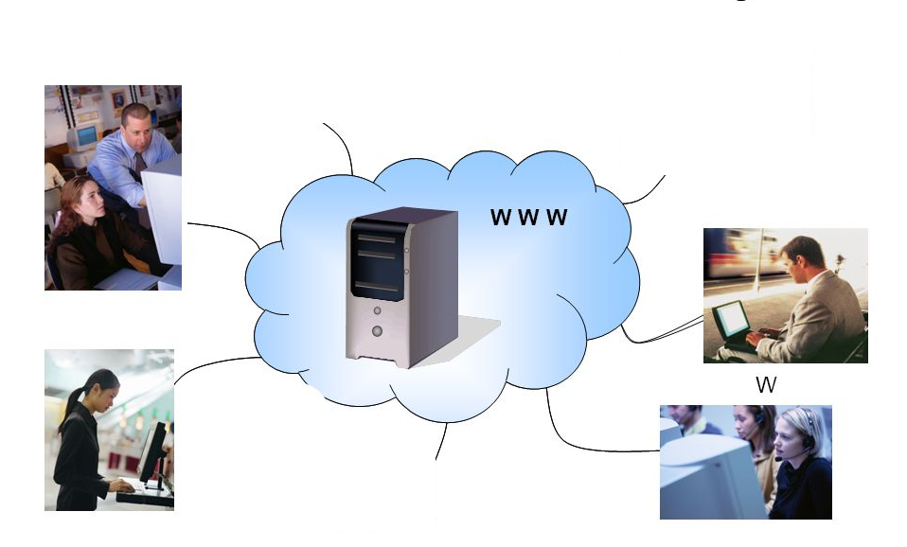
Internet Based Learning System
A Presentation By Md. Nafiz Kamal
Internet Based Learning System

Slide 2
Information Hierarchy
Internet Based Learning System
Admin’s Dashboard
Client-Side View
Top Navigation Panel
Side Navigation Panel
Main Content Panel
Footer Panel
Login Authentication
Server-Side View
Add New Page
Categories
Manage Admins
Comments
Live Blog
Logout
Blog Page
Post Details

Slide 3
Client-Side Presentation Flow
Client-Side View
Top Navigation Panel
Main Content Panel
Side Navigation Panel
Footer Panel
IBLS

Slide 4
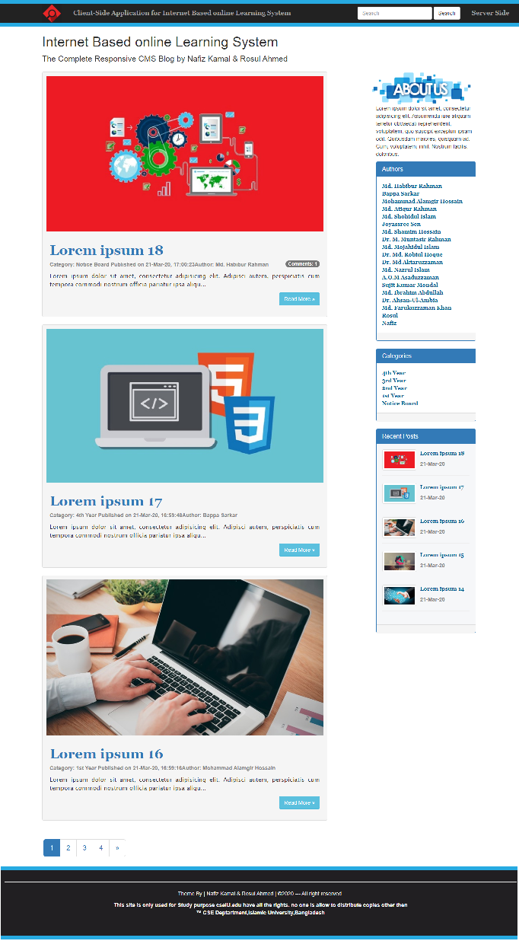
Client-Side
Client-Side View
Top Navigation Panel
Main Content Panel
Side Navigation Panel
Footer Panel
IBLS
From
Public-Point of View/
Client-Side View/
Front-End View
The main content panel contains
the blog posts of the blog and posts are organized in reverse chronological order so the latest post should on top

Slide 5



Top Navigation Panel
Client-Side View
Top Navigation Panel
Main Content Panel
Side Navigation Panel
Footer Panel
IBLS
The top navigation panel consists of
A Logo
which represents the symbol 'quest of knowledge'
A Search Box
for 'quick finding' through entire website;
A ‘Server Side’ Button
for accessing server side of the website

Slide 6
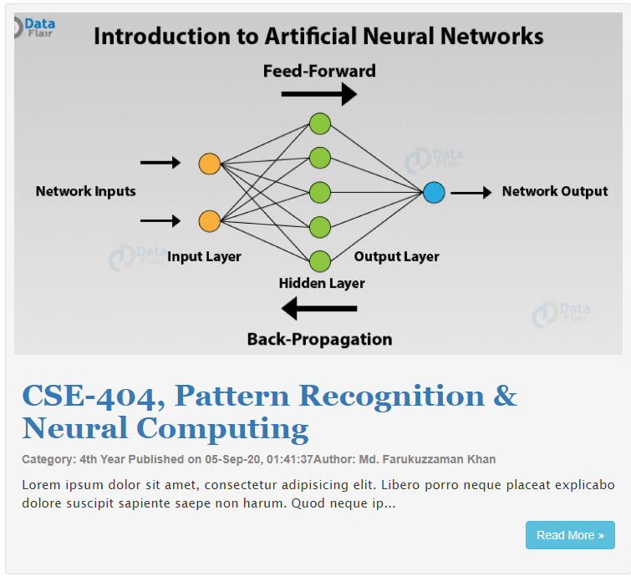

Main Blog Structure
Client-Side View
Top Navigation Panel
Main Content Panel
Side Navigation Panel
Footer Panel
IBLS
Each single blog post contains
post heading, category, author, published time and post summary with a 'Read More' button for details
a pagination is used at the end of the main content
for splitting the contents of the blog where each page contains five posts in reverse chronological order so the latest should be form the first page.

Slide 7

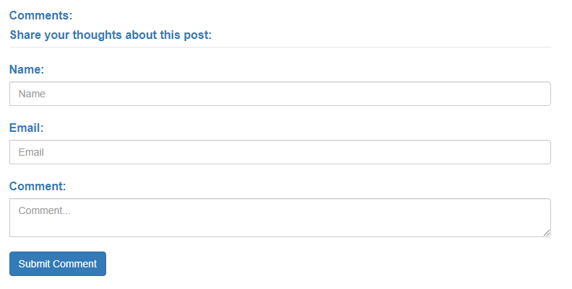
Post Details & Comments
Client-Side View
Top Navigation Panel
Main Content Panel
Side Navigation Panel
Footer Panel
IBLS
By clicking 'Read More' button viewer can access of the post details
And 'by the help of comment section' for express their feedback through comment
though the comments needs the admins approval to showcase in public view

Slide 8
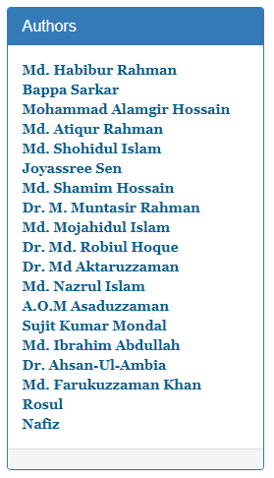
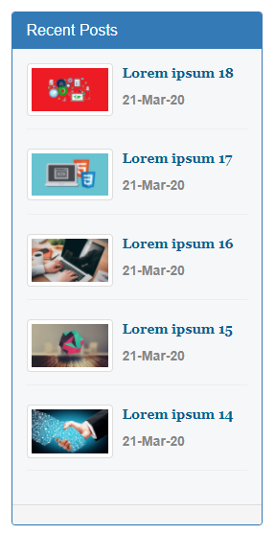
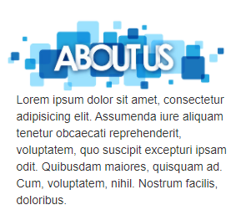
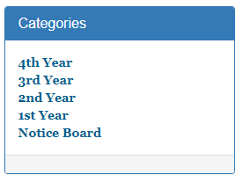
Sidebar
Client-Side View
Top Navigation Panel
Main Content Panel
Side Navigation Panel
Footer Panel
IBLS
used for speeding up the navigation process across the blog. Four groups are used here.
describing the visitors what we have to offer and details.
Authors are included here with link. By clicking here visitors can read all posts of the individual author.
Here the type of post in a list with links are included. And by clicking any individual visitors can read all posts of the individual
Here a list of five latest posts are included.

Slide 9

Footer
Client-Side View
Top Navigation Panel
Main Content Panel
Side Navigation Panel
Footer Panel
IBLS
which marks the end of the site and contains additional information as contact and copyright information.

Slide 10
Server-Side Presentation Flow
Server-Side View
Admin’s Dashboard
Add New Post
Categories
Admins
IBLS
Login Authentication
Comments
Live Blog / Logout

Slide 11
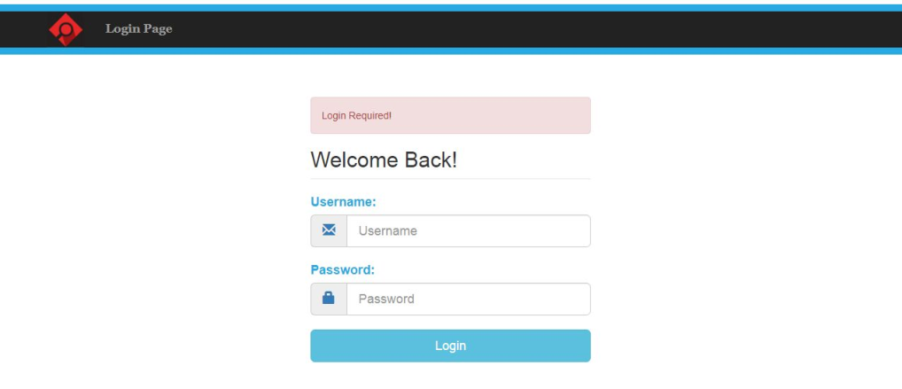
Login Page
Server-Side View
Admin’s Dashboard
Add New Post
Categories
Admins
IBLS
Login Authentication
Comments
Live Blog / Logout
By clicking 'Server Side' button in the navigation panel, the page will redirect to Login Page for authentication
Here admin must provide valid username and password to login.
After successful login user will access to server side view

Slide 12
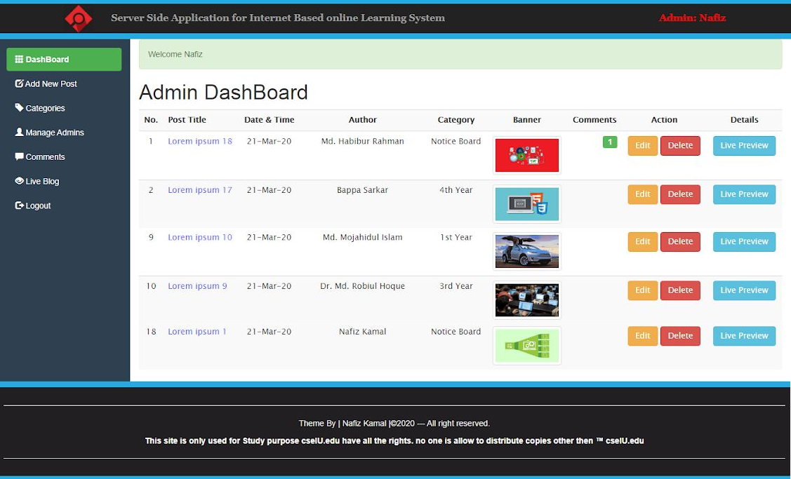
Admin’s Dashboard
Server-Side View
Admin’s Dashboard
Add New Post
Categories
Admins
IBLS
Login Authentication
Comments
Live Blog / Logout
after successful login, page will redirect to Admin's Dashboard; In here admin has the view of all post titles with their corresponding Author, Category, Banner, Published Time, Comments. Admin can also take action as Edit or Delete a post or check the Live preview look in Client-side view.

Slide 13
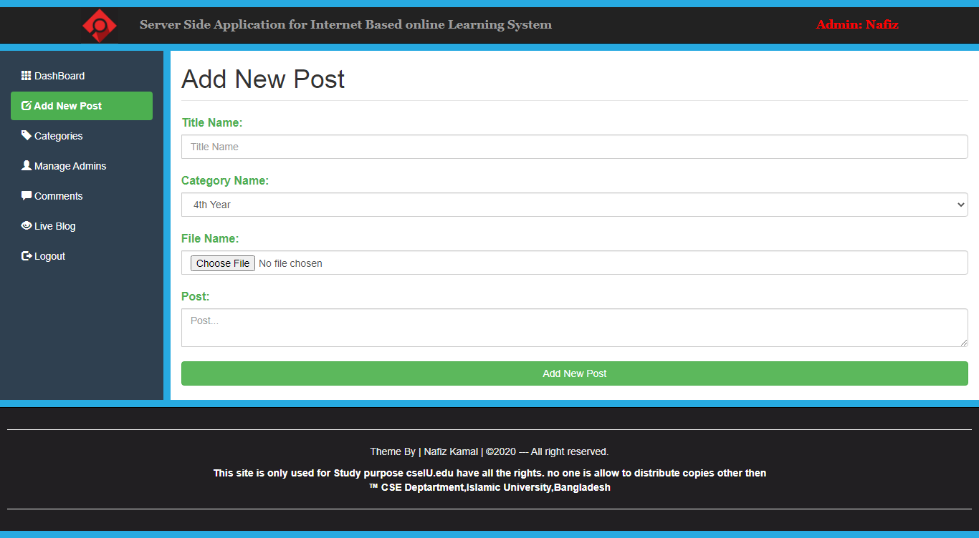
Add New Post
Server-Side View
Admin’s Dashboard
Add New Post
Categories
Admins
IBLS
Login Authentication
Comments
Live Blog / Logout
New post can be published by filling the form.

Slide 14
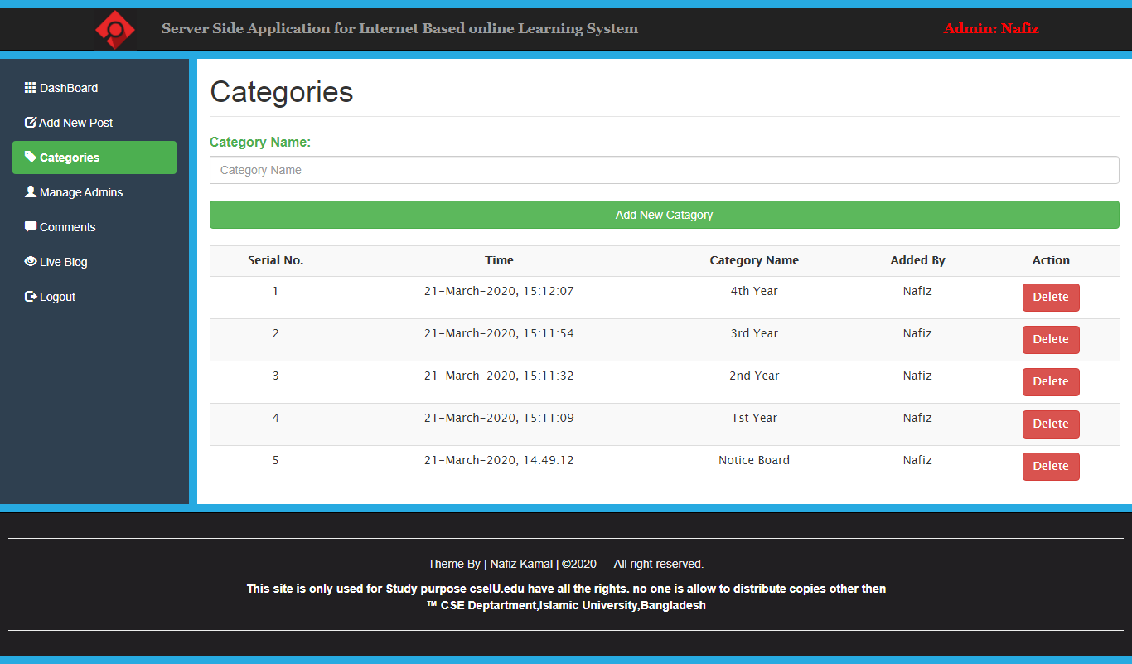
Manage Post Categories
Server-Side View
Admin’s Dashboard
Add New Post
Categories
Admins
IBLS
Login Authentication
Comments
Live Blog / Logout
Categories can be managed by this page.

Slide 15
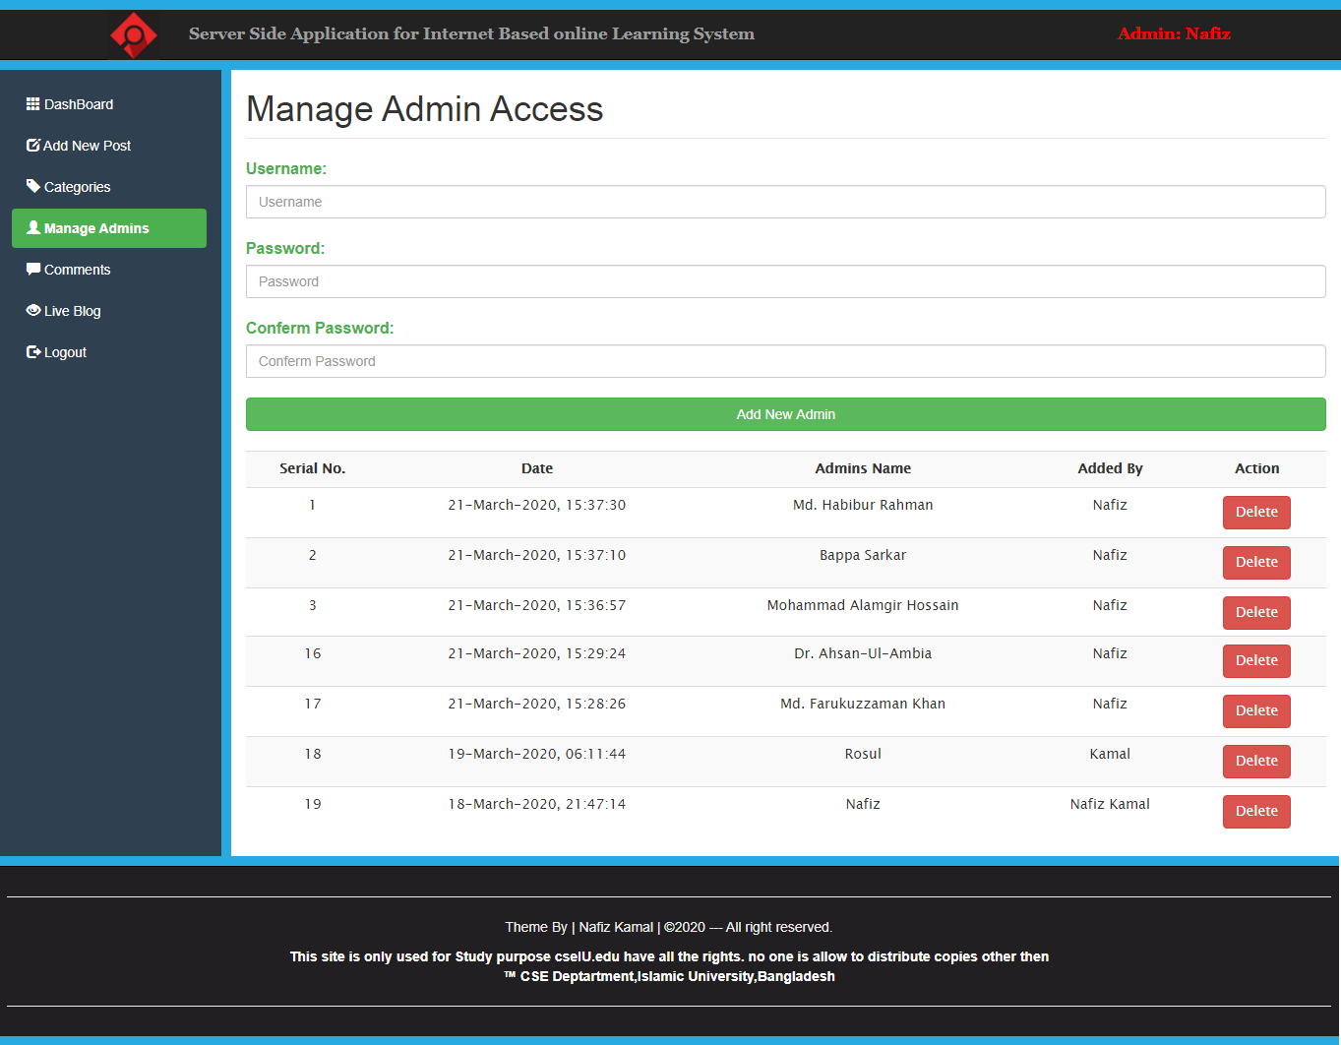
Manage Admins
Server-Side View
Admin’s Dashboard
Add New Post
Categories
Admins
IBLS
Login Authentication
Comments
Live Blog / Logout
For Addition or Removal of Admin's can work out by this page.

Slide 16
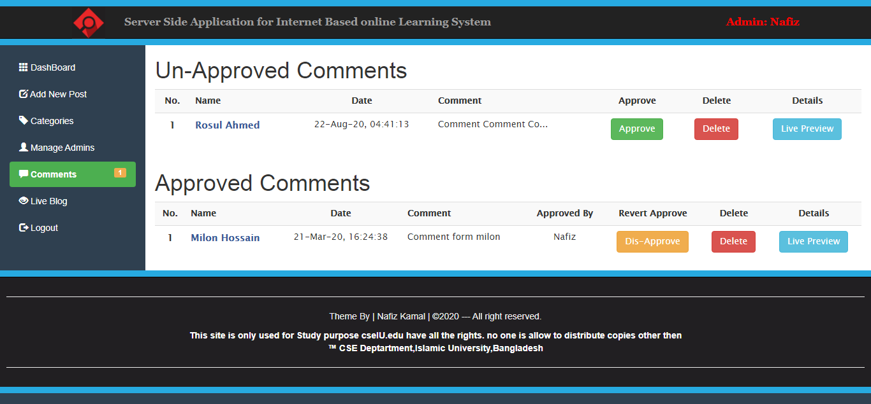
Manage Comments
Server-Side View
Admin’s Dashboard
Add New Post
Categories
Admins
IBLS
Login Authentication
Comments
Live Blog / Logout
Comments are managed by this page. There are two categories.
Approved Comment which can be seen by visitors after approval of admin &
Un-Approved Comment which are waiting for approval of admin to get published.

Slide 17
Live Blog \ Logout
Server-Side View
Admin’s Dashboard
Add New Post
Categories
Admins
IBLS
Login Authentication
Comments
Live Blog / Logout
Live Blog
by clicking live blog will take to public side view
Logout
for admin to sign-out. and redirect to login page

Slide 18
Conclusion
By the end of fourth year we knew languages as:
HTML, CSS, JavaScript, MySQL and a little of PHP and some other programming language
our favorite course was Internet & Web-Engineering (CSE-406)
after learning PHP & combining the other languages this project is the best we came up with.

