Slide 1

ECMAScript 6
Alvin Pivowar
May. 2016

Slide 2
Scope of Presentation
Why ES6?
ES6 New Features
Many Examples
  Karma / Jasmine Unit Tests
Assumes ES5 Familiarity

Slide 3
History
The fifth edition of Javascript was finalized in December 2009. It’s official name is Javascript 3.1 or ECMAScript Edition 5.
This is the most often targeted version.

Slide 4
History
The sixth edition of Javascript was finalized in June 2015. It’s official name is ECMAScript 6 (ES6).
Contains significant new syntax for writing complex applications, including classes and modules.

Slide 5
History
Other new features: iterators, for/of loops, python-style generators, arrow functions, binary data, typed arrays, collections (maps, sets and weak maps), promises, number and math enhancements, reflection, and proxies.
The complete list is extensive.

Slide 6
Why ES6?
New FE Frameworks target ES6 / ES7
Edge, FF, Chrome currently at 90% +
Full support in all “A” browsers
  End of 2016 – Middle of 2017
ES6 Revolutionary not Evolutionary change
  More concise, descriptive, and intuitive than ES5

Slide 7
Why ES6?
Arrows (Lambda expressions)
Classes
Sub-classes
Destructuring / Structuring
Function arguments:
default, rest, spread
Generators
Iterable
Iterators
(for…of)
Literals
object, binary, octal
Modules
Module Loaders
Template Strings
Variables
const, let (block scope)
Reflect API
Tail Calls
Array Enhancements
Maps
Math Enhancements
Number Enhancements
Object Enhancements
Promises
Proxies
Sets
String Enhancements
Symbols
Unicode enhancements
Weakmap
Weakset

Slide 8
ES6 is NOT JS !
ECMAScript 6 not Javascript?
Scoping
Library
“Fat Arrow” Functions
Spread Operator
Destructuring
Iterators, Iterable, and Generators
Classes
Part 1
Part 2
Part 3

Slide 9
Part I: Scopes
In ES5 variables are function scoped; they are “hoisted” to the innermost function definition.
EX: VS5-HOISTING
This can have surprising results to programmers familiar with block scoping.
  EX: VS5-SCOPING

Slide 10
Part I: Scopes
In ES6 variables declared with the let keyword are block scoped.
EX: VS6-SCOPING

Slide 11
Part I: spread operator
The spread operator is … and can preface any iterable object.
It is as if you had typed all the individual items.
Easy to create an array out of any iterable:
  let array = […anIterable];
EX: LA6-SPREAD

Slide 12
Part I: Destructuring
The destructuring assignment syntax extracts data from arrays or objects into distinct variables. It is as if you had typed all the individual items.
EX: LA6-DESTRUCTURING
EX: LO6-DESTRUCTURING

Slide 13
Part I: Fat Arrow Functions
“Fat Arrow Functions” expressions or functions that use lambda-calculus notation.
They are virtually identical to lambda notation in C# and Java.
Unlike a function, they do not redefine this.
VS6-LAMBDA-THIS

Slide 14
Part I: Function Parameters
Function declaration can specify default values for parameters omitted by the caller.
EX: FP(5, 6)-DEFAULT
Using ... in a function declaration denotes a variable number of parameters.
EX: FP(5, 6)-REST
You can use destructuring when defining a function.
EX: FP6-DESTRUCTURING

Slide 15
Part I: const
In ES6 variables declared with the const keyword are block scoped and immutable.
Very useful for fat arrow functions.
EX: VC6-CONST

Slide 16
ES6 has no Classes !
Classes is a new feature of ECMAScript 6.
Does ES6 have C# / Java –style classes?

Slide 17
Part 2: Iterators
An iterator is an object with a next() method that returns { done, value } tuples:
EX: IR6-ITERATOR
let iterator = obj.fn();
let v1 = iterator.next().value;
let v1 = iterator.next().value;
let v1 = iterator.next().value;
…
Iterator.next().done === true

Slide 18
Part 2: Iterable
An iterable is a method in an object that returns an iterator. The iterable method is always named:
  obj[@@iterator]
EX: IE6-ITERABLE

Slide 19
Part 2: Generators
Generators are iterators
  next(value)
  throw()
Unlike a “pure” iterator, a generator behavior (within next), can affect future next()s.

Slide 20
Part 2: Generators
A generator function is a “factory” for a generator.
Generator functions are marked with an asterisk.
Within a generator function, you can use yield() with next() or throw().

Slide 21
Part 2: Generators
A generator comprehension is an ES6 expression that creates a generator when executed.
for (let person of personCollection)
yield* iterable
  EX: IG6-GENERATORS

Slide 22
Part 2: Classes
ES6 classes are “syntactic sugar” that use ES5 functions, constructors, prototypes, and getter / setters.
  constructor
  generator methods
  inheritance / super
  methods
  static

Slide 23
Part 2: Classes
  Differences: ES6 classes vs ES5
  Class.prototype, prototype.constructor
      Not configurable, enumerable, or writable
prototype properties, static methods
      Not enumerable, but configurable and writable
static properties are inherited
constructors
      Can’t be called, must use new()
      Can be subclassed

Slide 24
Part 2: Classes
class declaration
      function declaration
      function expression
      classes are not hoisted EX: CF6-DECLARATION
class methods
      prototype
      static
      getters / setters EX: CF6-METHODS
class generators EX: CF6-GENERATORS

Slide 25
Part 2: Classes
Inheritance
      extends
      super in derived constructor
      super in derived methods
      this in derived methods
      class name in derived methods
  Remember: Inheritance uses ES5 prototypical inheritance!
    EX: CF6-INHERITANCE

Slide 26
Everything is NOT an Object
Isn’t everything in Javscript an object?

Slide 27
Part 3: Array
Building Arrays
      spread operator
      Array.from iterable
      Array.from “array like”
      Array.of EX: LA6-BUILDING
Data Methods
      Array.copyWithin
      Array.fill
      Array.find
      Array.findIndex EX: LA6-DATA_METHODS

Slide 28
Part 3: Array
Most objects (including Array) have three iterable methods:
      entries(): [name, value]
      keys():
      values(): EX: LA6-REFLECTION
Destructuring EX: LA6-DESTRUCTURING

Slide 29
Part 3: Number
Literal Notation
      binary: 0b11100
      decimal: 123
      hexadecimal: 0x4E
      octal: 0o173
New Properties
      EPSILON
      MAX_SAFE_INTEGER

Slide 30
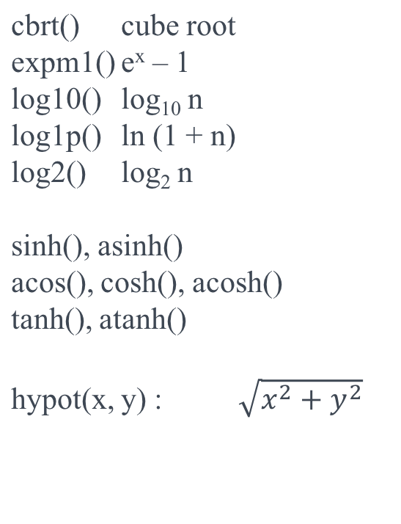
Part 3: Number
  clz32(): number of leading zeros
  fround(): nearest single-precison number
  imul(): 32-bit multiply
  sign(): -1, 0, 1 (sign of number)
  trunc(): integer portion
EX: LN6-FEATURES

Slide 31
Part 3: Object
Object Destructuring EX: LO6-DESTRUCTURING
Object Initialization
      Properties
      Functions EX: LO6-INITIALIZATION
Computed Property Names
    EX: LO6-COMPUTED
New Methods
      assign: cloning and merging
      is: more intuitive
      setPrototypeOf
      EX: LO6-METHODS

Slide 32
Part 3: String
Better unicode support
      codePointAt
      fromCodePoint
      normalize EX: LS6-UNICODE
New Methods
      endsWith
      includes
      repeat
      startsWith EX: LS6-METHODS

Slide 33
Part 3: String Templates
Template Syntax ` … `
      Expressions
      Multi-Line
      Raw Strings EX: LS6-TEMPLATES
Tagged Template Strings
      fn ` ... `
      String.raw ` ... `
Tag Function
      Custom template string processing function
    EX: LS6-TAGFN

Slide 34
Part 3: ArrayBuffers and Typed Arrays
ArrayBuffers are array-like objects that provide access to raw binary data.
      ArrayBuffers are not Arrays
      A DataView is used to get / set values.
      Indexing is by bytes
      EX: LB6-ARRAY_BUFFER
A typed array is an ArrayBuffer with a “typed” view.
      Indexing is by indices.
      EX: LB6-TYPED_ARRAY

Slide 35
Part 3: Map
The (new) Map object is a simple <key, value> collection.
      EX: LM6-CONSTRUCTION
      keys and values can be an object or primitive.
      map.size NOT map.length
      Map instances are iterable. EX: LM6-ITERABLE
Map Methods
      clear()
      delete()
      get() / set()
      has() EX: LM6-METHODS
The (new) WeakMap object is a non-iterable map where:
      keys must be objects.
      “The key is held weakly.” I.E. Garbage Collection
      Ideal for ‘internal’ information relating to an object.
      EX: LM6-WEAKMAP

Slide 36
Part 3: Set
The (new) Set object lets you store unique values of any type.
      EX: LS6-CONSTRUCTION
      set.size NOT set.length
      Sets are iterable EX: LS6-ITERABLE
Set Methods
      add()
      clear()
      delete()
      has() EX: LS6-METHODS
The (new) WeakSet object is a non-iterable set where:
      Items must be objects.
      “Each item is held weakly.” I.E. Garbage Collection
      Ideal for ‘internal’ reference list.
      EX: LS6-WEAKSET

Slide 37
Part 3: Symbol
A Symbol is a unique and immutable data type and may be used as an identifier for object properties.
      Symbols can be constructed with or without a string value.
        Symbol(“a”) ≠ Symbol(“a”)
      Shared symbols via the registry
      Property symbols
        Object.getOwnPropertySymbol()
Well-known Symbols
      Symbol.iterator
      .match, .replace, .search, .split
      .hasInstance, .isConcatSpreadable, .unscopables, .species, .toPrimitive, .toStringTag
      EX: LS6-SYMBOLS

Slide 38
AngularIntroApp
www.ng-al.com
Github.com/ng-al/AngularIntroApp
Requires
  git
  node
  bower

Slide 39
AngularIntroApp
Building
> git clone https://github.com/ng-al/AngularIntroApp.git
> cd AngularIntroApp
> npm install
> bower install
> node server
Then open a browser: localhost:3000

Slide 40
AngularIntroApp
Building
> git clone https://github.com/ng-al/AngularIntroApp.git
> cd AngularIntroApp
> npm install
> bower install
> node server
Then open a browser: localhost:3000

Slide 41
End of Presentation
Questions / Comments?
Have Fun with ECMAScript 6 !
  Angular-Al www.ng-al.com
github.com/ng-al

