Slide 1
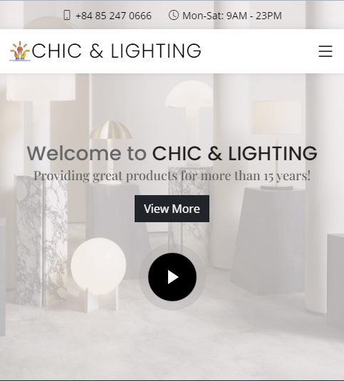
C2111L - Group 1
Welcome to Chic & Lighting
Our Member:
Nguyen Hoang Nam
Nguyen Tai Thanh
Nguyen Duc Hoang Son
Teacher:
Ngo Vinh Toan

Slide 2



Table of content:
Introduction
Database tables relationship
Sitemap
Demo
Q&A

Slide 3

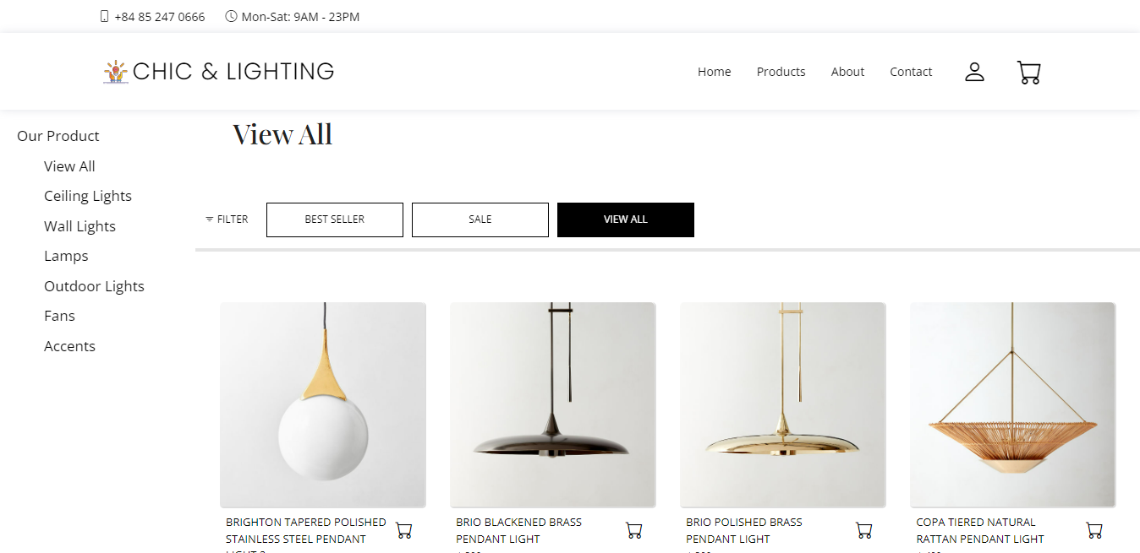

Introduction

Slide 4
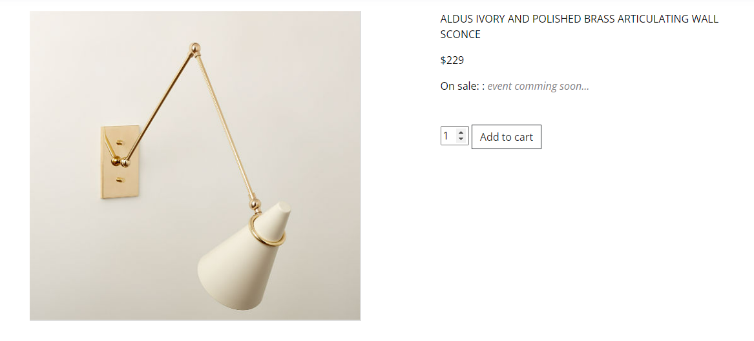
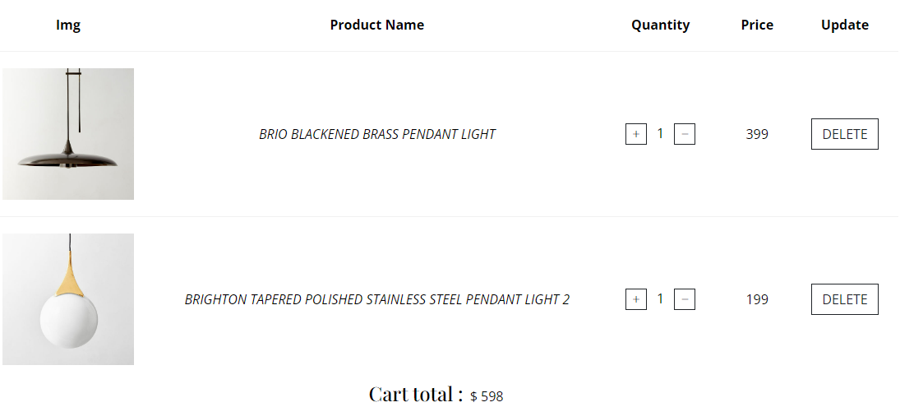
Traditional Shopping:
Waste of time
Products are not diversified
Have to travel a lot
Online Shopping:
Save time
Many products to choose
Flexibility when shopping

Slide 5
Functions:
Unregistered users:
Visit homepage
Visit the product page
Visit product detail page
Visit the about page
Registered users:
All functions just like unregistered users
Add to cart, order
Send feedback
Change password and recover password
View profile
Admin:
Products management
Add Products
Add Brands
Orders management
Users management

Slide 6
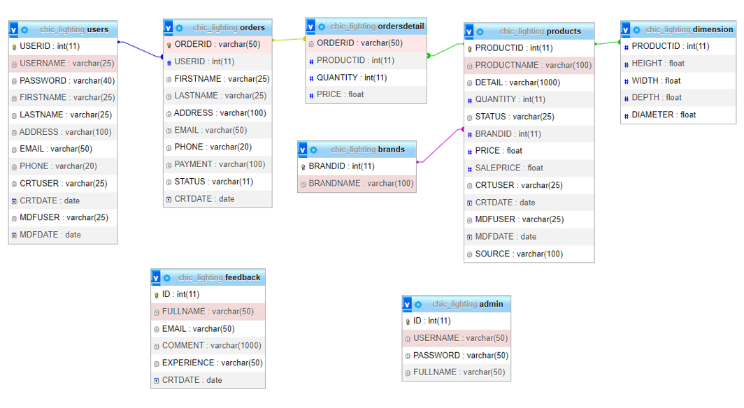
Database tables relationship

Slide 7
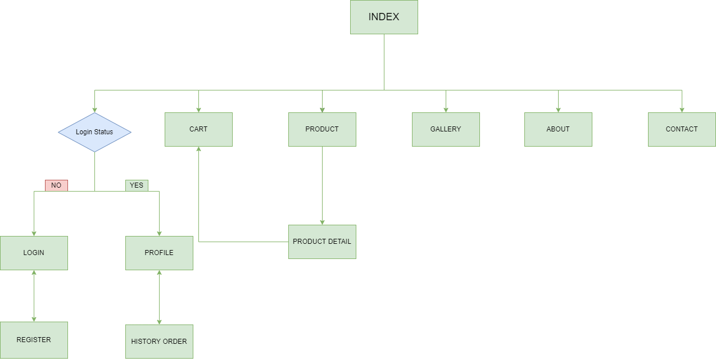
Site Map

Slide 8
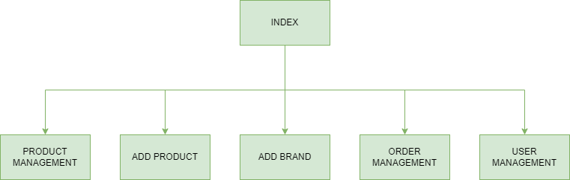
Admin Site Map

Slide 9
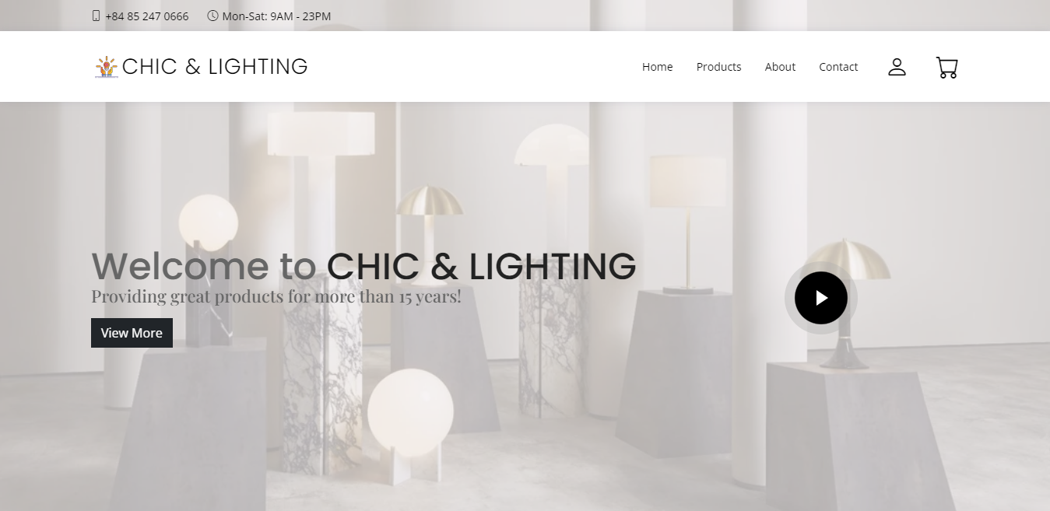
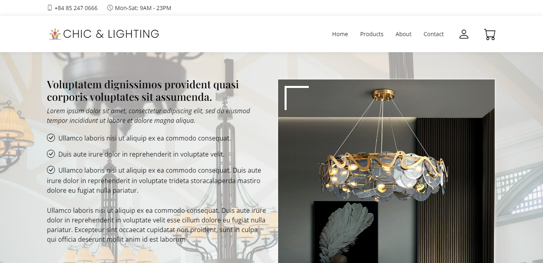
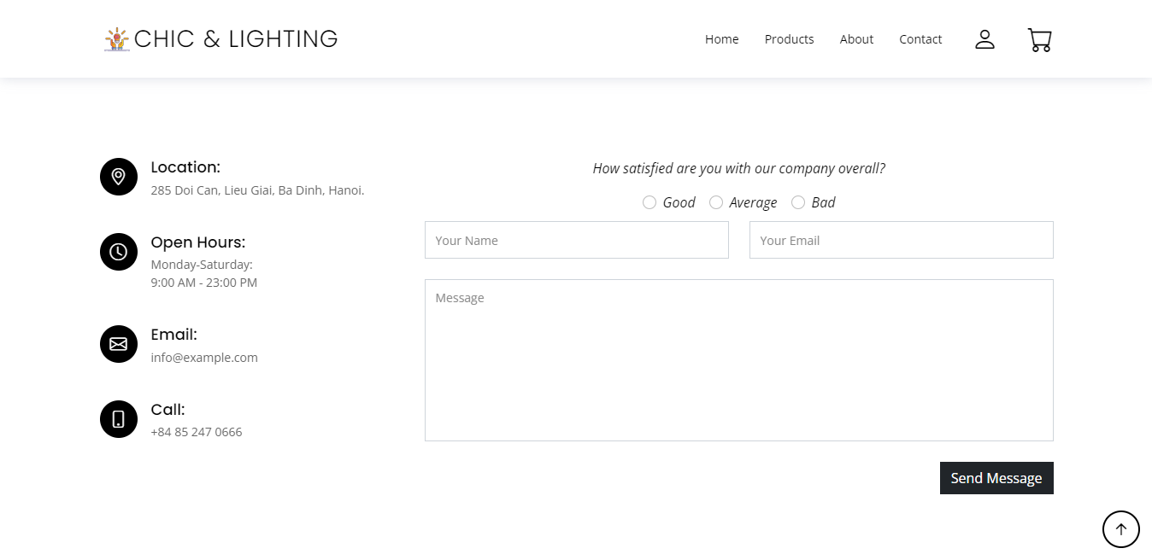
Demo
Visit our website to know more

Slide 10
Q&A

Slide 11
Thank you for listening

