Slide 1
Javascript
WEEK 1

Slide 2
What do you need to know?
Prerequisite for this class:
HTML and CSS Basics including: - basic html structure - class - id - tags - document flow

Slide 3
What is Javascript?
JavaScript is a high-level, dynamic, weakly typed, prototype-based, multi-paradigm, and interpreted programming language. Alongside HTML and CSS, JavaScript is one of the three core technologies of World Wide Web content production. The majority of websites employ it, and all modern web browsers support it without the need for plug-ins by means of a built-in JavaScript engine. Each of the many JavaScript engines represent a different implementation of JavaScript, all based on the ECMAScript specification, with some engines not supporting the spec fully, and with many engines supporting additional features beyond ECMA.

Slide 4
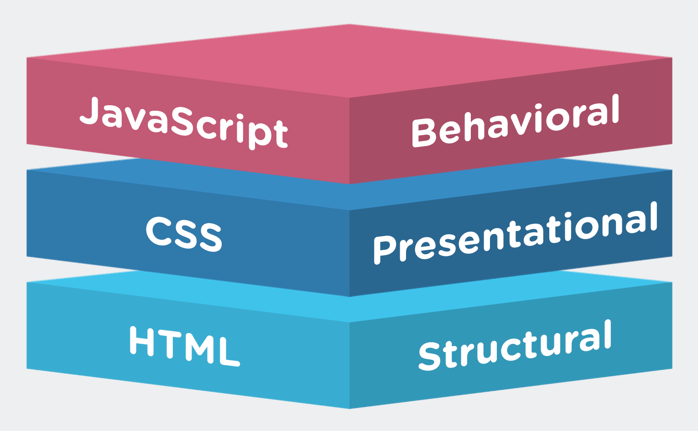
What is Javascript?
Simply: Behavioral layer of the modern web

Slide 5
Often asked questions
Java vs Javascript
History of Javascript: Mocha, LiveScript, Browser Wars
ECMAScript? ES6?

Slide 6
What do we need?
Code editors - Atom* - Visual Studio Code - Sublime Text *Atom Live Server

Slide 7
What do we need?
Browsers with development tools: - Chrome - Firefox - Edge - Opera - Brave
Use One and Test All

Slide 8
Demo
Dev Tools built right into browsers Inspect: Win - Ctrl+Shift+i Mac - Cmd+Opt+i Console: Win - Ctrl+Shift+j Mac - Cmd+Shift+j
Show Console Drawer - Esc key

Slide 9
Demo
Simple examples of Javascript:
alert()
var and Date
console

