Slide 1
Javascript
WEEK 10

Slide 2
Client-side Javascript
The Window object is the main entry point to all client-side JavaScript features and APIs. It represents a web browser window or frame, and you can refer to it with the identifier window. The Window object defines properties like location, which refers to a Location object that specifies the URL currently displayed in the window and allows a script to load a new URL into the window:
// Set the location property to navigate to a new web page window.location = "http://www.javascript.com/";

Slide 3
window.
Notice that you do not need to explicitly use the window property. In client-side JavaScript, the Window object is also the global object. This means that the Window object is at the top of the scope chain and that its properties and methods are effectively global variables and global functions. The Window object has a property named window that always refers to itself. You can use this property if you need to refer to the window object itself, but it is not usually necessary to use window if you just want to refer to access properties of the global window object.

Slide 4
A few window functions
location
history -back() -forward() -go(arg)
alert() prompt() confirm()

Slide 5
Overview of the DOM
The Document Object Model, or DOM, is the fundamental API for representing and manipulating the content of HTML and XML documents. The API is not particularly complicated, but there are a number of architectural details you need to understand.
First, you should understand that the nested elements of an HTML or XML document are represented in the DOM as a tree of objects. The tree representation of an HTML document contains nodes representing HTML tags or elements, such as <body> and <p> , and nodes representing strings of text. An HTML document may also contain nodes representing HTML comments.

Slide 6
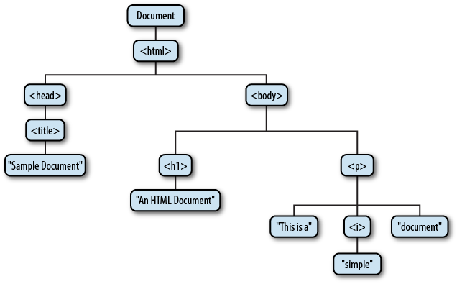
DOM - tree structure

Slide 7
Document and Element
The nodes that represent HTML elements are Element nodes, and the nodes that represent text are Text nodes. Document and Element are the two most important DOM classes. Node and its subtypes form the type hierarchy illustrated in the next slide. Notice that there is a formal distinction between the generic Document and Element types, and the HTMLDocument and HTMLElement types. The Document type represents either an HTML or an XML document, and the Element class represents an element of such a document. The HTMLDocument and HTMLElement subclasses are specific to HTML documents and elements.

Slide 8
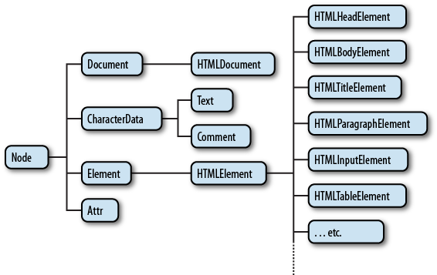
Document and Element - tree structure

Slide 9
Nodes
If you are not already familiar with tree structures in computer programming, it is helpful to know that they borrow terminology from family trees. The node directly above a node is the parent of that node. The nodes one level directly below another node are the children of that node. Nodes at the same level, and with the same parent, are siblings . The set of nodes any number of levels below another node are the descendants of that node. And the parent, grandparent, and all other nodes above a node are the ancestors of that node.

Slide 10
HTML and ID Attributes
If you name an element in your HTML document using the id attribute, and if the Window object does not already have a property by that name, the Window object is given a nonenumerable property whose name is the value of the id attribute and whose name is the HTMLElement object that represents that document element.
The Window object serves as the global object at the top of the scope chain in client-side JavaScript, so this means that the id attributes you use in your HTML documents become global variables accessible to your scripts. If your document includes the element <button id="okay"/> , you can refer to that element using the global variable okay .

Slide 11
HTML and ID Attributes - important note
There is an important caveat, however: this doesn’t happen if the Window object already has a property by that name. Elements with the ids “history”, “location,” or “navigator”, for example, won’t appear as global variables, because those IDs are already in use. Similarly, if your HTML document includes an element whose id is “x” and you also declare and assign a value to the global variable x in your code, the explicitly declared variable will hide the implicit element variable. If the variable is declared in a script that appears before the named element, its existence will prevent the element from getting a window property of its own. And if the variable is declared in a script that appears after the named element, your explicit assignment to the variable overwrites the implicit value of the property.

Slide 12
IDs and getElementById()
Any HTML element with an id attribute will become the value of a global variable, assuming the ID is not already used by the Window object. The following HTML elements also behave this way when given a name attribute: - a applet area embed form frame frameset iframe img object - The id element is required to be unique within a document: two elements cannot have the same id . This is not true for the name attribute, however. If more than one of the elements above has the same name attribute (or if one element has a name attribute, and another element has an id with the same value), the implicit global variable with that name will refer to an array-like object that holds each of the named elements.

Slide 13
Selecting Elements By ID
Any HTML element can have an id attribute. The value of this attribute must be unique within the document—no two elements in the same document can have the same ID. You can select an element based on this unique ID with the getElementById() method of the Document object.
var section1 = document.getElementById("section1");
This is the simplest and most commonly used way to select elements. If your script is going to manipulate a certain specific set of document elements, give those elements id attributes, and look up the Element objects using that ID.

Slide 14
IDs and getElementById()
The implicit use of element IDs as global variables is a historical quirk of web browser evolution. It is required for backward compatibility with existing web pages, but its use is not recommended—any time a browser vendor defines a new property of the Window object it breaks any code that uses an implicit definition of that property name.
Instead, use document.getElementById() to look up elements explicitly.

Slide 15
getElementById()
The use of getElementById() seems less onerous if we give it a simpler name:
var $ = function(id) { return document.getElementById(id); };
ui.prompt = $("prompt");
Many client-side libraries define a $ function that looks up elements by ID like this.
(We’ll see in later that jQuery’s $ function is a general-purpose element selection method that returns one or more elements based on their ID, tag name, class attribute, or other criteria.)

Slide 16
Selecting Elements by Name
The HTML name attribute was originally intended to assign names to form elements, and the value of this attribute is used when form data is submitted to a server. Like the id attribute, name assigns a name to an element. Unlike id, however, the value of a name attribute does not have to be unique: multiple elements may have the same name, and this is common in the case of radio buttons and checkboxes in forms. Also, unlike id, the name attribute is only valid on a handful of HTML elements, including forms, form elements, <iframe>, and <img> elements.

Slide 17
Selecting Elements by Name
To select HTML elements based on the value of their name attributes, you can use the getElementsByName() method of the Document object:
var radiobuttons = document.getElementsByName("favorite_color");
getElementsByName() is defined by the HTMLDocument class, not the Document class, and so it is only available for HTML documents, not XML documents. It returns a NodeList object that behaves like a read-only array of Element objects. For compatibility, you should be careful not to use the same string as both a name and an ID value of the attribute (assuming, of course, that the document does not already have a property with that name).

Slide 18
Selecting Elements by Type
You can select all HTML or XML elements of a specified type (or tag name) using the getElementsByTagName() method of the Document object. To obtain a read-only arraylike object containing the Element objects for all <span> elements in a document, for example, you might write:
var spans = document.getElementsByTagName("span");

Slide 19
getElementsByTagName - array-like indexing
Like getElementsByName() , getElementsByTagName() returns a NodeList object. (See the sidebar in this section for more on the NodeList class.) The elements of the returned NodeList are in document order, so you can select the first <p> element of a document like this:
var firstpara = document.getElementsByTagName("p")[0];
HTML tags are case-insensitive, and when getElementsByTagName() is used on an HTML document, it performs a case-insensitive tag name comparison. The spans variable above, for example, will include any <span> elements that were written as <SPAN> .

Slide 20
getElementsByTagName - array-like indexing
The Element class also defines a getElementsByTagName() method. It works in the same way as the Document version, but it only selects elements that are descendants of the element on which it is invoked. So to find all <span> elements inside the first <p> element of a document, you could write:
var firstpara = document.getElementsByTagName("p")[0];
var firstParaSpans = firstpara.getElementsByTagName("span");

Slide 21
Selecting Elements with CSS Selectors
CSS stylesheets have a very powerful syntax, known as selectors , for describing elements or sets of elements within a document. Elements can be described by ID, tag name, or class:
#nav // An element with id="nav" div // Any <div> element .warning // Any element with "warning" in its class attribute
More generally, elements can be selected based on attribute values:
p[lang="fr"] // A paragraph written in French: <p lang="fr"> *[name="x"] // Any element with a name="x" attribute

Slide 22
Selecting Elements with CSS Selectors
The key to this API is the Document method querySelectorAll() . It takes a single string argument containing a CSS selector and returns a NodeList that represents all elements in the document that match the selector. Unlike previously described element selection methods, the
NodeList returned by querySelectorAll() is not live: it holds the elements that match the selector at the time the method was invoked, but it does not update as the document changes. If no elements match, querySelectorAll() returns an empty NodeList. If the selector string is invalid, querySelectorAll() throws an exception.

Slide 23
Selecting Elements with CSS Selectors
In addition to querySelectorAll() , the document object also defines querySelector() , which is like querySelectorAll() , but returns only the first (in document order) matching element or null if there is no matching element.
These two methods are also defined on Elements. When invoked on an element, the specified selector is matched against the entire document, and then the result set is filtered so that it only includes descendants of the specified element. This may seem counterintuitive, as it means that the selector string can include ancestors of the element against which it is matched.

Slide 24
Attributes
HTML elements consist of a tag name and a set of name/value pairs known as attributes .
The <a> element that defines a hyperlink, for example, uses the value of its href attribute as the destination of the link. The attribute values of HTML elements are available as properties of the HTMLElement objects that represent those elements. The DOM also defines other APIs for getting and setting the values of XML attributes and nonstandard HTML attributes. The subsections that follow have details.

Slide 25
HTML Attributes As Element Properties
The HTMLElement objects that represent the elements of an HTML document define read/write properties that mirror the HTML attributes of the elements. HTMLElement defines properties for the universal HTTP attributes such as id , title lang , and dir , and event handler properties like onclick . Element-specific subtypes define attributes specific to those elements. To query the URL of an image, for example, you can use the src property of the HTMLElement that represents the <img> element:
var image = document.getElementById("myimage"); var imgurl = image.src; // The src attribute is the URL of the image image.id === "myimage" // Since we looked up the image by id

