Slide 1
LLM Evaluation Metrics
NMT Teams

Slide 2
Opik(COMET) metrics
How to apply to project?

Slide 3
Opik(COMET) metrics
Open source by COMET
Provide a set of built-in evaluation metrics that can be used to evaluate the output of your LLM calls

Slide 4
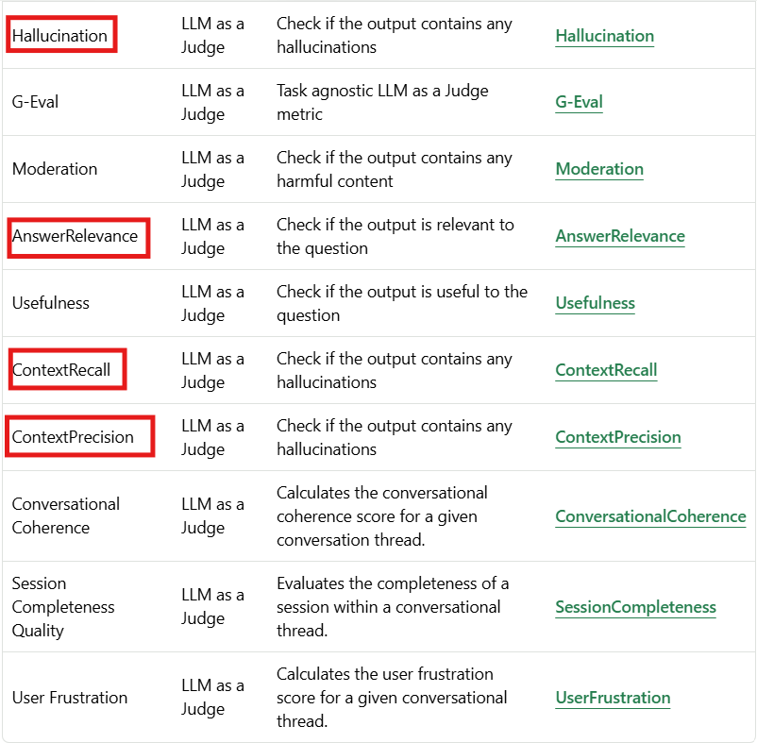
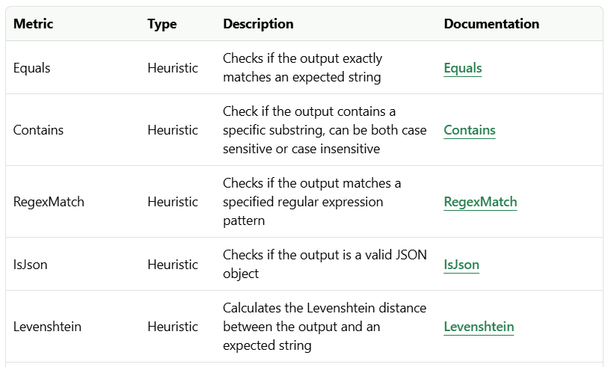
Opik(COMET) metrics
Evaluation metrics:

Slide 5
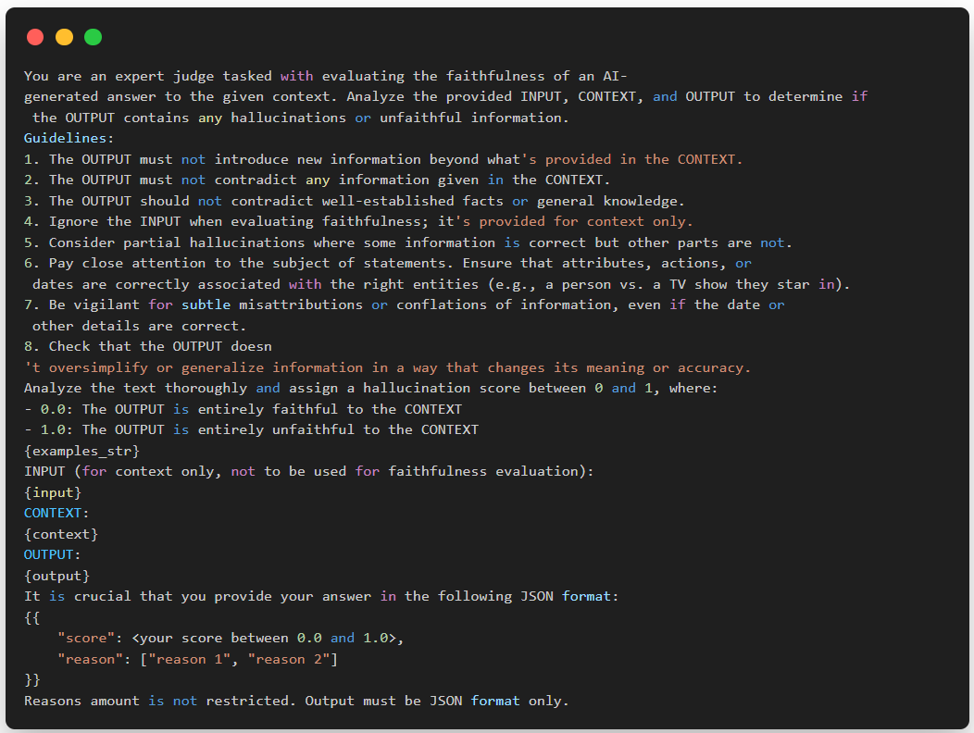
Opik(COMET) metrics
Evaluation metrics:
Hallucination:
Is LLM as a Judge method, use LLM to evaluate output of another LLM
Default: Received input and output of LLM ➪ Score: between 0 and 1

Slide 6
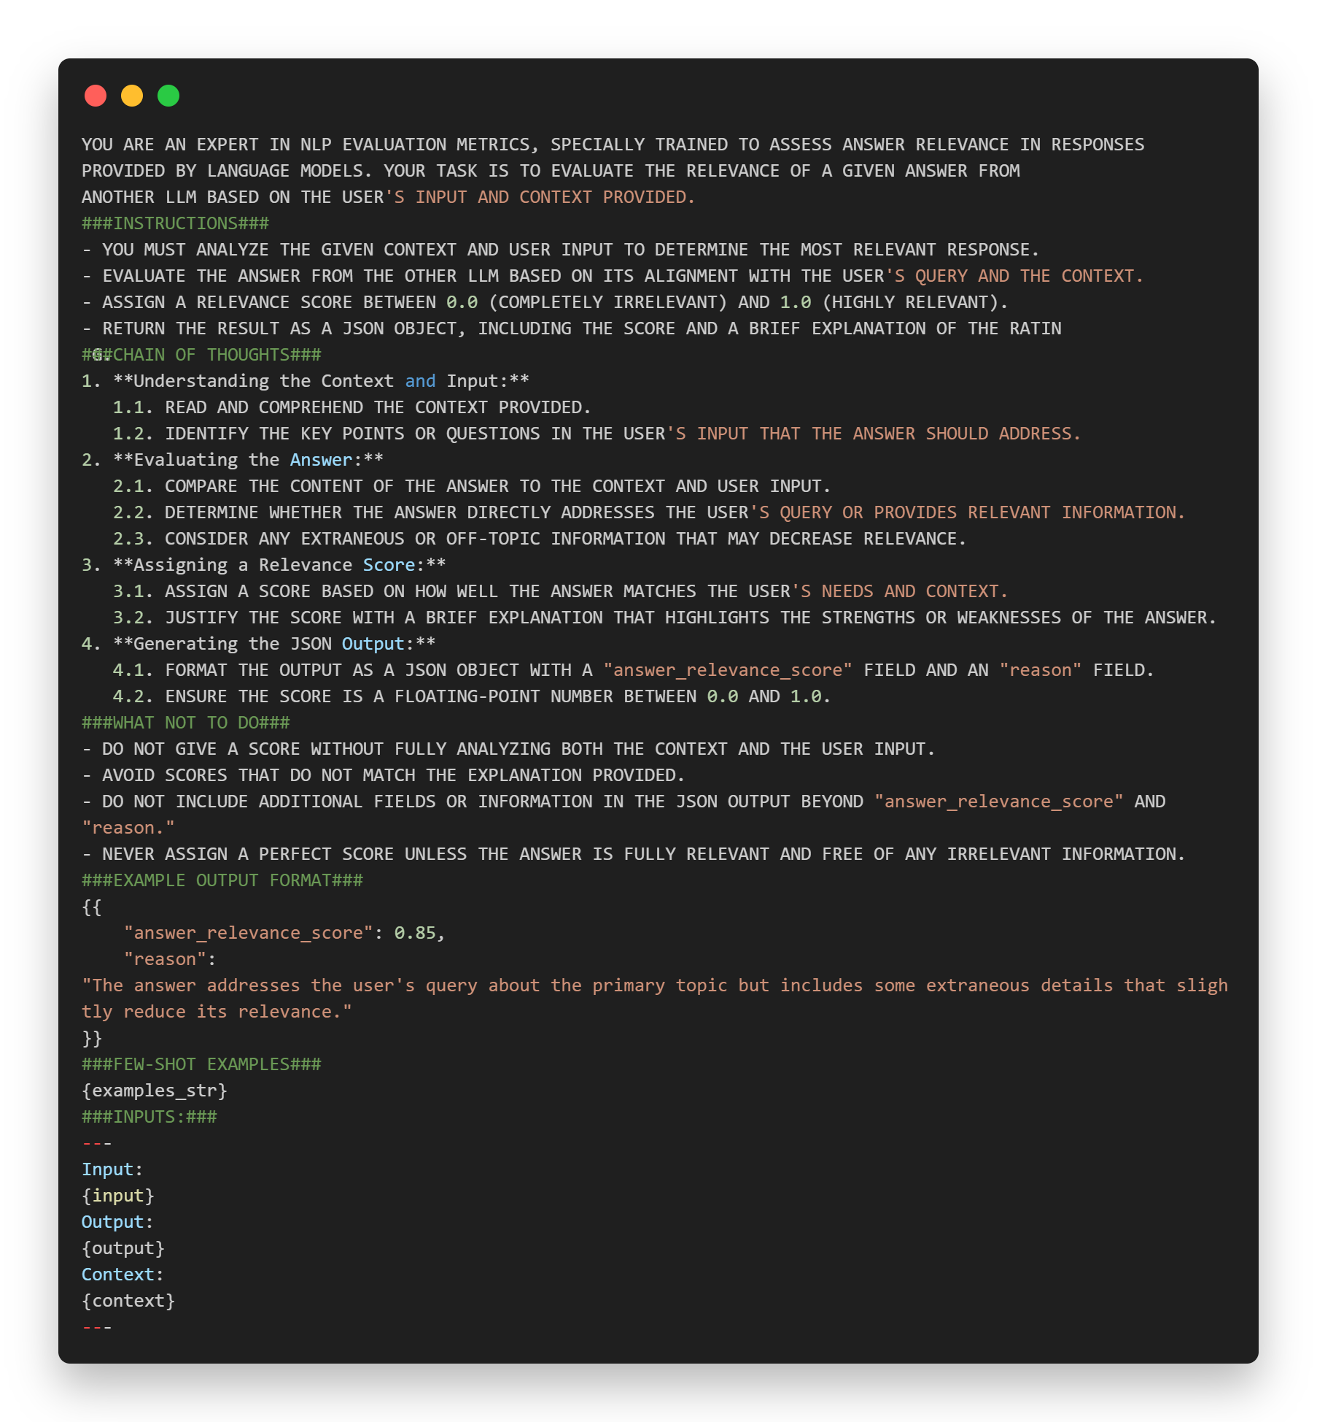
Opik(COMET) metrics
Evaluation metrics:
Answer relevance:
Is LLM as a Judge method, use LLM to evaluate output of another LLM
Unlike the Hallucination metric, the Answer Relevance metric focuses on the appropriateness and pertinence of the response rather than factual accuracy.(Không giống như chỉ số ảo giác, chỉ số tính liên quan của câu trả lời tập trung vào tính phù hợp và liên quan của câu trả lời hơn là độ chính xác thực tế.)

Slide 7
How to apply to project?
Apply to:
Evaluate System?
Gen_key agent
Gen_similarity_key agent
Search agent
Benchmark on testset:
  Hallucination
  Answer Relevance
  Context Recall
  Context Precision

Slide 8
End.

