Slide 1

DWDM :- Activate Learning/ Mini Project Overview
Batch - G3
Group - 01
Mentor -
Prof Vaishali Suryawanshi
TEAM MEMBERS -
PG_34 Yuvraj Singh Chauhan
PG_37 Naveen Maheshwari
PG_44 Shubham Shail
PG_36 Rashmita Chauhan

Slide 2

Problem Statement :
The main goal is to estimate the sentiment of movie reviews from the Internet Movie Database (IMDb).
Analysing and calculating the number of positive and negative reviews based on sentiments by using different classification models and finding the classification model with highest accuracy .
You can view the project here : https://github.com/ng3w-uv/DWDM_mini_prjct

Slide 3
Purpose /Scope :
We have to predict the number of positive and negative reviews based on sentiments by using different classification models.
A project that classifies the reviews sentiments (positive/negative) using machine learning, deep learning approach and Big ML approach.
By examining and evaluating consumer sentiments with such tools, brands can gain a comprehensive understanding of consumer behaviors and, as a result, better serve their audiences with the products, services, and experiences they offer.
Firms which take advantage of sentiment information quickly can gain an edge
Sentiment analysis is becoming more important for these businesses as the data underlying those interactions grows larger and more complex.

Slide 4
Objectives:
We applied Pre-processing techniques
We will also be using word tokenization and identifying different stop words from the dataset to stem the data and we have used neural networks for data classification.
There are three algorithms that we will be working on which are Naïve Bayes approach, Recurrent neural network and artificial neural network and we will be showing the accuracy of each approach in our project.
We want to study which approach provides us with the best result.

Slide 5
Abstract :
The area of analysis of sentiments is related closely to natural language processing and text mining. It can successfully be used to determine the attitude of the reviewer in regard to various topics or the overall polarity of the review. In the case of movie reviews, along with giving a rating in numeric to a movie, they can enlighten us on the favorableness or the opposite of a movie quantitatively; a collection of those then gives us a comprehensive qualitative insight on different facets of the movie.
Sentiment analysis from movie reviews can be challenging due to the fact that human language is rather complex, leading to situations where a positive word has a negative connotation and vice versa. In this study, the task of sentiment analysis from movie reviews has been achieved with the use of various methods like neural networks trained on the “ IMDB Movie Review Database”

Slide 6
Introduction :
The main objective of this project is to develop a sentiment analysis system by classifying the sentiment of the sentence from the IMDB reviews and show emoticons to the sentence ,we will be trying different machine learning and deep learning approaches to classify the sentiments ,we will also be using word tokenization and identifying different stop words from the dataset to stem the data and we have used neural networks for data classification ,there are three algorithms that we will be trying which are naïve Bayes approach, Recurrent neural network and artificial neural network and we will be showing the accuracy of each approach in our project.,

Slide 7
Preprocessing :
Cleaning, pre-processing, and normalising text to bring text components like phrases and words to some standard format is one of the key steps before going into the process of feature engineering and modelling.
Here in data head we can see some html code so first we need to clean that html strips. Also removing some noisy texts along with square brackets.
Because we’re working with English-language evaluations in our dataset, we need to make sure that any special characters are deleted.

Slide 8
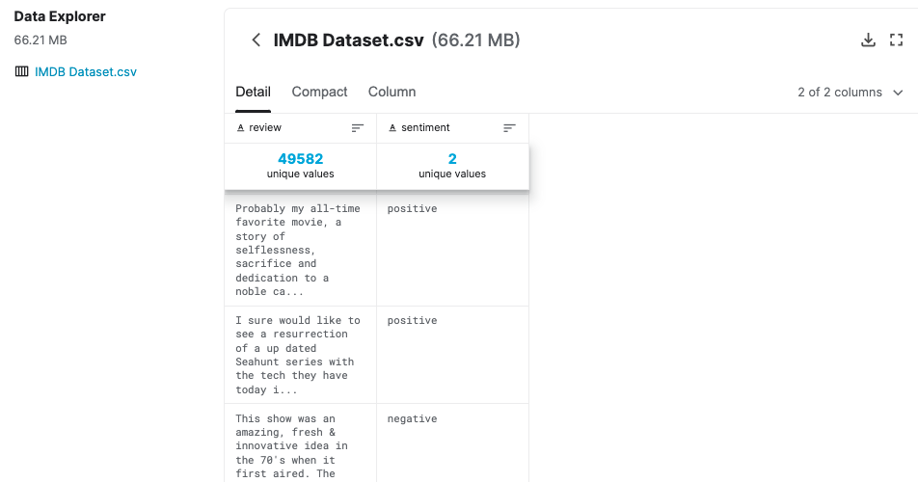
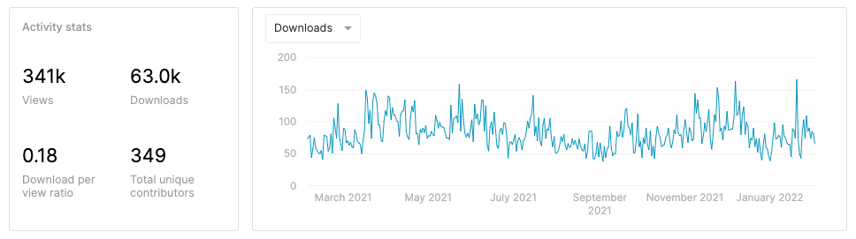
Dataset Insights :

Slide 9
Literature Survey :
Yuvraj
Wongkar, Meylan & Angdresey, Apriandy. (2019). Sentiment Analysis Using Naive Bayes Algorithm Of The Data Crawler: Twitter. 1-5. 10.1109/ICIC47613.2019.8985884.
S. M. Qaisar, "Sentiment Analysis of IMDb Movie Reviews Using Long Short-Term Memory," 2020 2nd International Conference on Computer and Information Sciences (ICCIS), 2020, pp. 1-4, doi: 10.1109/ICCIS49240.2020.9257657.

Slide 10
Literature Survey :
Yuvraj
Major Takeaways:
Comparing with other methods such as SVM and KNN. We classify by two classes namely positive and negative. From the results of our experiments, it can be seen that the Naïve Bayes method has a better accuracy level (i.e. 80.90%) compared to using other methods, such as KNN which only has an accuracy rate of 75.58% and an accuracy rate using SVM which is 63.99%.
In this paper, a Long Short-Term Memory classifier is used with Adam optimizer to automatically categorize the preprocessed IMDb movie reviews. In total 10k reviews are considered, 5k for positive and 5k for negative sentiments. Results have concluded that the highest accuracy attained by the devised approach is of 89.9%.
A superior accuracy can be attained by using further data preconditioning techniques. Furthermore, higher classification accuracy can be achieved by employing the ensemble classifiers or deep learning approaches.

Slide 11
Literature Survey :
Rashmita
Performance Analysis of Different Neural Networks for Sentiment Analysis on IMDb Movie Reviews
Md. Rakibul Haque;Salma Akter Lima;Sadia Zaman Mishu
2019 3rd International Conference on Electrical, Computer & Telecommunication Engineering (ICECTE)
Albert-based sentiment analysis of movie review
Zhongxiang Ding;Yali Qi;Deping Lin
2021 4th International Conference on Advanced Electronic Materials, Computers and Software Engineering (AEMCSE)

Slide 12
Overall Review:
1)SENTIMENT ANALYSIS
Sentiment analysis helps us to analyze user review about an entity and then drawing out a conclusion based on the sentiments it extracted from the reviews.
In this paper, we have compared between CNN, LSTM and LSTM-CNN architectures for sentiment classification on the IMDb movie reviews in order to find the best-suited architecture for the dataset. Experimental results have shown that CNN has achieved an F-Score of 91% which has outperformed LSTM, LSTM-CNN and other state-of-the-art approaches for sentiment classification on IMDb movie reviews.
2)ALBERT-BASED ANALYSIS
The network uses the lightweight convolutional neural network model Xception and combines with the convolutional block attention module (CBAM) to learn key facial features
In order to improve the user experience and ease the endurance of mobile terminals, this paper studies the task offloading strategy for optimizing the energy consumption of mobile terminals. At present, most of the research only focuses on a single cloud offload and edge offload, and the research on reducing the energy consumption of mobile terminals is insufficient

Slide 13
Literature Survey:
Shubham
“Sentiment Analysis of Review Datasets using Naive Bayes and K-NN Classifier”
Authors- Lopamudra Dey, Sanjay Chakraborty, Anuraag Biswas, Beepa Bose.
July 2019 DOI: 10.5815/ijieeb.2016.04.07
“Sentiment Analysis based on Deep Learning”
Authors- Nhan Cach Dang, Maria N. Moreno-Garcia, Fernando Priesta.
5th June,2020 DOI: https://doi.org/10.3390/electronics9030483

Slide 14
Literature Survey:
Shubham
Major Takeaways:
The concern of the paper is sentiment focused web crawling framework to facilitate quick discovery of sentimental contents of movie reviews and hotel reviews. This paper elaborately describes K-Nearest Neighbour(K-NN) and Naive Bayes and compares their overall accuracy, precisions as well as recall values. It was seen that in case of movie reviews Naive Bayes gave far better results than K-NN but for hotel reviews these algorithms gave lesser, almost same accuracies.
In this paper, the core of deep learning models and related techniques have been applied to sentiment analysis for social network data. Word embedding and TF-IDF is used to transform input data before feeding that data into deep learning models. The architectures of DNN, CNN, and RNN were analyzed and combined with word embedding and TF-IDF to perform sentiment analysis. However, the results show that it is better to combine deep learning techniques with word embedding than with TF-IDF when performing a sentiment analysis. The experiments also revealed that CNN outperforms other models, presenting a good balance between accuracy and CPU runtime. RNN reliability is slightly higher than CNN reliability with most datasets but its computational time is much longer.

Slide 15
Literature Survey :
Naveen
IMDb Sentiment Analysis COMP 551 - Group 17
Authors : Beatrice Lopez ,Minh Anh Nguyen and Xavier Sumba
February 2019
Kurniasari, Lilis & Setyanto, Arif. (2020). Sentiment Analysis using Recurrent Neural Network. Journal of Physics: Conference Series. 1471. 012018. 10.1088/1742-6596/1471/1/012018.

Slide 16
Literature Survey :
Naveen
Major Takeaways:
1.In this research they have proposed model for sentiment analysis using RNN and word2vec. RNN in this model is implemented using framework Tensorflow. The research results show that the model approach has better accuracy with other machine learning models with result of accuracy is 91.98%.
2.From this research, they also have to pay attention to the possibility of overfitting the model when carrying out the testing process. In the future They can try to use RNN and LSTM to overcome overfitting problems and to improve the performance of the model.
3.The working principle of deep learning using a neural network follows the architecture of neural networks in the human brain. One of the neural network architectures used in analytic sentiment is recurrent neural networks (RNN). RNN algorithm will associate each word in the input with a certain time step.

Slide 17
Conclusion :-
While sentiment analysis is useful, it is not a complete replacement for reading survey responses. In today’s environment where we’re suffering from data overload companies might have mountains of customer feedback collected. Yet for mere humans, it’s still impossible to analyze it manually without any sort of error or bias.
It is impossible to analyze large amounts of data without an error.
The system is tested for different reviews and the emotications are also successful for every review .It shows no of provided features, we are getting the accuracy of each algorithm we used . Different results show that the analysis gives good performance with ANN. The average accuracy of this system for test review is 85.399%

Slide 18
Thank You

