Slide 1
REORGANISATION OF INDIAN STATES ON LANGUAGE BASIS

Slide 2
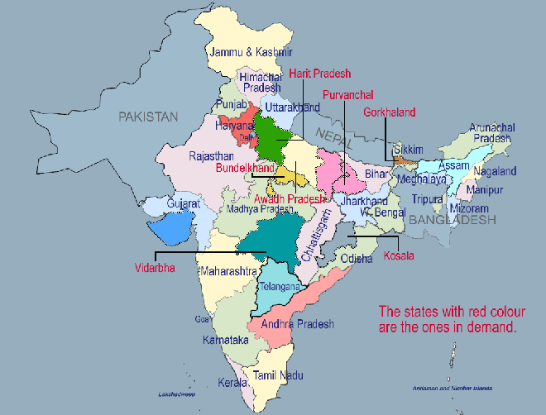

Slide 3
STAGES OF REORGANISATION.
British rule.
Pre-partition map.
Partition of India.
Why the language became basis for reorganization.
Andhra state (Triggered the reorganization of states based on language).
State Reorganization Commission of 1953 (SRC).
State Reorganization Act of 1956.
Reorganization of other states after 1956.
Formation of three new states in yr. 2000.
Telangana state formation’s approval.
Current map of India.

Slide 4
BRITISH RULE.
PROVINCES: These are the parts of India directly under the control of East India company of British.
PRINCELY STATES: These are the parts of India ruled by Indian kings, but were under control of British.
Ex: Nizams of Hyderabad, Meiti kings of Manipur, Vadiyar kings from Mysore

Slide 5
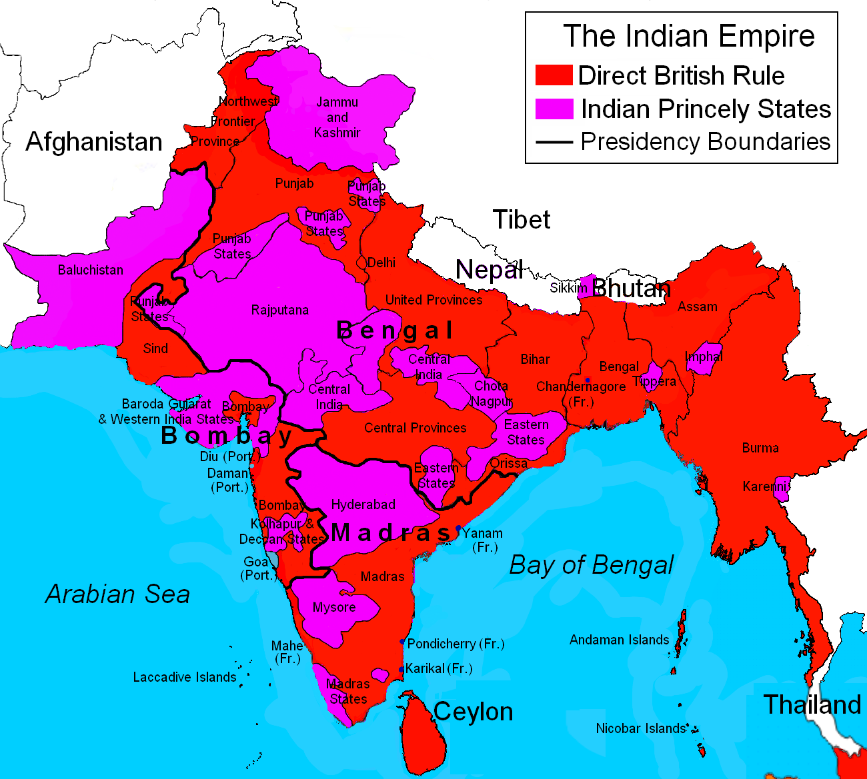
PRE-PARTITION MAP OF INDIA

Slide 6
PARTITION OF INDIA
In 1947, partition of India took place along sectarian lines.
Parts of northern India mainly containing Muslims got seperated into Pakistan.
Rest of India containing Hindus was named Republic of India.
Few ethnic conflicts between Hindus and Muslims broke out during partition resulting in death of 500000 people.

Slide 7
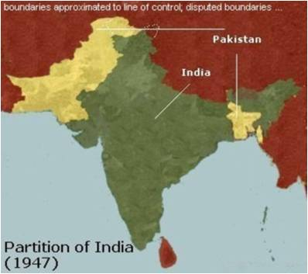
POST PARTITION MAP

Slide 8
WHY LANGUAGE AS THE BASIS ?
The movement to divide states based on the language became active in 1950.
It was first started by Telugu speaking people to get separated from Madras Presidency.
Language is closely related to culture and customs of the people.
Massive spread of education, growth of literacy can occur through medium of mother tongue.

Slide 9
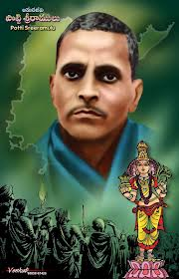
SRI POTTI SREE RAMULU.

Slide 10
ANDHRA STATE (Triggered the reorganisation of states based on language)
Sri Potti Sree Ramulu went on hunger strike demanding a separate state for Telugu speaking people from Madras Presidency.
P.M Nehru initially didn’t oblige for separation.
Potti Sree Ramulu died after 58 days of hunger strike, which resulted in widespread demonstrations.
As a result, on Oct. 1, 1953 Andhra state was formed with Kurnool as the first capital.

Slide 11
STATES REORGANISATION COMMISSION OF 1953.
Nehru appointed this commission(SRC) in August 1953 to examine objectively the reorganization of states.
The commission consisting of Justice Fazil Ali K.M.Panikkar and Kunzru.
They studied over a period of 2 years, were faced by some agitations and strikes .
They submitted report in October 1955.

Slide 12
STATES REORGANISATION ACT OF 1956
This act was passed in parliament in November 1956.
14 states and 7 union territories were formed initially .
Telangana area of Hyderabad was merged with Andhra to form A.P.
Malabar, Travancore and Cochin created Kerala. (Malayalam)
Certain Kannada speaking areas of Bombay state were added to Mysore state.
Certain Marathi speaking areas of Saurashtra were merged with Bombay state.
But due to pressure from Maharashtra, Bombay state was divided into Maharashtra and Gujarat.

Slide 13
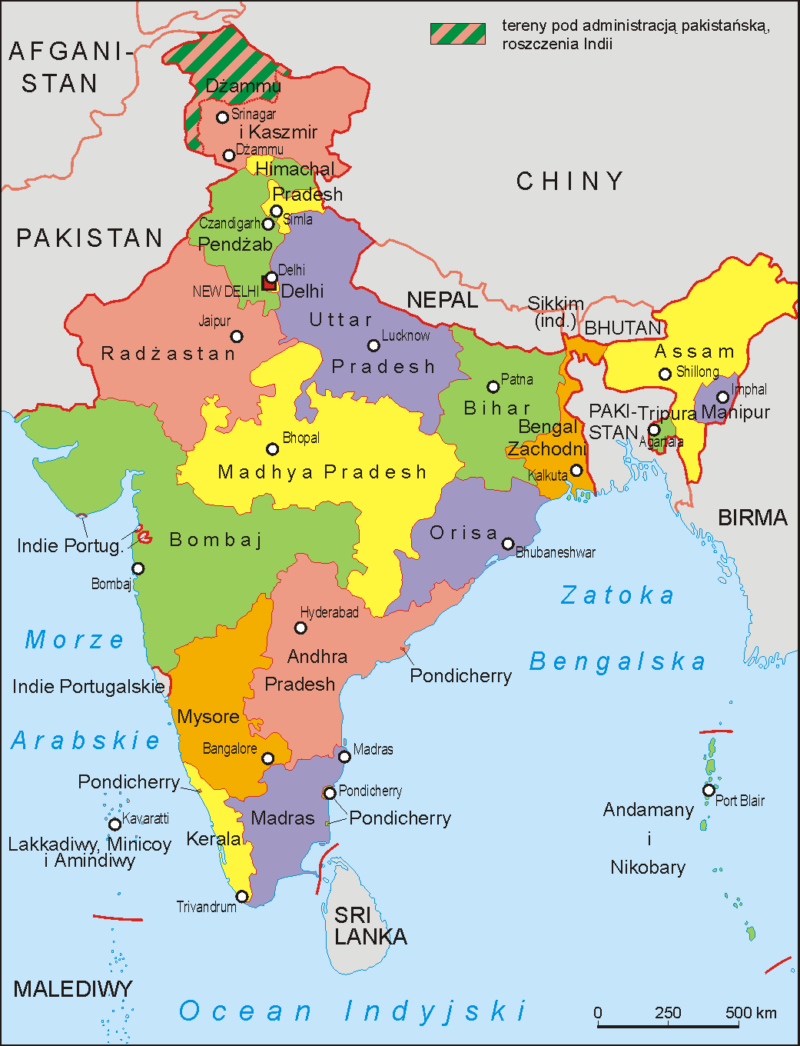
Map of INDIA after State Reorganisation Act of 1956

Slide 14
REORGANISATION OF OTHER STATES AFTER 1956
Nagaland was declared as a separate state in 1963.
Punjab Reorganization act of 1966 divided Punjab on linguistic lines.
Hindi speaking people to form a separate state of Haryana.
Northern districts of Punjab to form Himachal Pradesh
Rest of the area mainly dominated by Punjabi speaking people was formed as Punjab.
Chandigarh being formed as a common capital to Haryana and Punjab.

Slide 15
In 1972, Manipur, Meghalaya and Tripura were declared as separate states.
In 1975, Sikkim kingdom was joined to the Indian union as a sepearte state.
In 1987, Arunachal Pradesh, Mizoram and Goa became separate states.

Slide 16
FORMATION OF 3 NEW STATES IN 2000.
Chattisgarh.
Uttaranchal.
Jharkhand.

Slide 17
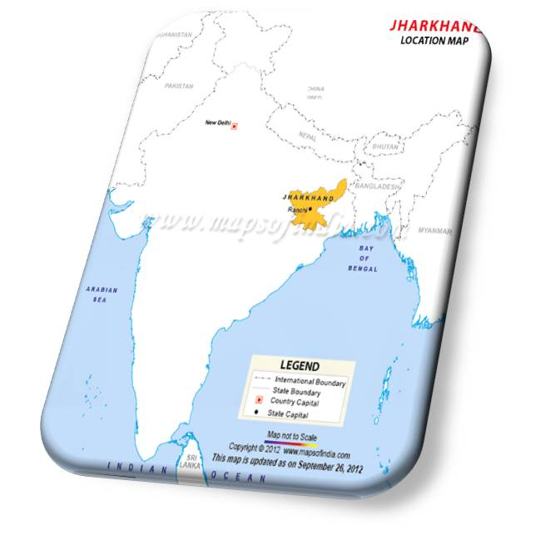
JHARKHAND
Jharkhand was formed from Bihar.
Again, 1956 Act did not oblige to the need of different state.
Jharkhand contains 18 south districts of Bihar.
It mainly contains tribal areas.
The partition was a bit politically motivated.
RJD leader Laloo Prasad Yadav was weak in south districts.

Slide 18
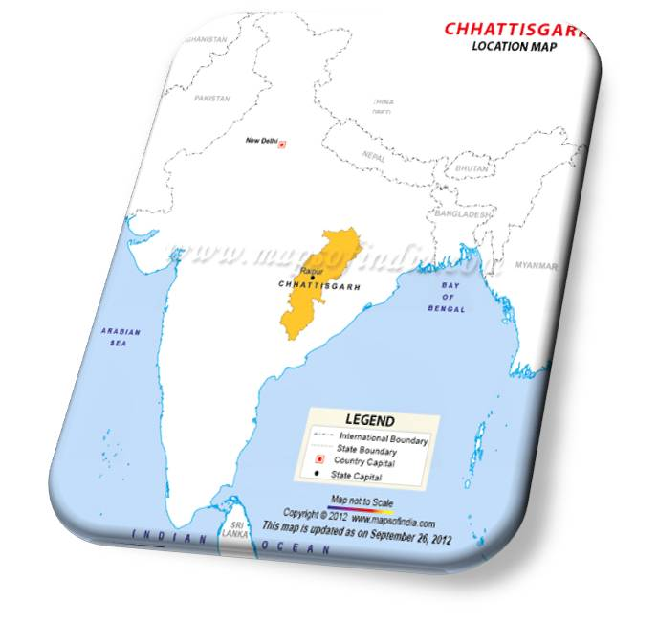
CHATTISGARH
Madhya pradesh was reorganized to form Chattisgarh .
Separate state demand rejected in 1956.
In 1994 resolution passed in Assembly
In 2000 Nov state is formed.
It includes upper peasant Brahmins and Kurmis.

Slide 19
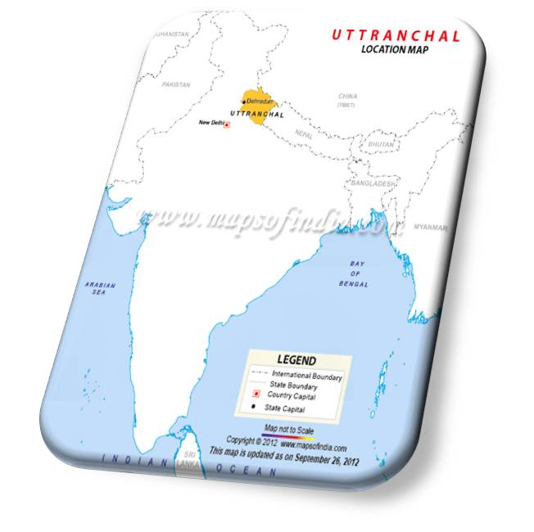
UTTARANCHAL
It is 28th state formed from Uttar Pradesh.
The tribes of Kumaon and Garhwal hills demanded.
It is formed in north western part of U.P.
Since 2007 its called as Uttarakhand.

Slide 20
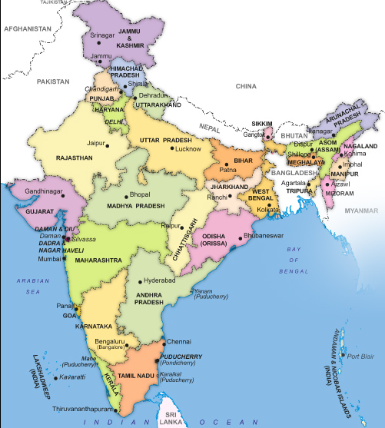
PRESENT MAP OF INDIA

Slide 21
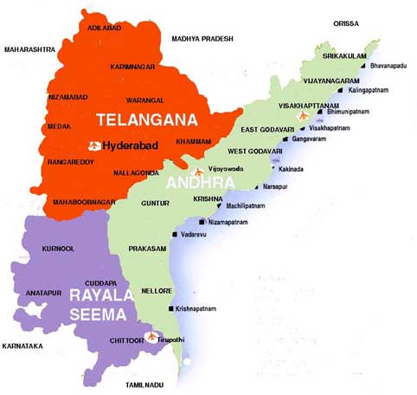
TELANGANA

Slide 22
TELANGANA
Telangana is the newly proposed state to be formed from A.P.
On 30 July 2013 Congress Working Group approved motion for Telangana recommending Central government.
Telangana contains 10 districts and Hyderabad as combined capital for 10 years.
Surprisingly the motion was defeated in A.P. state assembly with C.M. of A.P himself opposing separation.
The bill for separate Telangana state was passed in Parliament and got its approval by President of India in February 2014.

Slide 23
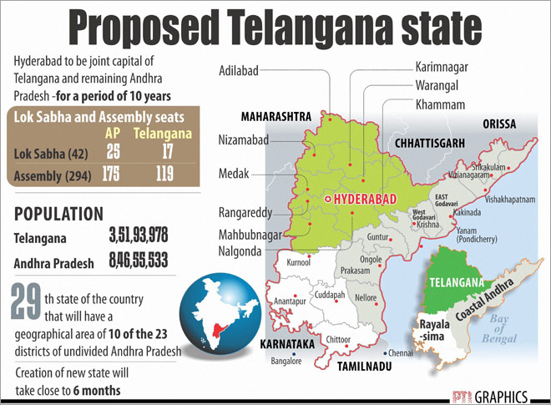

Slide 24
BASIS FOR TELANGANA STATE.
Was it language?
Was it political?
If not, what?

Slide 25
OTHER STATES IN DEMEND.
Gorkhaland from West Bengal.
Saurashtra from Gujarat.
Vidarbha from Maharashtra.
Harith Pradesh from U.P.
Bodoland from Assam.
Bundelkhand from Madhya Pradesh and Uttar Pradesh.

Slide 26
ADVANTAGES
Small states are easier to govern.
Administration is easy.
Economic development is possible.
Corruption becomes less.
We saw all three states Jharkhand, Uttarakhand and Chattisgarh grown economically.

Slide 27
DISADVANTAGES.
Naxals menace increased because of insufficient police force.
More regional parties.
More instability at the centre due to coalition governments.
Water disputes.

Slide 28


Slide 29
SUMMARY.
Since independence the division of states took place based on language(mainly).
SRC of 1953 played a vital role for linguistic division.
There is a clamor for other new states.
We have to wait and watch whether division into small states is for good or bad of our country!

Slide 30


