Slide 1
Now it’s Time for…
Recurrence
Relations

Slide 2
Recurrence Relations
A recurrence relation for the sequence {a_{n}} is an equation that expresses a_{n} is terms of one or more of the previous terms of the sequence, namely, a₀, a₁, …, a_{n-1}, for all integers n with
n ≥ n₀, where n₀ is a nonnegative integer.
A sequence is called a solution of a recurrence relation if it terms satisfy the recurrence relation.

Slide 3
Recurrence Relations
In other words, a recurrence relation is like a recursively defined sequence, but without specifying any initial values (initial conditions).
Therefore, the same recurrence relation can have (and usually has) multiple solutions.
If both the initial conditions and the recurrence relation are specified, then the sequence is uniquely determined.

Slide 4
Recurrence Relations
Example:
Consider the recurrence relation
a_{n} = 2a_{n-1} – a_{n-2} for n = 2, 3, 4, …
Is the sequence {a_{n}} with a_{n}=3n a solution of this recurrence relation?
For n ≥ 2 we see that
2a_{n-1} – a_{n-2} = 2(3(n – 1)) – 3(n – 2) = 3n = a_{n}.
Therefore, {a_{n}} with a_{n}=3n is a solution of the recurrence relation.

Slide 5
Recurrence Relations
Is the sequence {a_{n}} with a_{n}=5 a solution of the same recurrence relation?
For n ≥ 2 we see that
2a_{n-1} – a_{n-2} = 2⋅5 - 5 = 5 = a_{n}.
Therefore, {a_{n}} with a_{n}=5 is also a solution of the recurrence relation.

Slide 6
Modeling with Recurrence Relations
Example:
Someone deposits $10,000 in a savings account at a bank yielding 5% per year with interest compounded annually. How much money will be in the account after 30 years?
Solution:
Let P_{n} denote the amount in the account after n years.
How can we determine P_{n} on the basis of P_{n-1}?

Slide 7
Modeling with Recurrence Relations
We can derive the following recurrence relation:
P_{n} = P_{n-1} + 0.05P_{n-1} = 1.05P_{n-1}.
The initial condition is P₀ = 10,000.
Then we have:
P₁ = 1.05P₀
P₂ = 1.05P₁ = (1.05)²P₀
P₃ = 1.05P₂ = (1.05)³P₀
…
P_{n} = 1.05P_{n-1} = (1.05)^{n}P₀
We now have a formula to calculate P_{n} for any natural number n and can avoid the iteration.

Slide 8
Modeling with Recurrence Relations
Let us use this formula to find P₃₀ under the
initial condition P₀ = 10,000:
P₃₀ = (1.05)³⁰⋅10,000 = 43,219.42
After 30 years, the account contains $43,219.42.

Slide 9
Modeling with Recurrence Relations
Another example:
Let a_{n} denote the number of bit strings of length n that do not have two consecutive 0s (“valid strings”). Find a recurrence relation and give initial conditions for the sequence {a_{n}}.
Solution:
Idea: The number of valid strings equals the number of valid strings ending with a 0 plus the number of valid strings ending with a 1.

Slide 10
Modeling with Recurrence Relations
Let us assume that n ≥ 3, so that the string contains at least 3 bits.
Let us further assume that we know the number a_{n-1} of valid strings of length (n – 1).
Then how many valid strings of length n are there, if the string ends with a 1?
There are a_{n-1} such strings, namely the set of valid strings of length (n – 1) with a 1 appended to them.
Note: Whenever we append a 1 to a valid string, that string remains valid.

Slide 11
Modeling with Recurrence Relations
Now we need to know: How many valid strings of length n are there, if the string ends with a 0?
Valid strings of length n ending with a 0 must have a 1 as their (n – 1)st bit (otherwise they would end with 00 and would not be valid).
And what is the number of valid strings of length (n – 1) that end with a 1?
We already know that there are a_{n-1} strings of length n that end with a 1.
Therefore, there are a_{n-2} strings of length (n – 1) that end with a 1.

Slide 12
Modeling with Recurrence Relations
So there are a_{n-2} valid strings of length n that end with a 0 (all valid strings of length (n – 2) with 10 appended to them).
As we said before, the number of valid strings is the number of valid strings ending with a 0 plus the number of valid strings ending with a 1.
That gives us the following recurrence relation:
a_{n} = a_{n-1} + a_{n-2}

Slide 13
Modeling with Recurrence Relations
What are the initial conditions?
a₁ = 2 (0 and 1)
a₂ = 3 (01, 10, and 11)
a₃ = a₂ + a₁ = 3 + 2 = 5
a₄ = a₃ + a₂ = 5 + 3 = 8
a₅ = a₄ + a₃ = 8 + 5 = 13
…
This sequence satisfies the same recurrence relation as the Fibonacci sequence.
Since a₁ = f₃ and a₂ = f₄, we have a_{n} = f_{n+2}.

Slide 14
Solving Recurrence Relations
In general, we would prefer to have an explicit formula to compute the value of a_{n} rather than conducting n iterations.
For one class of recurrence relations, we can obtain such formulas in a systematic way.
Those are the recurrence relations that express the terms of a sequence as linear combinations of previous terms.

Slide 15
Solving Recurrence Relations
Definition: A linear homogeneous recurrence relation of degree k with constant coefficients is a recurrence relation of the form:
a_{n} = c₁a_{n-1} + c₂a_{n-2} + … + c_{k}a_{n-k},
Where c₁, c₂, …, c_{k} are real numbers, and c_{k} ≠ 0.
A sequence satisfying such a recurrence relation is uniquely determined by the recurrence relation and the k initial conditions
a₀ = C₀, a₁ = C₁, a₂ = C₂, …, a_{k-1} = C_{k-1}.

Slide 16
Solving Recurrence Relations
Examples:
The recurrence relation P_{n} = (1.05)P_{n-1}
is a linear homogeneous recurrence relation of degree one.
The recurrence relation f_{n} = f_{n-1} + f_{n-2}
is a linear homogeneous recurrence relation of degree two.
The recurrence relation a_{n} = a_{n-5}
is a linear homogeneous recurrence relation of degree five.

Slide 17
Solving Recurrence Relations
Basically, when solving such recurrence relations, we try to find solutions of the form a_{n} = r^{n}, where r is a constant.
a_{n} = r^{n} is a solution of the recurrence relation
a_{n} = c₁a_{n-1} + c₂a_{n-2} + … + c_{k}a_{n-k} if and only if
r^{n} = c₁r^{n-1} + c₂r^{n-2} + … + c_{k}r^{n-k}.
Divide this equation by r^{n-k} and subtract the right-hand side from the left:
r^{k} - c₁r^{k-1} - c₂r^{k-2} - … - c_{k-1}r - c_{k} = 0
This is called the characteristic equation of the recurrence relation.

Slide 18
Solving Recurrence Relations
The solutions of this equation are called the characteristic roots of the recurrence relation.
Let us consider linear homogeneous recurrence relations of degree two.
Theorem: Let c₁ and c₂ be real numbers. Suppose that r² – c₁r – c₂ = 0 has two distinct roots r₁ and r₂.
Then the sequence {a_{n}} is a solution of the recurrence relation a_{n} = c₁a_{n-1} + c₂a_{n-2} if and only if a_{n} = α₁r₁^{n} + α₂r₂^{n} for n = 0, 1, 2, …, where α₁ and α₂ are constants.
See pp. 321 and 322 for the proof.

Slide 19
Solving Recurrence Relations
Example: What is the solution of the recurrence relation a_{n} = a_{n-1} + 2a_{n-2} with a₀ = 2 and a₁ = 7 ?
Solution: The characteristic equation of the recurrence relation is r² – r – 2 = 0.
Its roots are r = 2 and r = -1.
Hence, the sequence {a_{n}} is a solution to the recurrence relation if and only if:
a_{n} = α₁2^{n} + α₂(-1)^{n} for some constants α₁ and α₂.

Slide 20
Solving Recurrence Relations
Given the equation a_{n} = α₁2^{n} + α₂(-1)^{n} and the initial conditions a₀ = 2 and a₁ = 7, it follows that
a₀ = 2 = α₁ + α₂
a₁ = 7 = α₁⋅2 + α₂ ⋅(-1)
Solving these two equations gives us
α₁ = 3 and α₂ = -1.
Therefore, the solution to the recurrence relation and initial conditions is the sequence {a_{n}} with
a_{n} = 3⋅2^{n} – (-1)^{n}.

Slide 21
Solving Recurrence Relations
a_{n} = r^{n} is a solution of the linear homogeneous recurrence relation
a_{n} = c₁a_{n-1} + c₂a_{n-2} + … + c_{k}a_{n-k}
if and only if
r^{n} = c₁r^{n-1} + c₂r^{n-2} + … + c_{k}r^{n-k}.
Divide this equation by r^{n-k} and subtract the right-hand side from the left:
r^{k} - c₁r^{k-1} - c₂r^{k-2} - … - c_{k-1}r - c_{k} = 0
This is called the characteristic equation of the recurrence relation.

Slide 22
Solving Recurrence Relations
The solutions of this equation are called the characteristic roots of the recurrence relation.
Let us consider linear homogeneous recurrence relations of degree two.
Theorem: Let c₁ and c₂ be real numbers. Suppose that r² – c₁r – c₂ = 0 has two distinct roots r₁ and r₂.
Then the sequence {a_{n}} is a solution of the recurrence relation a_{n} = c₁a_{n-1} + c₂a_{n-2} if and only if a_{n} = α₁r₁^{n} + α₂r₂^{n} for n = 0, 1, 2, …, where α₁ and α₂ are constants.
See pp. 321 and 322 for the proof.

Slide 23
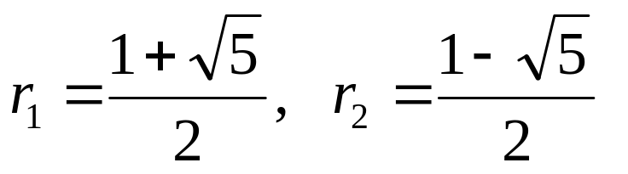
Solving Recurrence Relations
Example: Give an explicit formula for the Fibonacci numbers.
Solution: The Fibonacci numbers satisfy the recurrence relation f_{n} = f_{n-1} + f_{n-2} with initial conditions f₀ = 0 and f₁ = 1.
The characteristic equation is r² – r – 1 = 0.
Its roots are

Slide 24
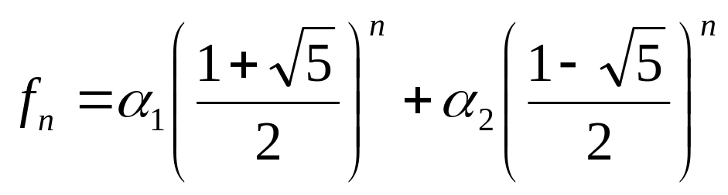
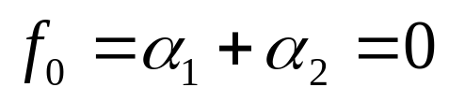
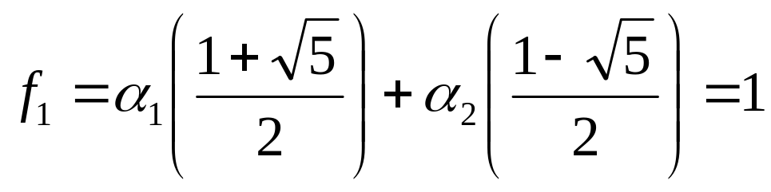
Solving Recurrence Relations
Therefore, the Fibonacci numbers are given by
for some constants α₁ and α₂.
We can determine values for these constants so that the sequence meets the conditions f₀ = 0 and f₁ = 1:

Slide 25
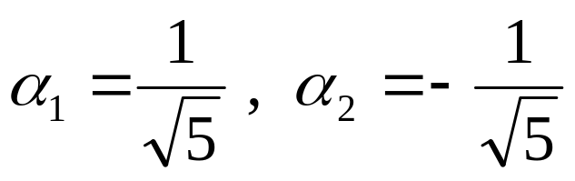
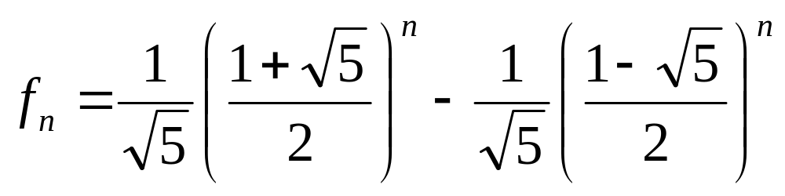
Solving Recurrence Relations
The unique solution to this system of two equations and two variables is
So finally we obtained an explicit formula for the Fibonacci numbers:

Slide 26
Solving Recurrence Relations
But what happens if the characteristic equation has only one root?
How can we then match our equation with the initial conditions a₀ and a₁ ?
Theorem: Let c₁ and c₂ be real numbers with c₂ ≠ 0. Suppose that r² – c₁r – c₂ = 0 has only one root r₀.
A sequence {a_{n}} is a solution of the recurrence relation a_{n} = c₁a_{n-1} + c₂a_{n-2} if and only if
a_{n} = α₁r₀^{n} + α₂nr₀^{n}, for n = 0, 1, 2, …, where α₁ and α₂ are constants.

Slide 27
Solving Recurrence Relations
Example: What is the solution of the recurrence relation a_{n} = 6a_{n-1} – 9a_{n-2} with a₀ = 1 and a₁ = 6?
Solution: The only root of r² – 6r + 9 = 0 is r₀ = 3.
Hence, the solution to the recurrence relation is
a_{n} = α₁3^{n} + α₂n3^{n} for some constants α₁ and α₂.
To match the initial condition, we need
a₀ = 1 = α₁
a₁ = 6 = α₁⋅3 + α₂⋅3
Solving these equations yields α₁ = 1 and α₂ = 1.
Consequently, the overall solution is given by
a_{n} = 3^{n} + n3^{n}.

