Slide 1
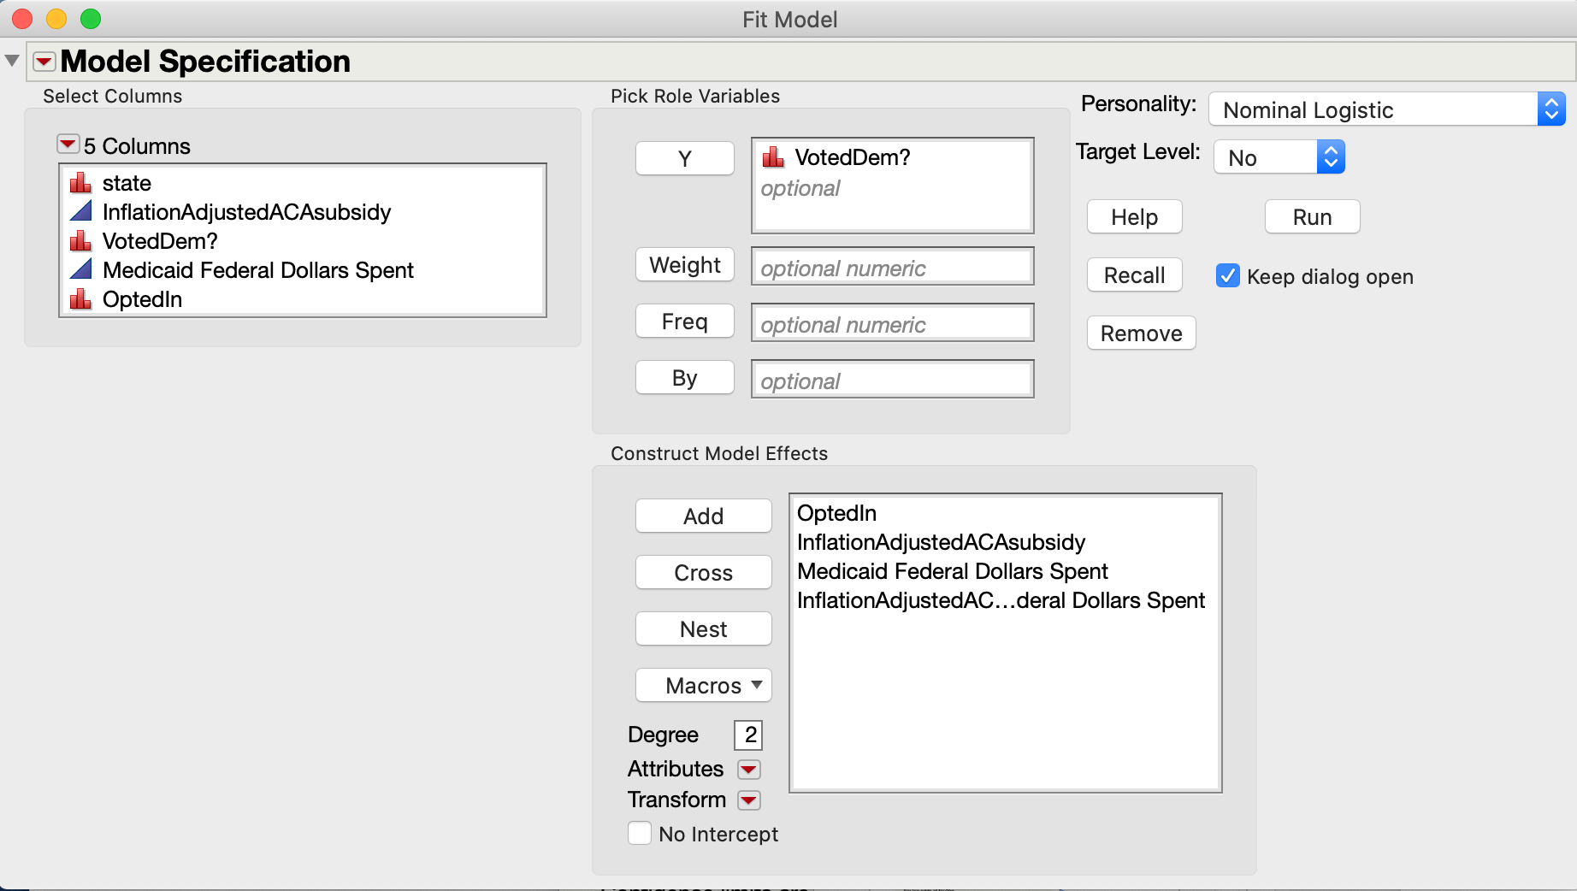

Slide 2
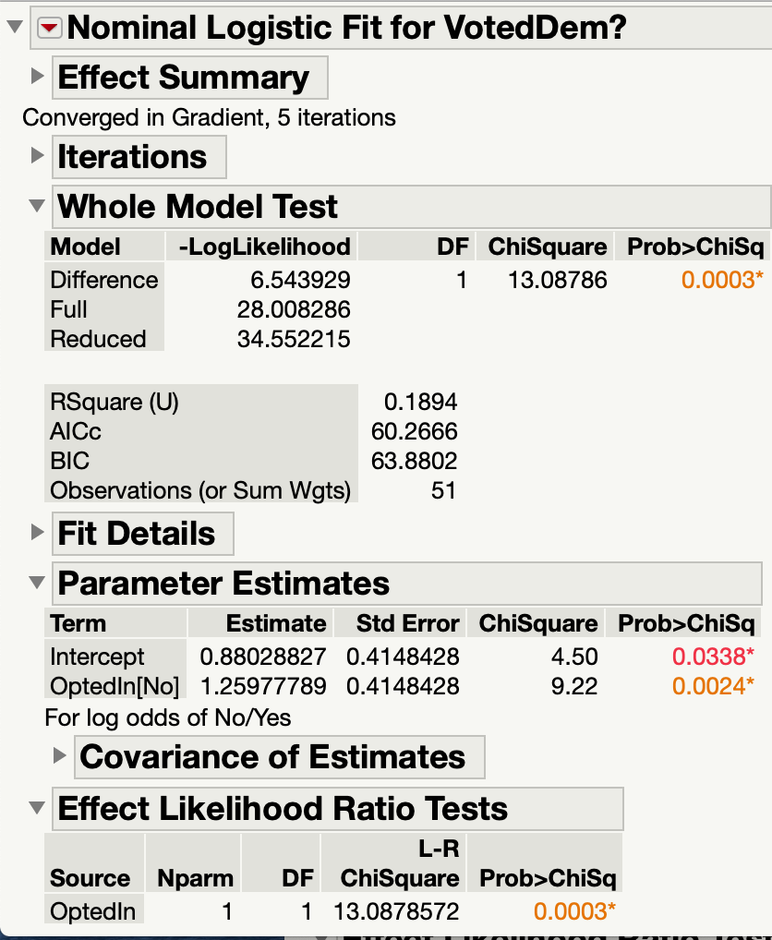
O: VotedDem vs P (OptedIn)

Slide 3
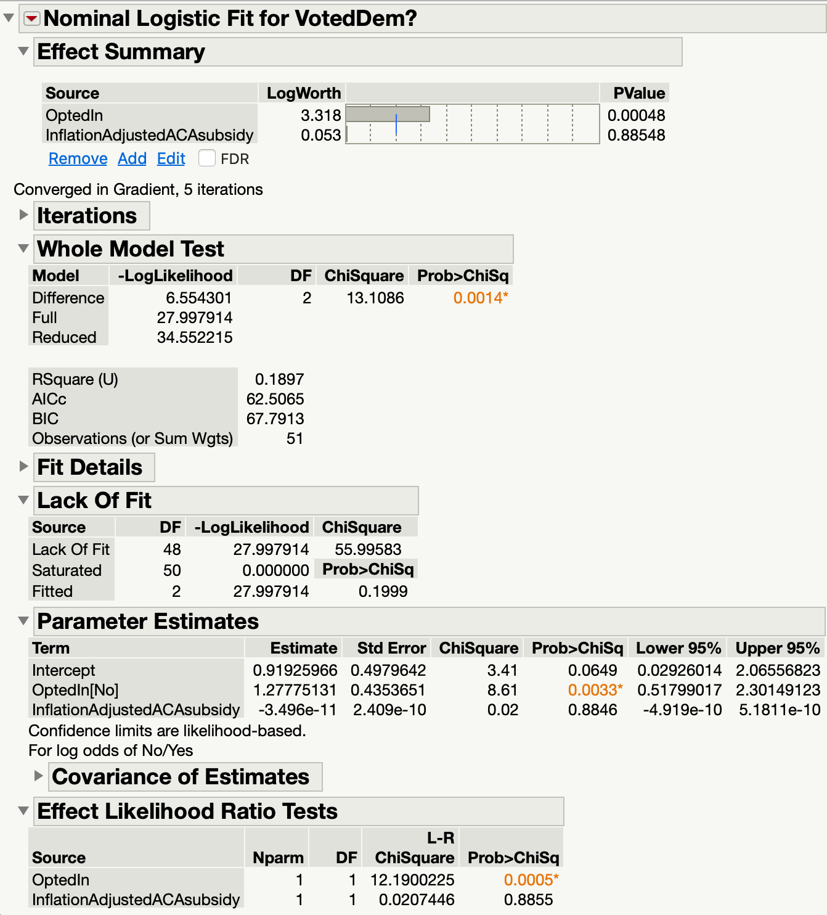
O: VotedDem vs P (OptedIn | Inflation)

Slide 4
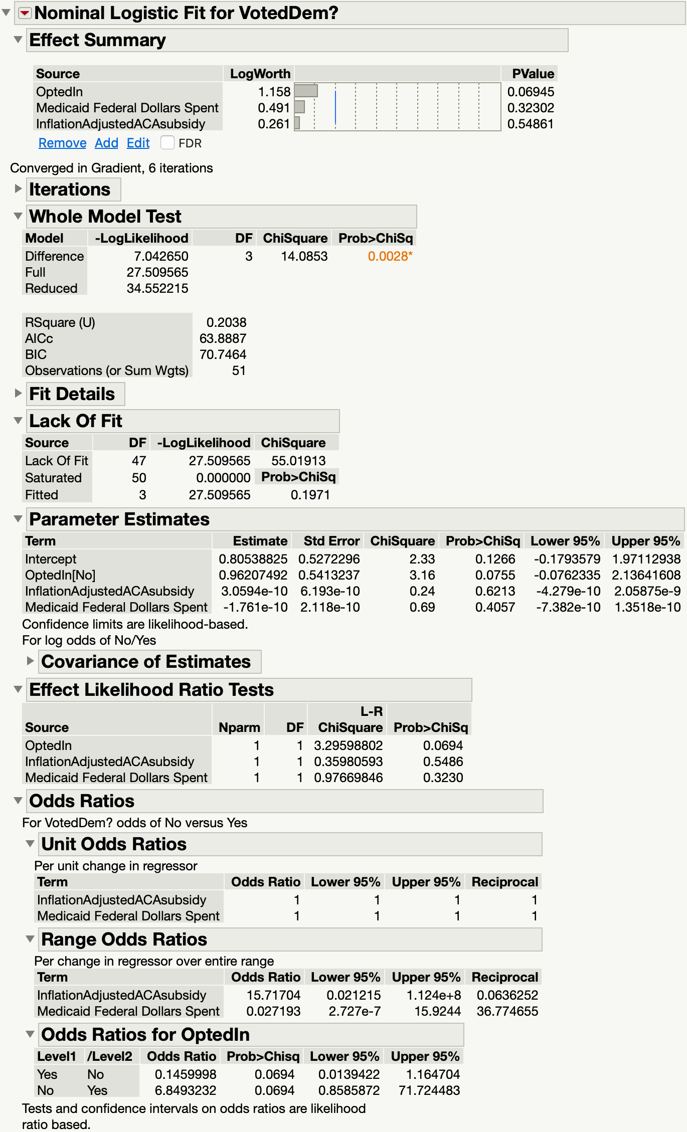
O VotedDem vs P OptedIn | Inflation | Medicaid

