Slide 1

Angular JS
Clyde D’Souza
@ClydeDz

Slide 2


Clyde D’Souza
Graduated from AUT in Dec 2015 with a
Postgraduate diploma in Computer and Information Sciences
Volunteer at Impact NPO events
@ClydeDz
Love web development and design

Slide 3
What is Angular JS?
Structural framework for creating dynamic web apps
Supported by Google
Open source made available on GitHub
Excellent documentation

Slide 4
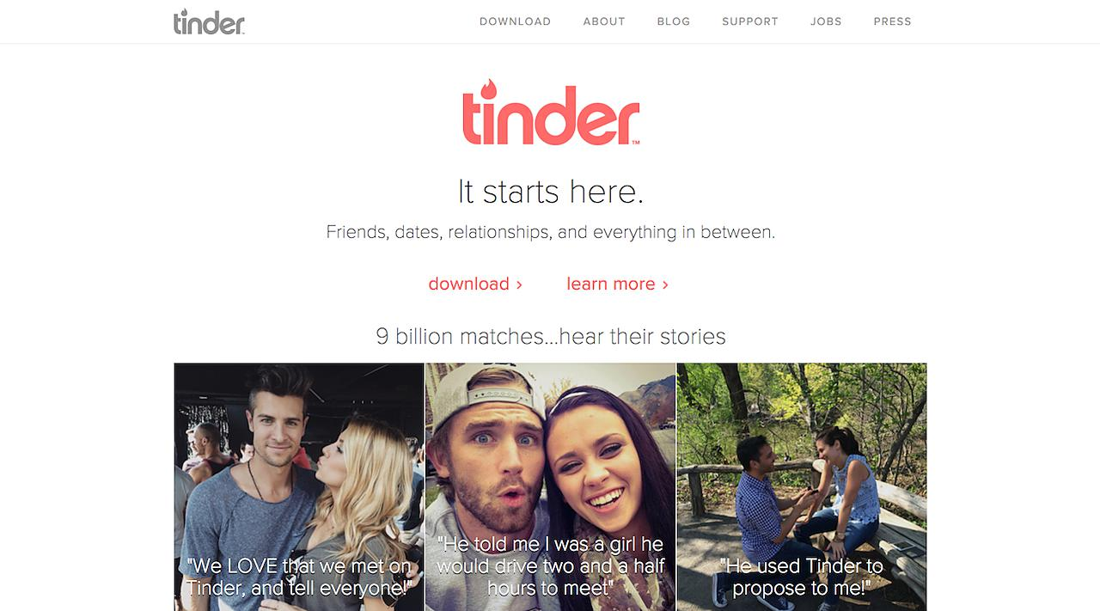
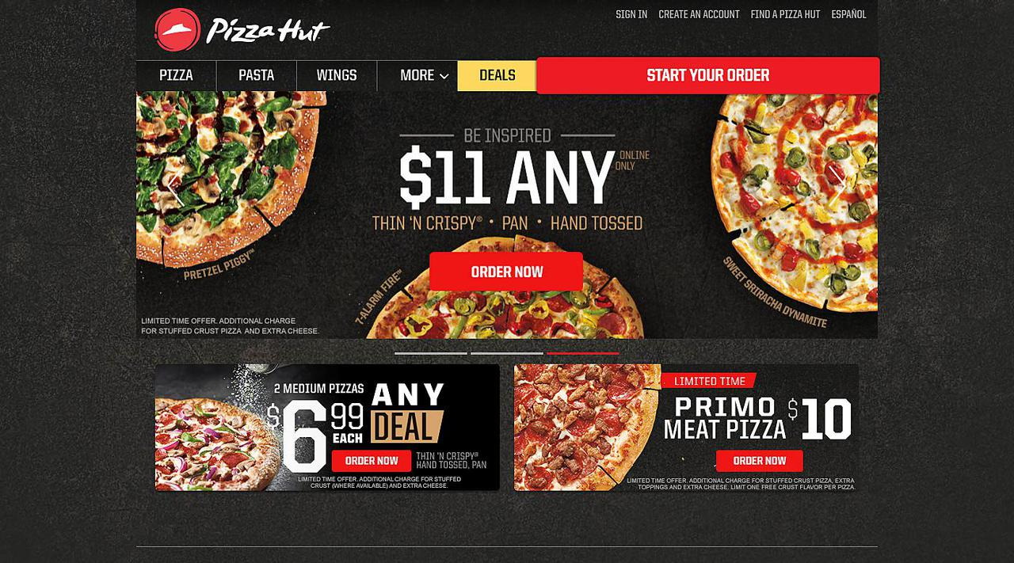
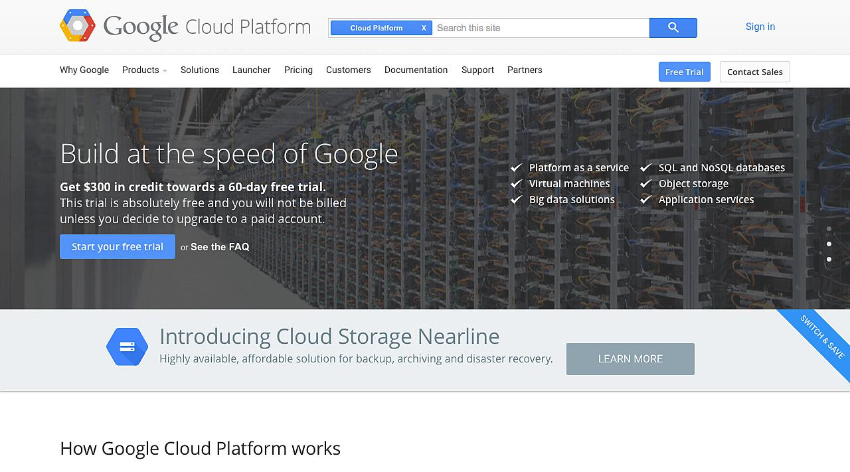
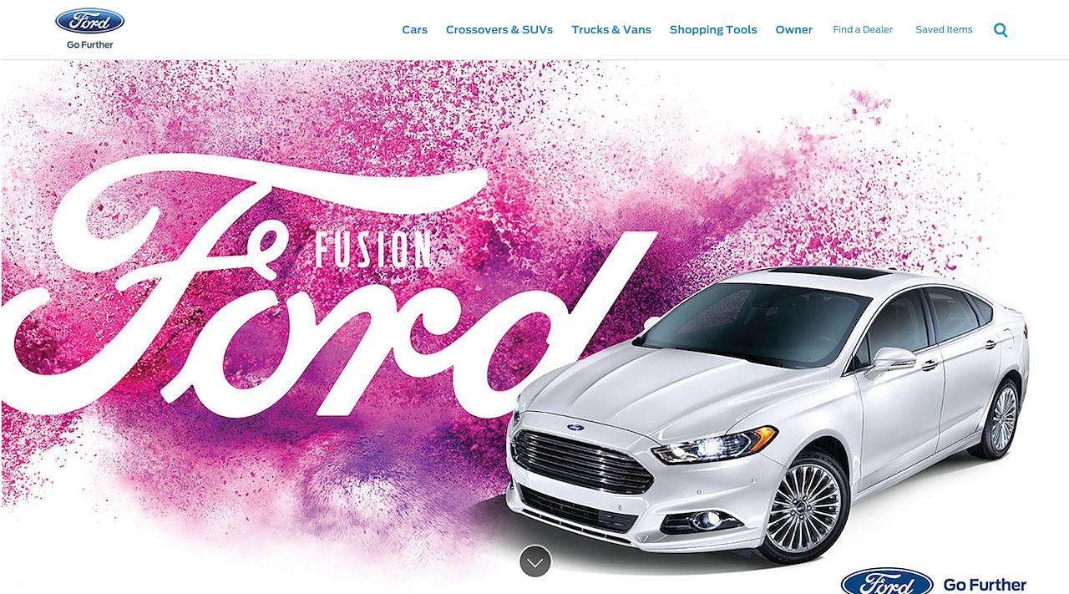
Why use Angular JS?
https://www.madewithangular.com/#/

Slide 5
Why use Angular JS?
Expressive HTML
Reusable components
Excellent documentation
2-way data binding
Write less code
Large community base
MVW
Open source
CRUD
Testable
Deep linking
Single page application

Slide 6
Conceptual overview
Scope
Templates
Data-model
Compiler
View
Controllers
Services

Slide 7
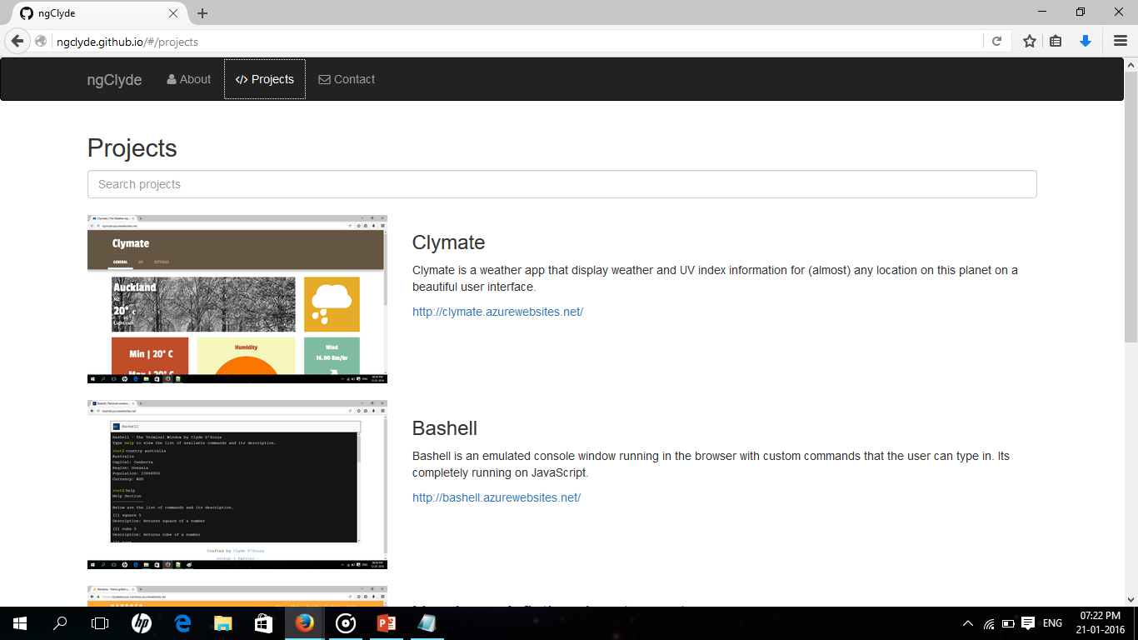
Let’s build this as we go
Project available at: http://github.com/ngClyde/ngClyde

Slide 8
Deep dive

Slide 9
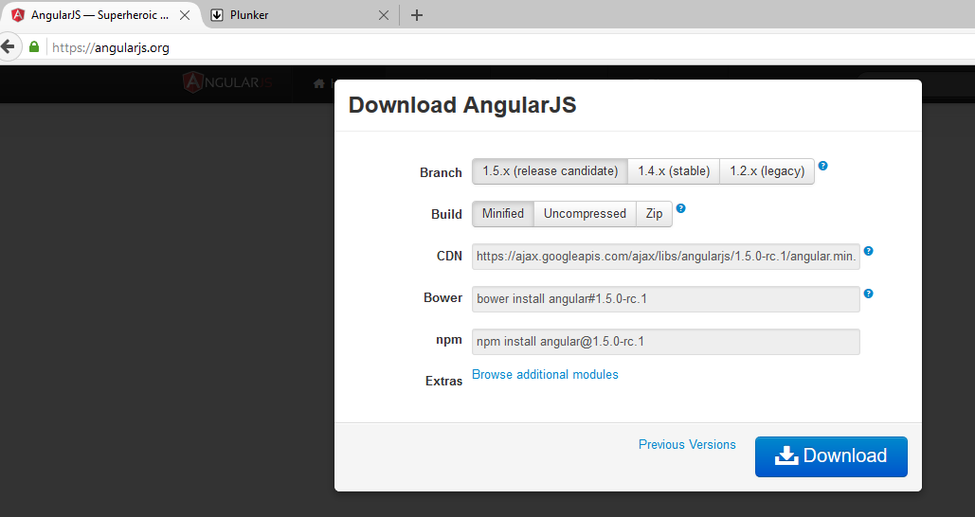
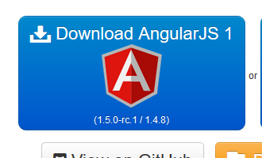
How do I get Angular?
1
2
3

Slide 10
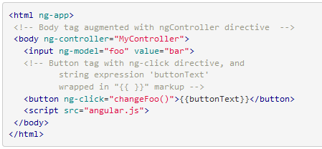
Templates
HTML + Angular stuff

Slide 11
Directives
Adds behaviour to HTML elements
Custom directives which make HTML more expressive
Angular’s compiler ($compile) matches directives
Examples of angular directives:
ng-view
ng-controller
ng-src
Examples of custom directives:
footer
custom-loader

Slide 12


Directives: Normalization
Normalized: Case-sensitive camelCase
Case-insensitive dash-delimited
Prefix data-custom attributes
ng-model
ng-app
data-ng-model
data-ng-app
ngModel
ngApp

Slide 13
Angular is watchful. It is only responsible for the angular stuff within the ng-app defined section. But what happens to the angular stuff outside the scope? Try it yourself on plunker.
http://plnkr.co/edit/J65qe6

Slide 14

Hands-on
Let’s get started with building our web app add the ng-app directive to it.

Slide 15
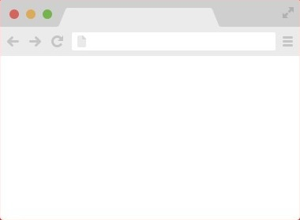
Expressions
{{ Expression | Filter }}
JavaScript-like code snippets to read & write variables in that $scope
<p>{{ 1+3 }}</p>
<p>{{ “Hello Angular” }}</p>
4
Hello Angular

Slide 16

Expressions
Use Filters
No comma or void
Context
Cannot use regular expressions
Forgiving
Cannot create an object using new operator
Ternary operator*
Cannot use control flow statements*

Slide 17
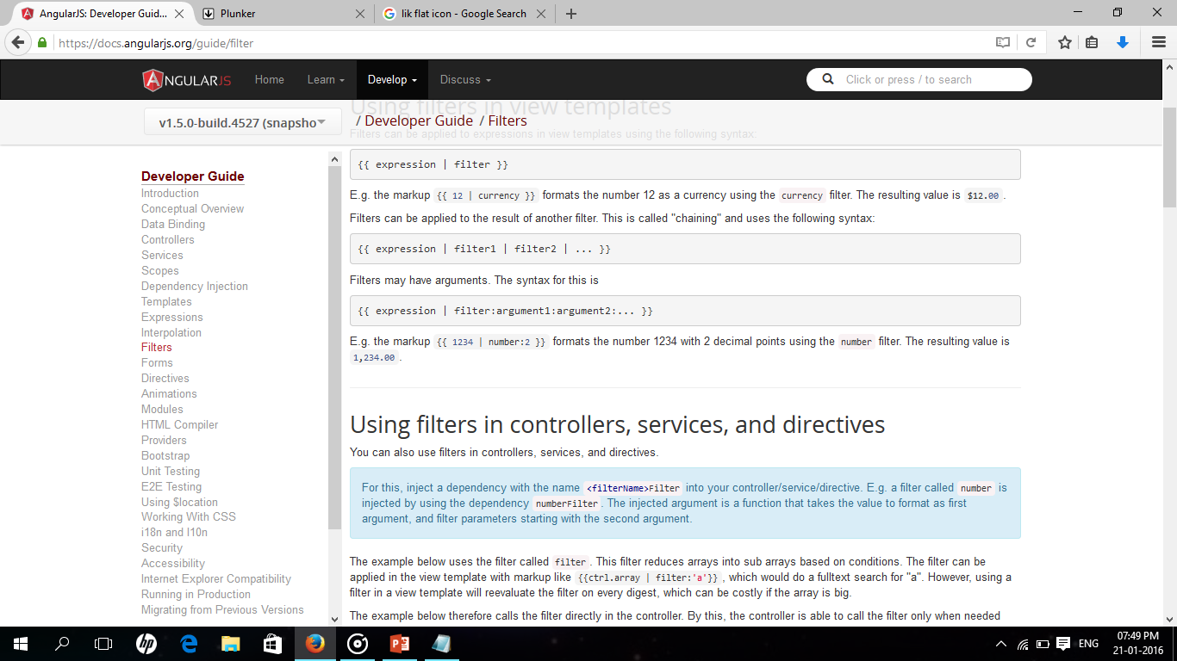
Filters
Formats the expression for view
Underlying API is filterProvider
Can use filters in controllers, directives and services as well
Inject dependency <filtername>Filter
Can create custom filters too
Valid name => Use alphabets and _

Slide 18
Creating custom filters is as easy as using it. But how do you get it going? Try it yourself on plunker.
http://plnkr.co/edit/xpQpNk

Slide 19
Modules
Container for different parts (directives, controllers, filters, services) of your web app.
Usually the starting point of your app
Consist of configuration and run block
Can create reusable modules

Slide 20
Modules
Declaring a module
angular.module(‘moduleName’,[]);
Bootstrap your module to your web app. Angular is responsible for this section
<div ng-app=“moduleName”>
…
</div>

Slide 21
Hands-on
Creating our app’s module

Slide 22
Controllers
Meant for the business logic pertaining to a single view
Preferably kept slim. Let services do the view-independent work

Slide 23
Controllers
Create a controller
angular.module(‘moduleName’,[])
.controller(‘nameOfController’,[‘$dependency’,function($dependency){
// business logic here
}]);
Use that controller in the view
<div ng-controller=“nameOfController”>
…
</div>

Slide 24
Controllers is the heart of your business logic and your app is big enough to use multiple controllers. But are you confident on handling multiple controllers? Try the basics of multiple controllers on plunker.
http://plnkr.co/edit/8U7gNz

Slide 25
Hands-on
Adding controllers to our web app

Slide 26
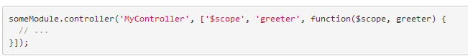


Dependency injection
It is a software design pattern that deals with how components get hold of their dependencies.
$injector => service locator => manages all dependencies
Dependency annotation
Inline array
Using $injector
Implicit
List of dependencies
Their function

Slide 27



Providers
Service
Provider
$injector
Recipe
Constant
Value
Services
Specialized objects
Factory

Slide 28
Services
Angular services are: lazily instantiated & singletons
Angular provides services => $http, $route, $location, $cookies, $log
Can create our own services too => add it as a dependency into another component
Use Module Factory API to register a new service

Slide 29
Forms
Instant client side feedback (but is not a substitute for server side validation).
ng-model is an important directive => model and view in sync
Use novalidate to disable default browser validation
Use ng-classnames for styling the form and giving feedback

Slide 30
FormController
Properties:
$valid, $invalid, $pristine, $error, $pending
Name attribute of input specifies the propertities on the form instance
contactForm.emailAddress.$valid
Instance of
<form></form>
<input name=“emailAddress”/>
<form name=“contactForm”></form>
Pushed into $scope using name attribute of form

Slide 31
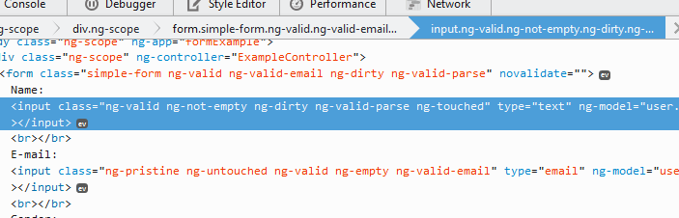
name.css
Output
.ng-dirty{
background-color:red;
}
.ng-pristine{
background-color:green;
}
Name
John
Email

Slide 32
It’s an ng-valid point to get your hands ng-dirty with Angular forms. Try it yourself on plunker.
http://plnkr.co/edit/UPTLMA

Slide 33
Hands-on
Adding a contact form with validation

Slide 34
XML Http Requests
Uses $http service
$http returns a Promise object with a success method
then(successCallback, errorCallback, notifyCallback)
Promise =>
finally(callback, notifyCallback)
Notes:
phonecatApp.config(['$routeProvider',
function($routeProvider) {
$routeProvider.
when('/phones', {
templateUrl: 'partials/phone-list.html',
controller: 'PhoneListCtrl'
}).
when('/phones/:phoneId', {
templateUrl: 'partials/phone-detail.html',
controller: 'PhoneDetailCtrl'
}).
otherwise({
redirectTo: '/phones'
});
}]);

Slide 35
Hands-on
Using XHR and $http to GET the list of projects

Slide 36
Routing
Requires additional angular routing script file
Uses a reusable angular module called ngRoute
$route service is provided by $routeProvider => routing
Routing => .config() on our app’s module => .when().otherwise() on $routeProvider
Assists in deep linking => browser’s history + bookmarks
Notes:
phonecatApp.config(['$routeProvider',
function($routeProvider) {
$routeProvider.
when('/phones', {
templateUrl: 'partials/phone-list.html',
controller: 'PhoneListCtrl'
}).
when('/phones/:phoneId', {
templateUrl: 'partials/phone-detail.html',
controller: 'PhoneDetailCtrl'
}).
otherwise({
redirectTo: '/phones'
});
}]);

Slide 37
Routing
No page refresh
Perfect for single page applications
Code is easy to manage
Notes:
phonecatApp.config(['$routeProvider',
function($routeProvider) {
$routeProvider.
when('/phones', {
templateUrl: 'partials/phone-list.html',
controller: 'PhoneListCtrl'
}).
when('/phones/:phoneId', {
templateUrl: 'partials/phone-detail.html',
controller: 'PhoneDetailCtrl'
}).
otherwise({
redirectTo: '/phones'
});
}]);

Slide 38
Layout template
Route: site.com/#/about
about.html
About page content
index.html
Route: site.com/#/
Website
Partial templates
Home | About | Contact
Home page content
Route: site.com/#/contact
Contact page content
<div ng-view></div>
contact.html

Slide 39
Hands-on
Separating individual sections into partial templates and using Angular routing

Slide 40



Testing
Unit testing
End to End testing
Karma + Jasmine
Protractor

Slide 41

Best practices
https://github.com/johnpapa/angular-styleguide
https://github.com/angular/angular.js/wiki/Best-Practices

Slide 42



Useful resources
https://docs.angularjs.org/guide/
http://www.w3schools.com/angular/
https://www.pluralsight.com/courses/angularjs-fundamentals
https://www.pluralsight.com/courses/aspdotnet-5-ef7-bootstrap-angular-web-app
https://github.com/angular/angular.js/wiki/Projects-using-AngularJS

Slide 43

Useful resources
http://campus.codeschool.com/courses/shaping-up-with-angular-js/intro
https://github.com/curran/screencasts/tree/gh-pages/introToAngular

Slide 44




People to follow
Todd Motto
Chris Sevilleja
Dean Sofer
Gerard Sans
@toddmotto
@sevilayha
@DeanSofer
@gerardsans

Slide 45

Clyde D’Souza
@ClydeDz
https://github.com/ngClyde

