Slide 1

Angular JS
Clyde D’Souza
@ClydeDz

Slide 2


Clyde D’Souza
Graduated from AUT in Dec 2015 with a
Postgraduate diploma in Computer and Information Sciences
Volunteer at Impact NPO events
@ClydeDz
Love web development and design

Slide 3
What is Angular JS?
Structural framework for creating dynamic web apps
Supported by Google
Open source made available on GitHub
Excellent documentation

Slide 4
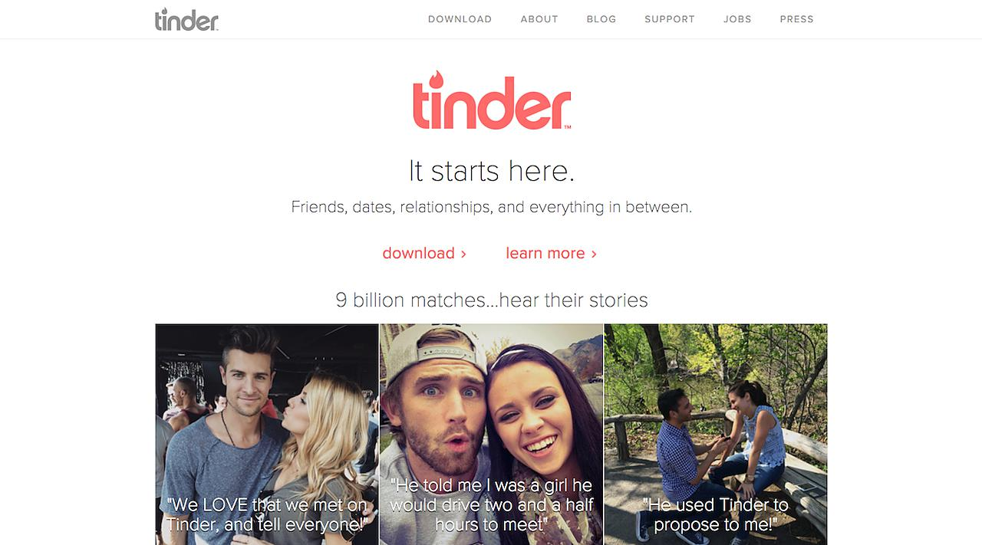
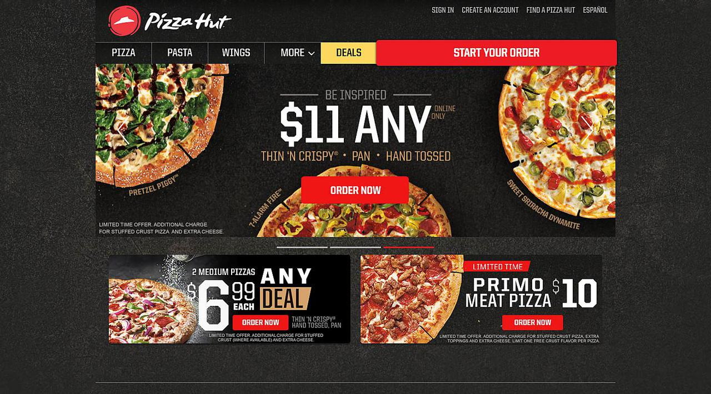
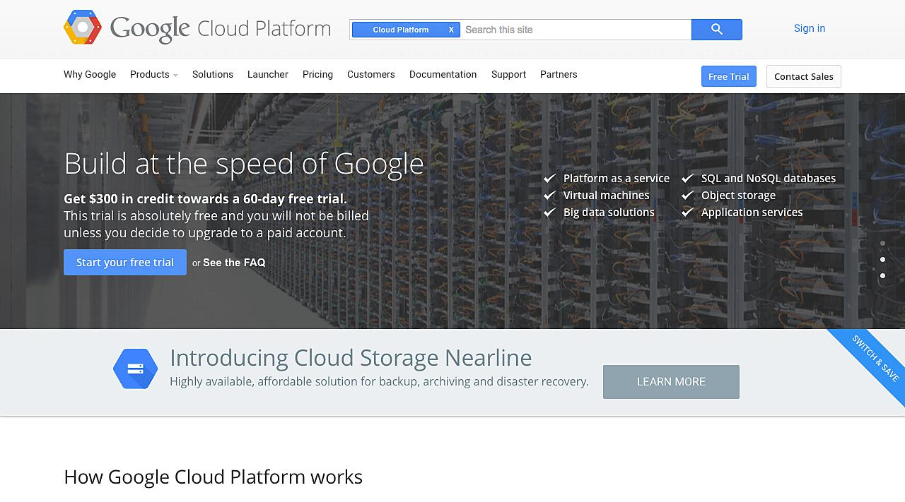
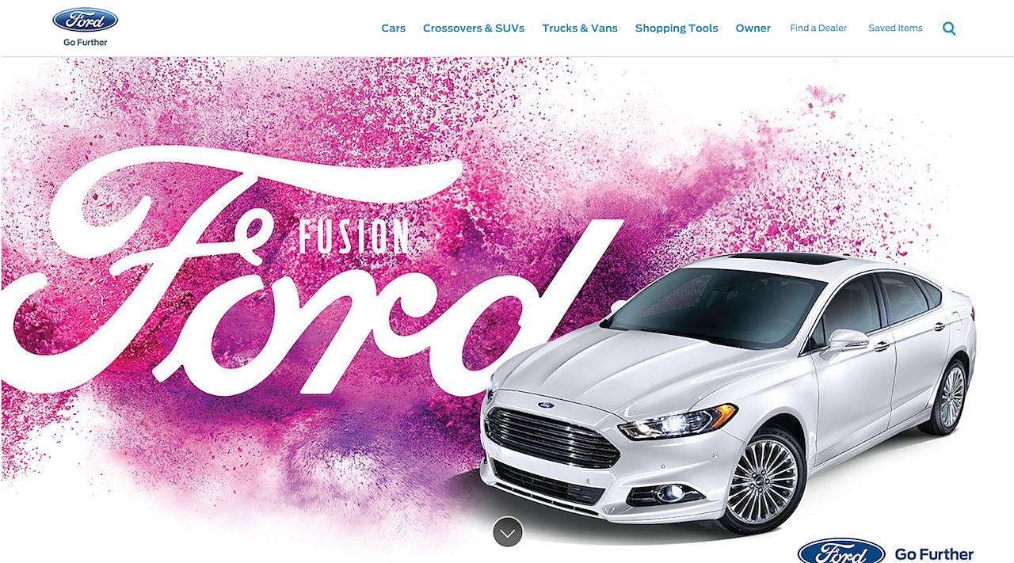
Why use Angular JS?
https://www.madewithangular.com/#/

Slide 5
Why use Angular JS?
Expressive HTML
Reusable components
Excellent documentation
2-way data binding
Write less code
Large community base
MVW
Open source
CRUD
Testable
Deep linking
Single page application

Slide 6
Conceptual overview
Scope
Templates
Data-model
Compiler
View
Controllers
Services

Slide 7
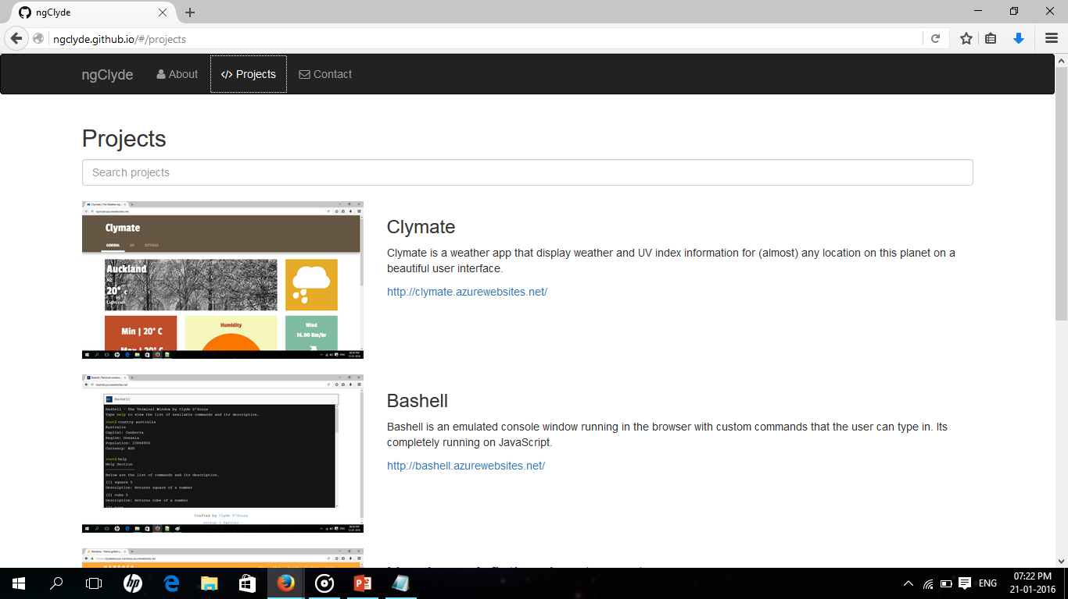
Let’s build this as we go
Project available at: http://github.com/ngClyde/ngClyde

Slide 8
Controllers
5
Modules
Custom directives
4
6
Dependency injection
Directives
Forms & validation
3
And also
7
Services
Providers
Angular mark-up + Expressions + Filters
$http requests
2
8
Getting started
1
Routing
9

Slide 9


Directives: Normalization
Normalized: Case-sensitive camelCase
Case-insensitive dash-delimited
Prefix data-custom attributes
ng-model
ng-app
data-ng-model
data-ng-app
ngModel
ngApp

Slide 10
FormController
Properties:
$valid, $invalid, $pristine, $error, $pending
Name attribute of input specifies the propertities on the form instance
contactForm.emailAddress.$valid
Instance of
<form></form>
<input name=“emailAddress”/>
<form name=“contactForm”></form>
Pushed into $scope using name attribute of form

Slide 11
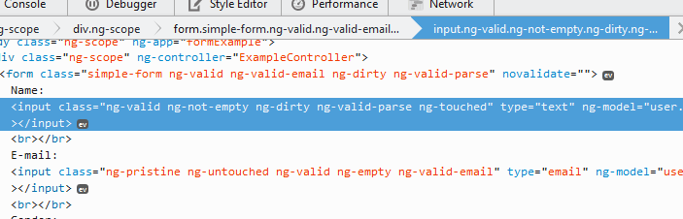
name.css
Output
.ng-dirty{
background-color:red;
}
.ng-pristine{
background-color:green;
}
Name
John
Email

Slide 12
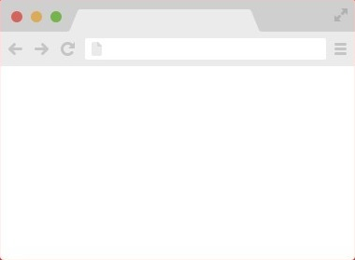
Layout template
Route: site.com/#/about
about.html
About page content
index.html
Route: site.com/#/
Website
Partial templates
Home | About | Contact
Home page content
Route: site.com/#/contact
Contact page content
<div ng-view></div>
contact.html

Slide 13
Try it yourself
http://plnkr.co/edit/J65qe6
http://plnkr.co/edit/xpQpNk
http://plnkr.co/edit/8U7gNz
http://plnkr.co/edit/UPTLMA

Slide 14

Best practices
https://github.com/johnpapa/angular-styleguide
https://github.com/angular/angular.js/wiki/Best-Practices

Slide 15



Useful resources
https://docs.angularjs.org/guide/
http://www.w3schools.com/angular/
https://www.pluralsight.com/courses/angularjs-fundamentals
https://www.pluralsight.com/courses/aspdotnet-5-ef7-bootstrap-angular-web-app
https://github.com/angular/angular.js/wiki/Projects-using-AngularJS

Slide 16

Useful resources
http://campus.codeschool.com/courses/shaping-up-with-angular-js/intro
https://github.com/curran/screencasts/tree/gh-pages/introToAngular

Slide 17




People to follow
Todd Motto
Chris Sevilleja
Dean Sofer
Gerard Sans
@toddmotto
@sevilayha
@DeanSofer
@gerardsans

Slide 18

Clyde D’Souza
@ClydeDz
https://github.com/ngClyde

