Slide 1

Machine Setup
High Country Angular Meetup
Monday, June 18, 2018

Slide 2


Slide 3
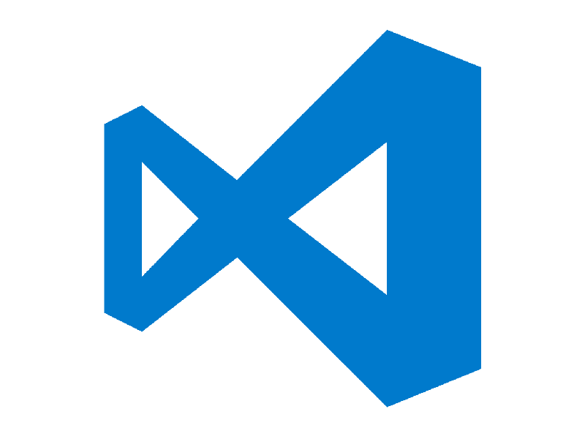
Selecting an Editor
Visual Studio
Visual Studio Code (VS Code)
Coda2
Atom
Eclipse
WebStorm

Slide 4
Selecting an Editor
VS Code runs on Windows, Mac, and Linux
Great support for Angular
Auto Completion
Intellisense
Syntax Checking
and Refactoring

Slide 5
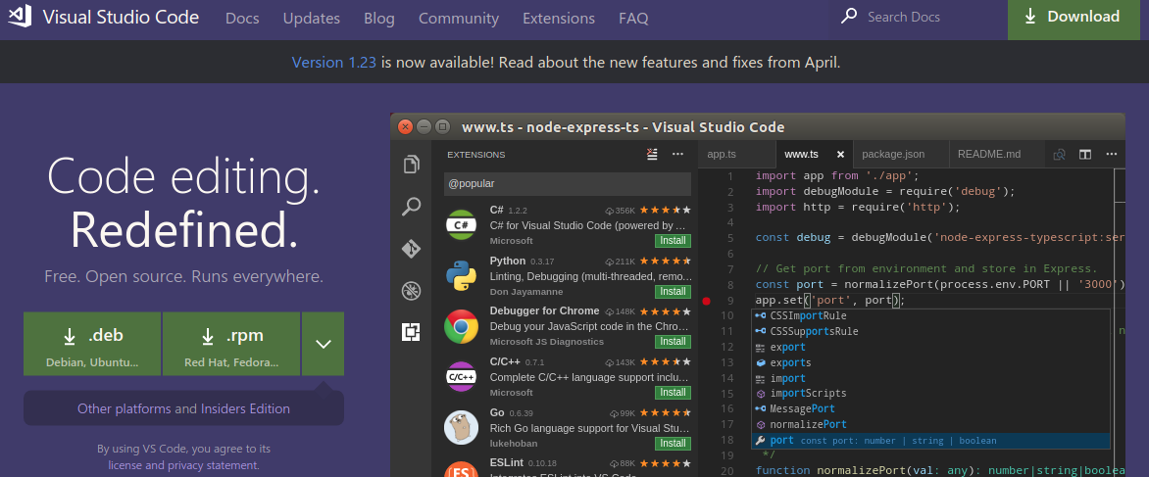
LAB – Installing VS Code
code.visualstudio.com

Slide 6
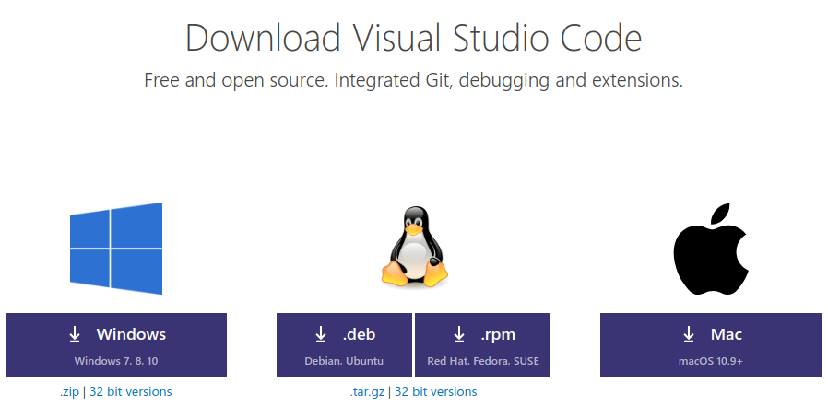
LAB – Installing VS Code
Choose the installer appropriate for your OS

Slide 7

LAB – Installing VS Code
Run the install

Slide 8
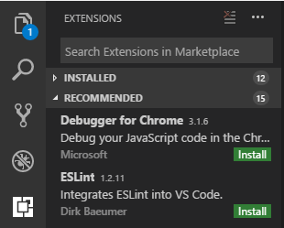
LAB – Installing VS Code
Once installed, open VS Code and open Extensions by clicking on the Extensions icon at the bottom of the left menu.
Use the Search to find Angular Essentials

Slide 9
LAB – Installing VS Code
Angular Essentials is an extension pack of several extensions that are very helpful for Angular development that are curated and maintained by Angular developer John Papa.
Angular v6 Snippets
Angular Language Service
EditorConfig for Visual Studio Code
TSlint
Debugger for Chrome
(You'll want to use Chrome with the Augury extension)
Path Intellisense
angular2-inline
Winter is Coming theme
Prettier – Code Formatter
Click INSTALL

Slide 10
LAB – Installing VS Code
Choose File > Preferences > Settings and in the User Settings and add the following to your settings to configure your new Extensions:
{
"window.zoomLevel": 1,
"gitlens.advanced.messages": {
"suppressShowKeyBindingsNotice": true
},
"editor.formatOnSave": true,
"prettier.singleQuote": true,
"prettier.eslintIntegration": true,
"prettier.tabWidth": 2,
"gitlens.historyExplorer.enabled": true,
"typescript.updateImportsOnFileMove.enabled": "always",
"editor.codeActionsOnSave": {
"source.organizeImports": true
}
}

Slide 11
LAB – Installing VS Code
Choose File > Preferences > Settings and in the User Settings and add the following to your settings to configure your new Extensions:
Grab it here: https://tinyurl.com/vscode-settings

Slide 12

NPM (Node Package Manager)
What is NPM? NPM is a command line utility that interacts with a repository of open source projects.
Using NPM, we can easily install libraries, packages, and applications - along with their dependencies.
We'll use NPM to install all of the libraries for Angular and to execute scripts to transpile our code and launch our Angular applications.

Slide 13
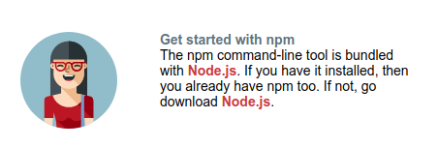
LAB – Installing NPM
npmjs.com
On the NPM site, scroll down to Get Started and then click on the link for node.js

Slide 14

LAB – Installing NPM
What is Node.js? Node.js is an open source server environment that uses JavaScript on the server
Node can:
generate dynamic page content
create, open, read, write, delete, and close files on the server
collect form data
add, delete, and modify data in your database

Slide 15
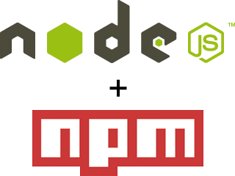
LAB – Installing NPM
Is Node.js a file?
.js is the conventional filename extension for JavaScript code
the name "Node.js" does not refer to a particular file in this context it is the name of the product
NPM is bundled with Node so to install NPM, you install Node.js and get both.

Slide 16
LAB – Installing Node.js and NPM
NVM – Node Version Manager
For Linux and macOS, use Node Version Manager (NVM). NVM is a community tool that allows you to run different versions of Node.js on your machine.

Slide 17
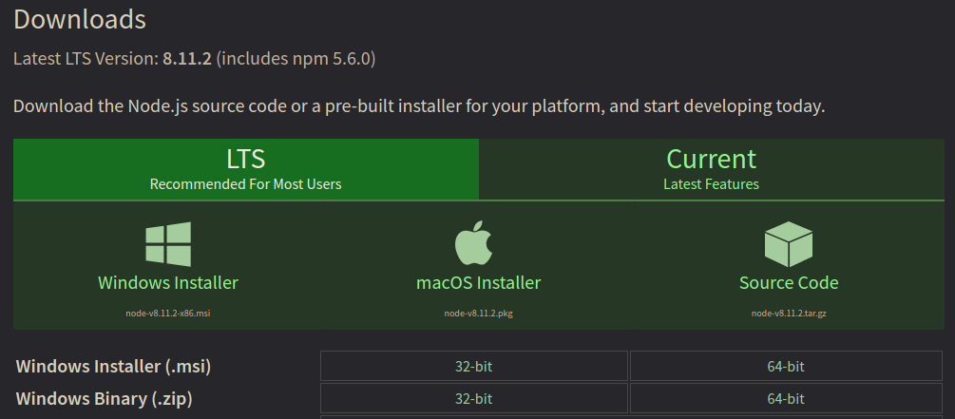
LAB – Installing Node.js and NPM
There is an NVM for Windows, but the install can be a bit involved, so for tonight just use the Nodejs.org Downloads page. Choose the LTS version installer appropriate for your version of Windows.

Slide 18
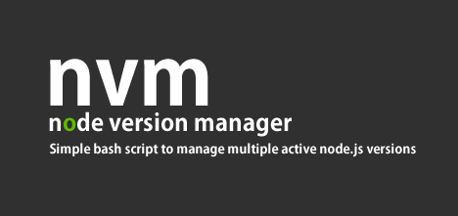
LAB – Installing NVM and Node.js and NPM
Install NVM on Linux or macOS - tinyurl.com/install-nvm
In your terminal install using Curl or Wget:
curl -o- https://raw.githubusercontent.com/creationix/nvm/v0.33.0/install.sh | bash
wget -qO- https://raw.githubusercontent.com/creationix/nvm/v0.33.0/install.sh | bash
Verify your installation:
nvm –version

Slide 19
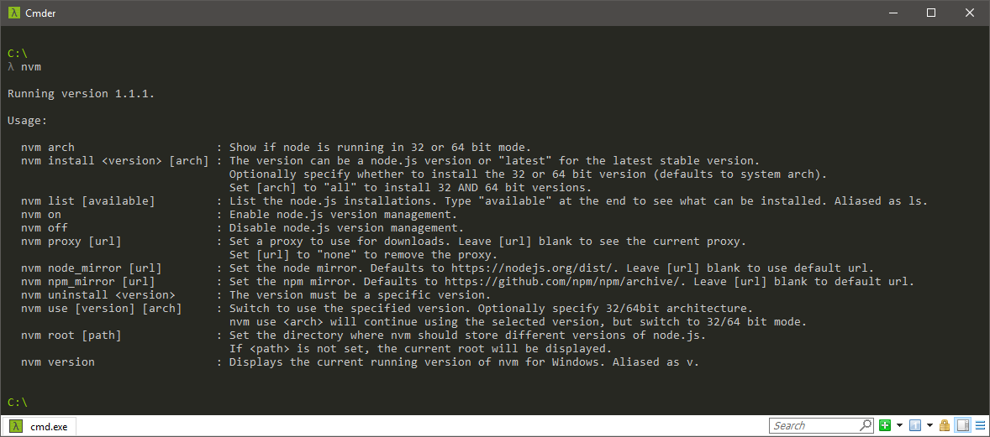
LAB – Installing NVM and Node.js and NPM
Install the latest available LTS version of Node.js and NPM:
nvm install –lts

Slide 20
Setting Up an Angular Application
Manual Steps:
Create an application folder
Add package definition and configuration files
Install the packages
Create the application's Angular Module
Create the main.ts file
Create the host page (index.html)

Slide 21

Setting Up an Angular Application

Slide 22
Setting Up an Angular Application
Setting this up manually is time consuming and prone to error, so luckily we have other options.
GitHub
The Angular team provides a set of quickstart files you can use to setup a boilerplate application. github.com/angular/quickstart
Angular CLI
Command line tool that will generate the setup files and boilerplate code for an Angular application.

Slide 23
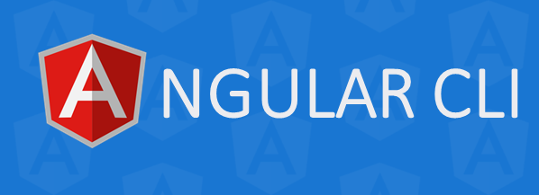
Setting Up an Angular Application
Angular CLI
Generates your components, services, modules, and other files.
Scaffolds and executes your unit and end-to-end-tests.
Provides options to minimize, package, and prepare the files you need for deployment.
Angular CLI is the recommended tool for building, testing, and deploying Angular applications. github.com/angular/angular-cli

Slide 24

LAB - Installing Angular CLI
Open a terminal and run:
npm install -g @angular/cli

Slide 25
LAB - Setting up a new Angular Project
Open a terminal and change to the directory where you want to place the new Angular project
Run:
ng new PROJECT-NAME
cd PROJECT-NAME
code .
ng serve -o
The application will automatically reload in your browser if you change any source files.
In VS Code, open src > app > app.component.html
Edit any of the text and you'll see the change in your browser.

Slide 26
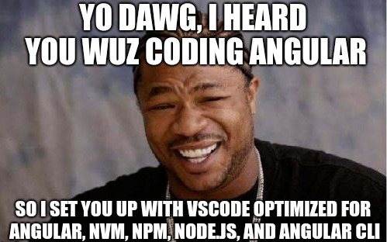
You now have all the tools you need to build Angular applications on your local machine.
But what about sharing your code and working collaboratively with a team ?
That's where Git comes in . . .

