Slide 1

May Meet-up
High Country Angular

Slide 2
Introduction
Why do we need another meet-up?
What’s so great about Angular?
Organizers
Wes Grimes
Chris Hampton
Sponsored by Samaritan’s Purse

Slide 3
Vision Statement
High Country Angular is a group of tech enthusiasts, web designers, software developers and engineers, gathering together on a regular basis to share knowledge, ideas, and lessons learned in working with the Angular framework.
We are working hard to create a culture of honor where questions big and small from beginners to experts are treated with the same respect.

Slide 4
Meetup Schedule
3rd Monday of Every Month
Future Location @ Samaritan’s Purse IHQ
Check meetup.com for schedule updates and changes
Submit topics for discussion via Twitter @ngHighCountry #meetup

Slide 5

Social Media
@ngHighCountry

Slide 6
Angular Basics
We’re going to build a Chuck Norris Joke Board
By the end you’ll be able to…
Use Stackblitz to create/develop a basic Angular App
Understand building blocks of a basic Angular App
Request data from external services using HttpClient

Slide 7
Angular Versions
AngularJS
v 1.x
Angular
v 2.x+
Actively Developed
TypeScript, ES2015 or ES5
Actively
Developed
Continued
Support
AngularJS is planning one more significant release, version 1.7, and on July 1, 2018 it will enter a 3 year Long Term Support period. - Angular Team, Jan 2018

Slide 8
Angular Overview
Languages
(TypeScript, ES2015+, ES5)
Modules
Components
Decorators
Dependency Injection
Services
Data Binding
Performance
Notes:
MODULE - Defines the set of injectable objects that are available in the injector of this module.
DECORATOR - Component decorator allows you to mark a class as an Angular component and provide additional metadata that determines how the component should be processed, instantiated and used at runtime.
COMPONENTS - Components are the most basic building block of an UI in an Angular application. An Angular application is a tree of Angular components. Angular components are a subset of directives. Unlike directives, components always have a template and only one component can be instantiated per an element in a template.
A component must belong to an NgModule in order for it to be usable by another component or application. To specify that a component is a member of an NgModule, you should list it in the declarations field of that NgModule.

Slide 9
The Big Picture
Header Component
Menu
Component
Grid Component
Footer Component

Slide 10
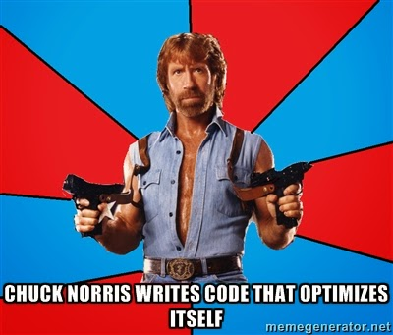



Slide 11
Typescript
The future of JavaScript is ES2015
Major update to the JavaScript language
Modules, classes and more
Will help you align with Angular
TypeScript builds on top of ES2015

Slide 12
Typescript
https://www.typescriptlang.org/play/
Notes:
Flip over to Chrome and go to https://www.typescriptlang.org/play/
- Explain that Typescript is just JavaScript under covers.
Types do not carry over.
For example, let greeter is really just var greeter.
function showAlert(message: string) {
alert(message);
}
showAlert(1);

Slide 13
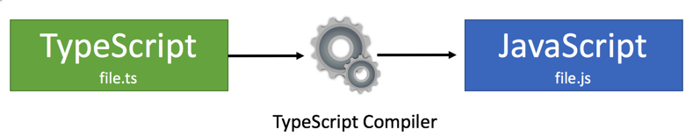
Typescript Compilation

Slide 14
Typescript Classes
TypeScript/ES2015 supports classes:
Define constructors
Define properties
Support for "inheritance" (uses prototyping)
Shortcut function names
Encapsulation of code!
Notes:
Flip back over to typescriptlang.org/play and show classes class Alert {
constructor(private message: string) { }
show() {
alert(this.message)
}
}
const myAlert = new Alert('Hello, world!');
myAlert.show();

Slide 15
Typescript Arrow Functions
Cleaner syntax
Easier nesting
“Fat arrow” =>
Function myFunction(inputVar)
Notes:
const strings = ['One', 'Two', 'Three'];
strings.forEach((item) => alert(item));
strings.forEach(showAlert);
function showAlert(item: string) {
alert(item);
}

Slide 16
Typescript Template Strings
Supports multi-line strings
Allow variables and expressions to be embedded in string literals using ${expression}
Use the ` character to start and end a string
Clean up situations where multiple strings are concatenated
Notes:
const showAlertWithPrefixNew = (prefix: string, message: string) => alert(`${prefix}: ${message}!`);
showAlertWithPrefixNew('Hello', 'Wes');
const showAlertWithPrefixOld = (prefix: string, message: string) => alert(prefix + ": " + message + "!");
showAlertWithPrefixOld('Hello', 'Wes');

Slide 17
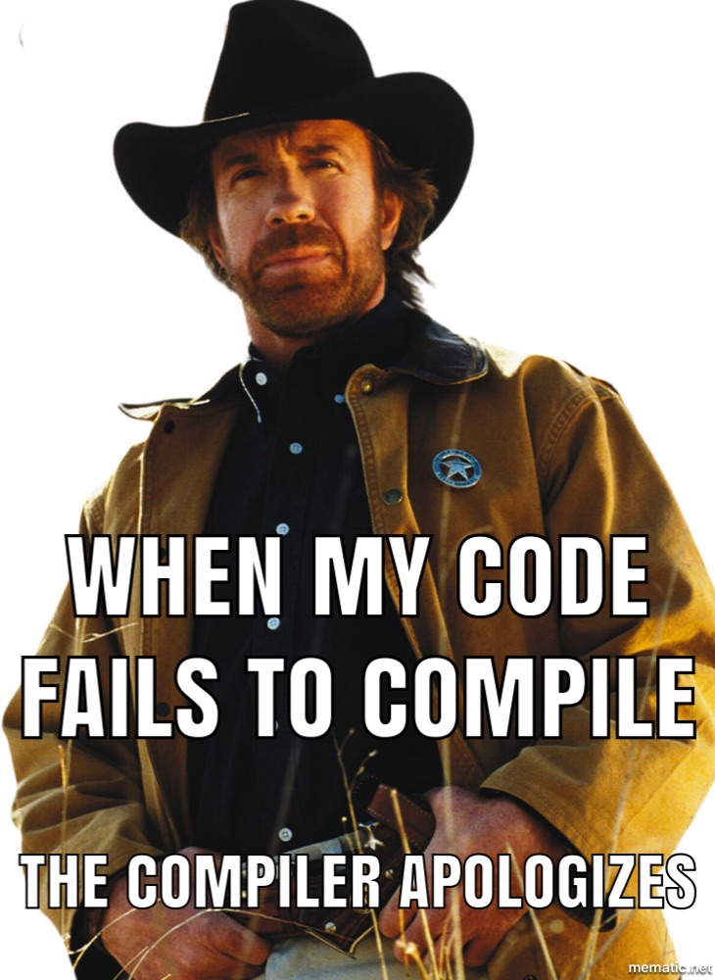
Let’s Get Coding…
Notes:
Go to stackblitz.com > Click Angular
Add @angular/material

