Slide 1

July Meet-up
High Country Angular

Slide 2
WiFi
Access Point: spvisitor
Password: greatness

Slide 3
Vision Statement
High Country Angular is a group of tech enthusiasts, web designers, software developers and engineers, gathering together on a regular basis to share knowledge, ideas, and lessons learned in working with the Angular framework.
We are working hard to create a culture of honor where questions big and small from beginners to experts are treated with the same respect.

Slide 4
Meetup Schedule
3rd Monday of Every Month
Future Location @ Samaritan’s Purse IHQ
Check meetup.com for schedule updates and changes
Submit topics for discussion via Twitter @ngHighCountry #meetup

Slide 5



Social Media
@ngHighCountry
facebook.com/ngHighCountry
bit.ly/ngHighCountryOnSlack

Slide 6
Website
HighCountryAngular.com

Slide 7
Angular Essentials
Languages
(TypeScript, ES2015+, ES5)
Modules
Components
Decorators
Dependency Injection
Services
Data Binding
Performance

Slide 8
Angular Components
What is an Angular Component? A component controls a patch of screen called a view

Slide 9
Angular Components
What are the major parts of a component?
A TypeScript Class
HTML Template
CSS/SASS Stylesheet

Slide 10
Angular Components
What are the major parts of a component?
TypeScript Class my.component.ts
HTML Template my.component.html
Stylesheet
my.component.css

Slide 11
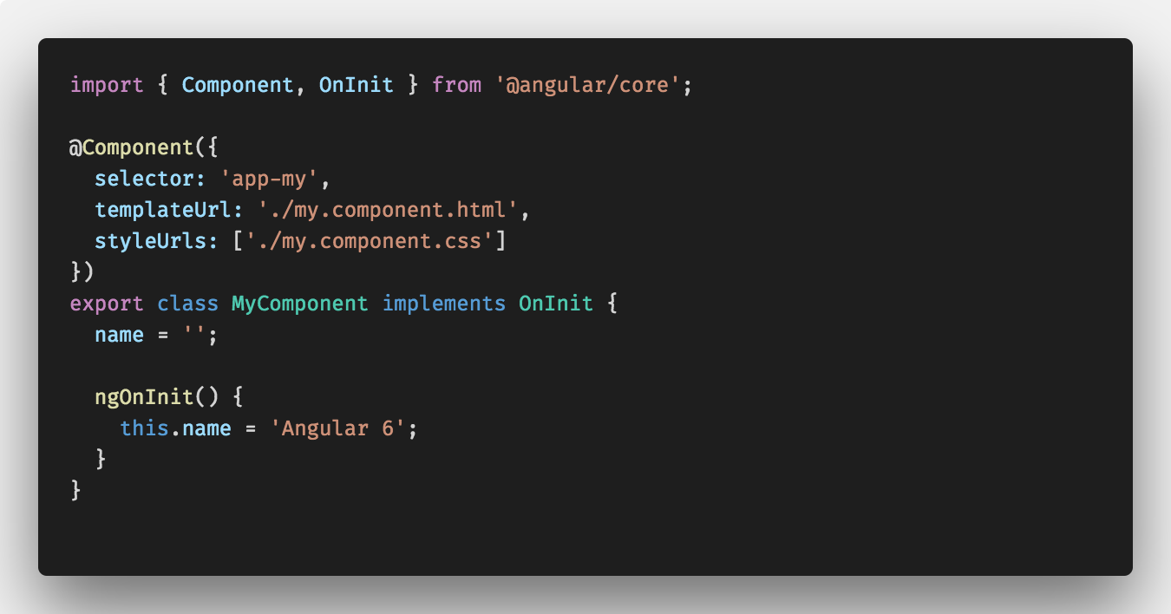
Angular Components
TypeScript Class - my.component.ts

Slide 12
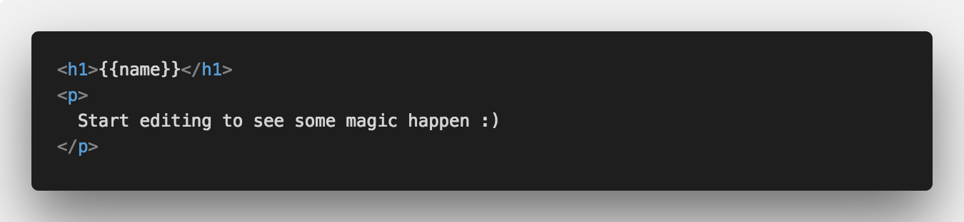
Angular Components
HTML Template - my.component.html

Slide 13
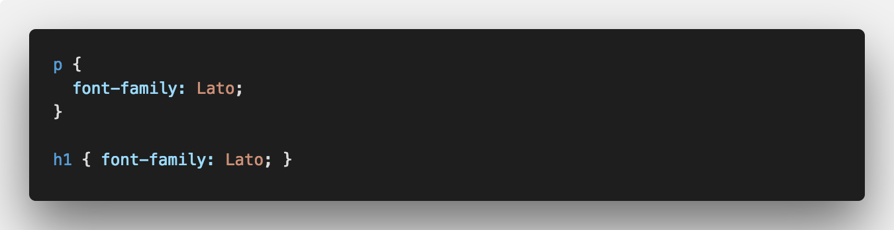
Angular Components
Stylesheet - my.component.css

Slide 14
Angular Components

Slide 15
Live Coding…

