Slide 1

May Meet-up
High Country Angular

Slide 2
Agenda
Introduction
Developer Machine Set-up
Let’s Build An Angular App

Slide 3
Who We Are
High Country Angular is a group of tech enthusiasts, web designers, software developers and engineers, gathering together on a regular basis to share knowledge, ideas, and lessons learned in working with the Angular framework.
We are working hard to create a culture of honor where questions big and small from beginners to experts are treated with the same respect.

Slide 4

Social Media
@ngHighCountry

Slide 5
WiFi Password
Password123

Slide 6
Machine Set-up
Essential Software
Visual Studio Code aka “VS Code”
Node
Angular CLI
Google Chrome

Slide 7
VS Code
Download from code.visualstudio.com
Installation
Mac - Drag “Visual Studio Code.app” to Applications
Windows - Double-click and run installer
Linux - code.visualstudio.com/docs/setup/linux

Slide 8
VS Code - Extensions
Launch command palette
Windows & Linux - Ctrl + Shift + P
Mac - Cmd + P
Angular Essentials “ext install johnpapa.angular-essentials”
Prettier “ext install prettier”

Slide 9
NodeJS
What is NodeJS?
Installation using NVM (Node Version Manager)
http://github.com/creationix/nvm - install-script
“nvm install lts”
“nvm alias default lts”

Slide 10
Angular CLI
What is Angular CLI?
“npm install -g @angular/cli”

Slide 11
Google Chrome
Why Chrome?
Download from google.com/chrome

Slide 12
Angular Basics
We’re going to build a Chuck Norris Joke Board
By the end you’ll be able to…
Use Stackblitz to create/develop a basic Angular App
Understand building blocks of a basic Angular App
Request data from external services using HttpClient

Slide 13
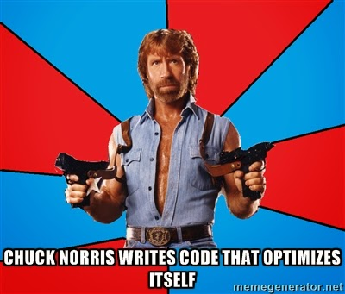



Slide 14
Angular Versions
AngularJS
v 1.x
Angular
v 2.x+
Actively Developed
TypeScript, ES2015 or ES5
Actively
Developed
Continued
Support
AngularJS is planning one more significant release, version 1.7, and on July 1, 2018 it will enter a 3 year Long Term Support period. - Angular Team, Jan 2018

Slide 15
Angular Overview
Languages
(TypeScript, ES2015+, ES5)
Modules
Components
Decorators
Dependency Injection
Services
Data Binding
Performance
Notes:
MODULE - Defines the set of injectable objects that are available in the injector of this module.
DECORATOR - Component decorator allows you to mark a class as an Angular component and provide additional metadata that determines how the component should be processed, instantiated and used at runtime.
COMPONENTS - Components are the most basic building block of an UI in an Angular application. An Angular application is a tree of Angular components. Angular components are a subset of directives. Unlike directives, components always have a template and only one component can be instantiated per an element in a template.
A component must belong to an NgModule in order for it to be usable by another component or application. To specify that a component is a member of an NgModule, you should list it in the declarations field of that NgModule.

Slide 16
The Big Picture
Header Component
Menu
Component
Grid Component
Footer Component

Slide 17
Typescript
The future of JavaScript is ES2015
Major update to the JavaScript language
Modules, classes and more
Will help you align with Angular
TypeScript builds on top of ES2015

Slide 18
Typescript
https://www.typescriptlang.org/play/
Notes:
Flip over to Chrome and go to https://www.typescriptlang.org/play/
- Explain that Typescript is just JavaScript under covers.
Types do not carry over.
For example, let greeter is really just var greeter.
function showAlert(message: string) {
alert(message);
}
showAlert(1);

Slide 19
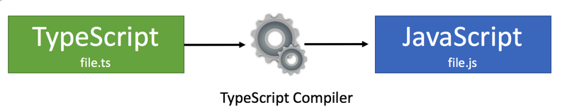
Typescript Compilation

Slide 20
Typescript Classes
TypeScript/ES2015 supports classes:
Define constructors
Define properties
Support for "inheritance" (uses prototyping)
Shortcut function names
Encapsulation of code!
Notes:
Flip back over to typescriptlang.org/play and show classes class Alert {
constructor(private message: string) { }
show() {
alert(this.message)
}
}
const myAlert = new Alert('Hello, world!');
myAlert.show();

Slide 21
Typescript Arrow Functions
Cleaner syntax
Easier nesting
“Fat arrow” =>
Function myFunction(inputVar)
Notes:
const strings = ['One', 'Two', 'Three'];
strings.forEach((item) => alert(item));
strings.forEach(showAlert);
function showAlert(item: string) {
alert(item);
}

Slide 22
Typescript Template Strings
Supports multi-line strings
Allow variables and expressions to be embedded in string literals using ${expression}
Use the ` character to start and end a string
Clean up situations where multiple strings are concatenated
Notes:
const showAlertWithPrefixNew = (prefix: string, message: string) => alert(`${prefix}: ${message}!`);
showAlertWithPrefixNew('Hello', 'Wes');
const showAlertWithPrefixOld = (prefix: string, message: string) => alert(prefix + ": " + message + "!");
showAlertWithPrefixOld('Hello', 'Wes');

Slide 23
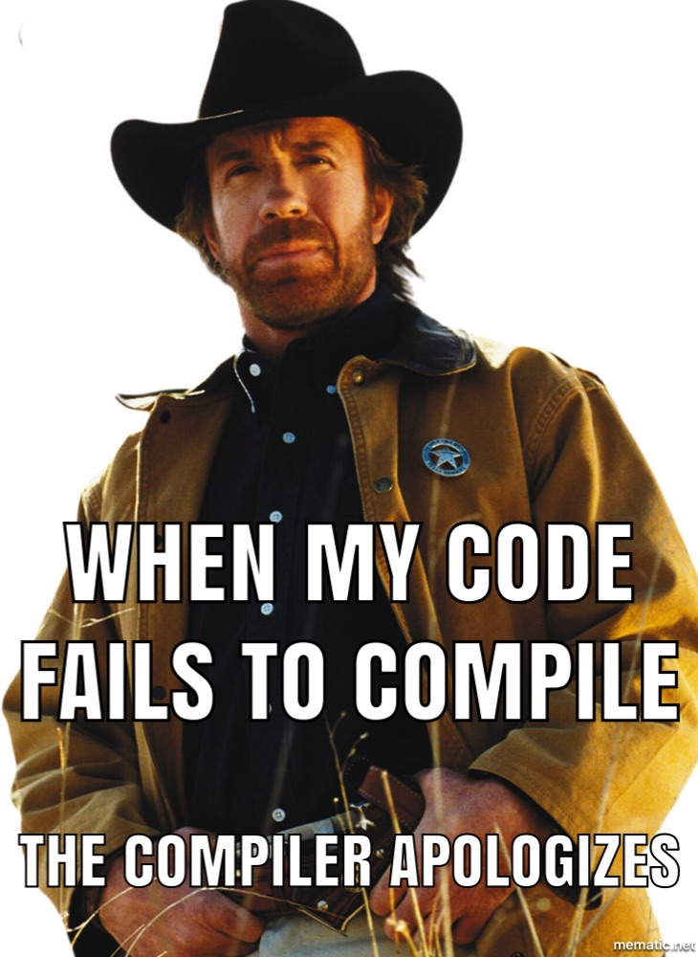
Let’s Get Coding…
Notes:
Go to stackblitz.com > Click Angular
Add @angular/material

