Slide 1
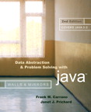
Chapter 1
Review of Java Fundamentals
© 2006 Pearson Addison-Wesley. All rights reserved
1-<number>

Slide 2

Program Structure
Typical Java program consists of
  User written classes
  Java Application Programming Interface (API) classes
Java application
  Has one class with a main method
Java program basic elements:
  Packages
  Classes
  Data fields
  Methods
© 2006 Pearson Addison-Wesley. All rights reserved
1-<number>

Slide 3
Packages
Provide a mechanism for grouping related classes
package statement
  Indicates a class is part of a package
Java assumes all classes in a particular package are contained in same directory
Java API consists of many predefined packages
import statement
  Allows you to use classes contained in other packages
Package java.lang is implicitly imported to all Java code
© 2006 Pearson Addison-Wesley. All rights reserved
1-<number>

Slide 4
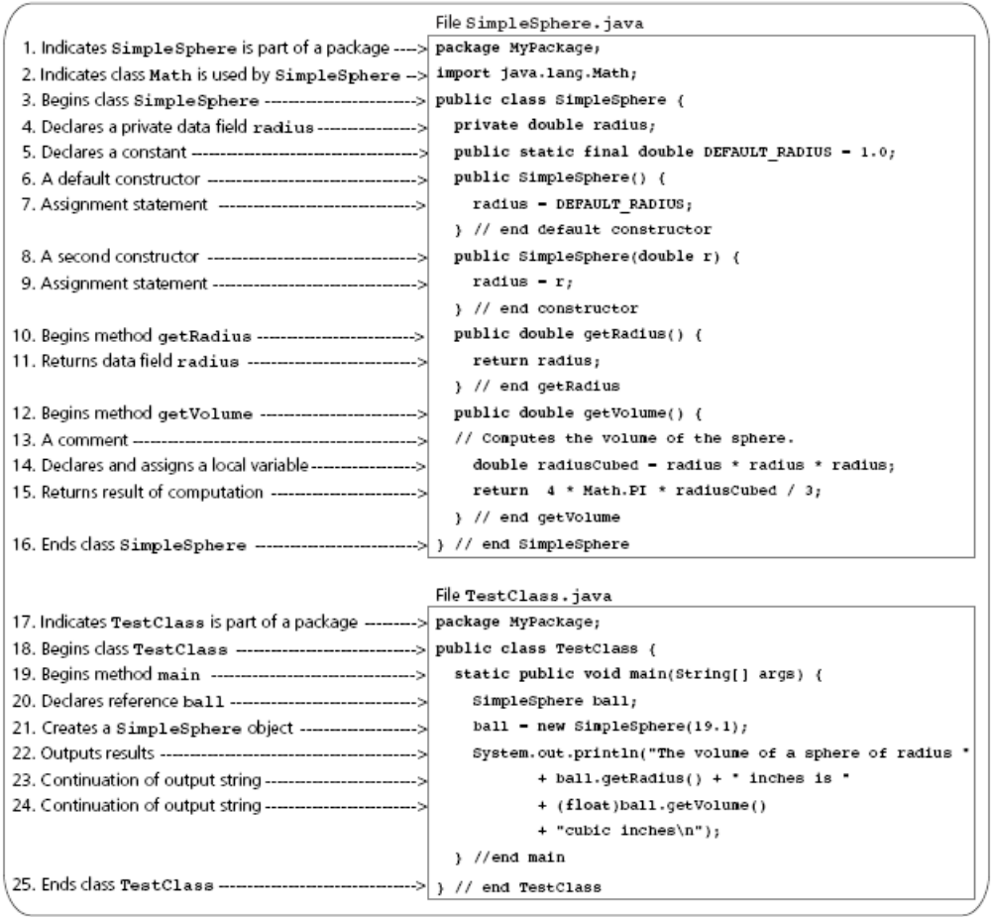
Packages
A simple Java Program
© 2006 Pearson Addison-Wesley. All rights reserved
1-<number>

Slide 5
Classes
Data type that specifies data and methods available for instances of the class
An object in Java is an instance of a class
Class definition includes
  Optional subclassing modifier
  Optional access modifier
  Keyword class
  Optional extends clause
  Optional implements clause
  Class body
© 2006 Pearson Addison-Wesley. All rights reserved
1-<number>

Slide 6
Classes
Every Java class is a subclass of either
  Another Java class
  Object class
new operator
  Creates an object or instance of a class
© 2006 Pearson Addison-Wesley. All rights reserved
1-<number>

Slide 7
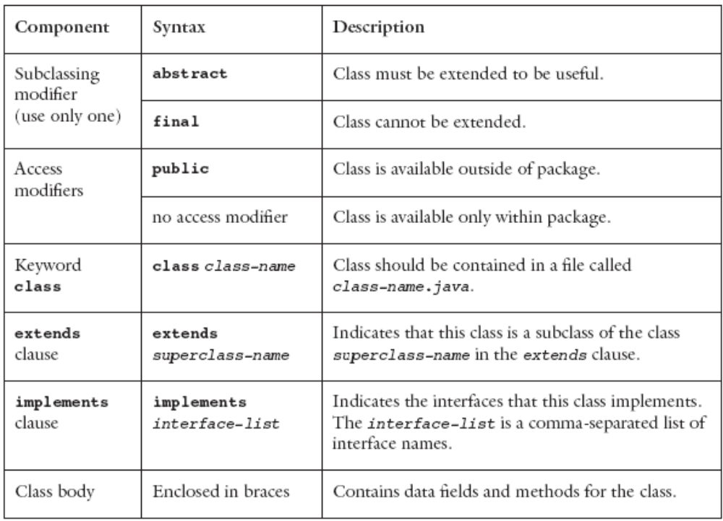
Classes
Components of a class
© 2006 Pearson Addison-Wesley. All rights reserved
1-<number>

Slide 8
Data Fields
Class members that are either variables or constants
Data field declarations can contain
  Access modifiers
  Use modifiers
© 2006 Pearson Addison-Wesley. All rights reserved
1-<number>

Slide 9
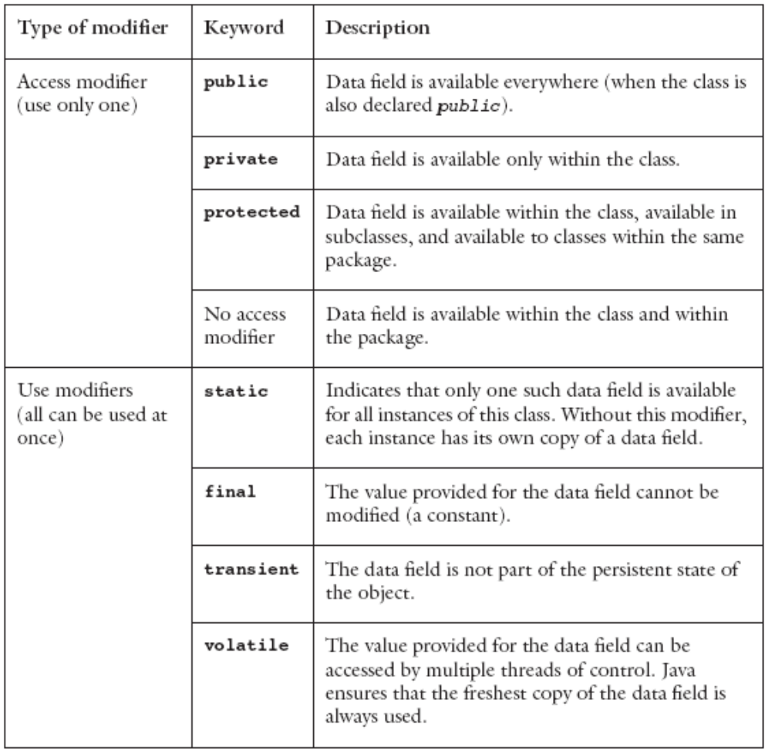
Data Fields
Modifiers used in data field declarations
© 2006 Pearson Addison-Wesley. All rights reserved
1-<number>

Slide 10
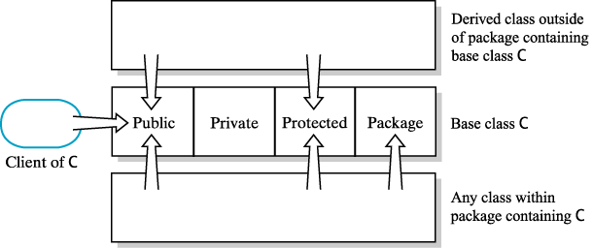
Access Scope
Public, private, protected, and package access
© 2006 Pearson Addison-Wesley. All rights reserved
1-<number>

Slide 11
Methods
Used to implement operations
Should perform one well-defined task
Method modifiers
  Access modifiers and use modifiers
Valued method
  Returns a value
  Body must contain return expression;
© 2006 Pearson Addison-Wesley. All rights reserved
1-<number>

Slide 12
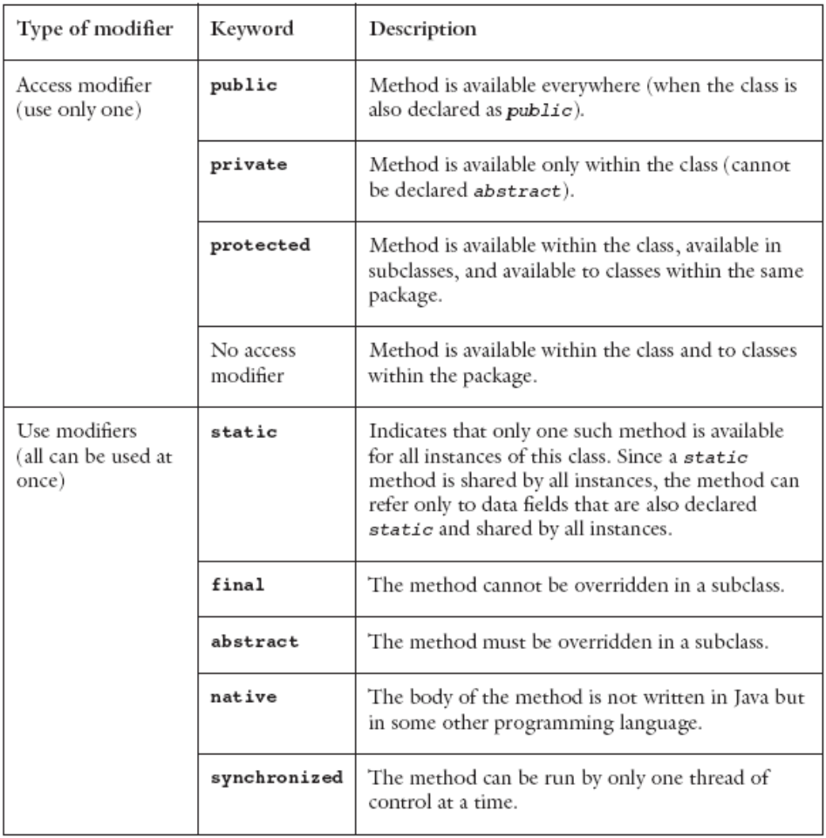
Method Modifiers
Modifiers used in a method declaration
© 2006 Pearson Addison-Wesley. All rights reserved
1-<number>

Slide 13
Methods
Syntax of a method declaration
  access-modifier use-modifiers return-type
  method-name (formal-parameter-list) {
  method-body
  }
Arguments are passed by value for primitive data type
  Except for objects and arrays
    A reference value is copied instead
© 2006 Pearson Addison-Wesley. All rights reserved
1-<number>

Slide 14
Constructor
Constructor
  Special kind of method
  Has the same name as the class and no return type
  Executed only when an object is created
A class can contain multiple constructors
© 2006 Pearson Addison-Wesley. All rights reserved
1-<number>

Slide 15
How to Access Members of an Object
Data fields and methods declared public
  Name the object, followed by a period, followed by member name
Members declared static
  Use the class name, followed by a period, followed by member name
© 2006 Pearson Addison-Wesley. All rights reserved
1-<number>

Slide 16
Language Basics
Java application
  Collection of classes
    One class contains the main method
Java programs can also be written as applets
  Comments
Comment line
  Begins with two slashes (//)
  Continues until the end of the line
Multiple-line comment
  Begins with /* and ends with */
  Useful for debugging
  Cannot contain another multiple-line comment
javadoc comments
  Begins with /** and ends with */
© 2006 Pearson Addison-Wesley. All rights reserved
1-<number>

Slide 17
Identifiers and Keywords
Identifier
  Sequence of letters, digits, underscores, and dollar signs
  Must begin with either a letter or underscore
  Used to name various parts of the program
  Java distinguishes between uppercase and lowercase letters
Keywords
  Java reserved identifiers
© 2006 Pearson Addison-Wesley. All rights reserved
1-<number>

Slide 18
Variables
Represents a memory location
Contains a value of primitive type or a reference
Its name is a Java identifier
Declared by preceding variable name with data type
  double radius; // radius of a sphere
  String name; // reference to a String object
© 2006 Pearson Addison-Wesley. All rights reserved
1-<number>

Slide 19
Static Fields and Methods
A data field that does not belong to any one object
Adding reserved word static:
  private static int numOfInvocation = 0;
Also called:
static field, static variable, class variable
One copy of that data item exists to be shared by all the instances of the class
© 2006 Pearson Addison-Wesley. All rights reserved
1-<number>

Slide 20
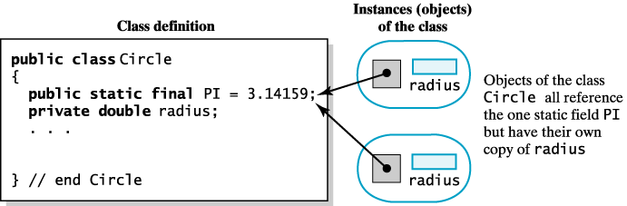
Static Fields
Static does not mean constant, shared by all objects of its class, but value can change. Objects can use a static field to communicate with each other to perform some joint action.
private static int numberOfInvocations = 0;
A static PI versus a non static field
© 2006 Pearson Addison-Wesley. All rights reserved
1-<number>

Slide 21
Static Methods
A method that does not belong to an object of any kind.
You use the class name instead of an object name to invoke the method.
Java predefined class math contains standard mathematical methods.
  int maximum = Math.max(2,3);
  double root = Math.sqrt(4.2);
Static method cannot access non-static fields, nor non-static methods.
Constructors cannot be static.
© 2006 Pearson Addison-Wesley. All rights reserved
1-<number>

Slide 22
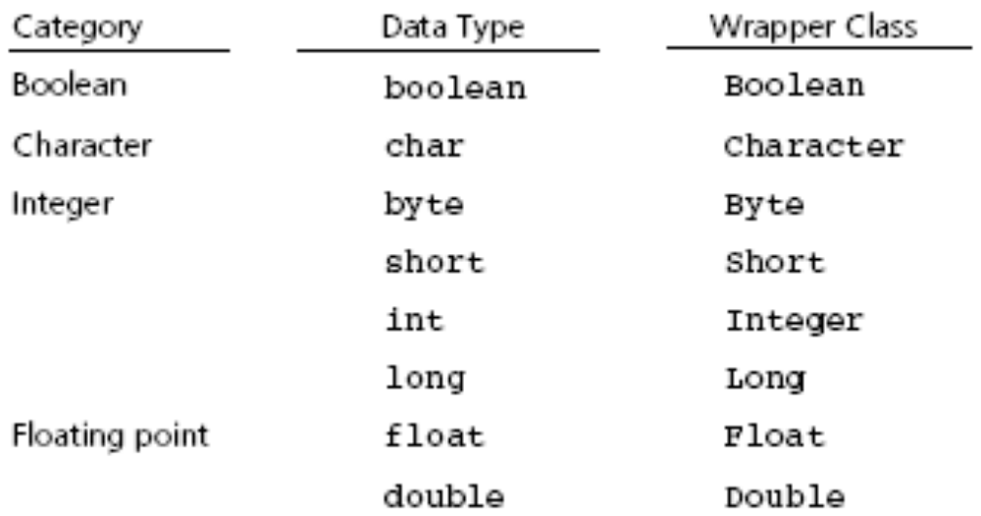
Primitive Data Types
Value of primitive type is not considered an object
java.lang provides wrapper classes for each of the primitive types
© 2006 Pearson Addison-Wesley. All rights reserved
1-<number>

Slide 23
Primitive type and Reference type
Primitive types: (Built-in to Java)
  A chunk of memory holding the data itself
  byte, short, int, long float, double, char, boolean
  E.g. int number1;
All other types are reference or class types
  All objects defined from classes
  The object “refers to” or “points to” the chunk of memory that actually holds the data
  String greeting = "Howdy";
  greeting is a reference variable instead of the actual string
  Set to null value for an reference-variable
  When two variables reference the same instance, they are considered aliases
© 2006 Pearson Addison-Wesley. All rights reserved
1-<number>

Slide 24
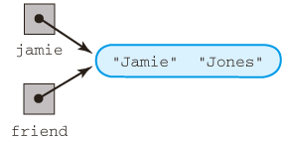
References and Aliases
Name jamie = new Name();
jamie.setFirst(“Jamie”);
jamie.setLast(“Jones”);
Name friend = jamie;
Two references, one chunk of data
Is friend == jamie?
© 2006 Pearson Addison-Wesley. All rights reserved
1-<number>
Aliases of an object

Slide 25
Method Passing Arguments
Call by value
  For primitive type, formal parameter initialized to value of corresponding argument in call. Method cannot change the value of the argument.
Call by reference
  For a reference type, formal parameter is initialized to the memory address of the object in the call. Method can change the data in the object.
© 2006 Pearson Addison-Wesley. All rights reserved
1-<number>

Slide 26
Example 1
public void giveLastNameTo(Name child)
{
  child.setLast(last);
}
public static void main(String[] args)
{
  Name jamie = new Name();
  jamie.setFirst(“Jamie”);
  jamie.setLast(“Jones”);
  Name jane = new Name();
  jane.setFirst(“Jane”);
  jane.setLast(“Doe”);
  jamie.giveLastNameTo(jane);
}
© 2006 Pearson Addison-Wesley. All rights reserved
1-<number>

Slide 27
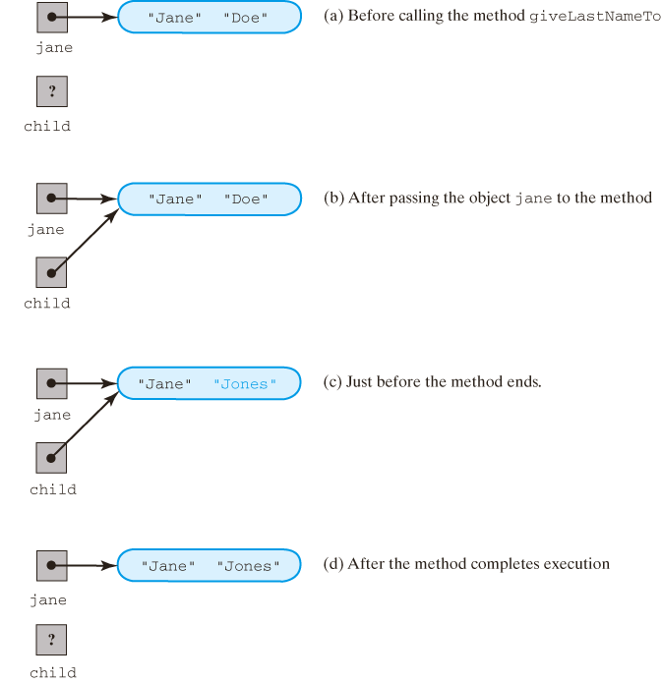
Passing Arguments
The method giveLastNameTo modifies the object passed to it as an argument.
© 2006 Pearson Addison-Wesley. All rights reserved
1-<number>

Slide 28
Passing Arguments
The method giveLastNameTo modifies the object passed to it as an argument.
© 2006 Pearson Addison-Wesley. All rights reserved
1-<number>

Slide 29
Example 2
public void giveLastNameTo(Name Child)
{
  String firstName = child.getFirst();
  child = new Name();
  child.setLast(last);
  child.setFirst(firstName);
}
public static void main(String[] args)
{
  Name jamie = new Name();
  jamie.setFirst(“Jamie”);
  jamie.setLast(“Jones”);
  Name jane = new Name();
  jane.setFirst(“Jane”);
  jane.setLast(“Doe”);
  jamie.giveLastNameTo(jane);
}
© 2006 Pearson Addison-Wesley. All rights reserved
1-<number>

Slide 30
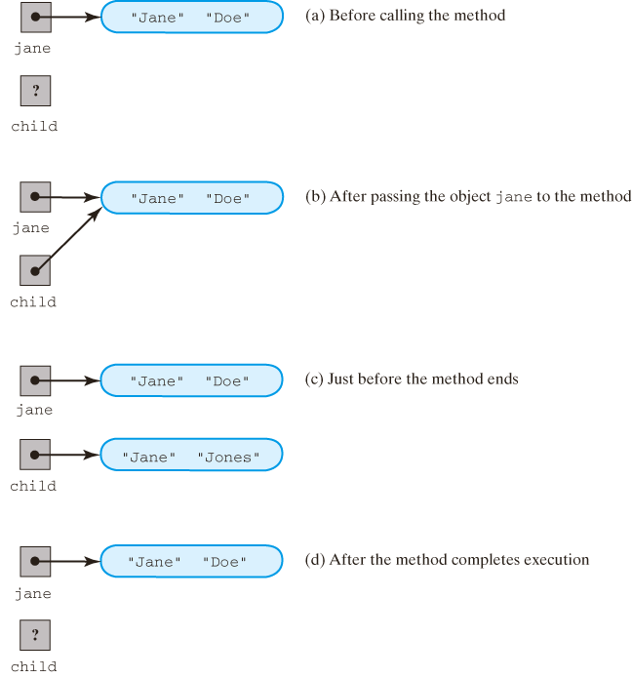
Passing Arguments
A method cannot replace an object passed to it as an argument.
© 2006 Pearson Addison-Wesley. All rights reserved
1-<number>

Slide 31
Passing Arguments
A method cannot replace an object passed to it as an argument.
© 2006 Pearson Addison-Wesley. All rights reserved
1-<number>

Slide 32
Coding Conventions
Naming conventions
  conventions are things we suggest to make code more consistent and easier to understand
  this is purely aesthetic; not enforced by the compiler
We use capitalization to distinguish an identifier’s purpose
  class names begin with upper case letters: Use noun or descriptive phrase
  method, variable names begin with lower case: Use verb or action phrase
  instance variables start with an underscore
Good Name
Student
takeClass
_cs220Student
Poor Name
Thing (no role, purpose)
doStuff (not specific)
c (too cryptic)
Class
Method
object
© 2006 Pearson Addison-Wesley. All rights reserved
1-<number>

Slide 33
Java Statements Review
© 2006 Pearson Addison-Wesley. All rights reserved
1-<number>

Slide 34
Assignments and Expressions
Expressions
  Combination of variables, constants, operators, and parentheses
Assignment statement
  Example: radius = r;
Arithmetic expression
  Combine variables and constants with arithmetic operators and parentheses
    Arithmetic operators: *, /, %, +, -
© 2006 Pearson Addison-Wesley. All rights reserved
1-<number>

Slide 35
Assignments and Expressions
Relational expressions
  Combine variables and constants with relational, or comparison, and equality operators and parentheses
    Relational or comparison operators: <, <=, >=. >
    Equality operators: ==, !=
  Evaluate to true or false
© 2006 Pearson Addison-Wesley. All rights reserved
1-<number>

Slide 36
Assignments and Expressions
Logical expressions
  Combine variables and constants of arithmetic types, relational expressions with logical operators
    Logical operators: &&, ||
  Evaluate to true or false
  Short-circuit evaluation
    Evaluates logical expressions from left to right
    Stops as soon as the value of expression is apparent
© 2006 Pearson Addison-Wesley. All rights reserved
1-<number>

Slide 37
Assignments and Expressions
Implicit type conversions
  Occur during assignment and during expression evaluation
  Right-hand side of assignment operator is converted to data type of item on left-hand side
  Floating-point values are truncated not rounded
  Integral promotion
    Values of type byte, char, or short are converted to int
  Conversion hierarchy
    int → long → float → double
© 2006 Pearson Addison-Wesley. All rights reserved
1-<number>

Slide 38
Assignments and Expressions
Explicit type conversions
  Possible by means of a cast
  Cast operator
    Unary operator
    Formed by enclosing the desired data type within parentheses
Multiple assignments
  Embed assignment expressions within assignment expressions
    Example: a = 5 + (b = 4)
    Evaluates to 9 while b is assigned 4
© 2006 Pearson Addison-Wesley. All rights reserved
1-<number>

Slide 39
Assignments and Expressions
Other assignment operators
  -=
  *=
  /=
  %=
  ++
  --
© 2006 Pearson Addison-Wesley. All rights reserved
1-<number>

Slide 40
Arrays
Collection of elements with the same data type
Array elements have an order
Support direct and random access
One-dimensional arrays
  Declaration example
    final int DAYS_PER_WEEK = 7;
    double [] maxTemps = new double[DAYS_PER_WEEK];
  Length of an array is accessible using data field length
  Use an index or subscript to access an array element
© 2006 Pearson Addison-Wesley. All rights reserved
1-<number>

Slide 41
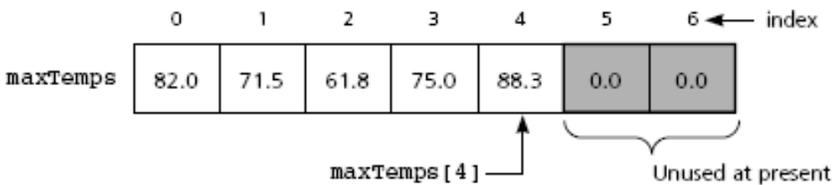
Arrays
Figure 1-7
One-dimensional array of at most seven elements
© 2006 Pearson Addison-Wesley. All rights reserved
1-<number>

Slide 42
Arrays
One-dimensional arrays (continued)
  Initializer list example
    double [] weekDayTemps = {82.0, 71.5, 61.8, 75.0, 88.3};
  You can also declare array of object references
Multidimensional arrays
  Use more than one index
  Declaration example
    final int DAYS_PER_WEEK = 7;
    final int WEEKS_PER_YEAR = 52;
    double[][] minTemps = new double[DAYS_PER_WEEK][WEEKS_PER_YEAR];
© 2006 Pearson Addison-Wesley. All rights reserved
1-<number>

Slide 43
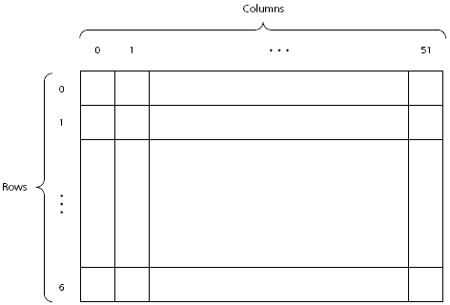
Arrays
Figure 1-8
A two-dimensional array
© 2006 Pearson Addison-Wesley. All rights reserved
1-<number>

Slide 44
Arrays
Passing an array to a method
  Declare the method as follows:
    public double averageTemp(double[] temps, int n)
  Invoke the method by writing:
    double avg = averageTemp(maxTemps, 6);
  Location of array is passed to the method
    Cannot return a new array through this value
  Method can modify content of the array
© 2006 Pearson Addison-Wesley. All rights reserved
1-<number>

Slide 45
Selection Statements
The if statement
  if (expression)
  statement1
or
  if (expression)
  statement1
  else
  statement2
Nested if
  if (expression) {
  statement1
  }
  else if (expression) {
  statement2
  }
  else {
  statement3
  } // end if
© 2006 Pearson Addison-Wesley. All rights reserved
1-<number>

Slide 46
Selection Statements
The switch statement
  switch (integral expression) {
  case 1:
  statement1;
  break;
  case 2, case 3:
  statement2;
  case 4:
  statement3;
  break;
  default:
  statement4;
  } //end of switch
© 2006 Pearson Addison-Wesley. All rights reserved
1-<number>

Slide 47
Iteration Statements
The while statement
  while (expression) {
  statement
  }
statement is executed as long as expression is true
statement may not be executed at all
continue expression
  Stops the current iteration of the loop and begins the next iteration at the top of the loop
© 2006 Pearson Addison-Wesley. All rights reserved
1-<number>

Slide 48
Iteration Statements
The for statement
  for (initialize; test; update)
  statement
statement is executed as long as test is true
for statement is equivalent to a while statement
The for loop and arrays
  for (ArrayElementType variableName : arrayName)
  statement
© 2006 Pearson Addison-Wesley. All rights reserved
1-<number>

Slide 49
Iteration Statements
The do statement
  do {
  statement
  } while (expression);
statement is executed until expression is false
do statement loops at least once
© 2006 Pearson Addison-Wesley. All rights reserved
1-<number>

Slide 50
Useful Java Classes
The Object class
  Java supports a single class inheritance hierarchy
    With class Object as the root
  More useful methods
    public boolean equals(Object obj)
    protected void finalize()
    public int hashCode()
    public String toString()
© 2006 Pearson Addison-Wesley. All rights reserved
1-<number>

Slide 51
Useful Java Classes
String classes
  Class String
    Declaration examples:
      String title;
      String title = “Walls and Mirrors”;
    Assignment example:
      Title = “Walls and Mirrors”;
    String length example:
      title.length();
    Referencing a single character
      title.charAt(0);
    Comparing strings
      title.compareTo(string2);
© 2006 Pearson Addison-Wesley. All rights reserved
1-<number>

Slide 52
Useful Java Classes
String classes (continued)
  Class String
    Concatenation example:
      String monthName = "December";
      int day = 31;
      int year = 02;
      String date = monthName + " " + day + ", 20" + year;
© 2006 Pearson Addison-Wesley. All rights reserved
1-<number>

Slide 53
Useful Java Classes
String classes (continued)
  Class StringBuffer
    Creates mutable strings
    Provides same functionality as class String
    More useful methods
      public StringBuffer append(String str)
      public StringBuffer insert(int offset, String str)
      public StringBuffer delete(int start, int end)
      public void setCharAt(int index, char ch)
      public StringBuffer replace(int start, int end, String str)
© 2006 Pearson Addison-Wesley. All rights reserved
1-<number>

Slide 54
Useful Java Classes
String classes (continued)
  Class StringTokenizer
    Allows a program to break a string into pieces or tokens
    More useful methods
      public StringTokenizer(String str)
      public StringTokenizer(String str, String delim)
      public StringTokenizer(String str, String delim, boolean returnTokens)
      public String nextToken()
      public boolean hasMoreTokens()
© 2006 Pearson Addison-Wesley. All rights reserved
1-<number>

Slide 55
Java Exceptions
Exception
  Handles an error during execution
Throw an exception
  To indicate an error during a method execution
Catch an exception
  To deal with the error condition
© 2006 Pearson Addison-Wesley. All rights reserved
1-<number>

Slide 56
Catching Exceptions
Java provides try-catch blocks
  To handle an exception
Place statement that might throw an exception within the try block
  Must be followed by one or more catch blocks
  When an exception occurs, control is passed to catch block
Catch block indicates type of exception you want to handle
© 2006 Pearson Addison-Wesley. All rights reserved
1-<number>

Slide 57
Catching Exceptions
try-catch blocks syntax
  try {
  statement(s);
  }
  catch (exceptionClass identifier) {
  statement(s);
  }
Some exceptions from the Java API cannot be totally ignored
  You must provide a handler for that exception
© 2006 Pearson Addison-Wesley. All rights reserved
1-<number>

Slide 58
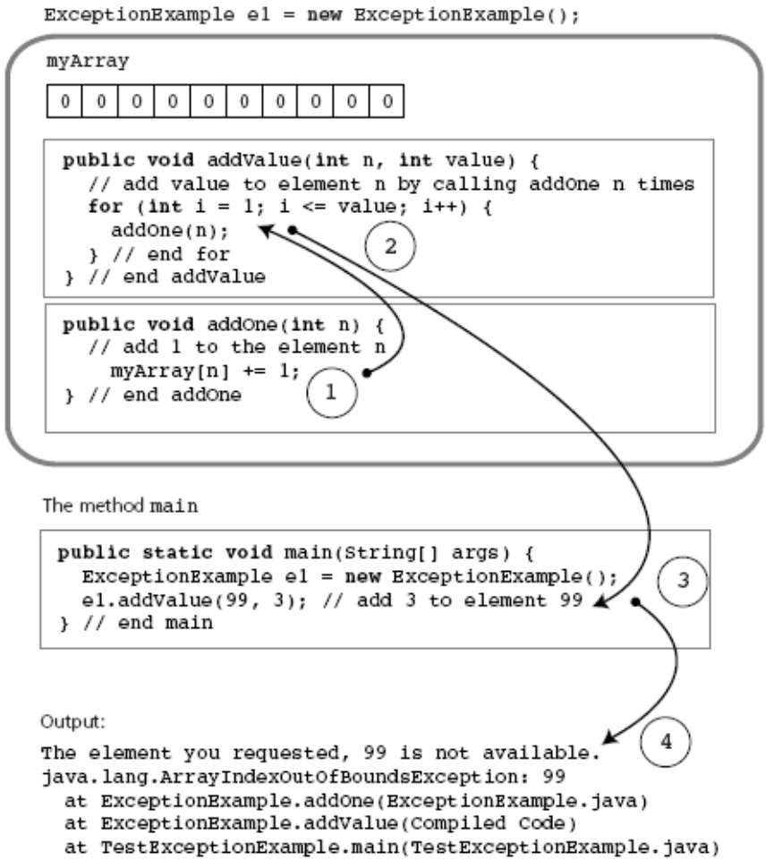
Catching Exceptions
Figure 1-9
Flow of control in a simple Java application
© 2006 Pearson Addison-Wesley. All rights reserved
1-<number>

Slide 59
Catching Exceptions
Types of exception
  Checked exceptions
    Instances of classes that are subclasses of java.lang.Exception
    Must be handled locally or thrown by the method
    Used when method encounters a serious problem
  Runtime exceptions
    Occur when the error is not considered serious
    Instances of classes that are subclasses of java.lang.RuntimeException
© 2006 Pearson Addison-Wesley. All rights reserved
1-<number>

Slide 60
Catching Exceptions
The finally block
  Executed whether or not an exception is thrown
  Can be used even if no catch block is used
  Syntax
    finally {
    statement(s);
    }
© 2006 Pearson Addison-Wesley. All rights reserved
1-<number>

Slide 61
Throwing Exceptions
throws clause
  Indicates a method may throw an exception
    If an error occurs during its execution
  Syntax
    public methodName throws ExceptionClassName
throw statement
  Used to throw an exception at any time
  Syntax
    throw new exceptionClass(stringArgument);
You can define your own exception class
© 2006 Pearson Addison-Wesley. All rights reserved
1-<number>

Slide 62
Text Input and Output
Input and output consist of streams
Streams
  Sequence of characters that either come from or go to an I/O device
  InputStream - Input stream class
  PrintStream - Output stream class
java.lang.System provides three stream variables
  System.in – standard input stream
  System.out – standard output stream
  System.err – standard error stream
© 2006 Pearson Addison-Wesley. All rights reserved
1-<number>

Slide 63
Input
Prior to Java 1.5
  BufferedReader stdin = new BufferedReader(new InputStreamReader(System.in));
  String nextLine = stdin.readLine();
  StringTokenizer input = new StringTokenizer(nextLine);
  x = Integer.parseInt(input.nextToken());
  y = Integer.parseInt(input.nextToken());
© 2006 Pearson Addison-Wesley. All rights reserved
1-<number>

Slide 64
Input
Java 1.5 – The Scanner class
  int nextValue;
  int sum=0;
  Scanner kbInput = new Scanner(System.in);
  nextValue = kbInput.nextInt();
  while (nextValue > 0) {
  sum += nextValue;
  nextValue = kbInput.nextInt();
  } // end while
  kbInput.close();
© 2006 Pearson Addison-Wesley. All rights reserved
1-<number>

Slide 65
Input
Java 1.5 – The Scanner class (continued)
  More useful next methods
    String next();
    boolean nextBoolean();
    double nextDouble();
    float nextFloat();
    int nextInt();
    String nextLine();
    long nextLong();
    short nextShort();
© 2006 Pearson Addison-Wesley. All rights reserved
1-<number>

Slide 66
Output
Methods print and println
  Write character strings, primitive types, and objects to System.out
  println terminates a line of output so next one starts on the next line
  When an object is used with these methods
    Return value of object’s toString method is displayed
    You usually override this method with your own implementation
  Problem
    Lack of formatting abilities
© 2006 Pearson Addison-Wesley. All rights reserved
1-<number>

Slide 67
Output
Method printf
  C-style formatted output method
  Syntax
    printf(String format, Object... args)
  Example:
    String name = "Jamie";
    int x = 5, y = 6;
    int sum = x + y;
    System.out.printf("%s, %d + %d = %d", name, x, y, sum);
    //produces output Jamie, 5 + 6 = 11
© 2006 Pearson Addison-Wesley. All rights reserved
1-<number>

Slide 68
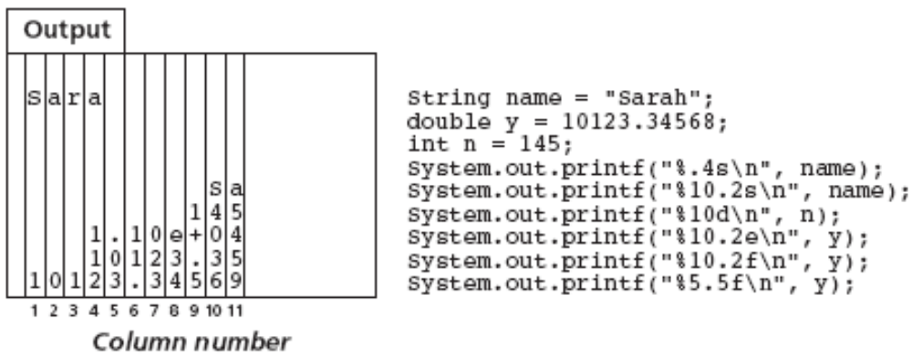
Output
Figure 1-10
Formatting example with printf
© 2006 Pearson Addison-Wesley. All rights reserved
1-<number>

Slide 69
File Input and Output
File
  Sequence of components of the same type that resides in auxiliary storage
  Can be large and exists after program execution terminates
Files vs. arrays
  Files grow in size as needed; arrays have a fixed size
  Files provides both sequential and random access; arrays provide random access
File types
  Text and binary (general or nontext) files
© 2006 Pearson Addison-Wesley. All rights reserved
1-<number>

Slide 70
Text Files
Designed for easy communication with people
  Flexible and easy to use
  Not efficient with respect to computer time and storage
End-of-line symbol
  Creates the illusion that a text file contains lines
End-of-file symbol
  Follows the last component in a file
Scanner class can be used to process text files
© 2006 Pearson Addison-Wesley. All rights reserved
1-<number>

Slide 71
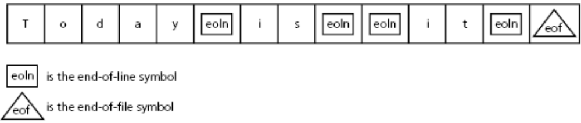
Text Files
Figure 1-11
A text file with end-of-line and end-of-file symbols
© 2006 Pearson Addison-Wesley. All rights reserved
1-<number>

Slide 72
Text Files
Example
  String fname, lname;
  int age;
  Scanner fileInput;
  File inFile = new File("Ages.dat");
  try {
  fileInput = new Scanner(inFile);
  while (fileInput.hasNext()) {
  fname = fileInput.next();
  lname = fileInput.next();
  age = fileInput.nextInt();
  age = fileInput.nextInt();
  System.out.printf("%s %s is %d years old.\n",
  fname, lname, age);
  } // end while
  fileInput.close();
  } // end try
  catch (FileNotFoundException e) {
  System.out.println(e);
  } // end catch
© 2006 Pearson Addison-Wesley. All rights reserved
1-<number>

Slide 73
Text Files
Open a stream to a file
  Before you can read from or write to a file
  Use class FileReader
    Constructor throws a FileNotFoundException
  Stream is usually embedded within an instance of class BufferedReader
    That provides text processing capabilities
  StringTokenizer
    Used to break up the string returned by readLine into tokens for easier processing
© 2006 Pearson Addison-Wesley. All rights reserved
1-<number>

Slide 74
Text Files
Example
  BufferedReader input;
  StringTokenizer line;
  String inputLine;
  try {
  input = new BufferedReader(new FileReader("Ages.dat"));
  while ((inputLine = input.readLine()) != null) {
  line = new StringTokenizer(inputLine);
  // process line of data
  ...
  }
  } // end try
  catch (IOException e) {
  System.out.println(e);
  System.exit(1); // I/O error, exit the program
  } // end catch
© 2006 Pearson Addison-Wesley. All rights reserved
1-<number>

Slide 75
Text Files
File output
  You need to open an output stream to the file
  Use class FileWriter
  Stream is usually embedded within an instance of class PrintWriter
    That provides methods print and println
© 2006 Pearson Addison-Wesley. All rights reserved
1-<number>

Slide 76
Text Files
Example
  try {
  PrintWriter output = new PrintWriter(new FileWriter("Results.dat"));
  output.println("Results of the survey");
  output.println("Number of males: " + numMales);
  output.println("Number of females: " + numFemales);
  // other code and output appears here...
  } // end try
  catch (IOException e) {
  System.out.println(e);
  System.exit(1); // I/O error, exit the program
  } // end catch
© 2006 Pearson Addison-Wesley. All rights reserved
1-<number>

Slide 77
Text Files
Closing a file
  Syntax
    myStream.close();
Adding to a text file
  When opening a file, you can specify if file should be replaced or appended
  Syntax
    PrintWriter ofStream = new PrintWriter(new FileOutputStream("Results.dat", true));
© 2006 Pearson Addison-Wesley. All rights reserved
1-<number>

Slide 78
Object Serialization
Data persistence
  Data stored in a file for later use
Object serialization
  Java mechanism to create persistent objects
Serialization
  Transforming an object into a sequence of bytes that represents the object
  Serialized objects can be stored to files for later use
© 2006 Pearson Addison-Wesley. All rights reserved
1-<number>

Slide 79
Object Serialization
Deserialization
  Reverse process
Interface java.io.Serializable
  Needed to save an object using object serialization
  Contains no methods
Objects referenced by a serialized object are also serialized
  As long as these objects also implement the Serializable interface
© 2006 Pearson Addison-Wesley. All rights reserved
1-<number>

Slide 80
Summary
Java packages
  Provide a mechanism for grouping related classes
import statement
  Required to use classes contained in other packages
Object in Java is an instance of a class
Class
  Data type that specifies data and methods available
  Data fields are either variables or constants
  Methods implement object behavior
Method parameters are passed by value
© 2006 Pearson Addison-Wesley. All rights reserved
1-<number>

Slide 81
Summary
Comments in Java
  Comment lines
  Multiple-line comments
Java identifier
  Sequence of letters, digits, underscores, and dollar signs
Primitive data types categories
  Integer, character, floating point, and boolean
Java reference
  Used to locate an object
© 2006 Pearson Addison-Wesley. All rights reserved
1-<number>

Slide 82
Summary
Define named constant with final keyword
Java uses short-circuit evaluation for logical and relational expressions
Array
  Collection of references that have the same data type
Selection statements
  if and switch
Iteration statements
  while, for, and do
© 2006 Pearson Addison-Wesley. All rights reserved
1-<number>

Slide 83
Summary
String
  Sequence of characters
  String classes: String, StringBuffer, StringTokenizer
Exceptions
  Used to handle errors during execution
Files are accessed using Scanner class or streams
Data persistence and object serialization
© 2006 Pearson Addison-Wesley. All rights reserved
1-<number>

