Slide 1
Community Code
BY: nicole gaehle, Brian horne, January johnson, chen ouyang, carmen ross, & yibei wang

Slide 2
Hack the Stack: Which Problem?
Education
Offering the opportunity to learn about coding
Community
Increasing volunteerism by allowing a peer to peer coding format

Slide 3
Technologies Used
Stack = METEOR
MongoDB
ExpressJS
MeteorJS (FrontEnd)
NodeJS (BackEnd)
Features
HighlightJS
Pusher: Chatkit
Pusher: Channel
Live Viewer
Notes:
HighlightJS - Allows users editor to correctly color the known terminology
Pusher - Powers realtime experiences through bi-directional hosted APIs that are flexible, scalable, and easy to use
Pusher Channel – allowed us to have a text editor with rendered text
Pusher Chatkit –allows for two uses to communicate via a chat
Live Viewer – allows the user to see their HTML code as they complete it and runs JS

Slide 4
Overview of Application
Free web-app to increase mentorship through volunteerism by utilizing the community and education system.
Recruiting volunteers to help our users in different coding languages.
Mentees can connect with mentors or other mentees to learn.
Target Audience:
Ages 13 +
Lower-Class Income
Accessibility Issues

Slide 5
demo

Slide 6
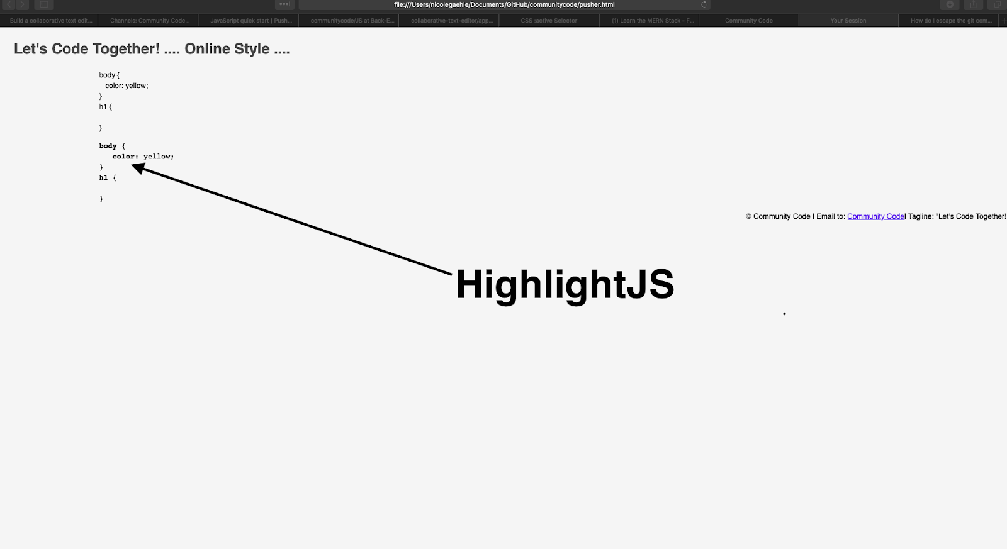
Backup Screenshots: HighlightJS
*taken in testing stage

