Slide 1
Inventorifo

Slide 2
Masterdata product, stock, location, condition
Product
ID
short_name
name
product_group
barcode
is_active
Condition
New
Used
Refurbished
Damaged, etc
Location | Group
Warehouse | Warehouse location
Aisle | Buffer stock location
Store Floor 1 Rack 1 | Selling location
Store Floor 1 Rack 2, etc | Selling location
stock
ID
quantity
unit
condition
location
price
stock
ID
quantity
unit
condition
location
price
stock
ID
quantity
unit
condition
location
price
stock
ID
quantity
unit
condition
location
price

Slide 3
Masterdata Person, Supplier, Customer, User
Person
ID
name
address
phone_number
national_id_number
is_active
tax_id_number
Customer group | Role
Regular Customers | Price, tax, discount, payment method
VIP Customers
Wholesale Customers
Employee Customers
Branch Customers, etc
Supplier
ID
person_id
organization_id
Customer
ID
person_id
customer_group
organization_id
User
ID
person_id

Slide 4
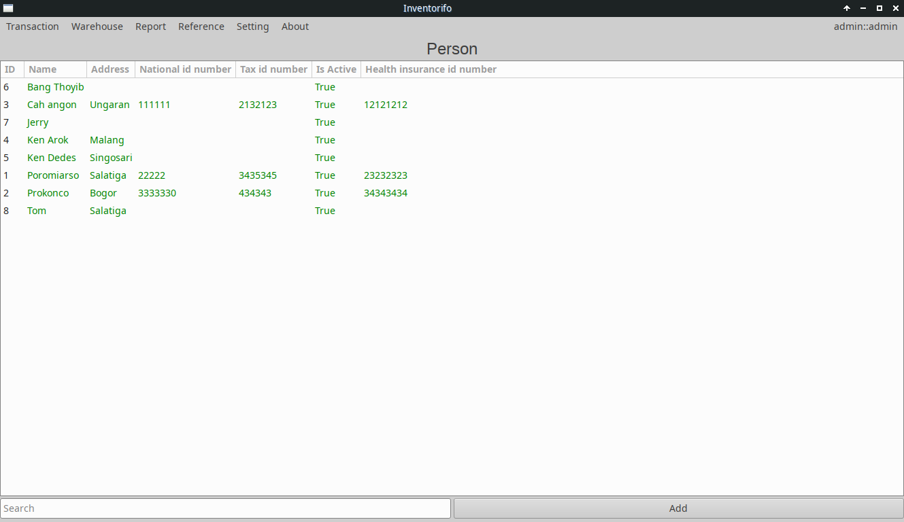
Masterdata person

Slide 5
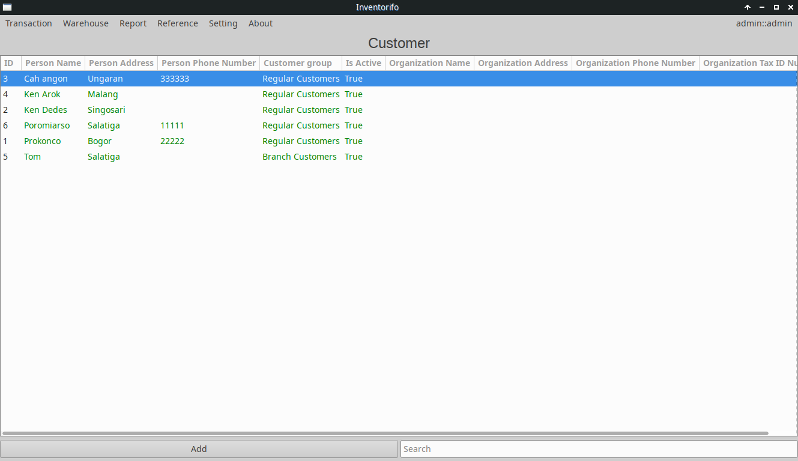
Masterdata Customer

Slide 6
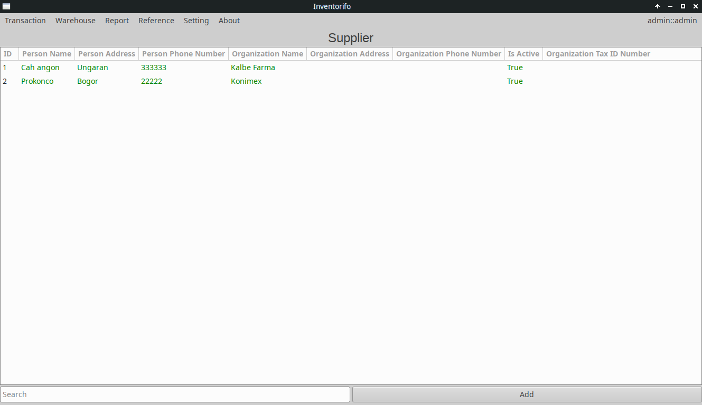
Masterdata supplier

Slide 7
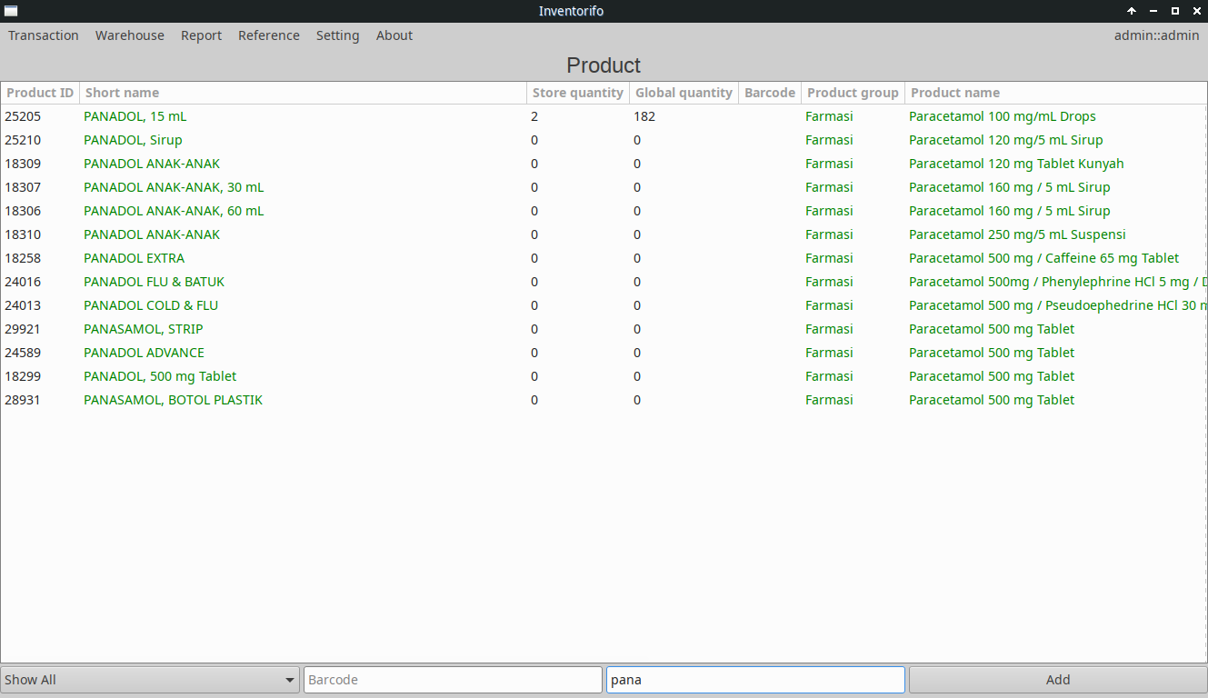
Masterdata product

Slide 8
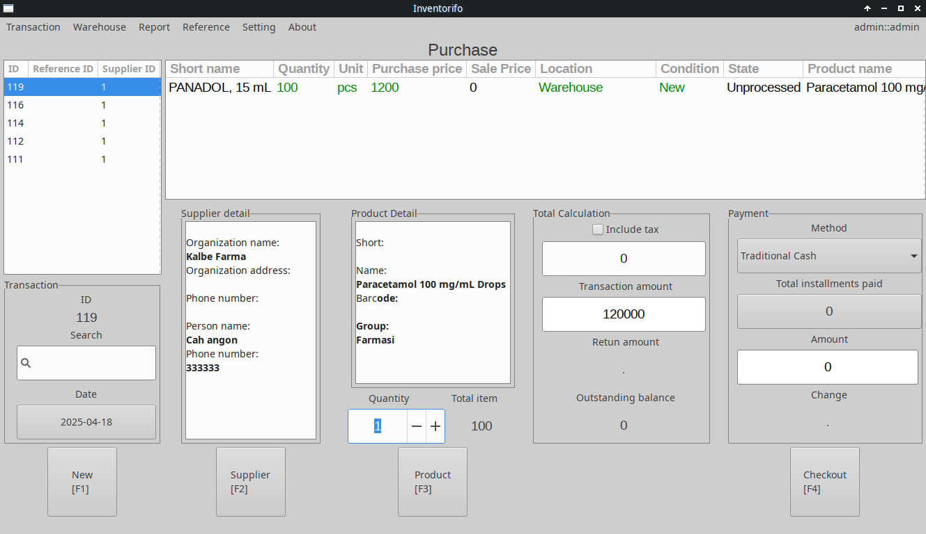
Purchase

Slide 9
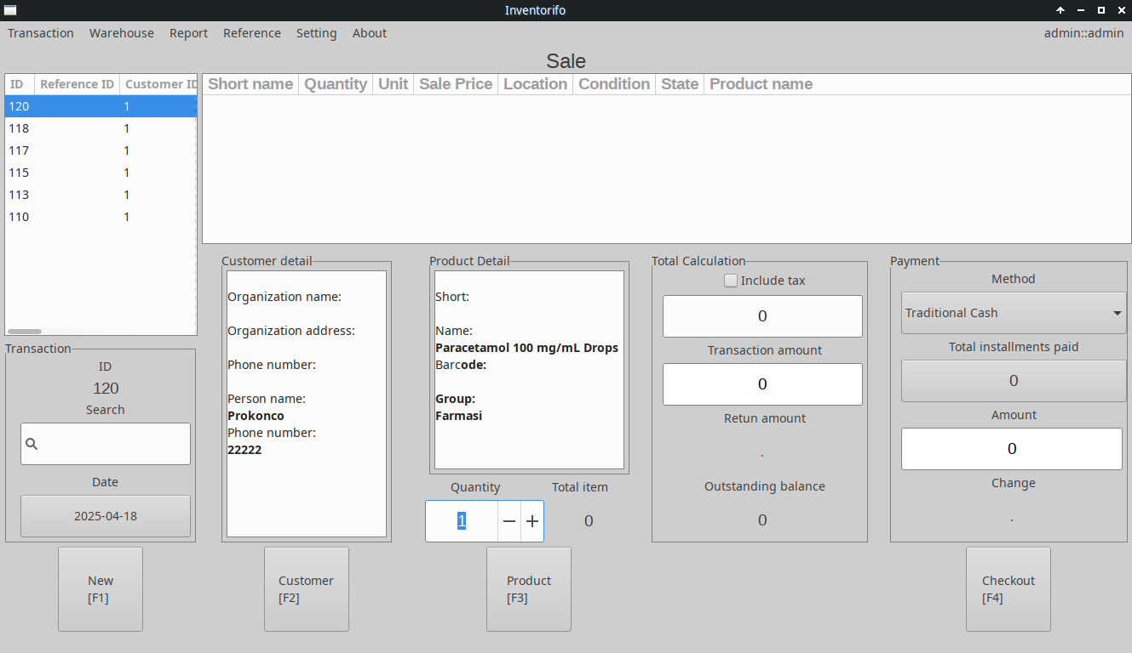
Sale

