Slide 1


Android Application Development
Daw Nwe Mar Khaing
31/10/2016

Slide 2
Outlines
What is Android?
Version History of Android
Features of Android
Architecture of Android
Android devices in the Market
Android Market

Slide 3
What is Android?
Android is a mobile operating system developed by Google, based on the Linux Kernel and designed primarily for touchscreen mobile devices such as smartphone and tablets.
Android's user interface is mainly based on direct manipulation, using touch gestures that loosely correspond to real-world actions, such as swiping, tapping and pinching, to manipulate on-screen objects, along with a virtual keyboard for text input.
In addition to touchscreen devices, Google has further developed Android TV for televisions, Android Auto for cars, and Android Wear for wrist watches, each with a specialized user interface. Variants of Android are also used on notebooks, game console, digital cameras, and other electronics.
Android applications are written in the Java programming language.

Slide 4
Version History of Android
The version history of the Android mobile operating system began with the release of the Android alpha in November 2007.
The first commercial version, Android 1.0, was released in September 2008. Android is continually developed by Google and the Open Handset Alliance, (OHA) and has seen a number of updates to its base operating system since the initial release.
Versions 1.0 and 1.1 were not released under specific code names, but since April 2009's Android 1.5 "Cupcake", Android versions have had confectionery-themed code names. Each is in alphabetical order, with the most recent being Android 7.0 "Nougat", released in August 2016.

Slide 5
Android Versions
Android Version | Released Date | Code Name | API Level
1.0 | Sept, 2008 |  | 1
1.1 | February 09, 2009 |  | 2
1.5 | April 30, 2009 | Cupcake | 3
1.6 | September 15, 2009 | Donut | 4
2.0, 2.1 | October 26, 2009 | Eclair | 5-7
2.2 | May 20, 2010 | Froyo | 8
2.3, 2.3.7 | December 06, 2010 | Gingerbread | 9-10
3.0, 3.1, 3.2 | February 22, 2011 | Honeycomb | 11-13
4.0 | October 19, 2011 | Ice Cream Sandwich | 14-15
4.1, 4.2,4.3 | June 27 2012 | Jelly Bean | 16-18
4.4 | Announced on 3rd September 2013 | KitKat | 19
4.4 W |  | Wearable Extension | 20
5.0, 5.1, 5.1.1 | Aug 5, 2015 | Lollipop | 21-22
6.0 | Oct 5, 2015 | Marshmallow | 23
7.0 | Aug 22, 2016 | Nougat | 24-25

Slide 6
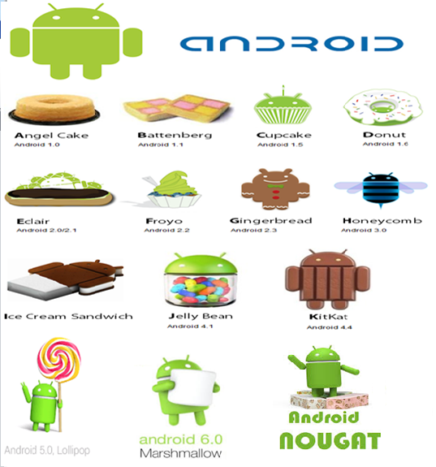

Slide 7
Features of Android
Storage — Uses SQLite, a lightweight relational database, for data storage.
Connectivity — Supports GSM/EDGE, IDEN, CDMA, EV-DO, UMTS, Bluetooth (includes A2DP and AVRCP), Wi-Fi, LTE, and WiMAX.
Messaging — Supports both SMS and MMS, Android Cloud To Device Messaging(C2DMA) and Google Cloud Messaging (GCM).
Web browser — Based on the open source WebKit, together with Chrome’s V8 JavaScript engine
Media support — Includes support for the following media: H.263, H.264 (in 3GP or MP4 container), MPEG-4 SP, AMR, AMR-WB (in 3GP container), AAC, HE-AAC (in MP4 or 3GP container), MP3, MIDI, Ogg Vorbis, WAV, JPEG, PNG, GIF, and BMP
Notes:
GSM—Global System for Mobile Communication
LTE—Mobile communication standard(4G)
CDMA—Code division multiple access-is a channel access method used by radio communication
EV-Do—telecommunication standard for wireless transmission
UMTS—Universal Mobile Telecommunications System
NFC—Near field communication-establish communication by bringing them within 4 cm(2 in) of each other, used in credit card and electronic tickets
IDEN—Integrated Digital Enhanced Network
WiMAX—Worldwide interoperability for microwave access—wireless communication

Slide 8
Hardware support — Accelerometer Sensor, Camera, Digital Compass, Proximity Sensor, and GPS, gyroscope, barometer.
Multi-touch — Supports multi-touch screens
Multi-tasking — Supports multi-tasking applications
Tethering — Supports sharing of Internet connections as a wired/wireless hotspot.
Multiple Language Support—Android supports multiple languages.
Screen Capture--- Support capturing a screenshot
External Storage-include microSD card slots and can read microSD cards formatted with FAT32,Ext3,Ext4 file system.
Notes:
Gyroscope-navigation System
Baromenter-atomosphere presurre

Slide 9
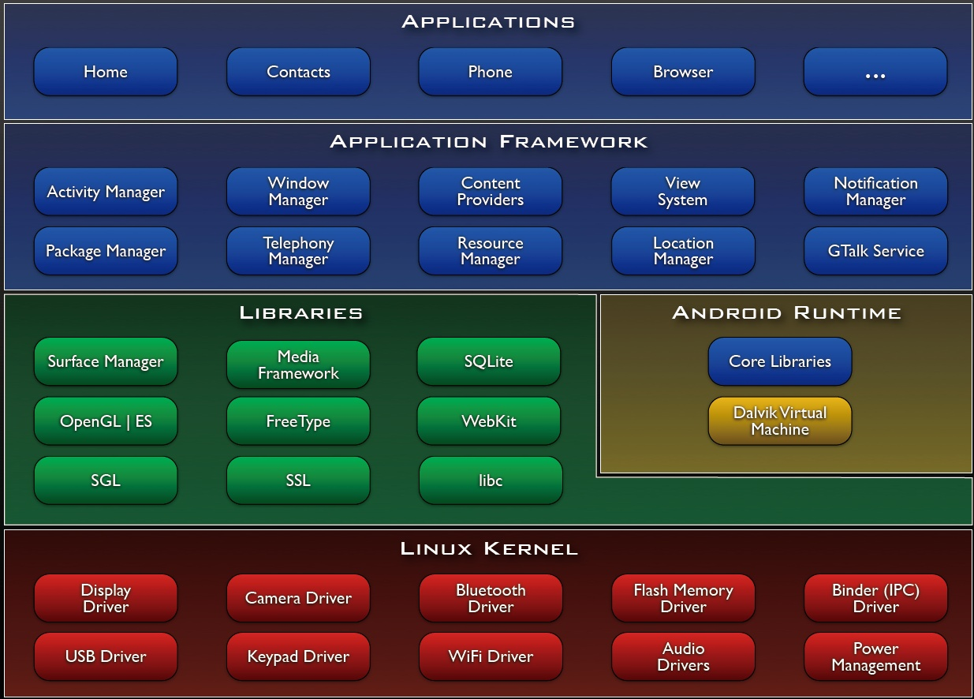
Architecture of Android

Slide 10
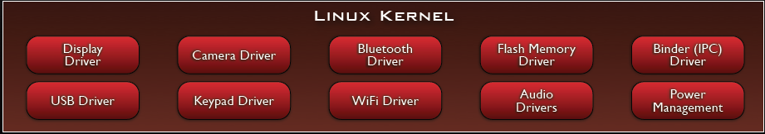
Linux Kernel
Note that Android based on a Linux kernel not a Linux OS
Supplies Security, Memory management, Process management, Network stack and Driver model
Acts as an abstraction layer between the hardware and the rest of the software stack

Slide 11
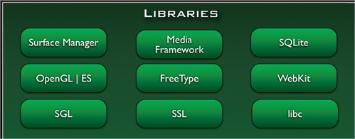
Libraries
Run in system background
Using C/C++ Language
4 types of Libraries
Bionic Libc, system C libraries
Function Libraries, supporting multimedia, web browser, SQLite...
Native Servers
Hardware
Abstraction Libraries

Slide 12
Core Libraries
System C library, the standard C system library, tuned for embedded Linux-based devices
Media Libraries, support playback and recording of many popular audio and video formats, as well as image files, including MPEG4, H.264, MP3, AAC, AMR, JPG, and PNG
Surface Manager, manages access to the display subsystem and seamlessly composites 2D and 3D graphic layers from multiple applications
WebKit, a modern web browser engine which powers both the Android browser and an embeddable web view
SGL, the underlying 2D graphics engine
3D libraries, an implementation based on OpenGL ES 1.0 APIs
SQLite , a powerful and lightweight relational database engine

Slide 13
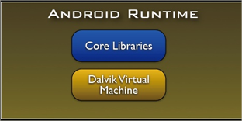
Andoid Runtime(ART)
The core of Android platform
Dalvik Virtual Machine
Register-based
Executes files in the Dalvik Executable (.dex) format
Java core Libraries
Provides most of the functionality of the Java programming language.

Slide 14
Android Runtime (cont.)
The functions of Java core libraries rely on the Dalvik VM and the underlying Linux kernel
Multiple Dalvik VMs may run at the same time
Every Android application runs in its own process, with its own instance of the Dalvik virtual machine
The "dx" tool in Android SDK can transform compiled JAVA class into the .dex format

Slide 15
Dalvik Virtual Machine
Android custom implementation virtual machine
Provides application portability and runtime consistency
Runs optimized file format (.dex) and Dalvik bytecode
Java .class / .jar files converted to .dex at build time
Designed for embedded environment
Supports multiple virtual machine processes per device
Highly CPU-optimized bytecode interpreter
Efficiently Using runtime memory
Core Libraries
Core APIs for Java language provide a powerful, yet simple and familiar development platform

Slide 16
DVM vs. JVM
DVM
Google
Dalvik executable
Only supports a subset of standard Java Library
JVM
Sun
Java bytecode

Slide 17
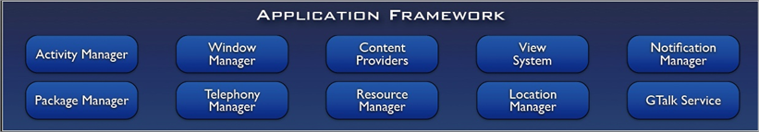
Application Framework
Simplify the reuse of components
Applications can publish their capabilities and any other application may then make use of those capabilities
Applications is a set of services and systems, include
Views system, content providers, resources manager and so on

Slide 18
Application Framework (cont.)
Activity Manager, manages the lifecycle of applications and provides a common navigation backstack
Notification Manager, enables all applications to display custom alerts in the status bar
Resource Manager, providing access to non-code resources such as localized strings, graphics, and layout files
Content Providers, access data from other applications (such as Contacts), or to share their own data
Views, used to build an application, including lists, grids, text boxes, buttons, and even an embeddable web browser

Slide 19
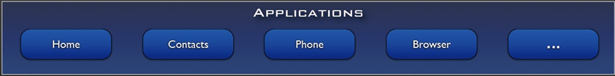
Applications
A set of core applications shipped with Android platform
an email client, SMS program, calendar, maps, browser, contacts, and others
All written in Java
Our applications are in the same level as these applications

Slide 20
Android Devices in the Market
Smartphones
Tablets
E-reader devices
Netbooks
MP4 players
Internet TVs

Slide 21
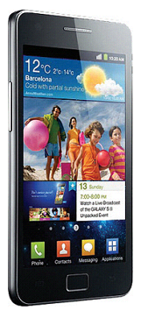
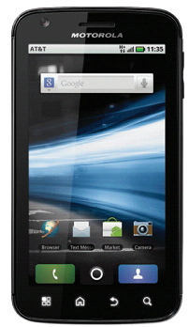
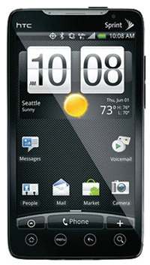
Smartphones

Slide 22
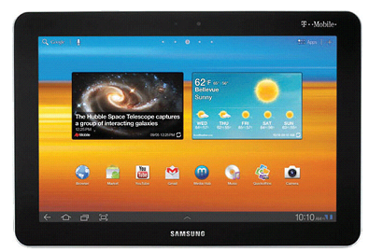
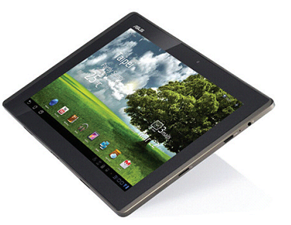
Tablets

Slide 23
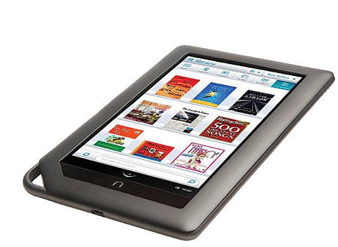
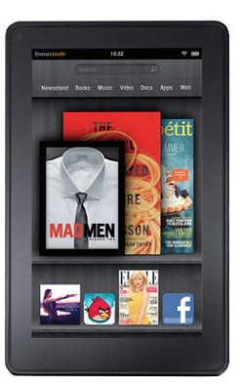
E-book Readers

Slide 24
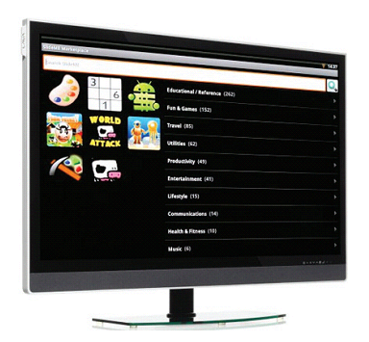
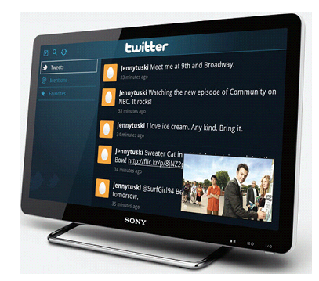
Android TV

Slide 25
The Android Market
Google Play is the premier marketplace for selling and distributing Android apps. When you publish an app on Google Play, you reach the huge installed base of Android.
Android Market, an online application store for Android devices, and made it available to users in October 2008
Once developed, Android applications can be packaged easily and sold out either through a store such as Google Play or the Amazon Appstore.

Slide 26
Thank You !!!!!
Any Question ?

