Slide 1
Android: Fonts
Daw Thet Su Hlaing

Slide 2
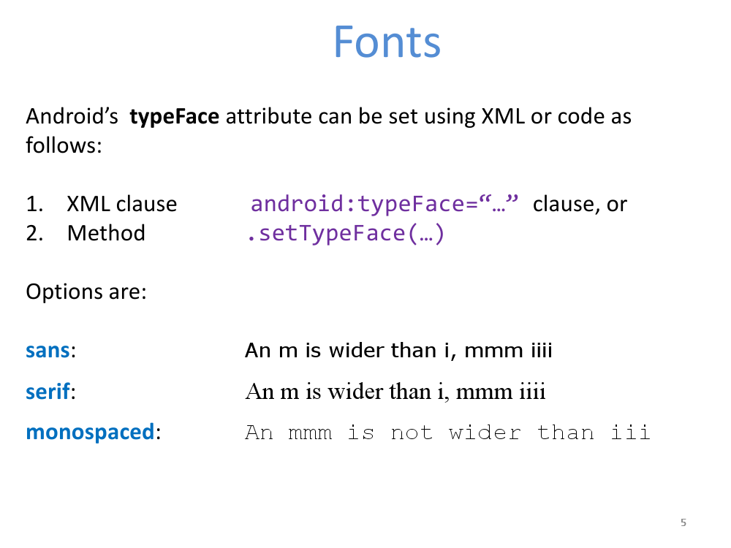

Slide 3
Font
Developer may add any font to their application by following the next steps:
Create the “assets” directory
Create the “font” folder in the “assets” directory
Copy any fonts you plan to use into the new folder (look at C:\Windows\Fonts for your basic local collection)
Use Java code to bind the font with the UI widget wanting to display the custom typeface(see example)

Slide 4
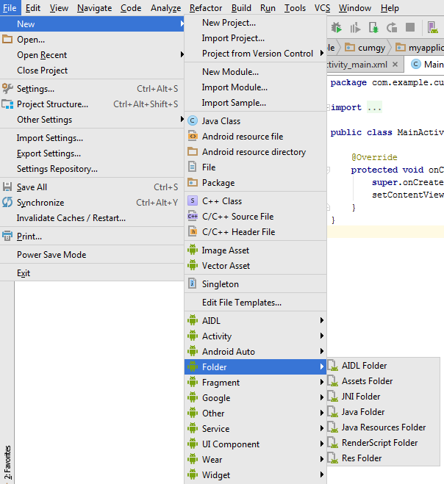
Creating Font Folder

Slide 5
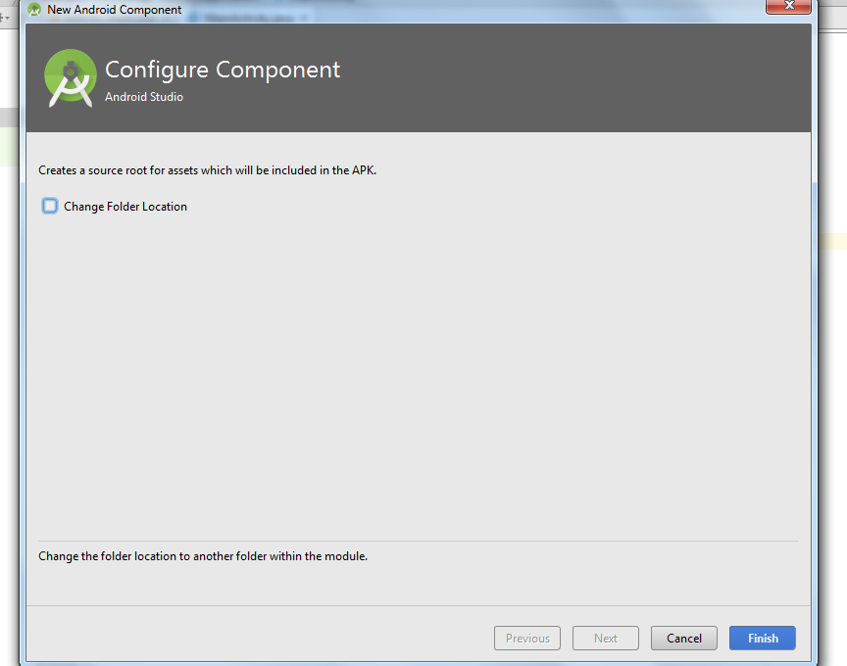
Creating Font Folder

Slide 6
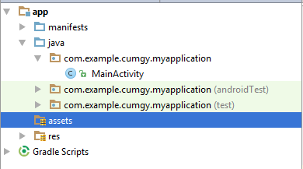
Creating Font Folder

Slide 7
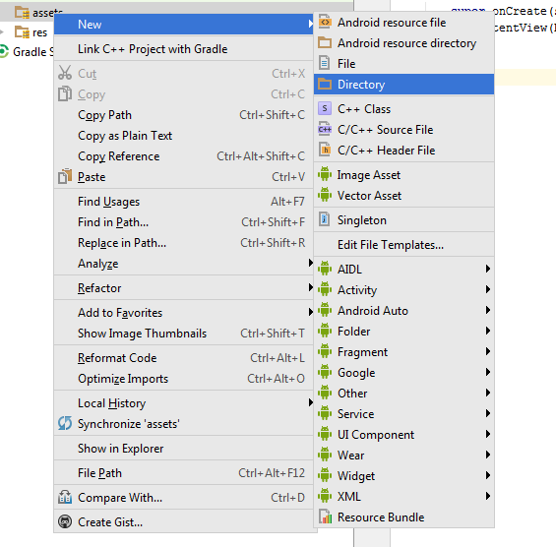
Creating Font Directory

Slide 8
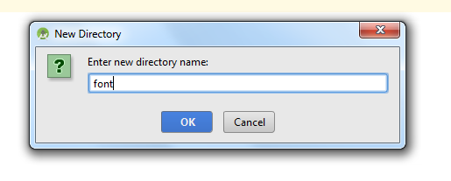
Creating Font Directory

Slide 9
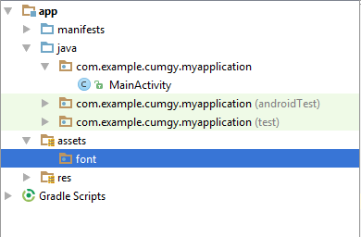
Creating Font Directory

Slide 10
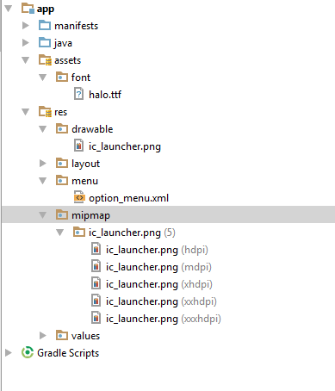
Copying Font Finish

Slide 11
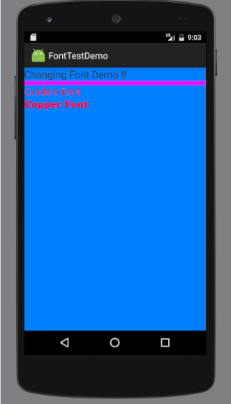
Example Demo

Slide 12
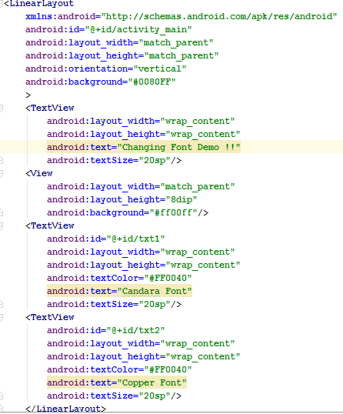
Example Demo

Slide 13
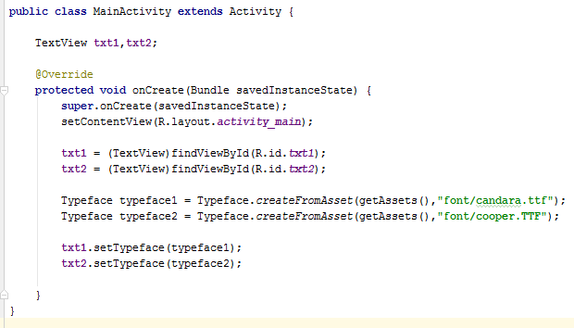
Example Demo

