Slide 1
Android: Using Menu
Daw Thet Su Hlaing

Slide 2
Menu
Menus are used to add functionality without cluttering the UI.
A menu is displayed as an overlapping layer on top of the current UI.
In principle an unlimited number of additional operations could be added in a single menu.
An application could have any number of menus.
There are three types of menu in android
Options menu
Context menu
Popup menu

Slide 3
Options Menu
is triggered by pressing the hardware/virtual Menu button on the device
is the primary collection of menu items for an activity.
is where you should include actions and other options that are relevant to the current activity context, such as “Search”, “Compose email” and “Settings”.
where the items in your options menu appear on the screen depends on the version for which you’ve developed your application

Slide 4
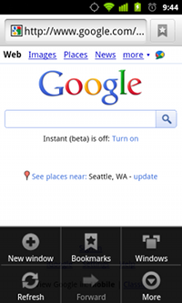
Android 2.3x(API Level 10) or lower
Options menu in the Browser, on Android 2.3

Slide 5
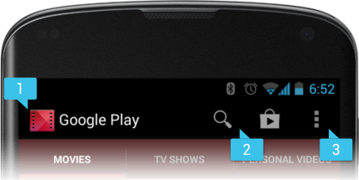
Android 3.0(API Level 11) or higher
App bar from the Honeycomb Gallery app, showing navigation tabs and a camera action item (plus the action overflow button).

Slide 6
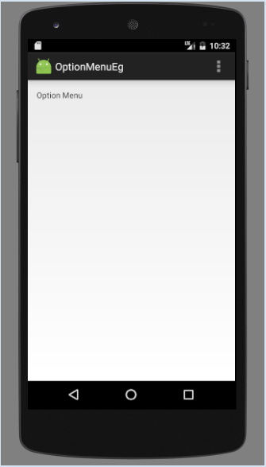
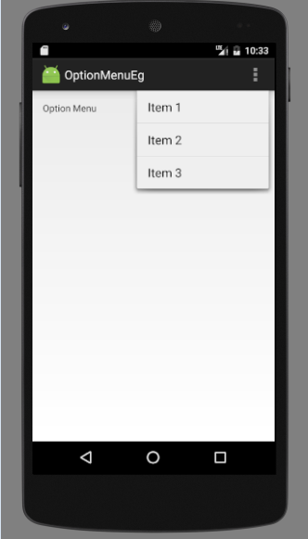
Creating Options Menu
Figure – Output of the Options Menu

Slide 7
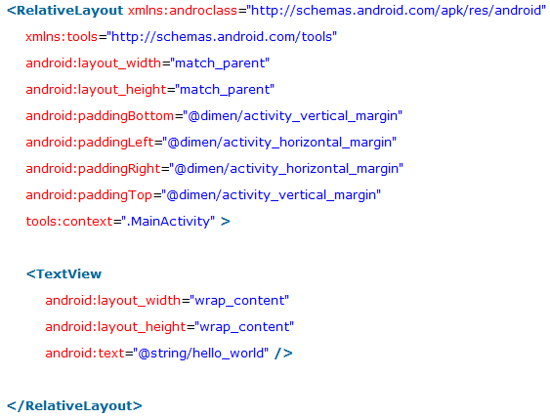
Creating Options Menu By MenuInflater

Slide 8
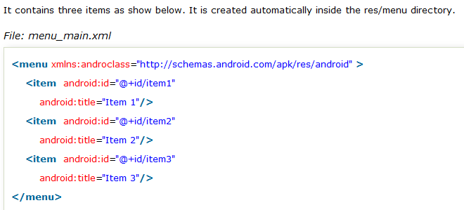
Creating Options Menu By MenuInflater

Slide 9
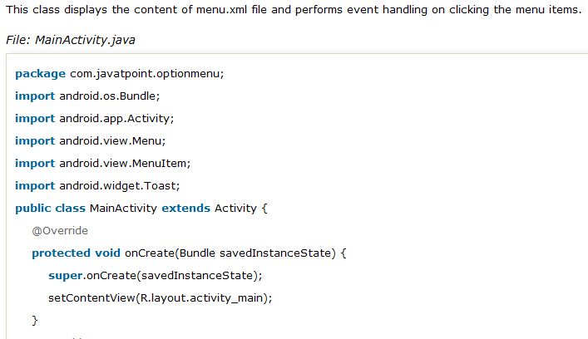
Creating Options Menu by MenuInflater

Slide 10
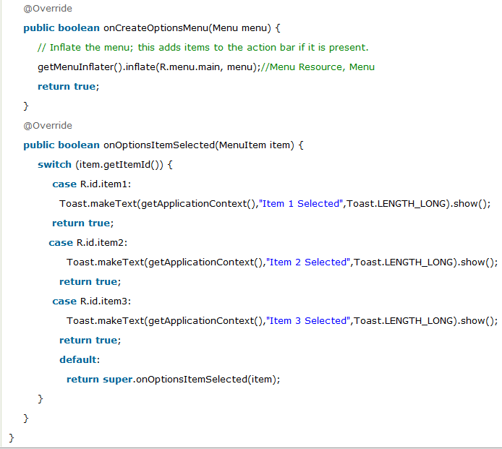
Creating Options Menu by MenuInflater

Slide 11
Creating Option Menu with icon
need to have icon images inside the res/drawable directory
android:icon element is used to display the icon on the option menu.

Slide 12
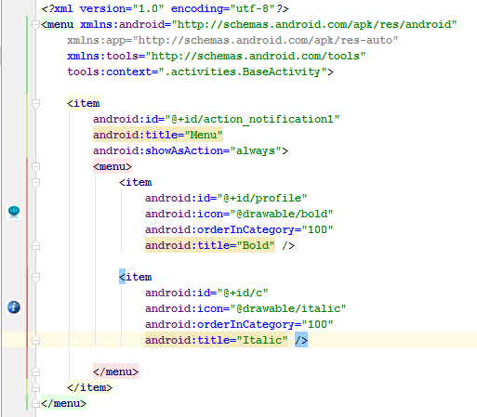
Creating Option Menu with icon By xml file

Slide 13
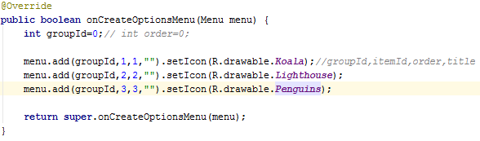
Creating Option Menu with icon By Java

Slide 14
Context Menu
is raised by a tap-and-hold interaction on the widget associated to the menu.
is a floating menu that appears when the user performs a long-click on an element.
provides actions that affect the selected content or context frame.
doesn't support item shortcuts and icons.

Slide 15
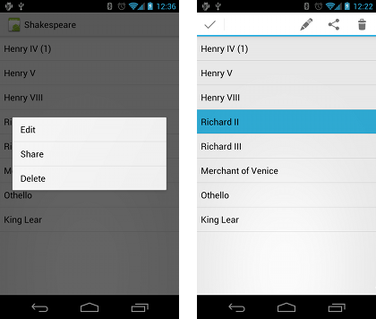
Example of Context Menu
Screenshots of a floating context menu (left) and the contextual action bar (right).

Slide 16
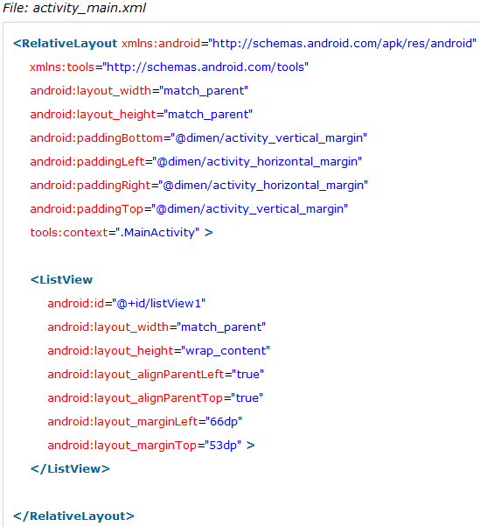
Creating Context Menu

Slide 17

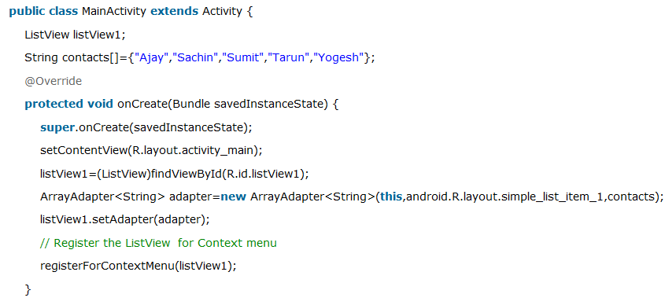
Creating Context Menu

Slide 18
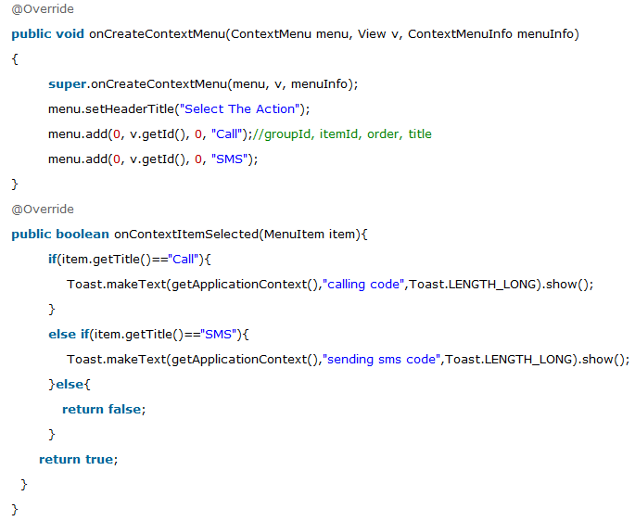
Creating Context Menu
onCreateContextMenu Method in Java Class

Slide 19
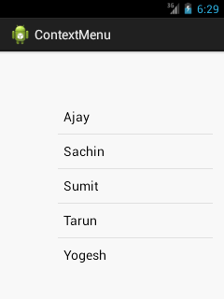
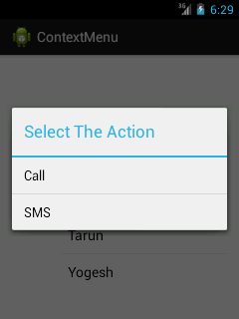
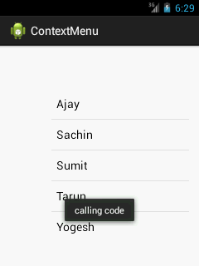
Creating Context Menu
Figure – Output of Context Menu

Slide 20
Popup Menu
is a graphical user interface display area usually a small window that suddenly appears A special kind of menu option.
Which appears just below the item you selected.
is an overflow menu like Spinner actions.
is available from API level 11 (Android 3.0)
is introduced in Android HoneyComb (API level11) version.

Slide 21
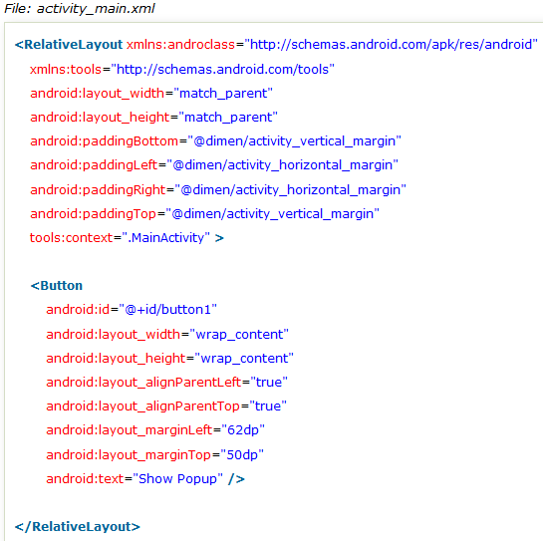
Creating Popup Menu

Slide 22
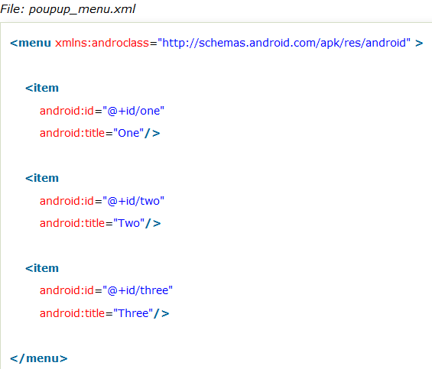
Creating Popup Menu

Slide 23
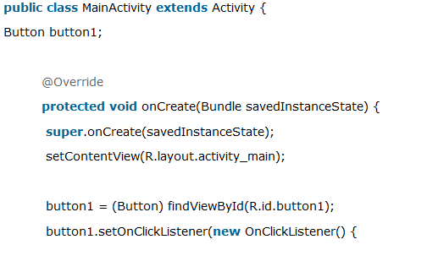
Creating Popup Menu

Slide 24
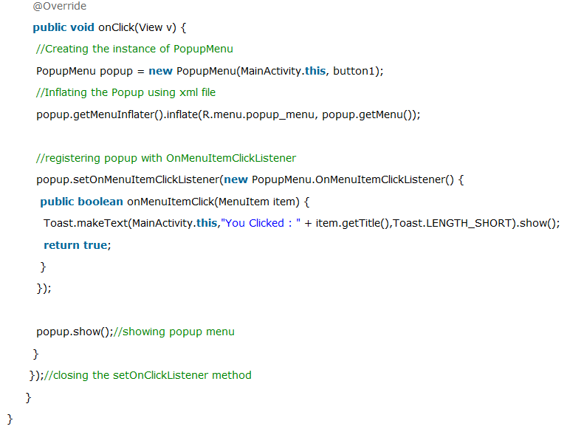
Creating Popup Menu

Slide 25
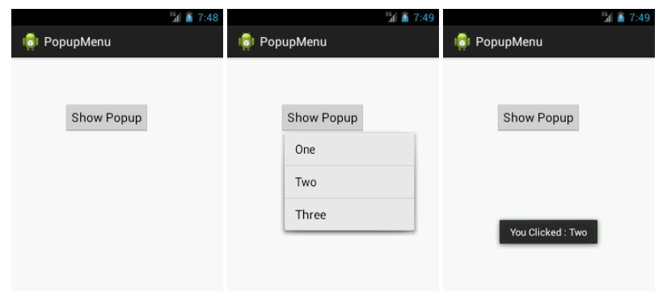
Creating Popup Menu
Figure – Output of Popup Menu

Slide 26
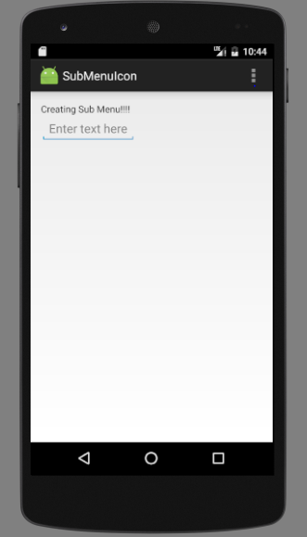
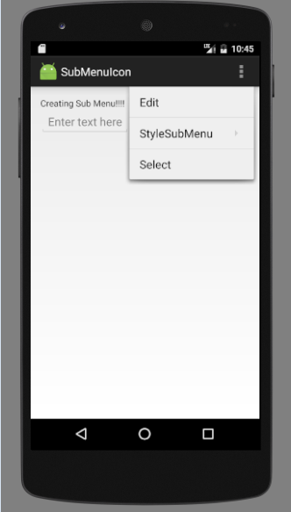
Creating Sub Menu

Slide 27
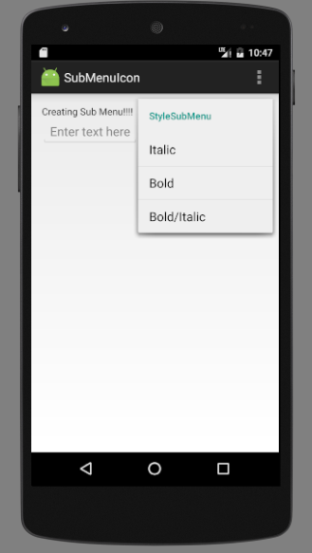
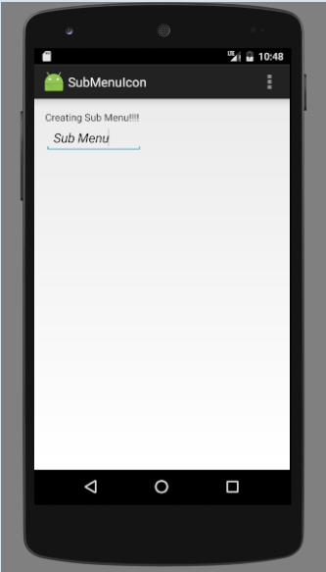
Creating Sub Menu

Slide 28
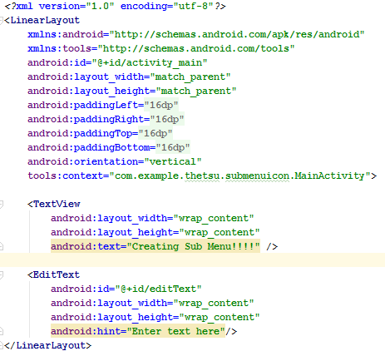
Creating Sub Menu

Slide 29
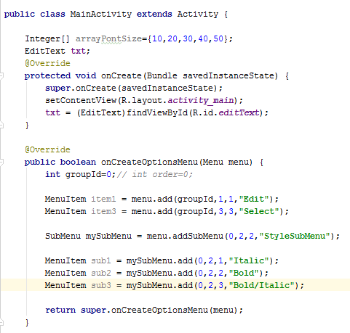
Creating Sub Menu

Slide 30
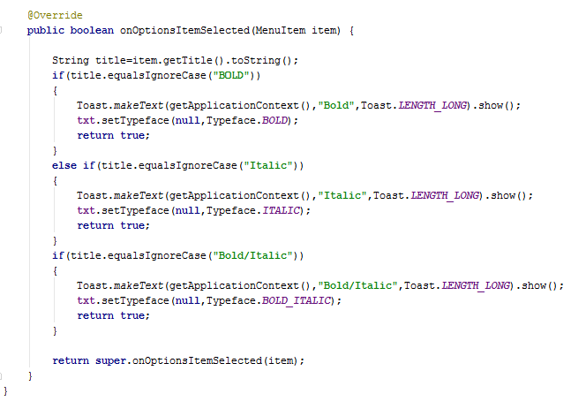
Creating Sub Menu

