Slide 1

Android Application’s Life Cycle

Slide 2
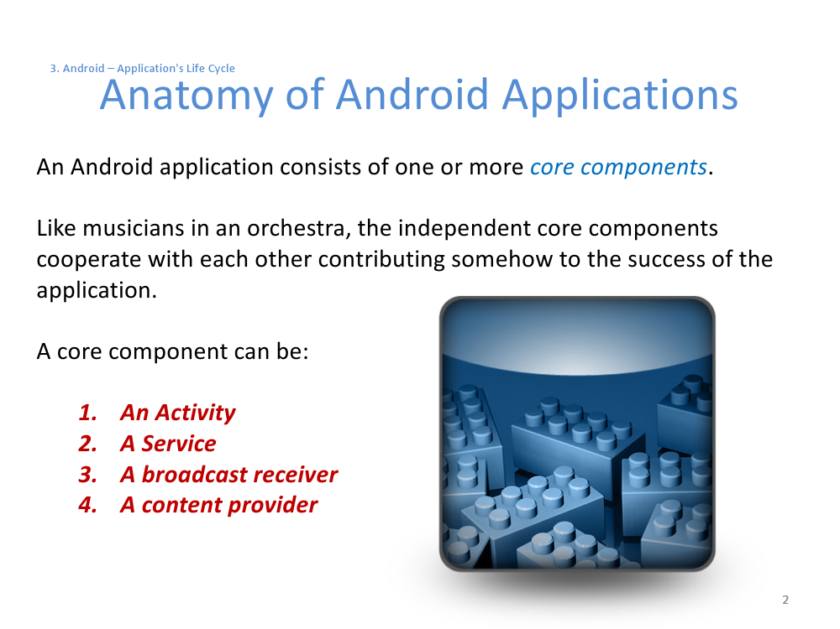

Slide 3
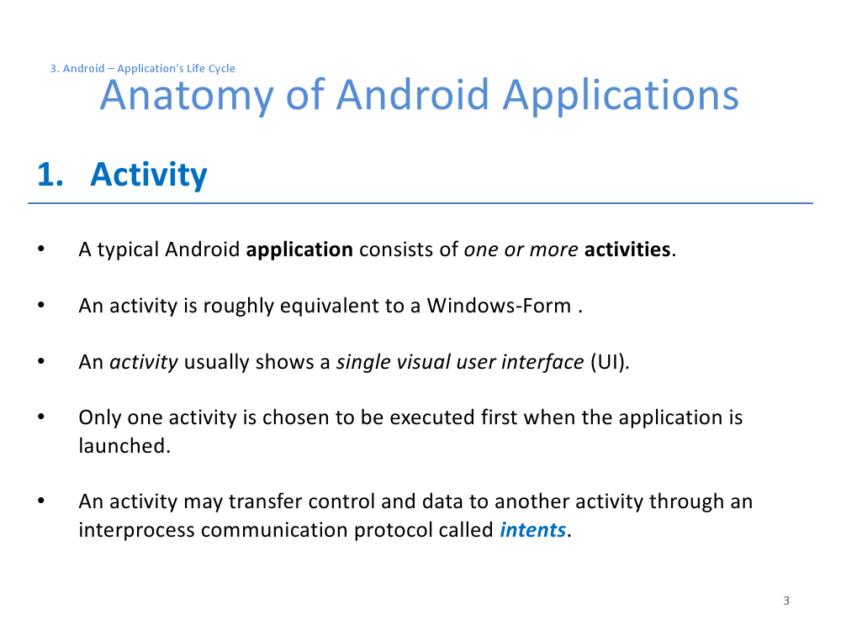

Slide 4
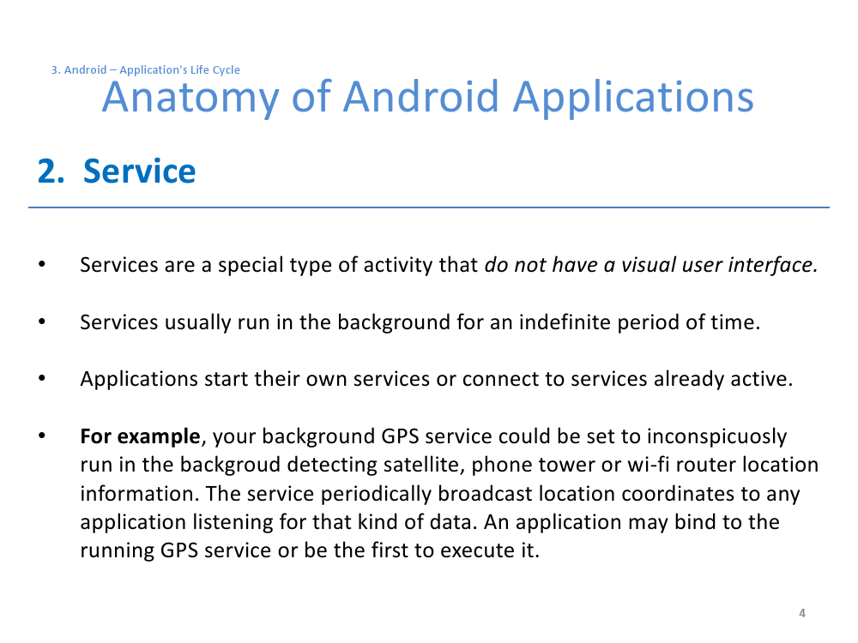

Slide 5
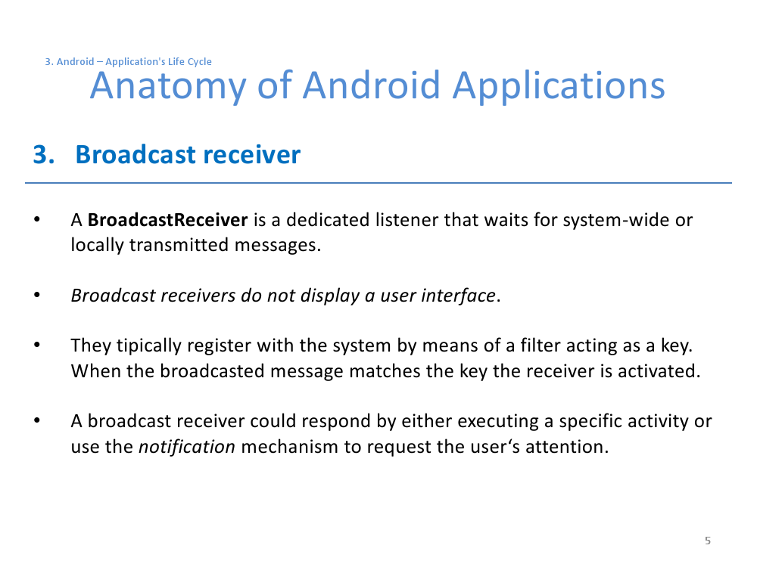

Slide 6
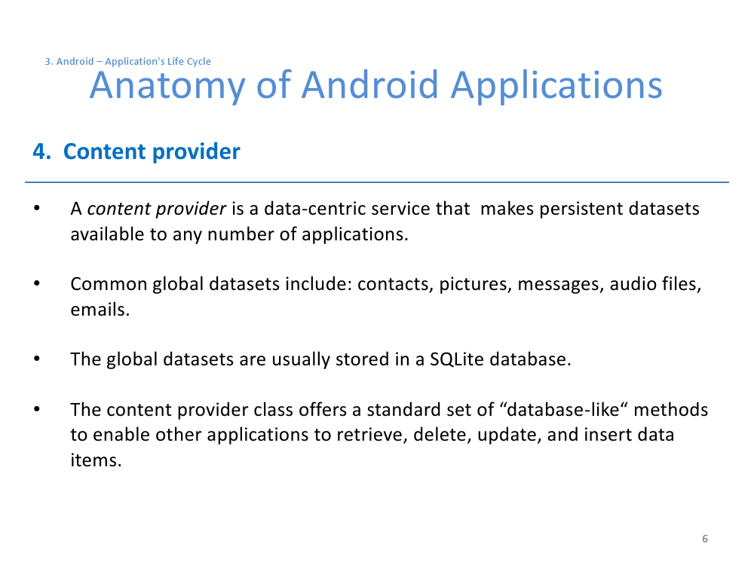

Slide 7
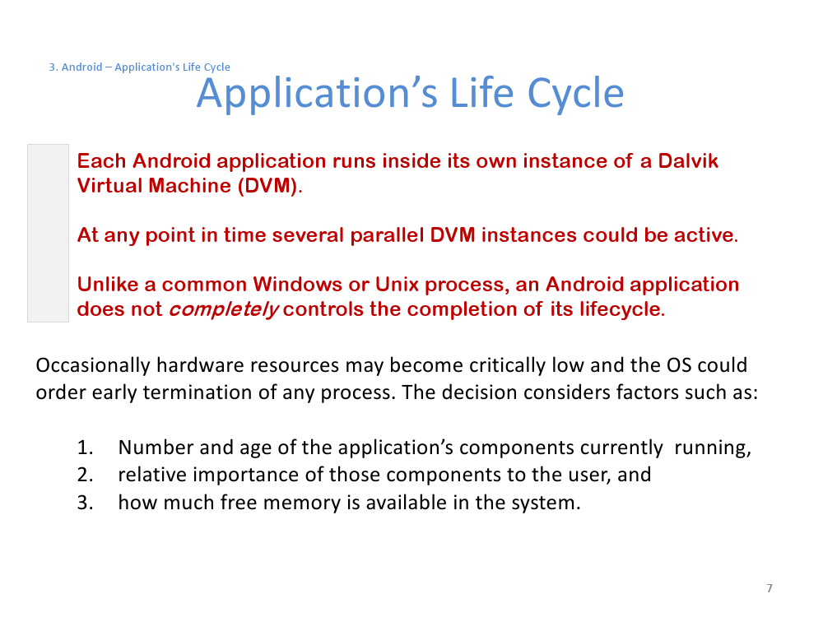

Slide 8
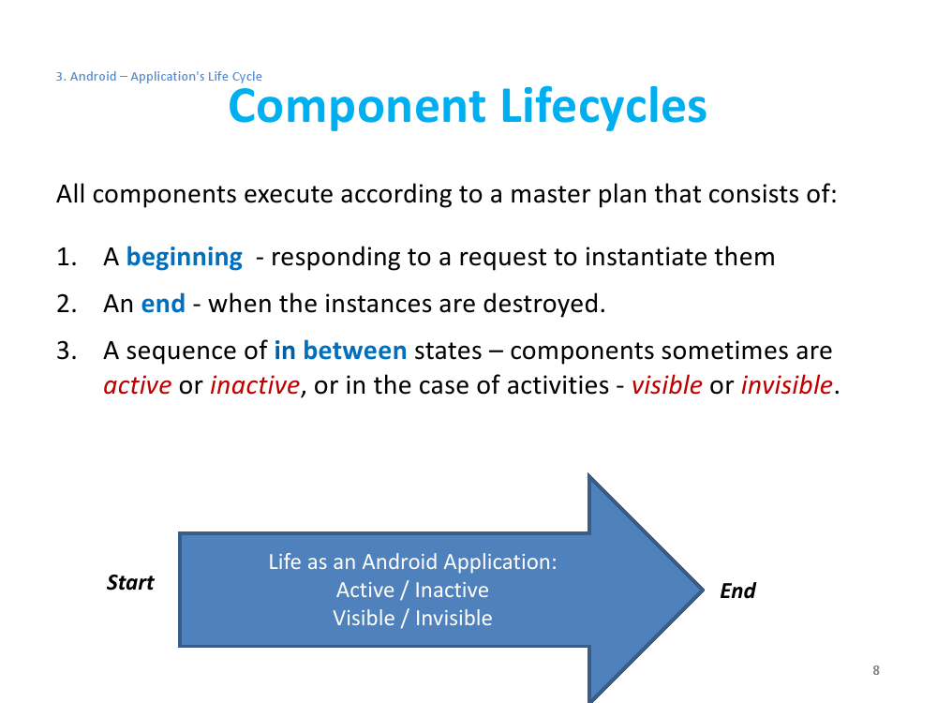

Slide 9
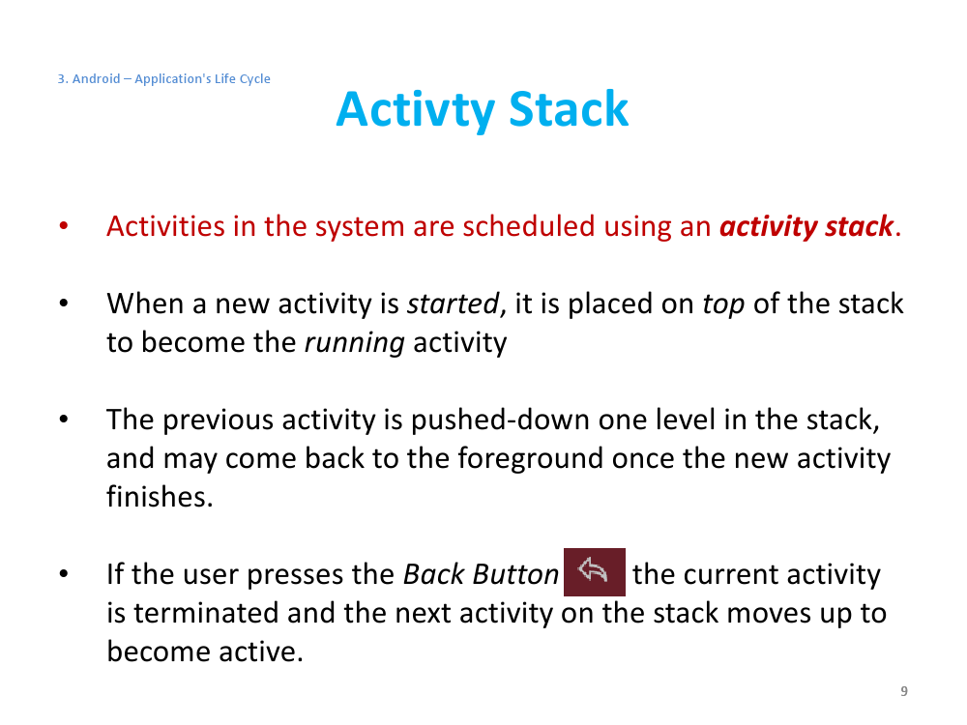

Slide 10
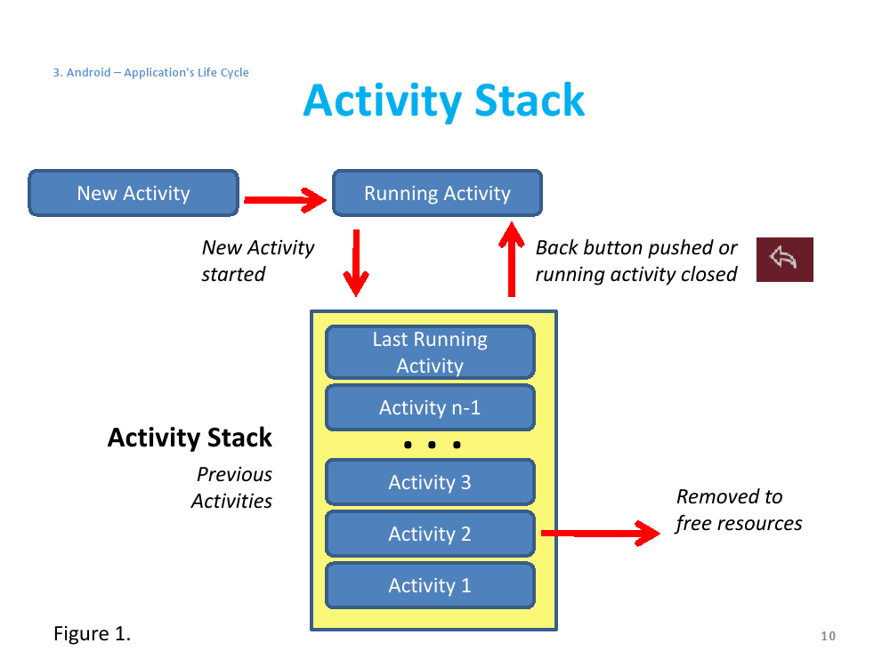

Slide 11
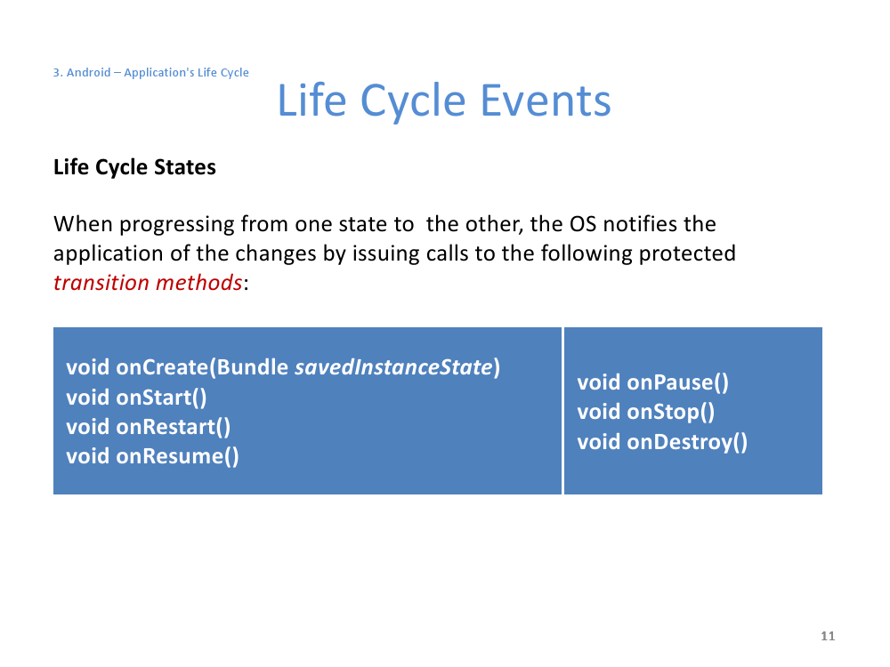

Slide 12
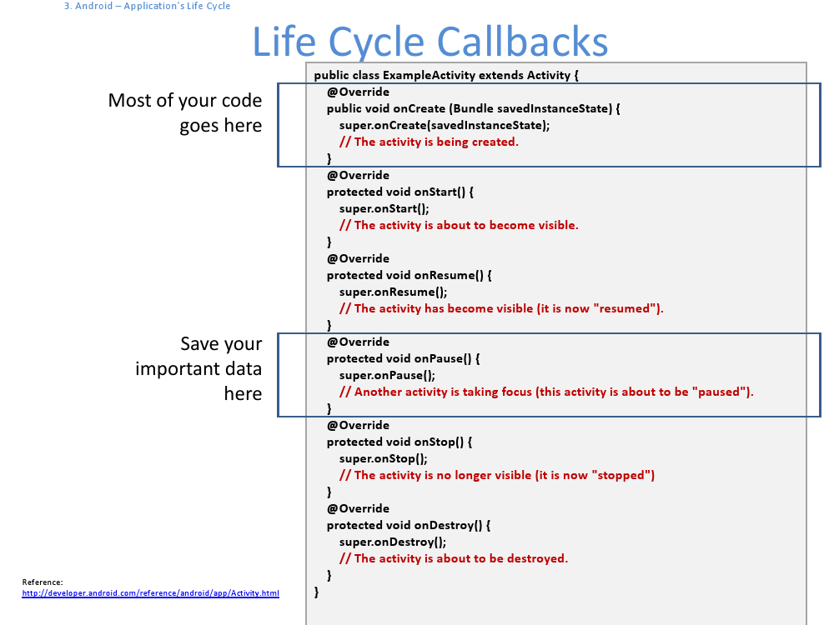

Slide 13
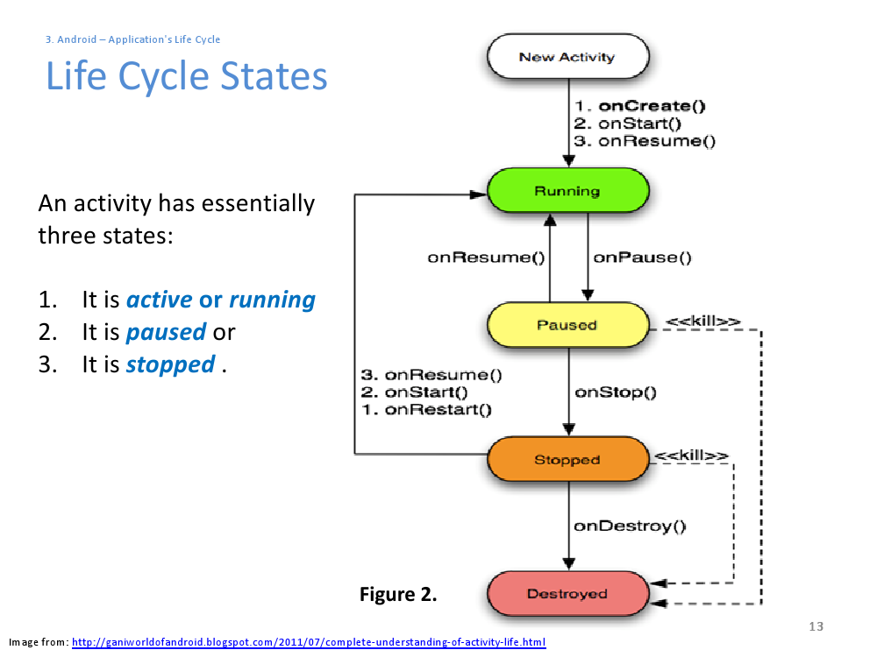

Slide 14
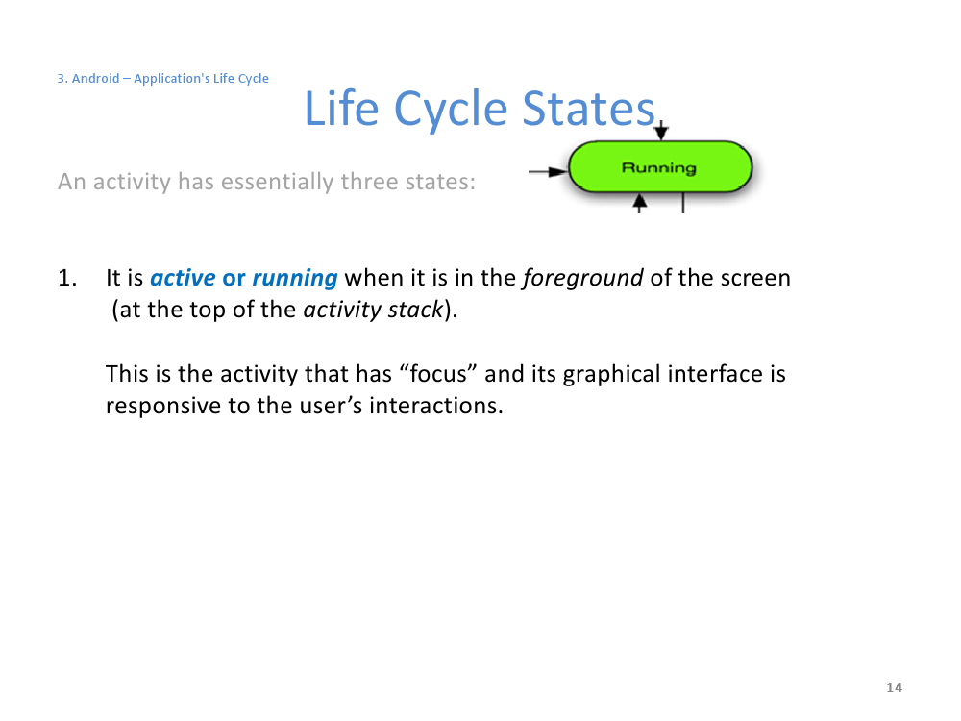

Slide 15
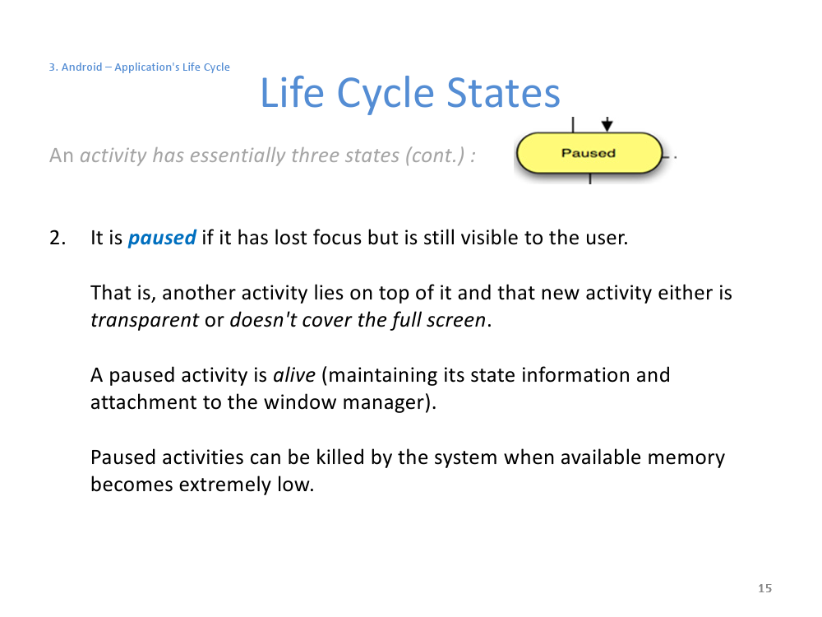

Slide 16
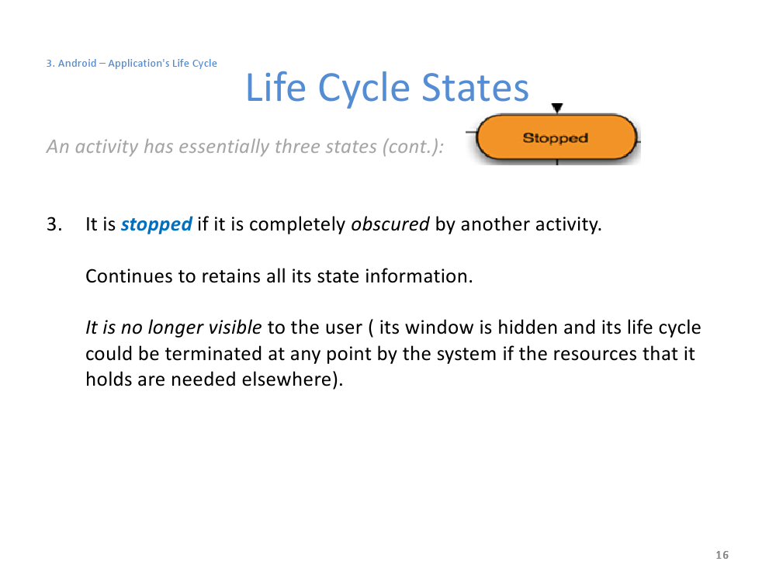

Slide 17
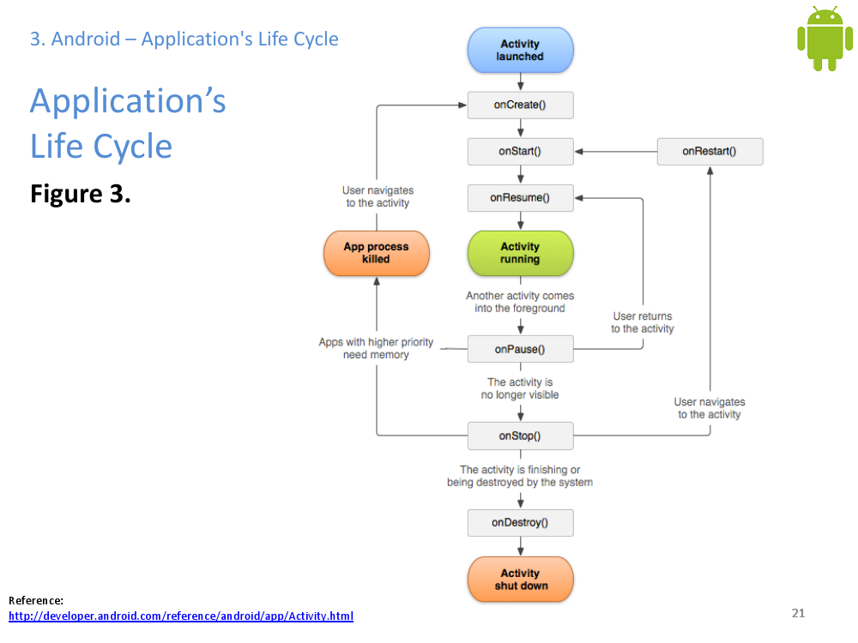

Slide 18
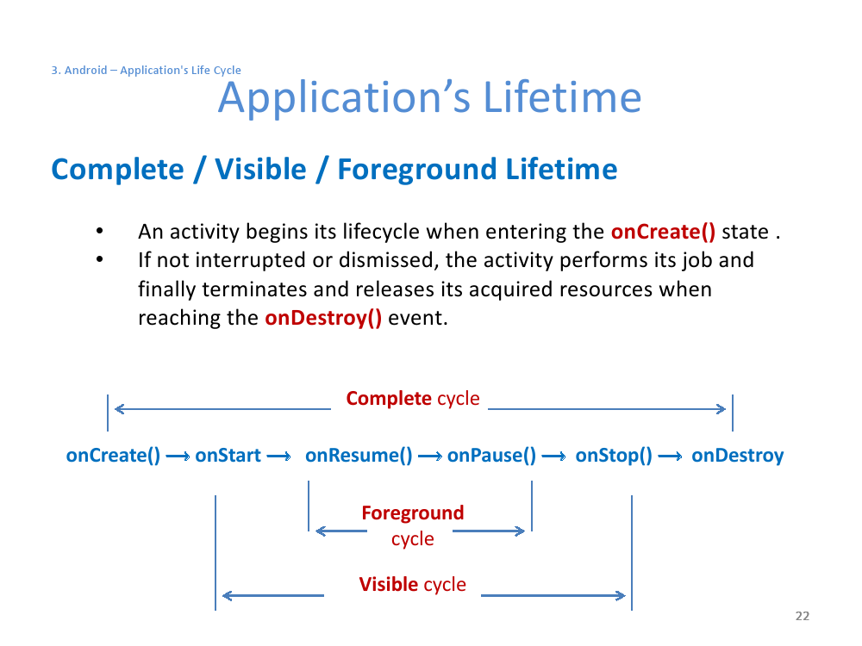

Slide 19
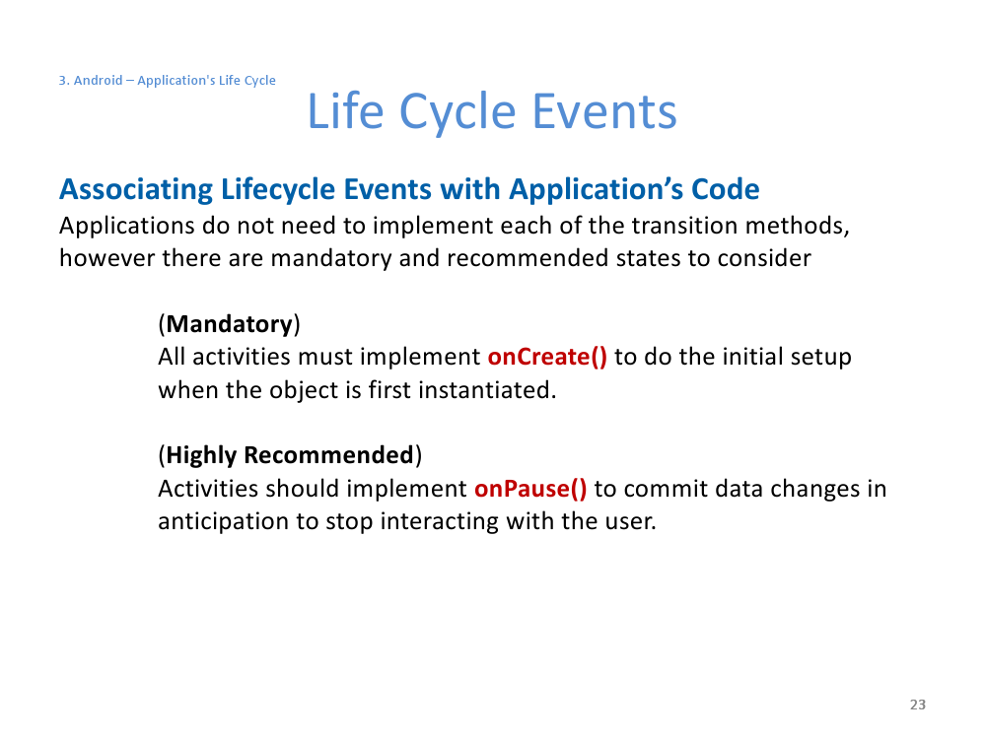

Slide 20
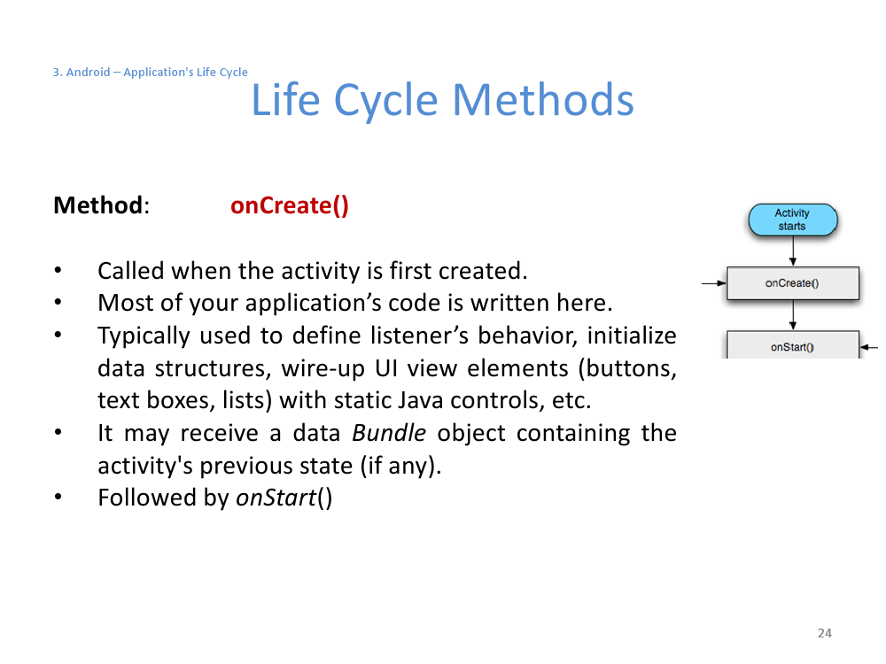

Slide 21
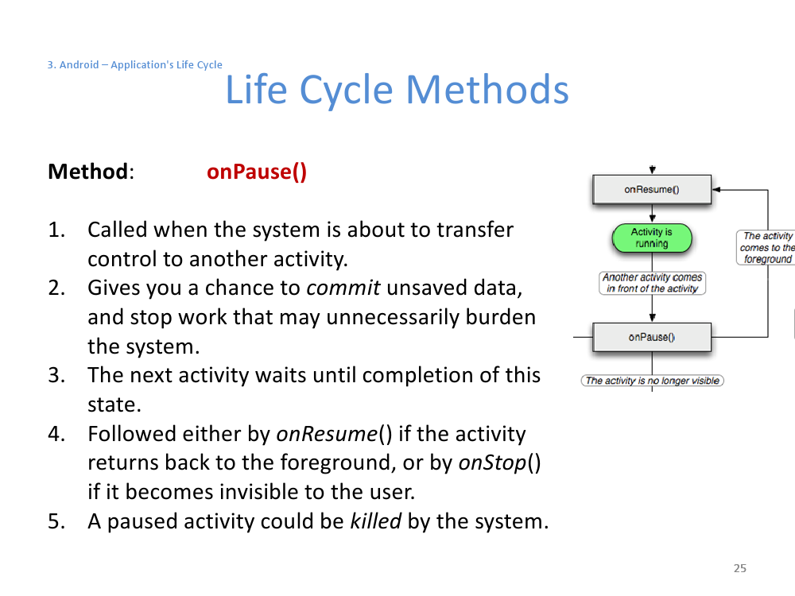

Slide 22
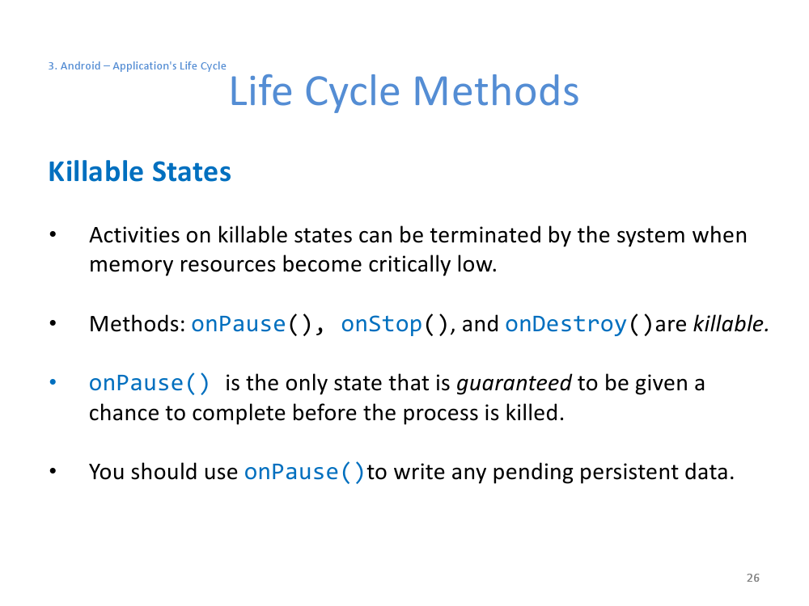

Slide 23
Example :Life Cycle
package android.LifeCycle;
import android.app.Activity;
import android.os.Bundle;
import android.util.Log;
import android.widget.Toast;
public class LifeCycleActivity extends Activity {
@Override
public void onCreate (Bundle savedInstanceState) {
super.onCreate(savedInstanceState);
setContentView(R.layout.main);
Toast.makeText(this, "OnCreate", 1).show();
Log.i("Debugging","OnCreate");
Button btn = (Button) findViewById(R.id.button1);
btn.setOnClickListener(new OnClickListener() {
@Override
public void onClick (View arg0) {
finish();
}});
}

Slide 24
Example : Life Cycle(Con't:)
@Override
protected void onDestroy() {
// TODO Auto-generated method stub
super.onDestroy();
Toast.makeText(this, "OnDestroy", 1).show();
Log.i("Debugging","OnDestroy");
}
@Override
protected void onPause() {
// TODO Auto-generated method stub
super.onPause();
Toast.makeText(this, "OnPause", 1).show();
Log.i("Debugging","OnPause");
}

Slide 25
Example : Life Cycle (Con't : )
@Override
protected void onRestart() {
// TODO Auto-generated method stub
super.onRestart();
Toast.makeText(this, "OnRestart", 1).show();
Log.i("Debugging","OnRestart");
}
@Override
protected void onResume() {
// TODO Auto-generated method stub
super.onResume();
Toast.makeText(this, "OnResume", 1).show();
Log.i("Debugging","OnResume");
}

Slide 26
Example : Life Cycle (Con't : )
@Override
protected void onStart() {
// TODO Auto-generated method stub
super.onStart();
Toast.makeText(this, "OnStart", 1).show();
Log.i("Debugging","OnStart");
}
@Override
protected void onStop() {
// TODO Auto-generated method stub
super.onStop();
Toast.makeText(this, "OnStop", 1).show();
Log.i("Debugging","OnStop");
}
}

Slide 27
Life Cycle
New Instance (onCreate, onstart, onResume)
Back Arrow (onPause, onStop, onDestroy)
Finish (onPause, onStop, onDestroy)
Home (onPause, onStop)
After 4 -> App Tap -> re execute current app (onRestart, onStart, onResume)
Run DDMS -> Receive a phone call or SMS (onRestart, onStart, onResume)

Slide 28
