Slide 1
Android: Graphical User Interface
Daw Nwe Mar Khaing
2/10/2016

Slide 2
Agenda
UI Overview
View Class
Using View
Graphical User Interfaces
Android Layouts
Input Controls
Toast, Dialog and Snackbar
Navigation, ActionBar and Menus
Assignments

Slide 3
UI Overview
All user interface elements in an Android app are built using View and View Group objects.
A View is an object that draws something on the screen that the user can interact with.
A ViewGroup is an object that holds other View (and ViewGroup ) objects in order to define the layout of the interface.
Android provides a collection of both View and ViewGroup subclasses that offer you common input controls (such as buttons and text fields) and various layout models (such as a linear or relative layout).

Slide 4
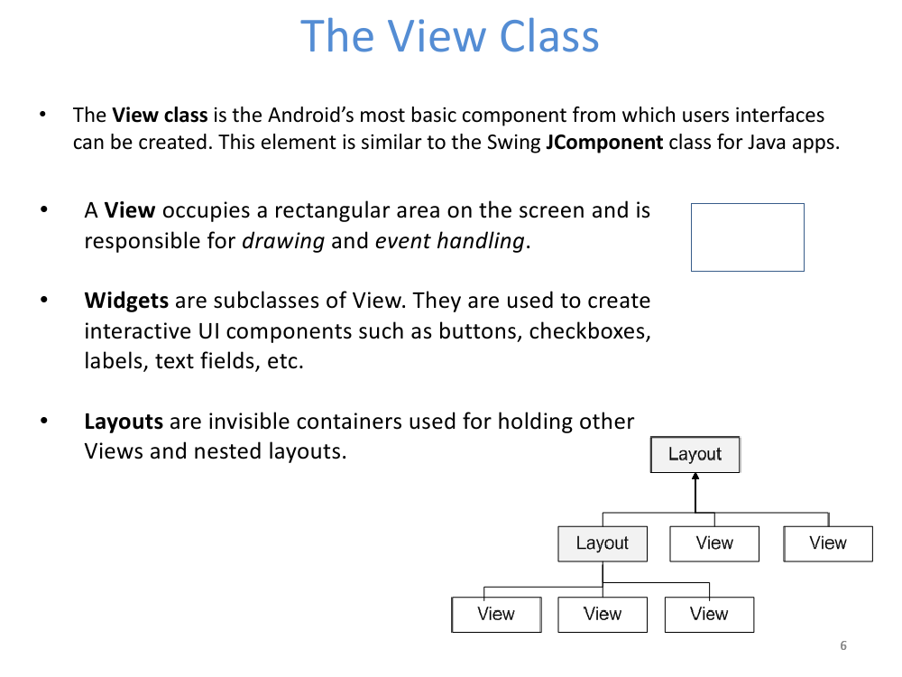

Slide 5
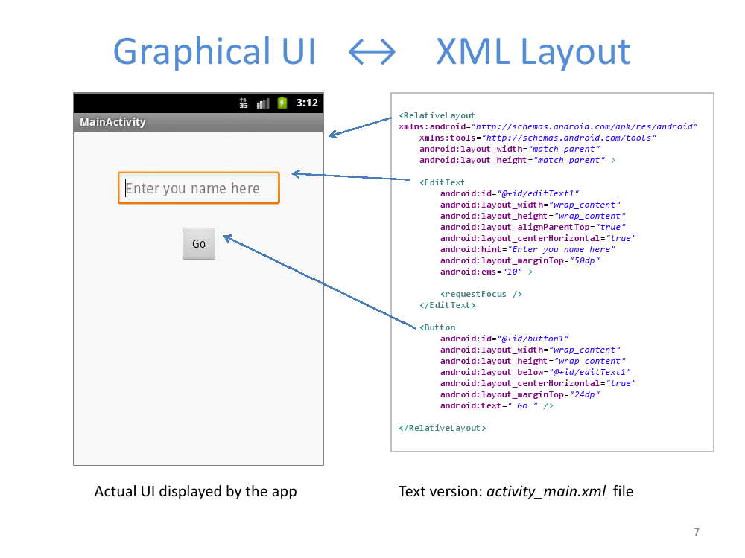

Slide 6
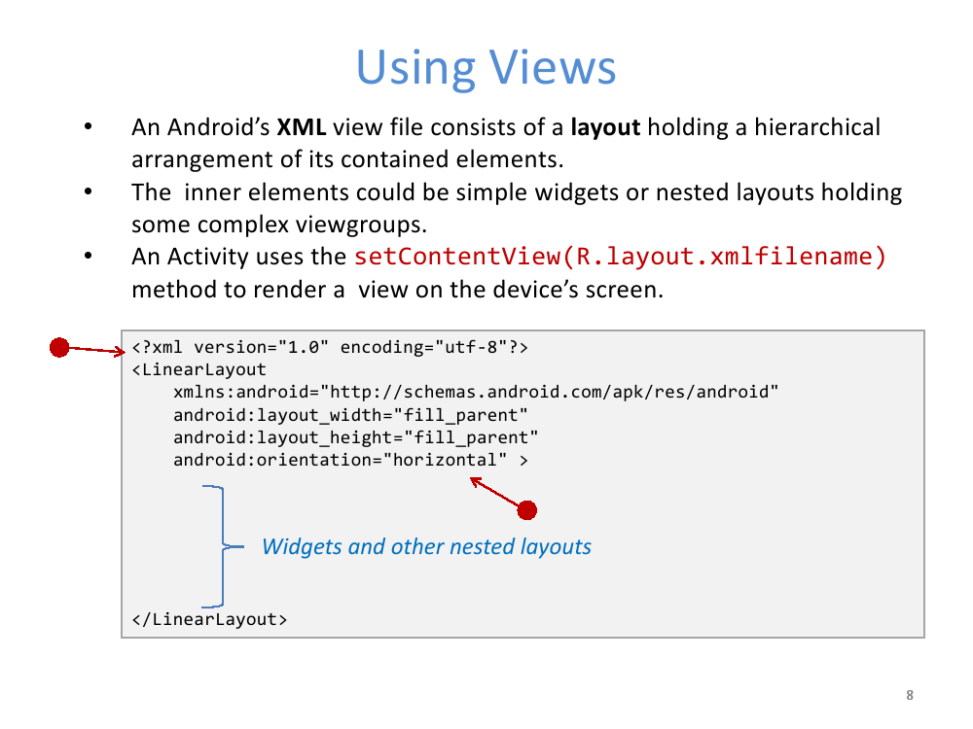

Slide 7
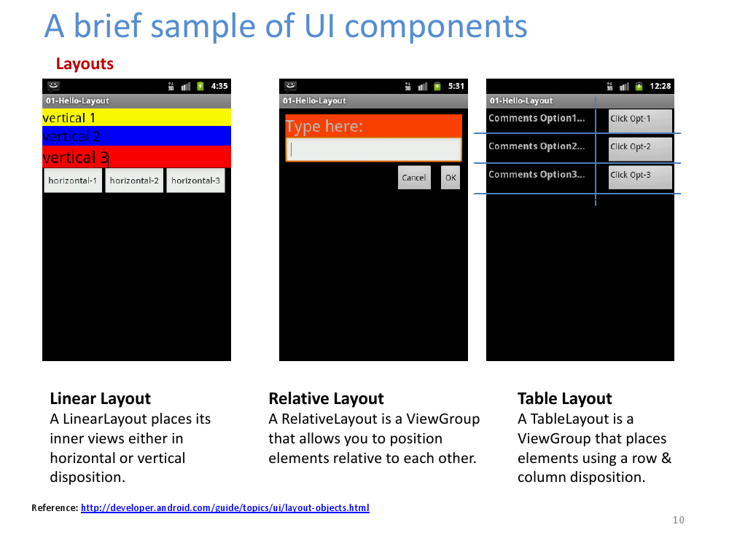

Slide 8
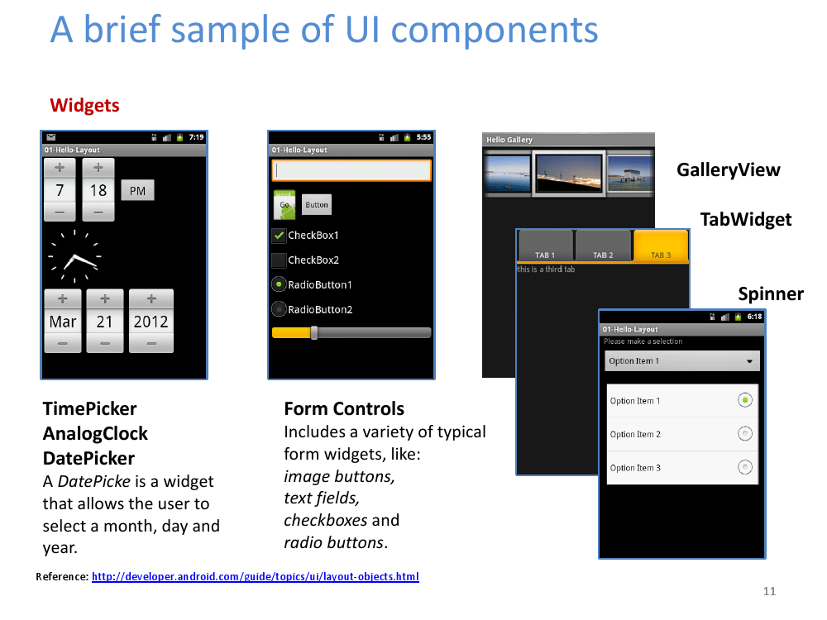

Slide 9
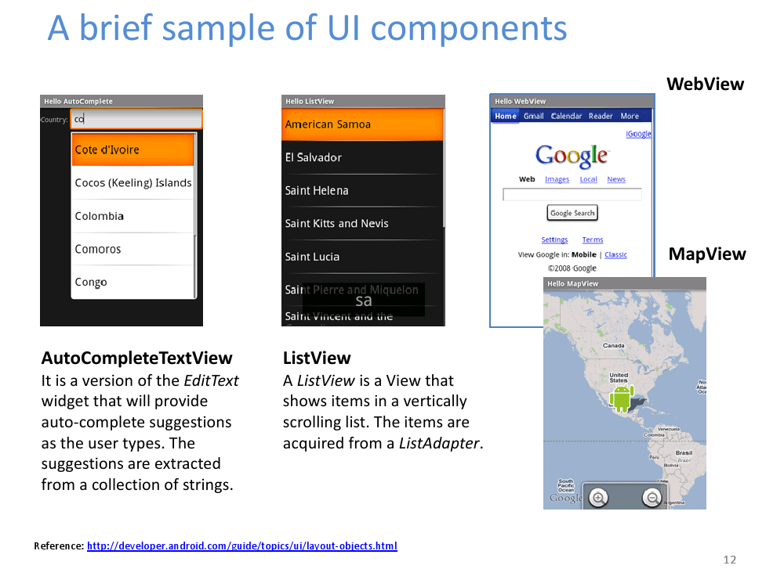

Slide 10
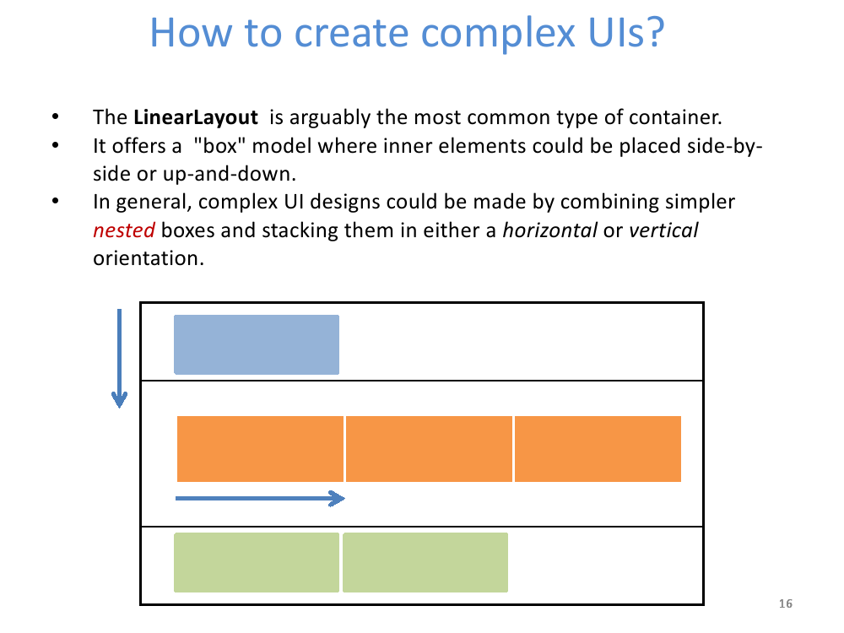

Slide 11
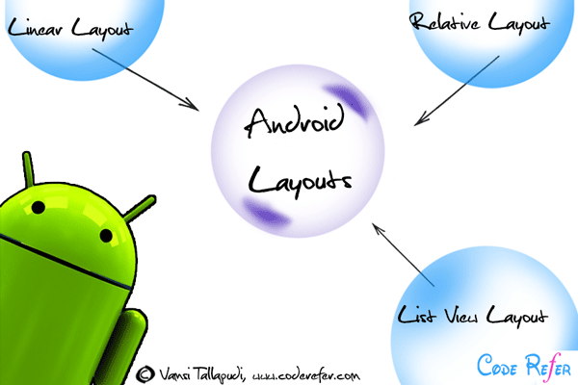
Graphical User Interface: Android Layouts
A Layout dictates the alignment of widgets (such as Text, Buttons, EditText box) as we see in the Android Application.

Slide 12
Common Layouts
Linear Layout
Relative Layout
Table Layout
Frame Layout
Absolute Layout
Scroll View (Vertical)
Horizontal Scroll View
Simple List View
List View in Android

Slide 13
Graphical User Interface: Input Controls
Android Button
Image Button
Edit Text
Check Box
Radio Button
Switch Button
Toggle Button
Rating Bar
Spinner Example
Date Picker
Time Picker

Slide 14
Toast, Dialog and Snackbar
Toast Message
Alert Dialog
Snackbar
Android User Interface Design: Navigation, ActionBar and Menus
Navigation Drawer
Sliding Menu with WebView
Dropdown Menu
Action Bar/App Bar
Toolbar
Action Bar Tabs

Slide 15
Linear Layout
Linear Layout is a layout which aligns the widgets or elements in a linear (Straight) fashion. Linear Layout consists of two types of orientation:
Vertical Orientation,
Horizontal Orientation.
Vertical Orientation is shown above where the widgets such as Text View, Edit Text, and Button are aligned in a Vertical manner.

Slide 16
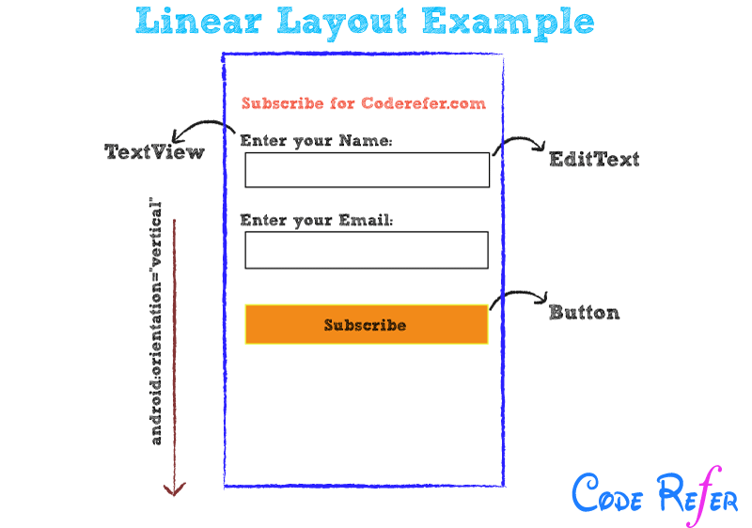

Slide 17
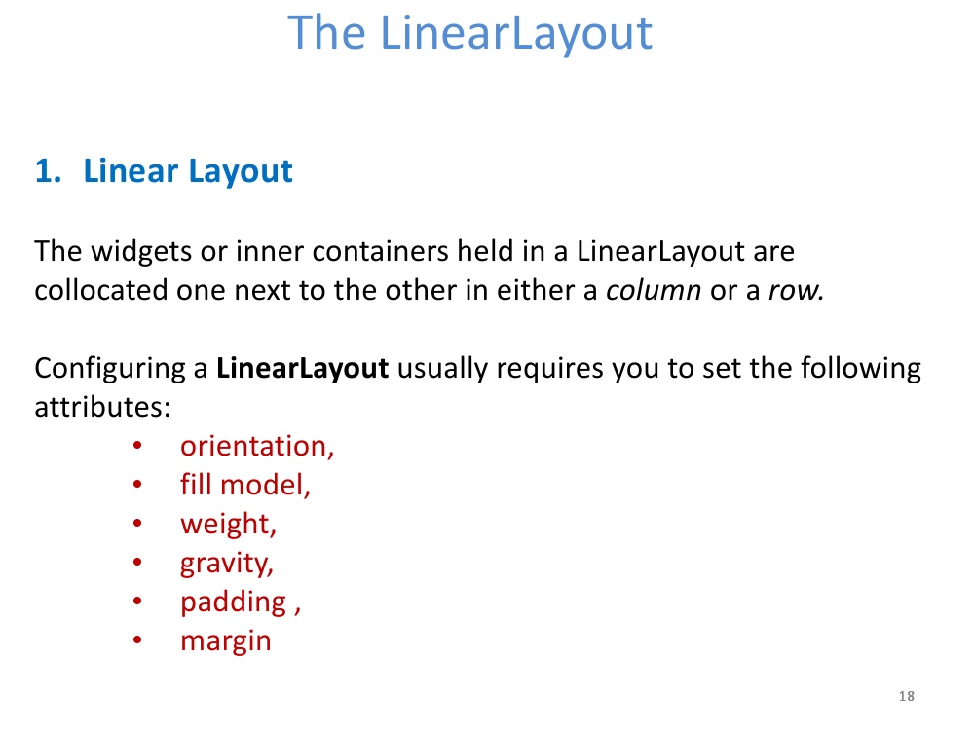

Slide 18
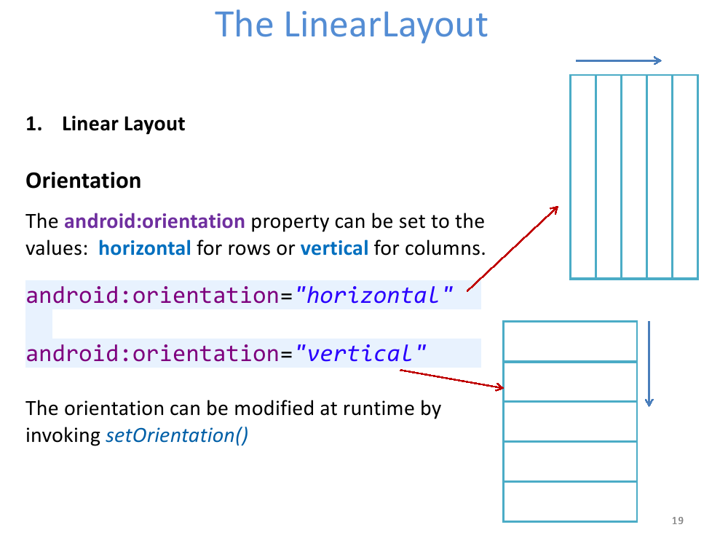

Slide 19
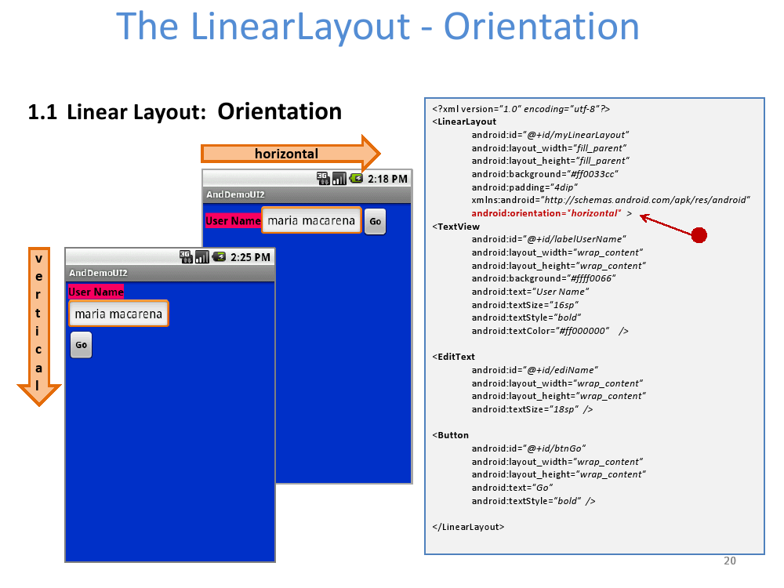

Slide 20
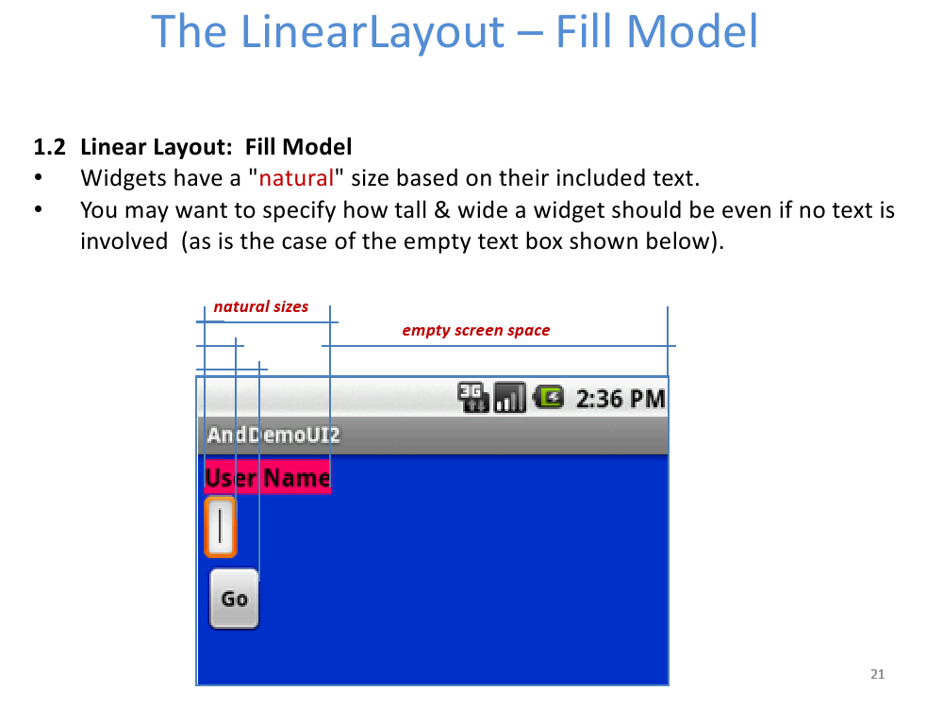

Slide 21
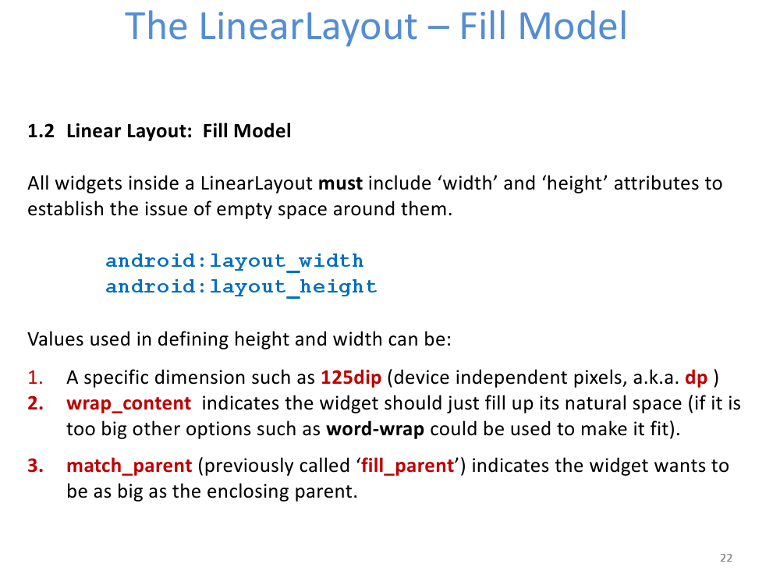

Slide 22
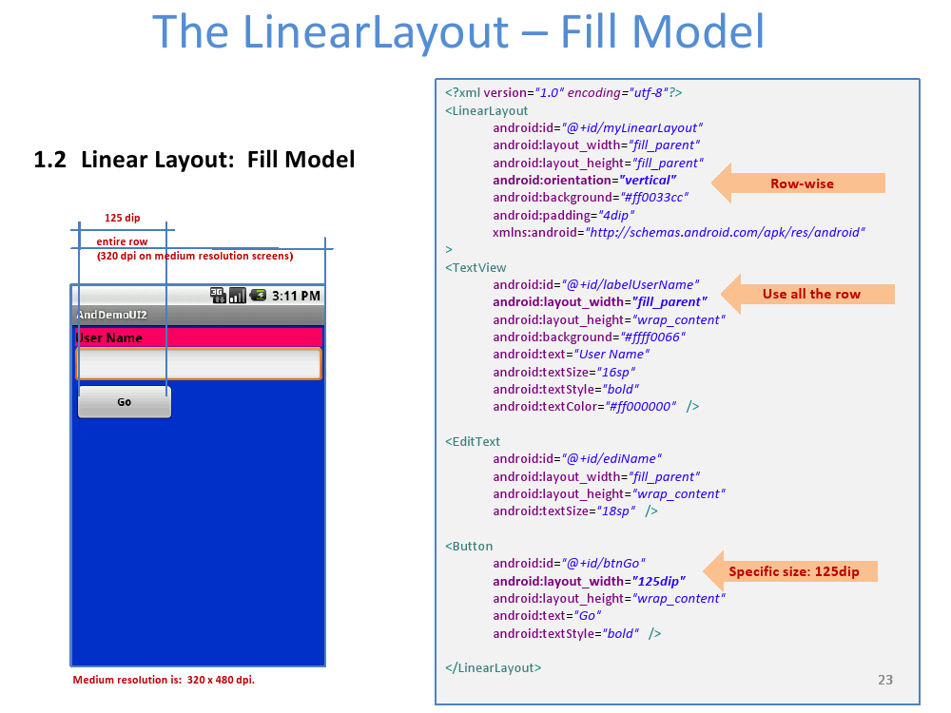

Slide 23
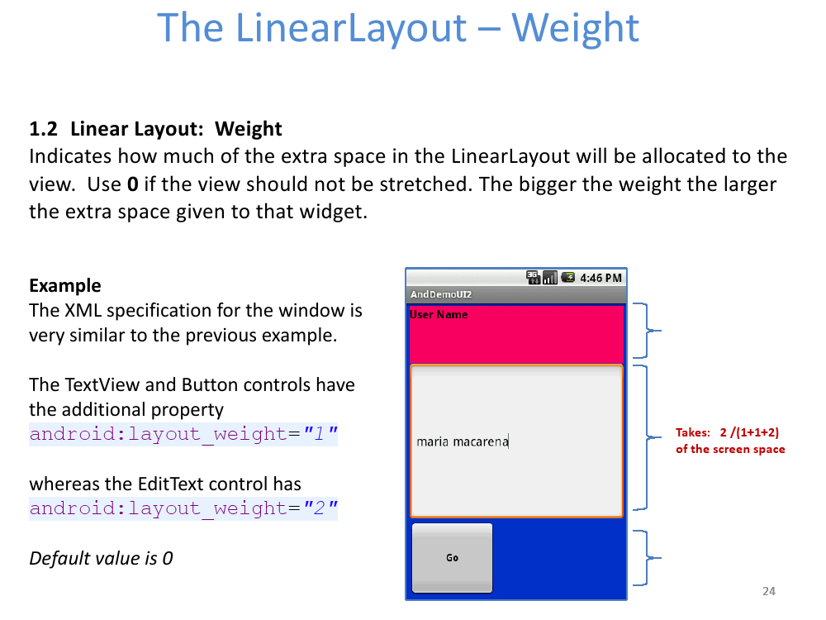

Slide 24
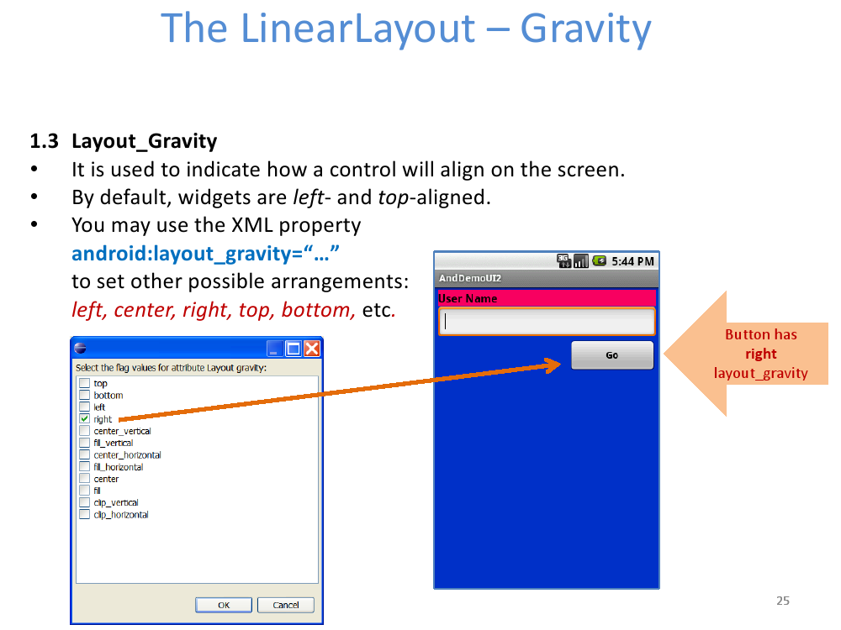

Slide 25
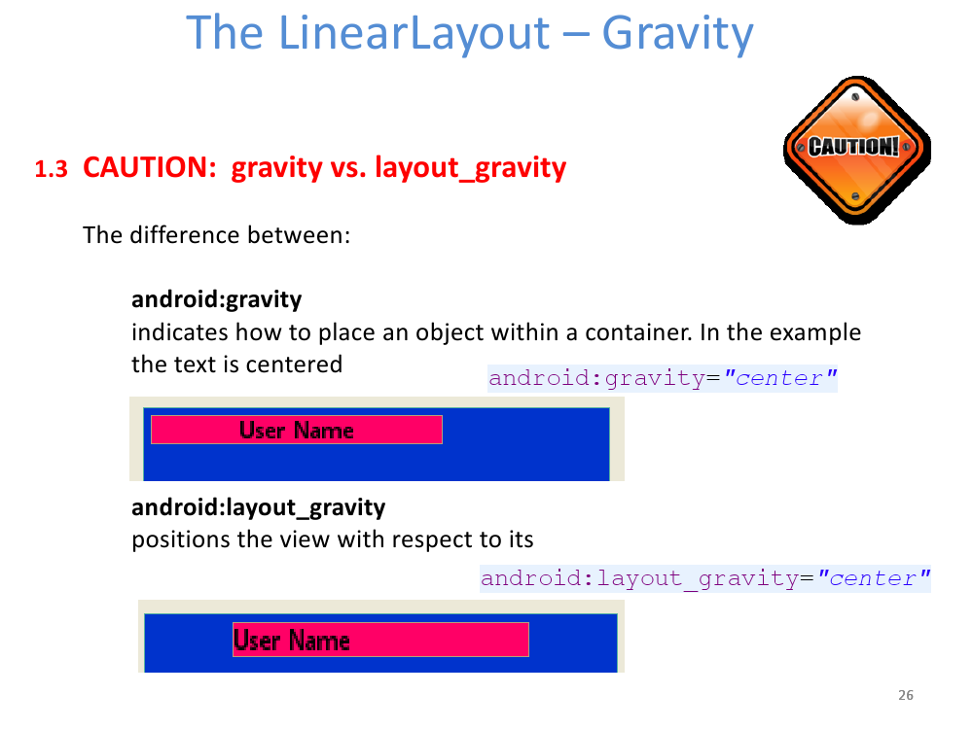

Slide 26
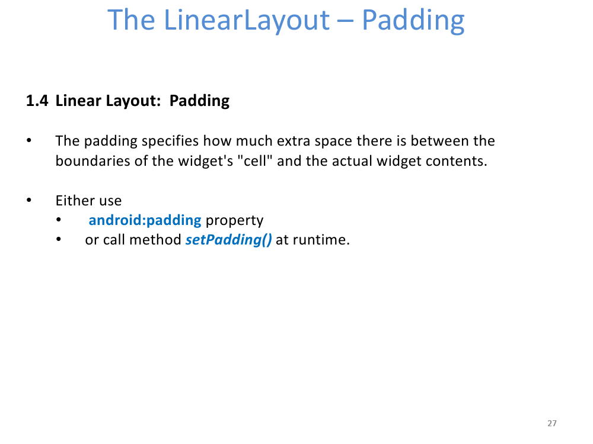

Slide 27
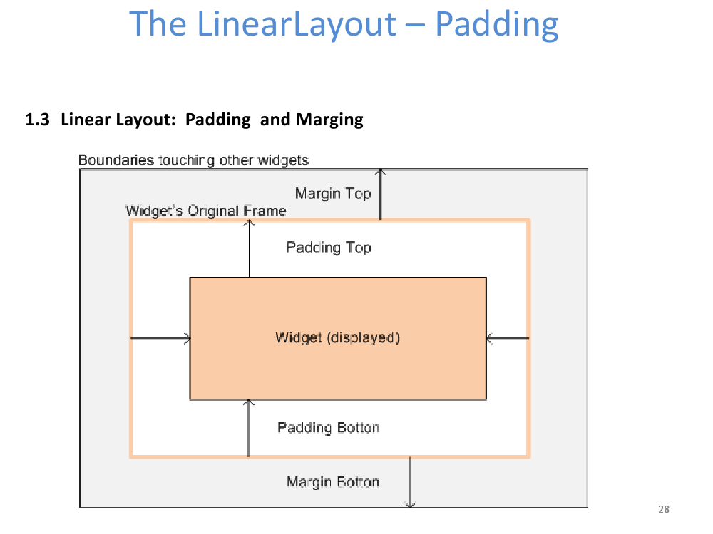

Slide 28
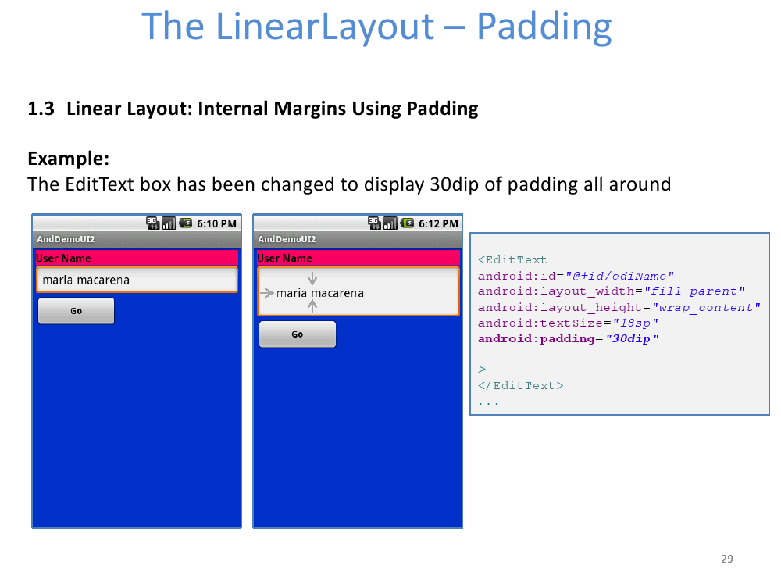

Slide 29
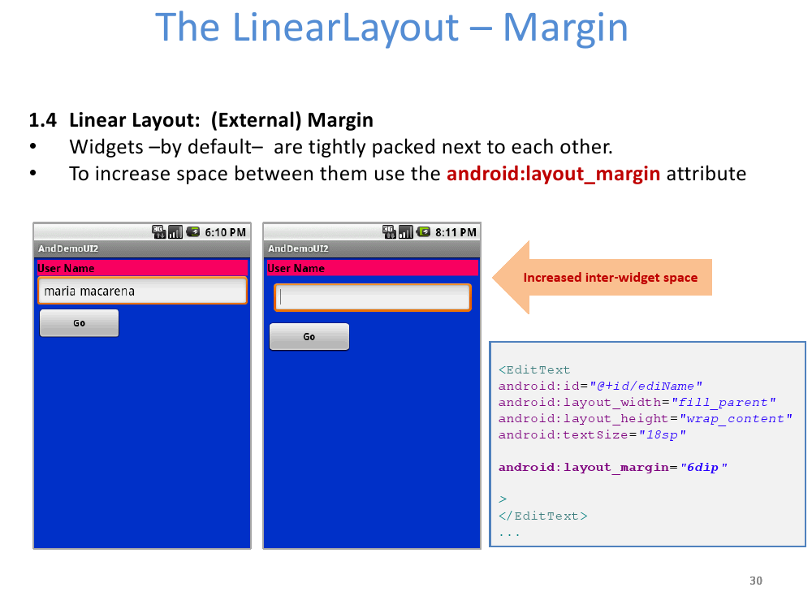

Slide 30
Thank You!

