Slide 1
Graphical User Interface: Widgets
Daw Nwe Mar Khaing
4/11/2016

Slide 2
Agenda
TextView
EditText
Button
ImageButton
CheckBox
RadioButton
Basic Widget Example

Slide 3
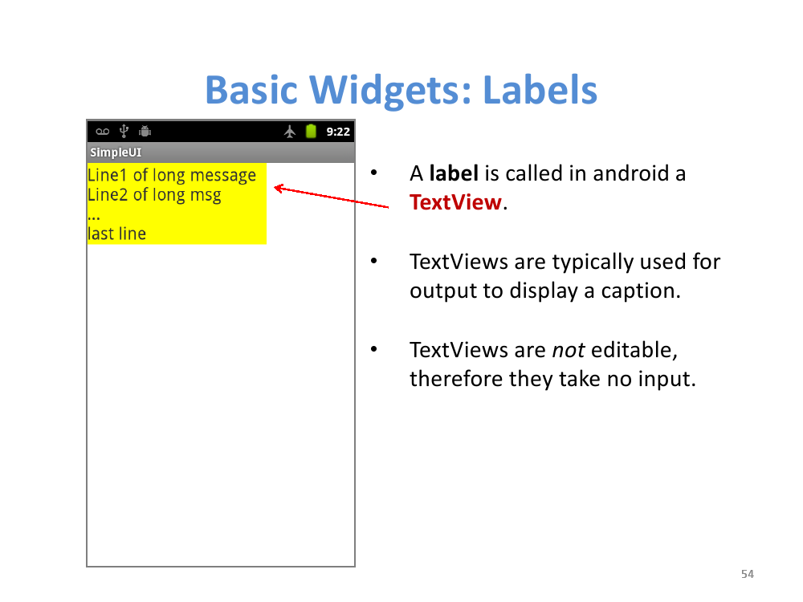

Slide 4
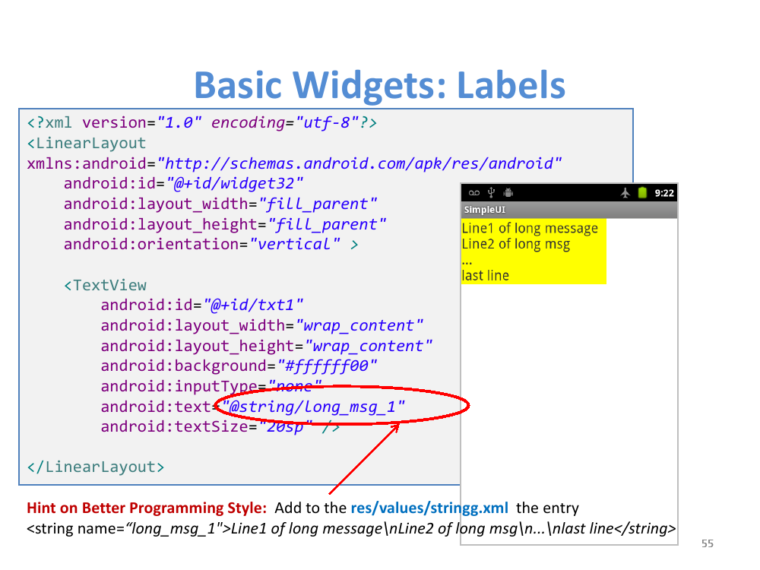

Slide 5
TextView
TextView is one of the most fundamental Android user interface widget, which is used to display text on Android screen.
TextView is like a label, doesn’t allow to edit text input.
For all TextView properties and attributes follow official website TextView documentation. (or)
https://developer.android.com/reference/android/widget/TextView.html

Slide 6
TextView Example
<?xml version="1.0" encoding="utf-8"?>
<LinearLayout xmlns:android="http://schemas.android.com/apk/res/android" android:layout_width="match_parent"
android:layout_height="match_parent"
android:layout_marginTop="10dp"
android:orientation="vertical“
android:padding="10dp">
<TextView android:id="@+id/textView1" android:layout_width="match_parent" android:layout_height="wrap_content" android:layout_marginBottom="10dp" android:gravity="center_horizontal" android:text="stacktips.com" android:textAllCaps="true" android:textColor="#86AD33"
android:textSize="25dp"
android:textStyle="bold" />

Slide 7
<TextView android:id="@+id/textView2" android:layout_width="wrap_content" android:layout_height="wrap_content" android:layout_gravity="center_horizontal" android:layout_marginBottom="20dp" android:ellipsize="end" android:letterSpacing="1.5" android:maxLines="2" android:text="Free programming tutorials on Java, Android development, Xamarin, Java Design Pattern, Data Structure Algorithm and examples on related technologies." android:textAppearance="?android:attr/textAppearanceMedium" />
<TextView android:id="@+id/textView3" android:layout_width="wrap_content" android:layout_height="wrap_content" android:layout_gravity="center_horizontal" android:autoLink="email|web" android:lineSpacingMultiplier="1.5" android:text="Have questions about stacktips.com or just want to chat? Contact us at javatechig@gmail.com" /> </LinearLayout>

Slide 8
EditText
A text field allows the user to type text into your app.
It can be either single line or multi-line. Touching a text field places the cursor and automatically displays the keyboard.
In addition to typing, text fields allow for a variety of other activities, such as text selection (cut, copy, paste) and data look-up via auto-completion.
You can add a text field to you layout with the EditText object. You should usually do so in your XML layout with a <EditText> element.

Slide 9
Specifying the Keyboard type
Text fields can have different input types, such as number, date, password, or email address. The type determines what kind of characters are allowed inside the field, and may prompt the virtual keyboard to optimize its layout for frequently used characters.
You can specify the type of keyboard you want for your EditText object with the android:inputType attribute. For example, if you want the user to input an email address, you should use the textEmailAddress input type:

Slide 10
There are several different input types available for different situations. Here are some of the more common values for android:inputType:
"text“ →Normal text keyboard.
"textEmailAddress” →Normal text keyboard with the @ character.
"textUri“→Normal text keyboard with the / character.
"number“→Basic number keypad.
"phone“→Phone-style.

Slide 11
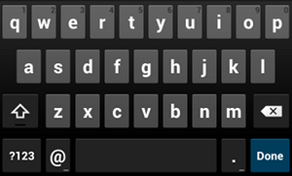
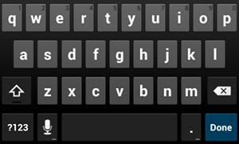
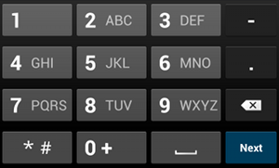
Fig. textEmailAddress input type
Fig. default text input type
Fig. default type input type

Slide 12
EditText Example
<EditText android:id="@+id/email_address" android:layout_width="fill_parent" android:layout_height="wrap_content" android:hint="@string/email_hint" android:inputType="textEmailAddress" />

Slide 13
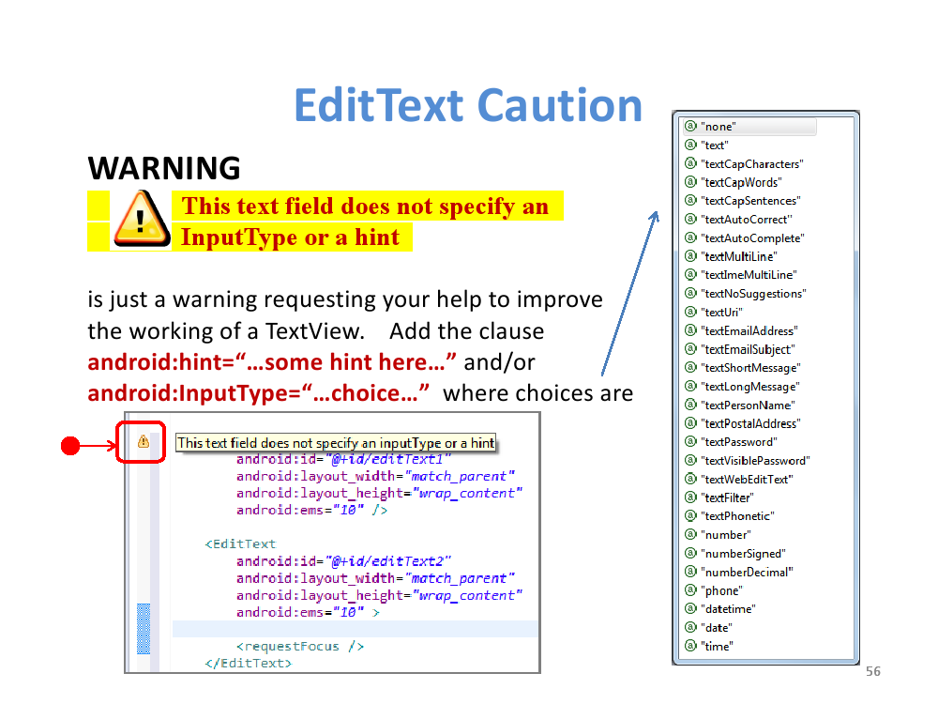

Slide 14
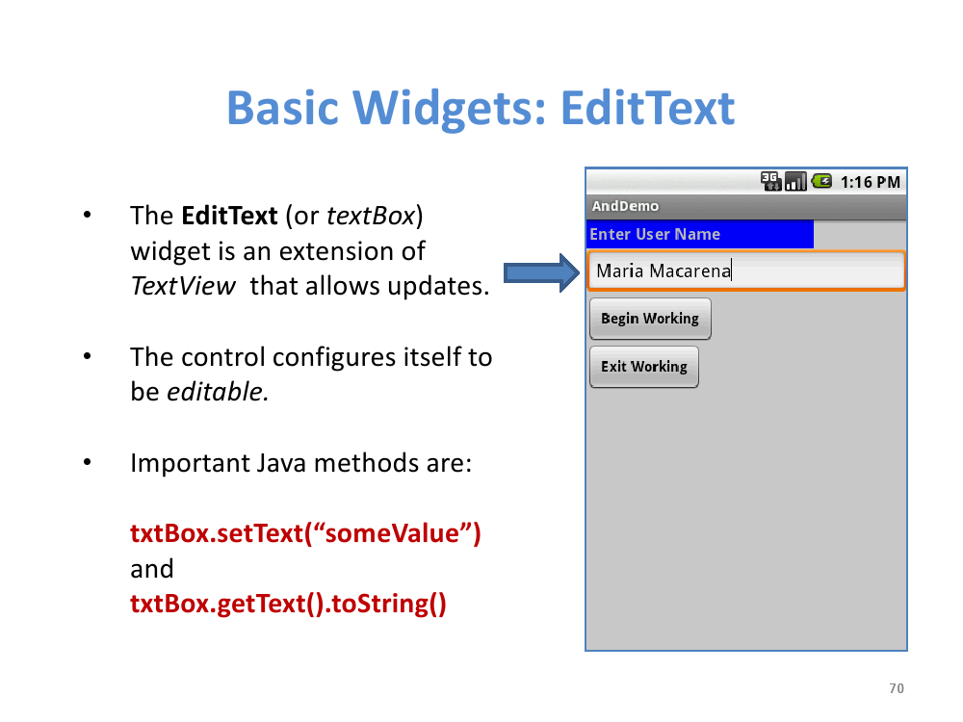

Slide 15
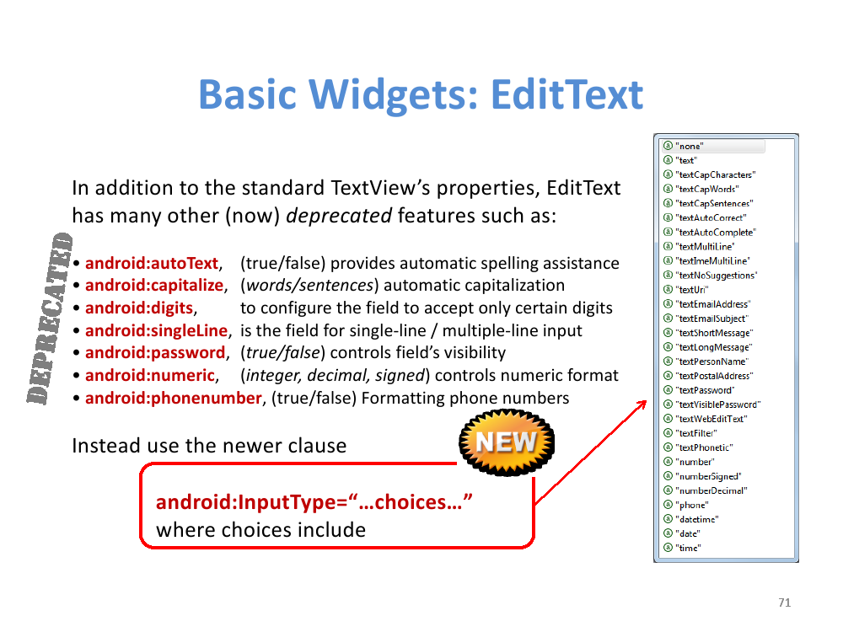

Slide 16
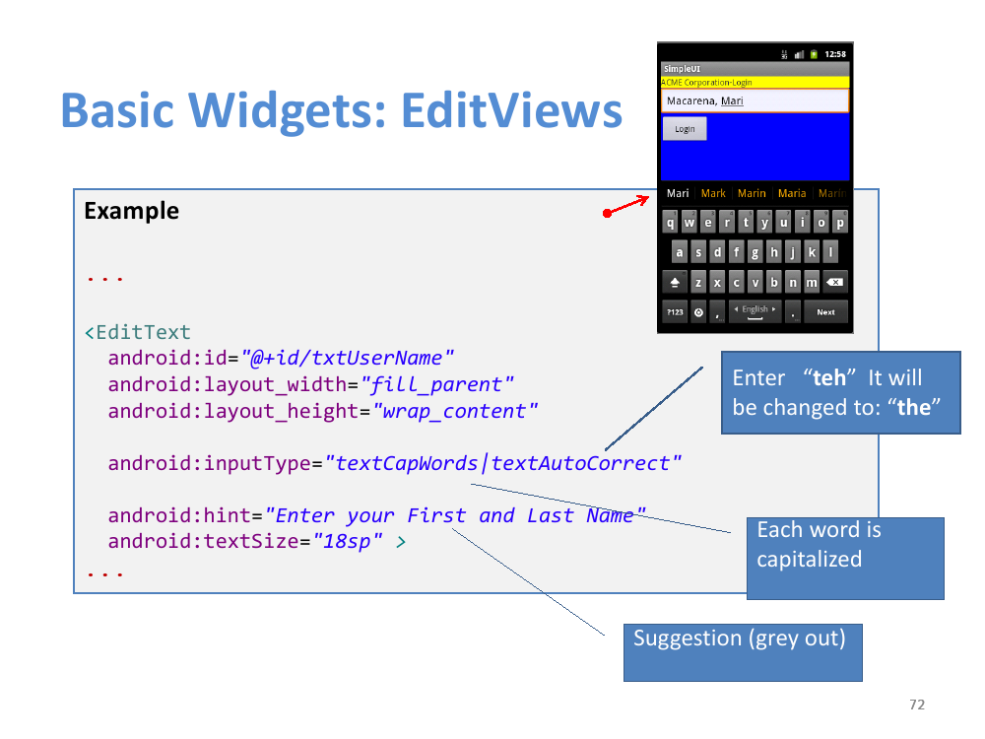

Slide 17
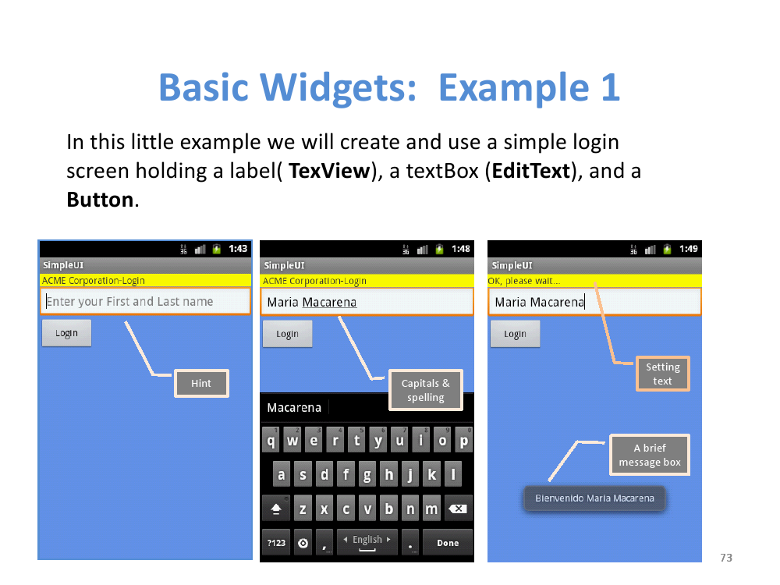

Slide 18
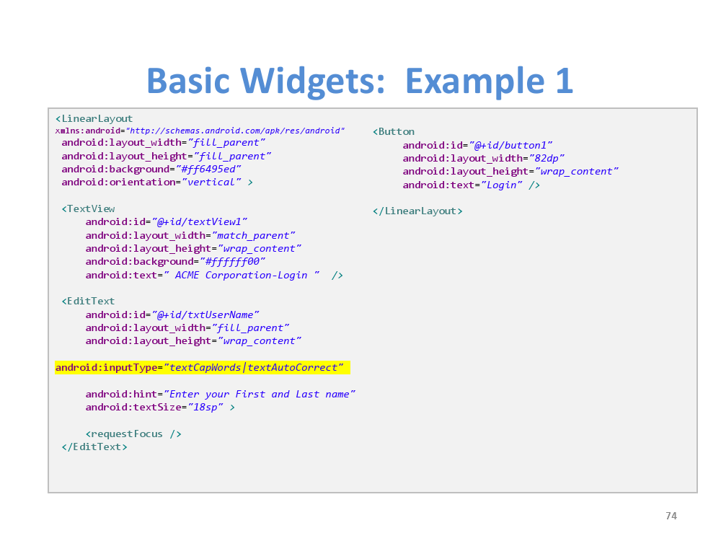

Slide 19
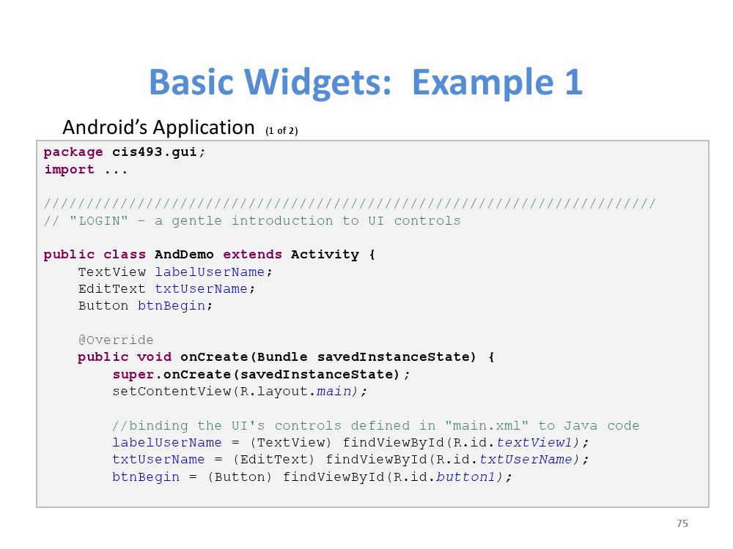

Slide 20
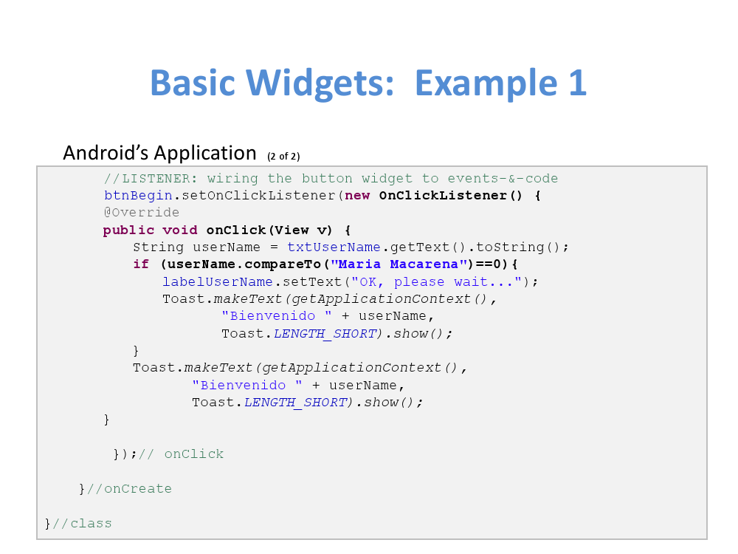

Slide 21
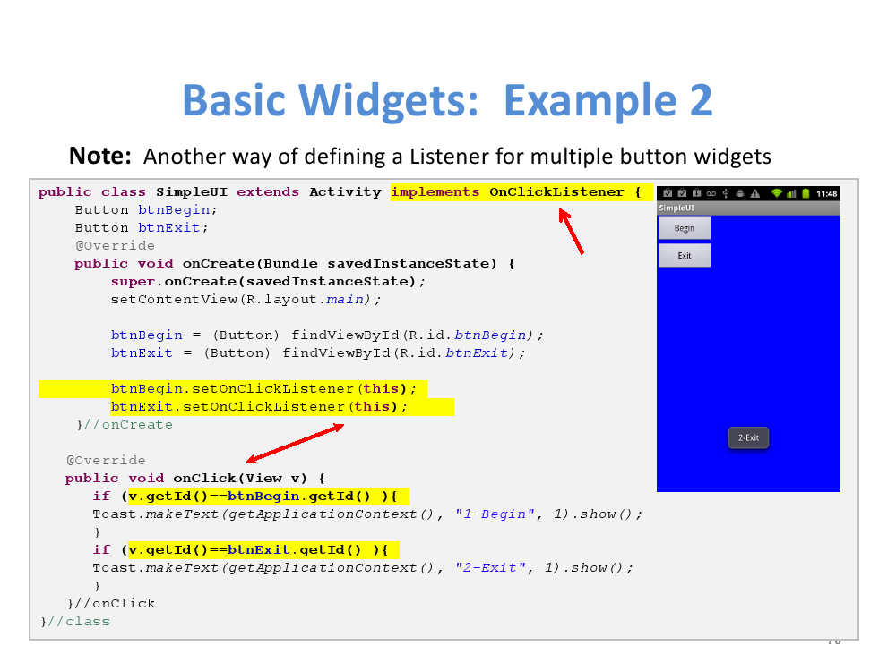

Slide 22
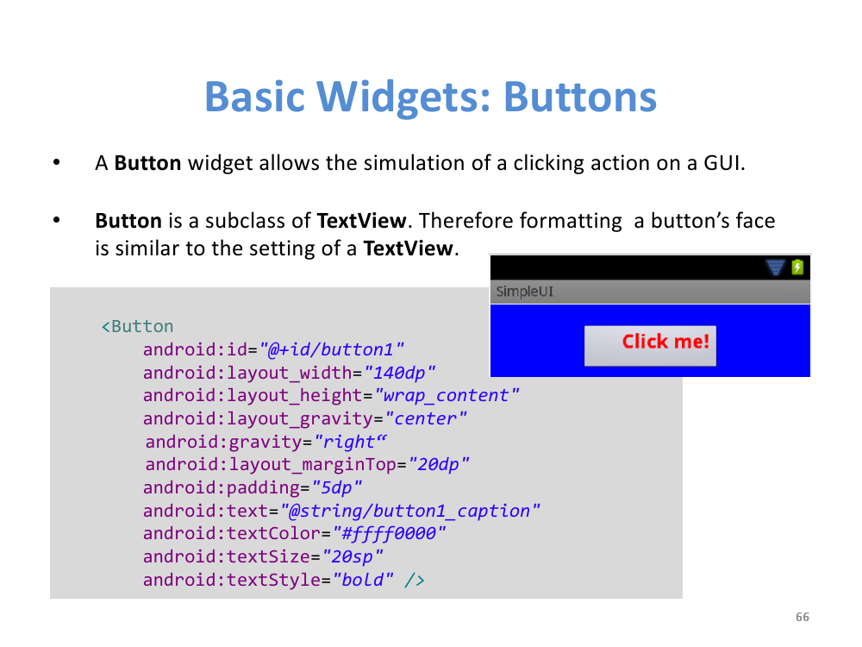

Slide 23
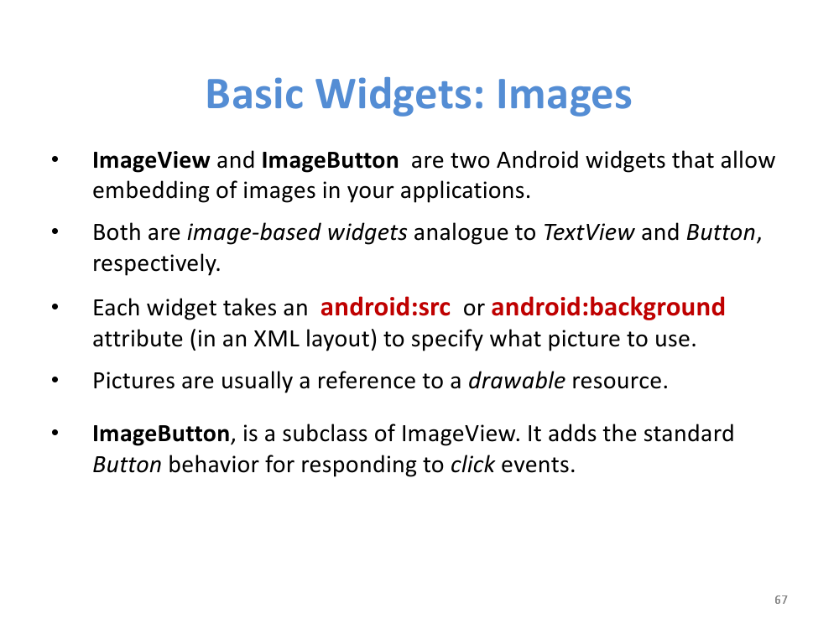

Slide 24
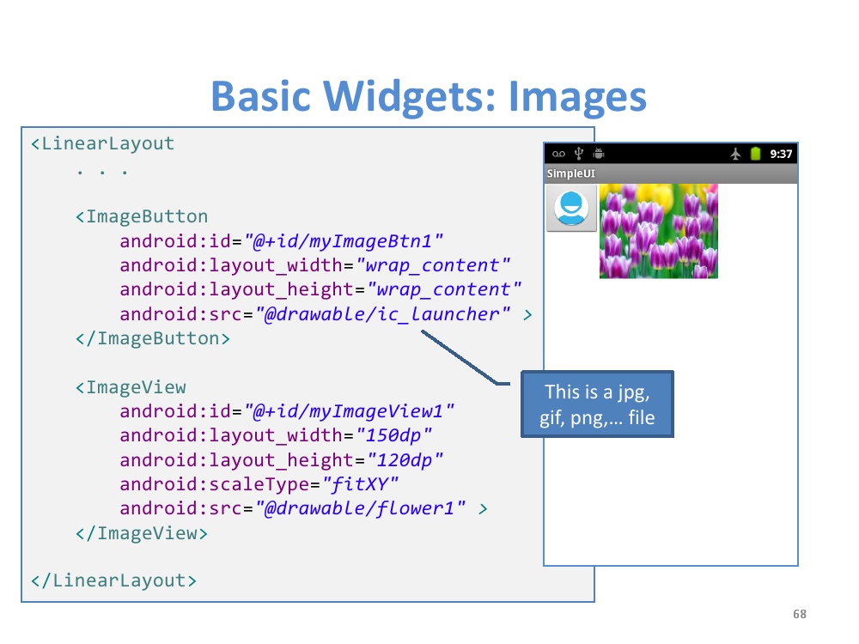

Slide 25
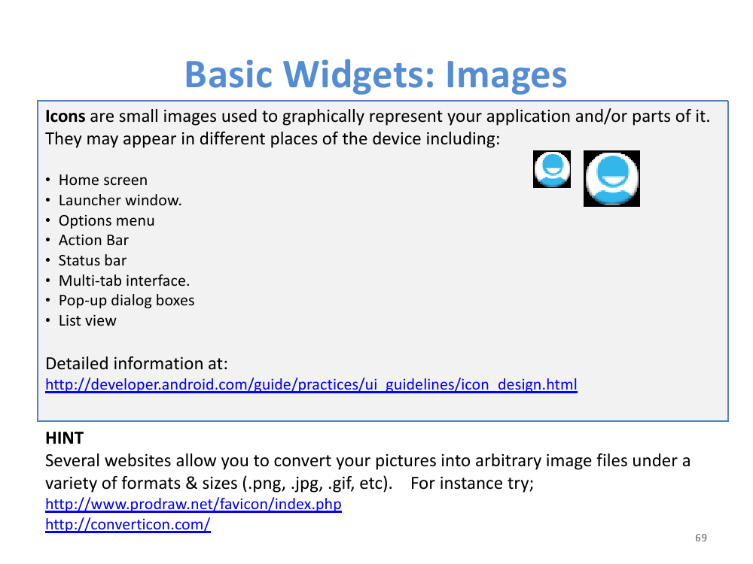

Slide 26
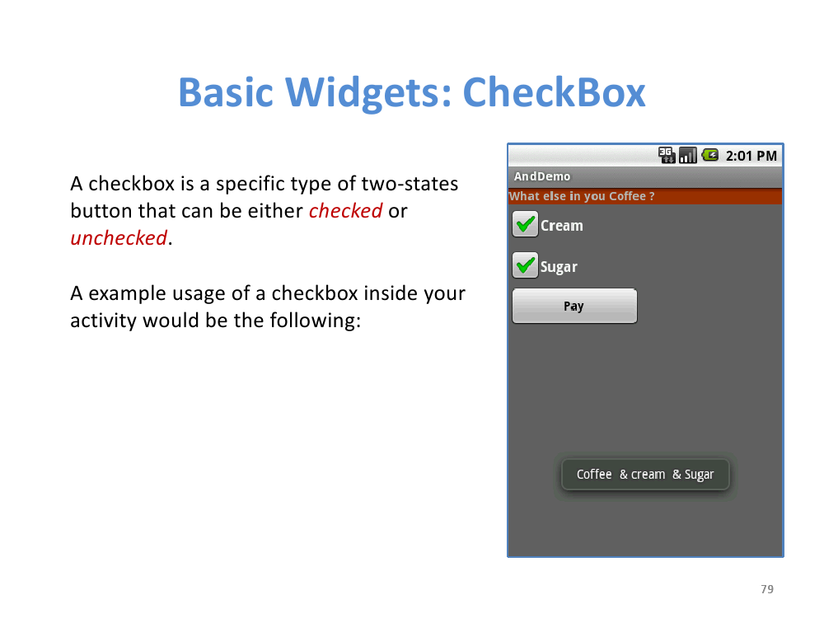

Slide 27
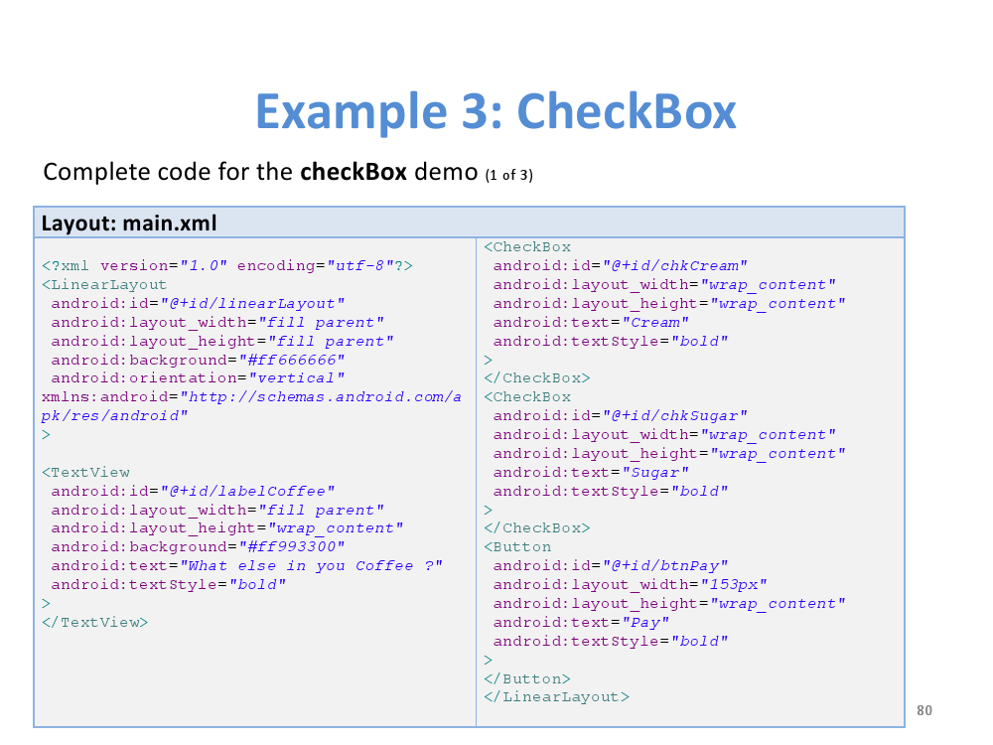

Slide 28
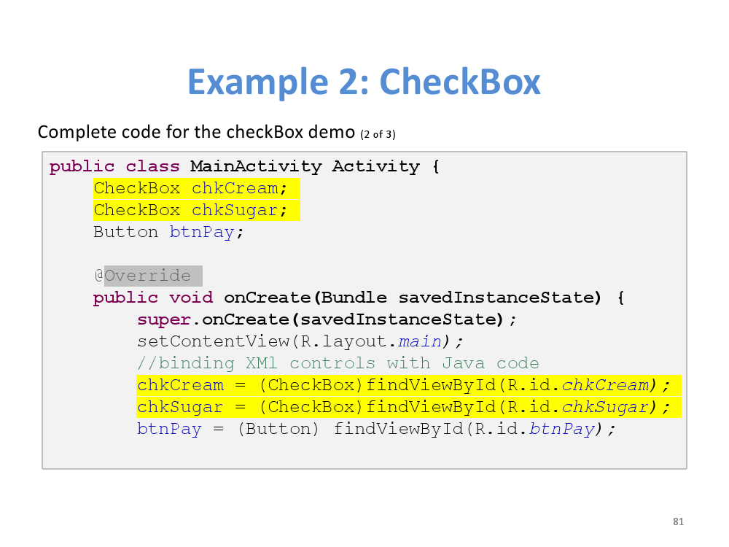

Slide 29
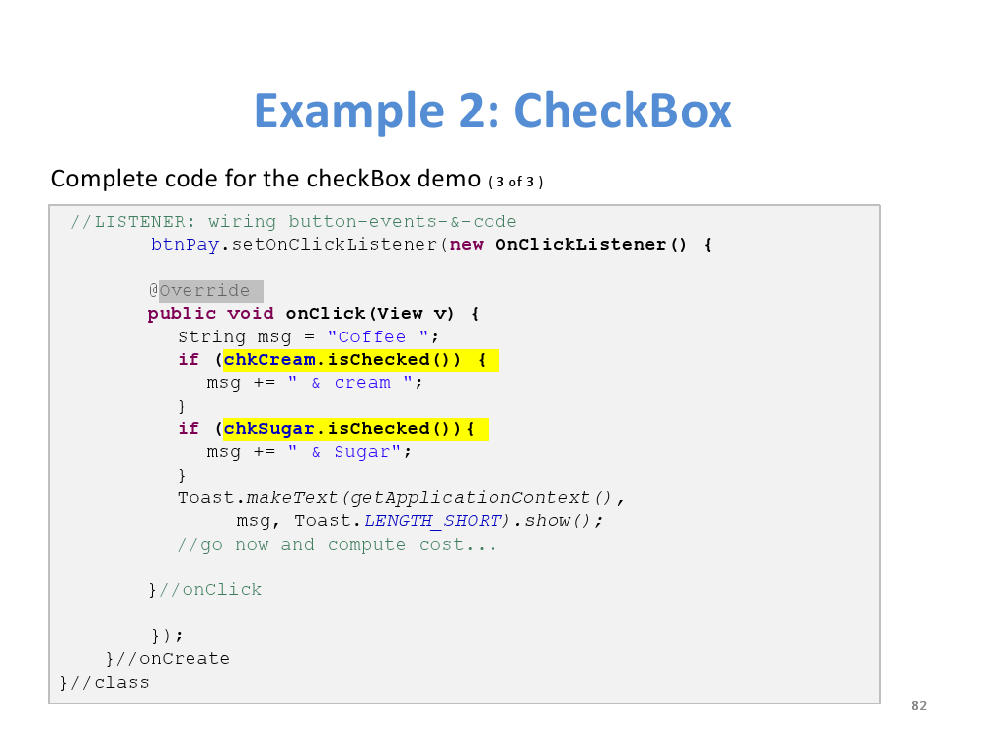

Slide 30
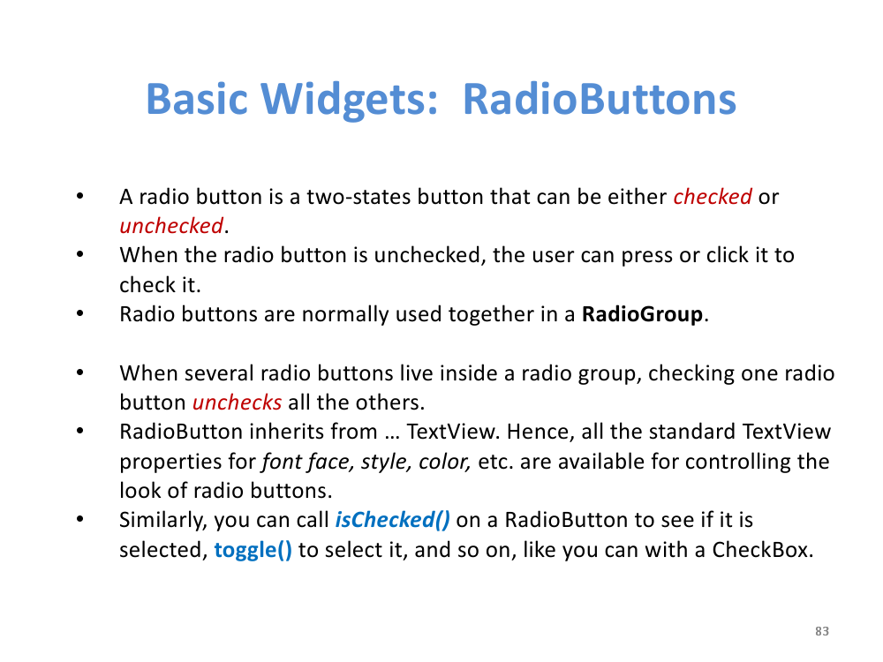

Slide 31
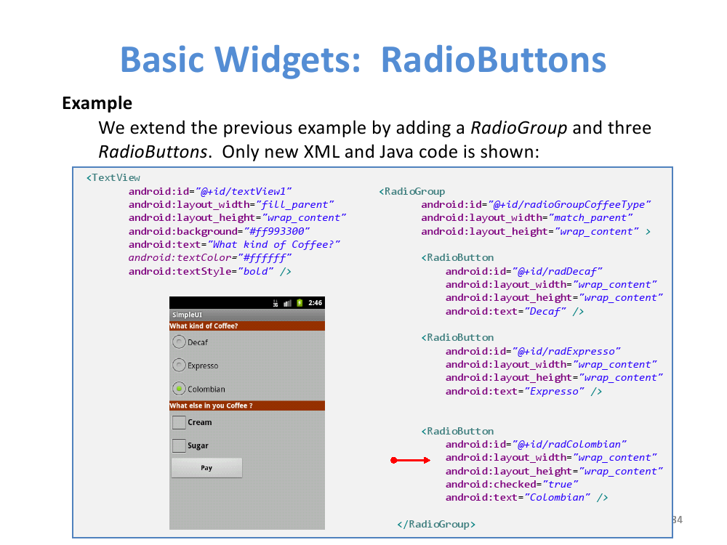

Slide 32
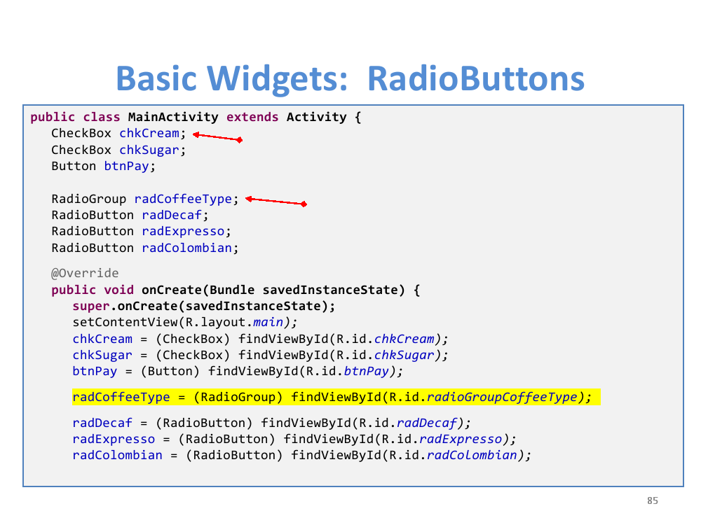

Slide 33
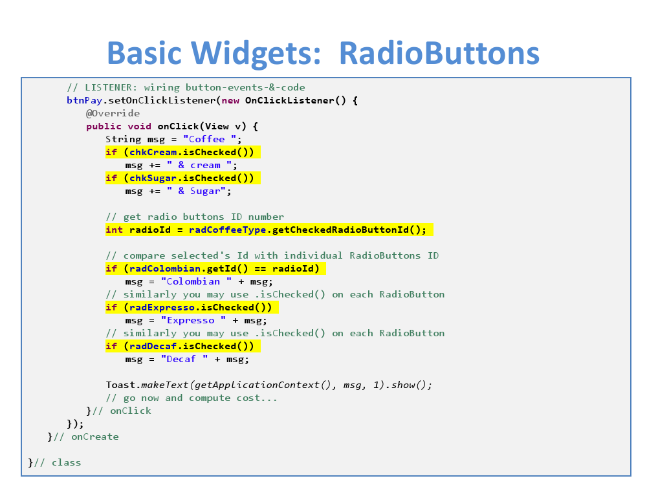

Slide 34
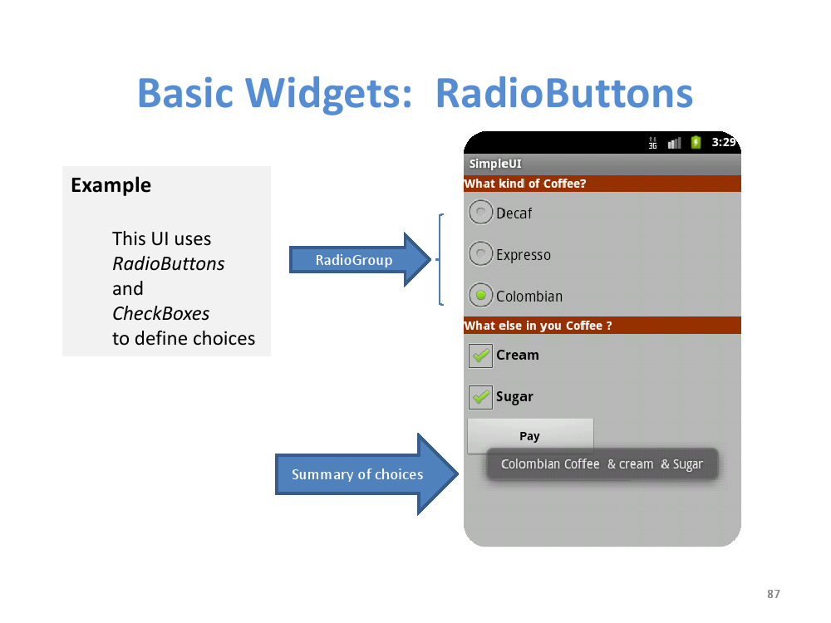

Slide 35
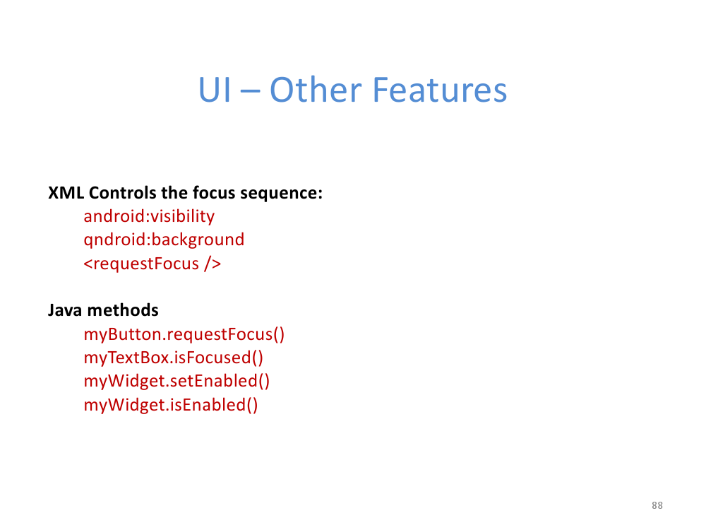

Slide 36
