Slide 1

Vacci Nation
Modeling a flu breakout

Slide 2
Motivation
Medicine and vaccines form a foundation of modern societies
“Anti-vaccination“ groups are on the rise
Cases of formerly extinct diseases are appearing again
Flu / Influenza especially interesting
Mutation every year
Almost yearly outbreaks
→ Vaccination behaviour as an interesting game theoretical problem

Slide 3

Literature Review

Slide 4
Modeling infectious diseases
Compartmental models are commonly used in disease modelling (SIR, SEI, SIS, SIRS, etc.)
Kermack and McKendrick (1927)
Adaptations for different subpopulations and disease processes (Dadlani, 2013)
Mass-action assumption – homogeneous, fully connected populations -> Networks (Keeling and Eames, 2005)
Network structure is decisive for the spread of a disease (Pastor-Satorras and Vespignani, 2002; Liu et al., 2015; etc.)

Slide 5
Game Theoretical Analyses
Insufficient uptake levels, given selfish agents and even minimal costs of vaccination (Bauch and Earn, 2004)
Game theory and network model (Shi et al., 2017):
Heterogeneous network structures can preserve vaccination rates if relative costs are increasing
Highly connected agents more likely to vaccinate if only neighbours are considered
Strong effects of belief-groups on uptakes and spreading
Committed vaccinators increase uptakes and avoid clustering (Liu et al., 2012)
Fraction of sceptics drives reduced uptake rates rather than discrepancy in cost assessments (Shim et al., 2012; Stegehuis et al. 2016)

Slide 6
Our Model

Slide 7
General Assumptions
SIVR-model with a constant population and two belief groups (trusters vs. sceptical)
Agents are almost rational utility-maximisers and rely on local prevalence of the disease for their assessments
Time-horizon of an agent is bounded (only a few time steps are considered in decisions)
The population is modelled using a small-world graph based on the Watts-Strogatz model

Slide 8
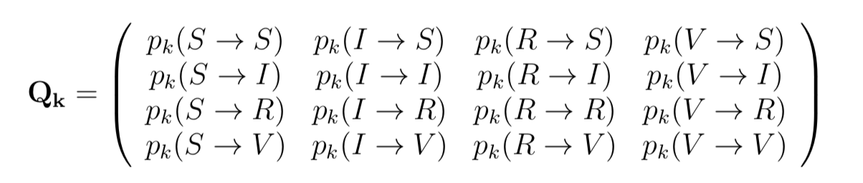
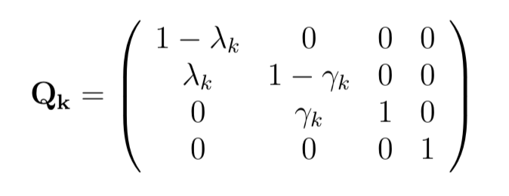
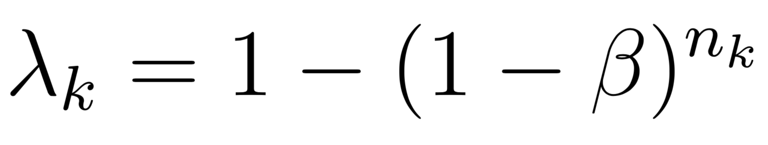
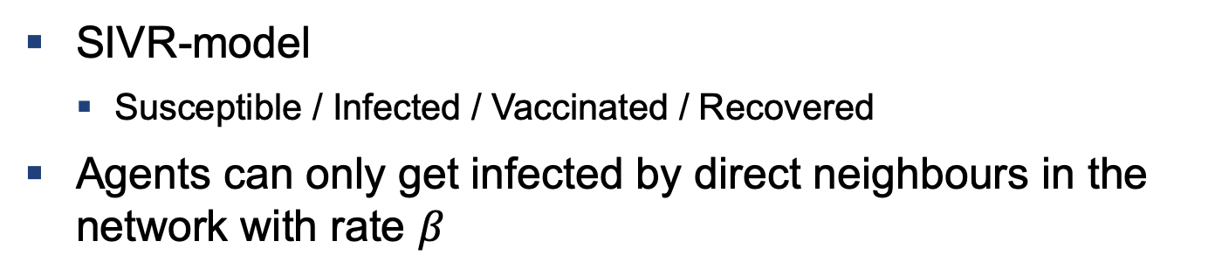
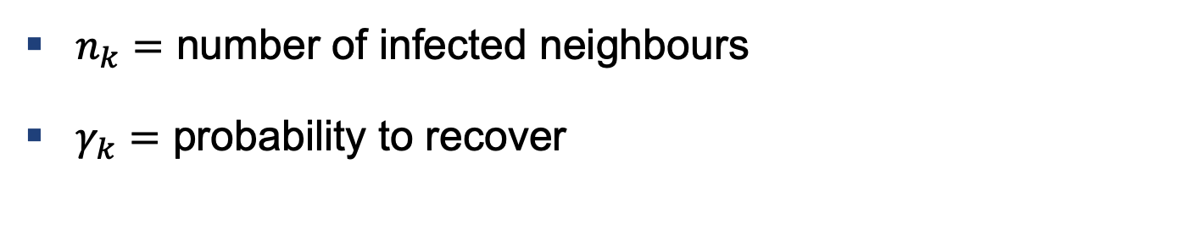
Epidemiology
SIVR-model
Susceptible / Infected / Vaccinated / Recovered
Agents can only get infected by direct neighbours in the network with rate $β$
$n_{k}=$ number of infected neighbours
$γ_{k}=$ probability to recover

Slide 9
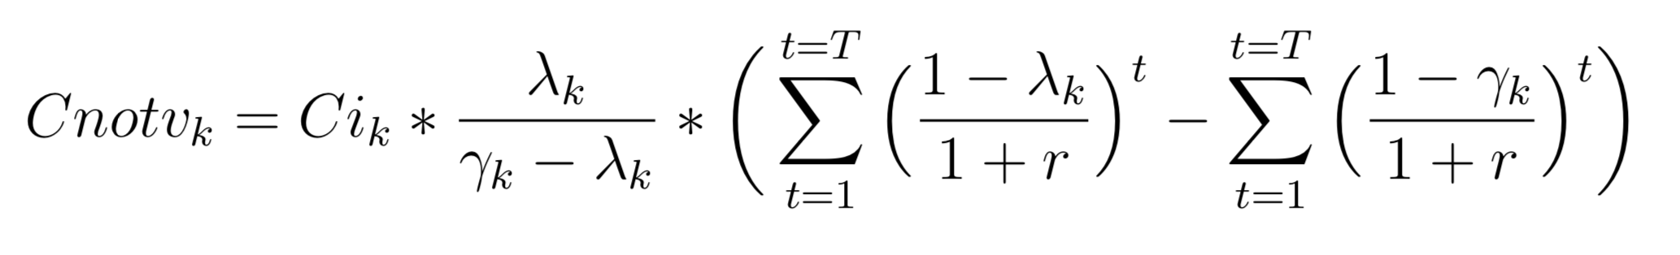
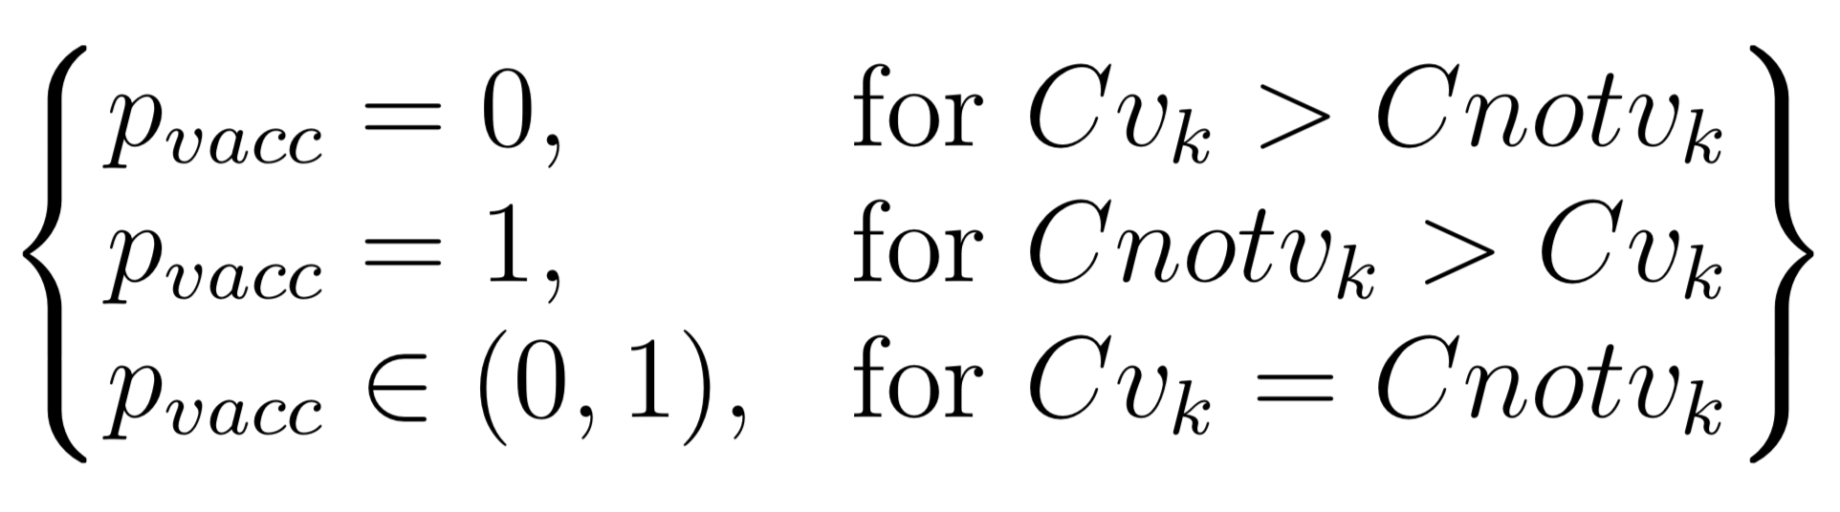
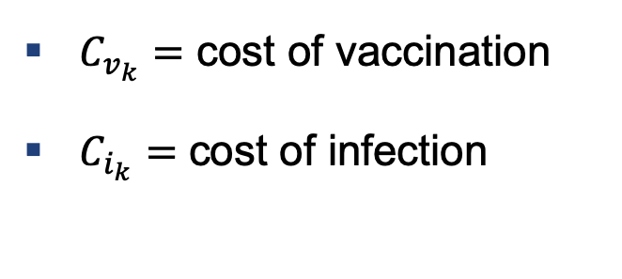

Epidemiology
With this data the agent derives its utility function
The decision to vaccinate or not can be expressed as
$C_{v_{k}}=$ cost of vaccination
$C_{i_{k}}=$ cost of infection
$C_{notv_{k}}=$ cost of not vaccinating

Slide 10
Implementation
Simulation carried out using Python
Specifically numpy, networkx and matplotlib
main.py to loop over network for each timestep
SmallWorld class to create the network
Agent class containing utility function and maximization problem

Slide 11
Initial Setup

Slide 12
Results and Outlook

Slide 13
Main Results

Slide 14
Possible Extensions
Agents:
Individual costs for Ci, Cv or different decision tresholds
Non-binary coding of the groups, hence groups in-between
Age-dependency of parameters: disease-specifics, costs, time-horizons
Allow for births and deaths in the population
Networks:
Work with different networks structures
Allow for non-static network where agents can cut edges as prevention
Non-static population and nodes are added/removed

Slide 15
Thank you very much for your attention

