Slide 1
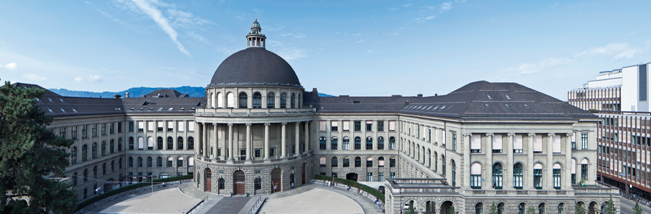
Vacci Nation
Modeling a flu breakout

Slide 2
Motivation
Medicine and vaccines form a foundation of modern society
“Anti-vaxxer“ groups are on the rise
Cases of formerly extinct diseases are appearing again
Flu / Influenza especially interesting
Mutation every year
Almost yearly outbreaks
→ Vaccination behaviour as an interesting game theoretical problem

Slide 3

Literature Review

Slide 4
Modeling infectious diseases
Kermack and McKendrick (1927)
First SIR-model
Forms the basis for any sort of disease modeling
Most analytic disease models rely on homogeneous, fully connected populations
Keeling and Eames (2005)
Networks instead of homogeneous populations
Combination of population and disease transmission

Slide 5
Game Theoretical Analyses
Bauch and Earn (2004)
Assuming selfish behaviour
Disease eradication is hard to achieve; even with minimal cost of vaccination
Bauch and Bhattacharyya (2012)
Evolutionary game theory with social learning
Better explanation for vaccine-scares
Shim, Grefenstette, Albert, Carkouros and Burke (2012)
Dividing population into vaccine-believers and –sceptics
Vaccination decision based on a cost-return-calculation
Main motivation for our simulations

Slide 6
Our Model

Slide 7
General Assumptions
Vaccination or recovery ensures permanent immunity
Agent decides whether to vaccinate by maximizing a utility function
Time-horizon of an agent is bounded (only a few time steps are considered in decisions)
Each agent is either vaccine-trusting or –sceptical
The population is modelled using a small-world graph based on the Watts-Strogatz model

Slide 8
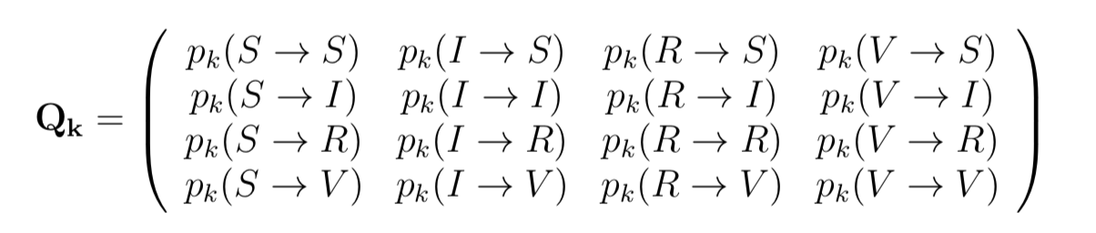
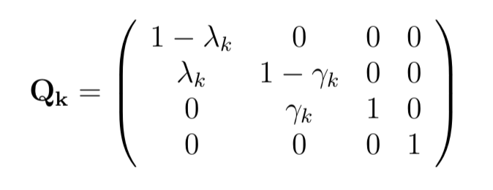
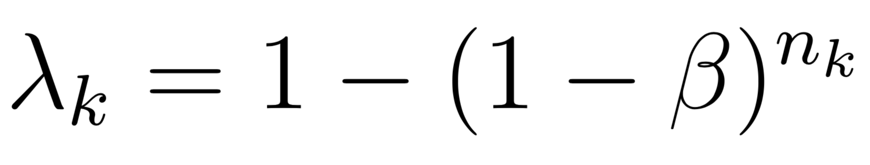
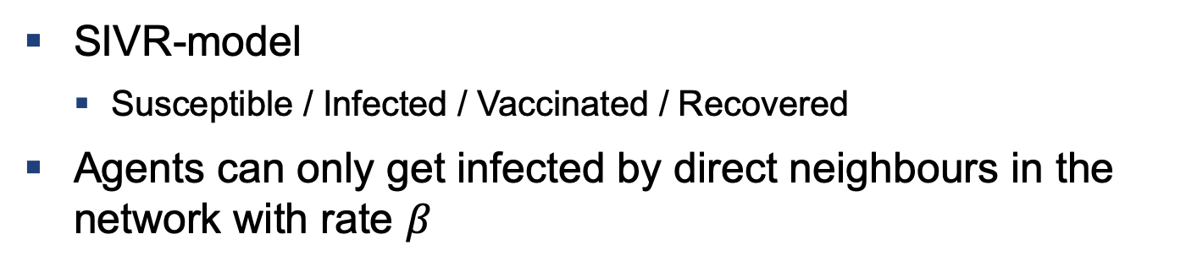
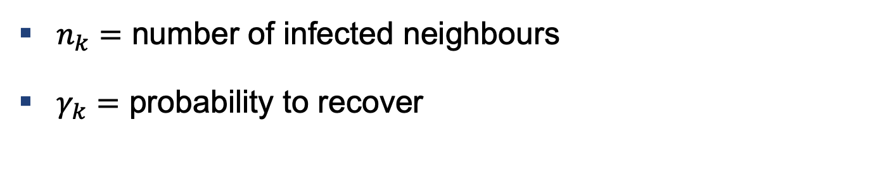
Epidemiology
SIVR-model
Susceptible / Infected / Vaccinated / Recovered
Agents can only get infected by direct neighbours in the network with rate $β$
$n_{k}=$ number of infected neighbours
$γ_{k}=$ probability to recover

Slide 9
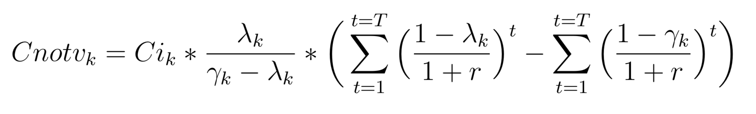
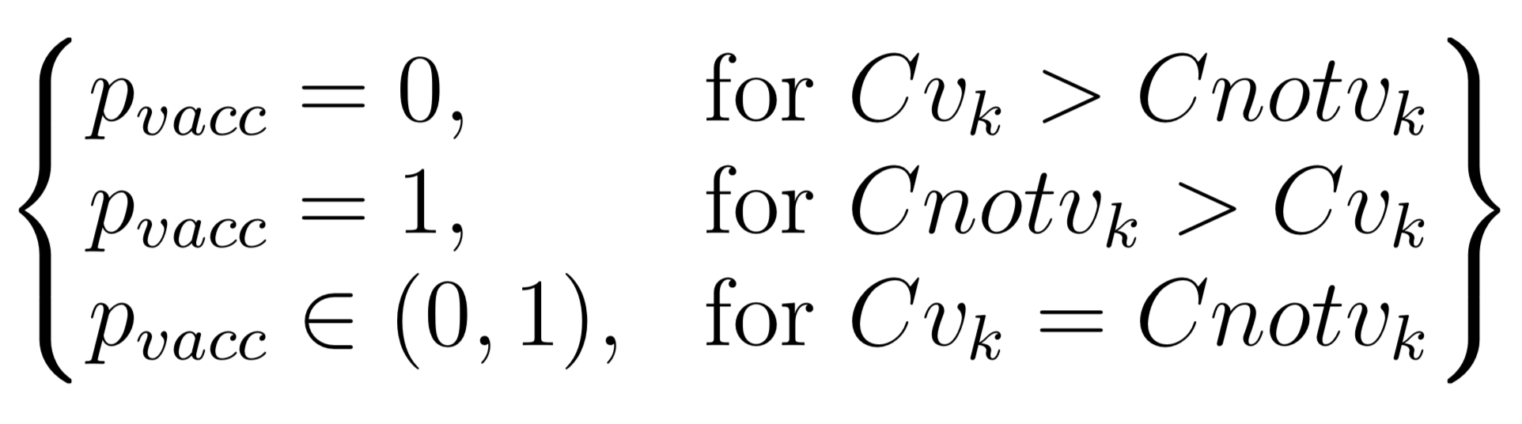
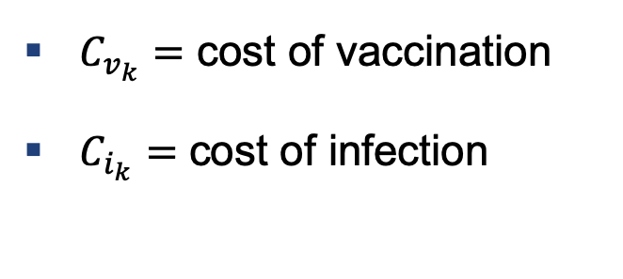

Epidemiology
With this data the agent derives its utility function
The decision to vaccinate or not can be expressed as
$C_{v_{k}}=$ cost of vaccination
$C_{i_{k}}=$ cost of infection
$C_{notv_{k}}=$ cost of not vaccinating

Slide 10
Implementation
Simulation carried out using Python
Specifically numpy, networkx and matplotlib
main.py to loop over network for each timestep
SmallWorld class to create the network
Agent class containing utility function and maximization problem

Slide 11
Initial Setup

Slide 12
Results and Outlook

Slide 13
Main Results

Slide 14
Possible Extensions

Slide 15
Thank you very much for your attention

