Slide 1
Research updates, 2020-12-02
Mark torres

Slide 2
Outline
Past work
General approach
Data collection
Exploratory data analysis
Topic models
Next steps

Slide 3
Past work
Use multimodal approach
Different ways to frame the question:
What is the fewest number of tweets we need in order to classify a person’s tweets as depressed or not?

Slide 4
General approach
Use multimodal approach:
Tweet text
User information / Twitter behavior
Demographics / location
Topic assignment of tweet (from LDA, topic models)
All scripts stored at https://github.com/ngandhi01/TextMining

Slide 5
Data collection
Scraped three sets of tweets:
2020-11-25: Scraped 25,000 COVID tweets (keywords: covid,

Slide 6
Exploratory data analysis

Slide 7
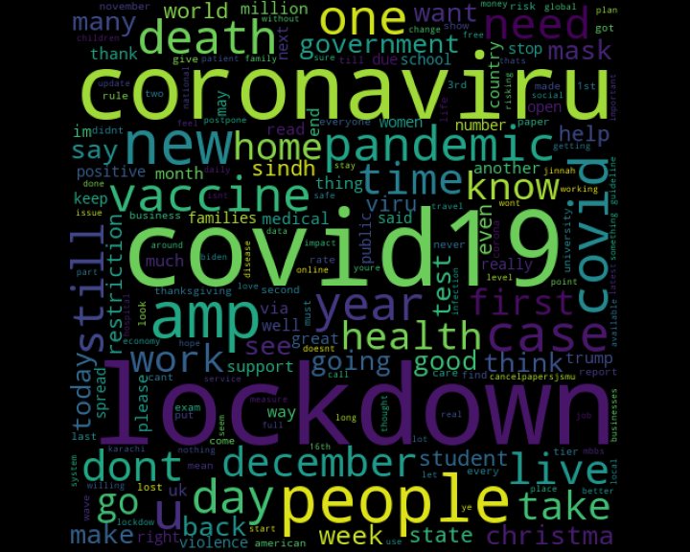
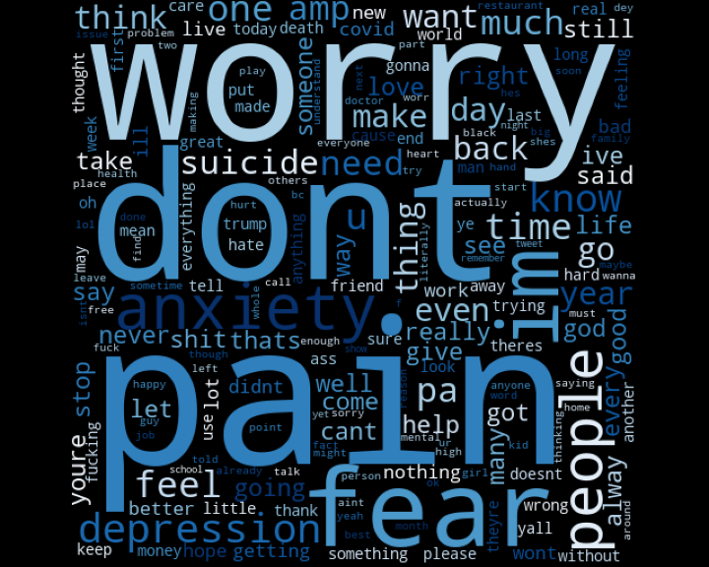
Wordclouds
COVID tweets, November 25th, 2020
Mental health tweets, November 30th, 2020

