Slide 1

Twitter Research updates, 2020-12-02
Mark torres

Slide 2
Outline
Past Work
General Approach
Data Collection
Exploratory Data Analysis
Topic Models
(Possible) Next Steps

Slide 3
Past work
Use multimodal approach
Different ways to frame the question:
What is the fewest number of tweets we need in order to classify a person’s tweets as depressed or not?

Slide 4
Multimodal approach
User text
Images in the tweet
User Twitter behavior
Demographics

Slide 5
General approach
Use multimodal approach:
Tweet text
User information / Twitter behavior
Demographics / location
Topic assignment of tweet (from LDA, topic models)
All scripts stored at https://github.com/ngandhi01/TextMining

Slide 6
Data collection
Scraped three sets of tweets:
2020-11-25: Scraped 25,000 COVID tweets (keywords: covid19, coronavirus, lockdown)
2020-11-30: Scraped 35,000 depression tweets (keywords: depression, anxiety, fear, worry, distress, suicide, pain)
2020-11-30: Scraped 35,000 miscellaneous tweets (keywords: happy, alive, brave, confident, sport, office, animal, meal, computer)
After data cleaning, the number of tweets in each set was:
COVID tweets (2020-11-25): 8,178 (original: 25,000)
Depression tweets (2020-11-30): 15, 777 (original: 35,000)
Miscellaneous tweets (2020-11-30): 14, 811 (original: 35,000)
Total number of tweets: 38, 766

Slide 7
Exploratory data analysis

Slide 8
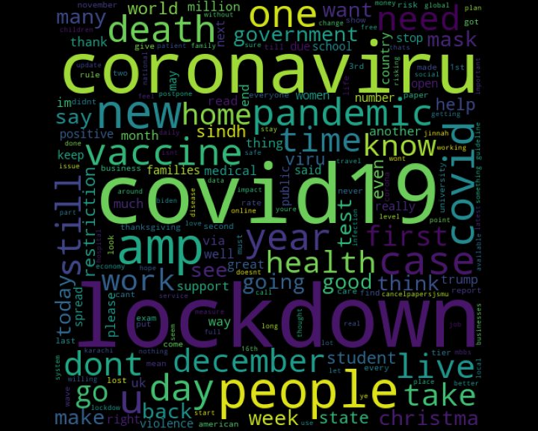
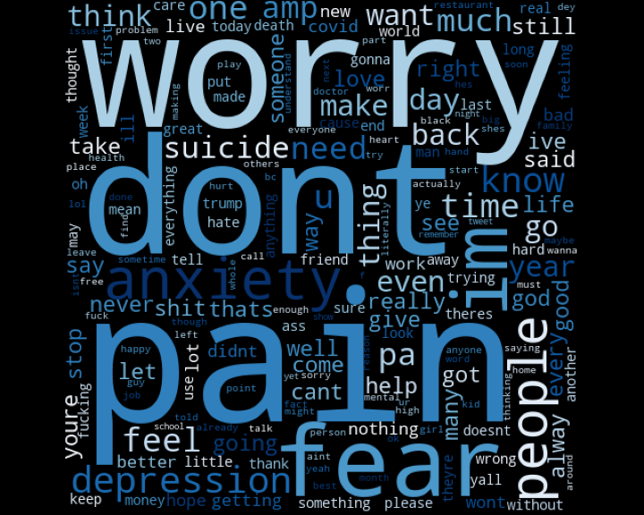
Word clouds
COVID tweets, November 25th, 2020
Mental health tweets, November 30th, 2020

Slide 9
Topic models
(Insert topic models here)

Slide 10
Obstacles in approach
Doing a raw keyword search on Twitter leads to many false positives
E.g., “It’s sad to see that our baseball team lost today” != “depression”
Possible Solution: Some research filtered for specific phrases (e.g., “I feel depressed”)
Hard to build a predictive model without “ground truth” labels
Past research crowdsourced, using Amazon Mechanical Turk, to get information about which Twitter users reported symptoms of depression and at what point in time
Possible Solution: use topic models + sentiment analysis, in order to classify tweets as pertaining to mental health
Language of post != presence of mental health concerns (at least, in the absence of ground truth labels)
E.g., self-deprecation or sarcasm

Slide 11
(possible) Next steps
Scrape tweets from different points in time
Which dates/times to scrape tweets from?
How many tweets to scrape?
Measure “sentiment” of tweets over time:
Are people posting more about mental health issues as the pandemic progresses?
Can any trend be associated to COVID trends /timelines (e.g., do more people post about mental health issues as states go into lockdown)?
Possible approaches:
Topic models
Using fine-tuned NLP model (e.g., BERT, fine-tuned to detect depression) or a pretrained model, in order to perform sentiment classification

