Slide 1


Original image
Segmentation into Superpixels
Each superpixel has an id
1
2
3
4
28
29

Slide 2
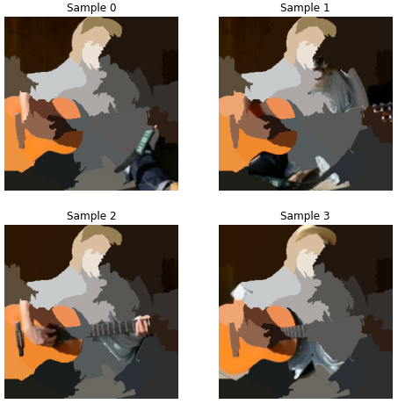
Drawing samples in the neighborhood of the original image by randomly deactivating superpixels
Map each sampled image to its interpretable representation
Sample ID | dummy of superpixel 1 | dummy of superpixel 2 | ... | dummy of superpixel M
0 | 1 | 0 |  | 0
1 | 0 | 1 |  | 0
... | 1 | 1 |  | 1
N | 1 | 0 |  | 0
Each superpixel is represented by a dummy variable. Each sampled image can then be represented as a binary vector containing only 0s and 1s.

