Slide 1
FlickerFace 4
V3_2023-03-28
Task: Look at the Face in the centre but attend to the Cartoon in the periphery. When the cartoon swings, press the Spacebar. Continue to look at the Face and pay attention to the Face. When the Face swings, press the Spacebar again. The Face/Cartoon move for 500 ms. Motion onset is jittered (can be either 83 ms or 333 ms after NoAtt/Att epoch ends).
Blk_1 = 20 tr
Blk_2
No Att
Att
Ani Moves
RT
Face Moves
RT
Right
Static Anim
Centre
Face
nonFlick
Fade In
6Hz Face; 10 RefCy/FliCy; 6 FliCy/sec
12Hz Face; 5 RefCy/FliCy
Fade In
ITI
Left
Static Ani
Ref Cy
0
50
170
190
250
370
390
450
Time (ms)
0
833
2833
3167
4167
6167
6500
7500

Slide 2
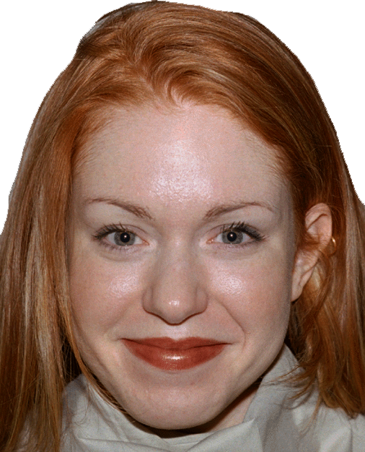
FlickerFace 4
Flicker Freq: 6 Hz vs 12 Hz (blocked trials)
Central Stim: Face (19 faces NimStim db)
Peripheral Stim: Cartoon
5.5 deg
5 deg
10 deg
Chose 6 Hz because we plan to use 6 Hz fq for babies.

